Slide 1
Clean code
Code Smells

Slide 2
Introduction

Slide 3
Definition
Clean
free from dirt; unsoiled; unstained
Code
a system of words, letters, figures, or symbols used to represent others, especially for the purposes of secrecy
program instructions

Slide 4
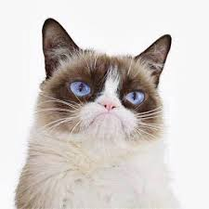
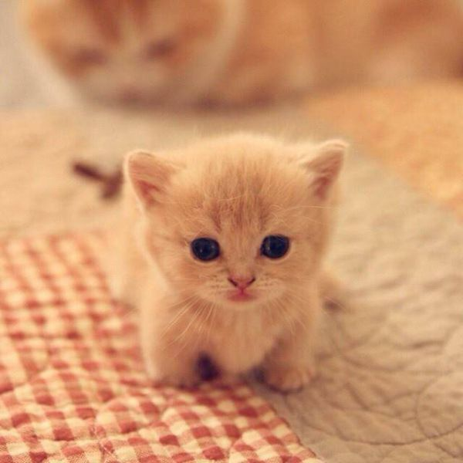
Clean code
Easy to understand
Easy to change
Easy to maintain
Notes:
Clean code is subjective and every developer has a personal take on it. There are some ideas that are considered best practice and what constitutes as clean code within the industry and community, but there is no definitive distinction. And I don’t think there ever will be.
Easy to understand means the code is easy to read, whether that reader is the original author of the code or somebody else. It’s meaning is clear so it minimizes the need for guesswork and possibility for misunderstandings. It is easy to understand on every level, specifically:
It is easy to understand the execution flow of the entire application
It is easy to understand how the different objects collaborate with each other
It is easy to understand the role and responsibility of each class
It is easy to understand what each method does
It is easy to understand what is the purpose of each expression and variable
Easy to change means the code is easy to extend and refactor, and it’s easy to fix bugs in the codebase. This can be achieved if the person making the changes understands the code and also feels confident that the changes introduced in the code do not break any existing functionality. For the code to be easy to change:
Classes and methods are small and only have single responsibility
Classes have clear and concise public APIs
Classes and methods are predictable and work as expected
The code is easily testable and has unit tests (or it is easy to write the tests)
Tests are easy to understand and easy to change

Slide 5
Basic concepts
Definitions that any developer should now

Slide 6
OOP
is a programming paradigm based on the concept of "objects", which may contain data, in the form of fields, often known as attributes; and code, in the form of procedures, often known as methods
Method
in object-oriented programming (OOP) is a procedure associated with a message and an object. An object is mostly made up of data and behavior, which form the interface that an object presents to the outside world. Data is represented as properties of the object and behavior as methods.
in class-based programming, methods are defined in a class, and objects are instances of a given class. One of the most important capabilities that a method provides is method overriding. The same name (e.g., area) can be used for multiple different kinds of classes. This allows the sending objects to invoke behaviors and to delegate the implementation of those behaviors to the receiving object.
Function or procedure calls
is a sequence of program instructions that perform a specific task, packaged as a unit. This unit can then be used in programs wherever that particular task should be performed.
Subprograms may be defined within programs, or separately in libraries that can be used by multiple programs. In different programming languages, a subroutine may be called a procedure, a function, a routine, a method, or a subprogram. The generic term callable unit is sometimes used
Notes:
Typically, a program consists of instruction s that tell the computer what to do and data that the program uses when it is running. The data consists of constants or fixed values that never change and variable values (which are usually initialized to "0" or some default value because the actual values will be supplied by a program's user). Usually, both constants and variables are defined as certain data type s. Each data type prescribes and limits the form of the data. Examples of data types include: an integer expressed as a decimal number, or a string of text characters, usually limited in length.
Significant object-oriented languages include Java, C++, C#, Python, PHP, Ruby, Perl, Object Pascal, Objective-C, Dart, Swift, Scala, Common Lisp, and Smalltalk.

Slide 7
Encapsulation
methods also provide the interface that other classes use to access and modify the data properties of an object. This is known as encapsulation. Encapsulation and overriding are the two primary distinguishing features between methods and procedure calls
Class
is an extensible program-code-template for creating objects, providing initial values for state (member variables) and implementations of behavior (member functions or methods). In many languages, the class name is used as the name for the class (the template itself), the name for the default constructor of the class (a subroutine that creates objects), and as the type of objects generated by instantiating the class; these distinct concepts are easily conflated.
Interface
is often used to define an abstract type that contains no data or code but defines behaviours as method signatures
Variable
value that can change, depending on conditions or on information passed to the program

Slide 8
Inheritance vs polymorphism
Inheritance
Polymorphism
Inheritance is creating a new class using the properties of the already existing class
Inheritance is basically implemented on clases
To support the concept of reusability in OOP and reduces the length of code
Inheritance may be a single inheritance, multiple inheritance, multilevel inheritance, hierarchical inheritance and hybrid inheritance
Polymorphism is basically a common interface for multiple form
Polymorphism is basically implemented on function/methods
Allows object to decide which form of the function to be invoked when, at compile time(overloading) as well as run time(overriding)
Polymorphism may be a compile time polymorphism (overloading) or run-time polymorphism (overriding)
Notes:
https://developer.mozilla.org/en-US/docs/Learn/JavaScript/Objects/Inheritance
https://beginnersbook.com/2013/03/polymorphism-in-java/
https://beginnersbook.com/2013/03/polymorphism-in-java/

Slide 9
Comments

Slide 10
Code smells: comments
Comments should be reserved for technical notes about the code and design
Inappropriate Information
Don’t put sensitive information on your comments
Obsolete Comment
Redundant Comment
Commented-Out Code
Just remove it. Git keeps the history.
Never use //TODO
Create your own US
Comments can sometimes be useful:
When explaining why something is being implemented in a particular way.
When explaining complex algorithms (when all other methods for simplifying the algorithm have been tried and come up short).
Notes:
If a comment is intended to explain a complex expression, the expression should be split into understandable subexpressions using Extract Variable.
If a comment explains a section of code, this section can be turned into a separate method via Extract Method. The name of the new method can be taken from the comment text itself, most likely.
If a method has already been extracted, but comments are still necessary to explain what the method does, give the method a self-explanatory name. Use Rename Method for this.
If you need to assert rules about a state that is necessary for the system to work, use Introduce Assertion.

Slide 11
Functions

Slide 12
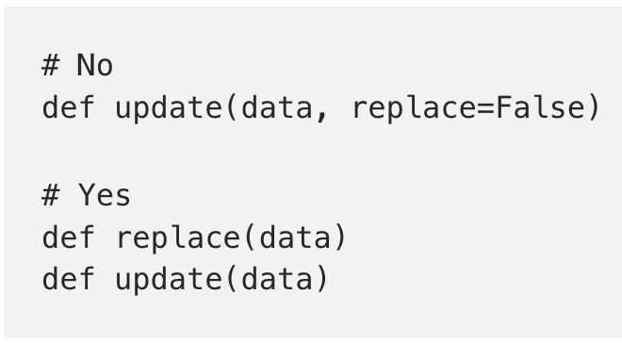
Functions
Code smells: functions
Too Many Arguments
3 maximun
No arguments is best
Output Arguments
It is ok only if you don’t update things implicitly.
If your function must change the state of something have it change the state of the object it is called on
Flag Arguments
Are confunsing and declare that the function does
more than one thing
Dead Function
Remove all unused functions. Git keeps the history.
Notes:
https://sourcemaking.com/design_patterns/decorator
https://blog.codinghorror.com/code-smells/

Slide 13
Naming

Slide 14
Names
Code smells: naming
Choose Descriptive Names
Make sure the name is descriptive. Names in software are 90 percent of what make software readable
Use Standard Nomenclature Where Possible
Ex: If you are using the Decorator Pattern, you should use the word Decorator in the names of the decoring classes
Unambiguous Names
Choose names that make the working of a function or variable unambiguous
Use Long Names for Long Scopes
Names Should Describe Side-Effects
Name should describe everything that a function, variable, or class is or does
What is the worst ever variable name? data
What is the second-worst name? data2
What is the third-worst name ever? data_2
Notes:
https://github.com/standard/standard
http://hilton.org.uk/blog/naming-smells
+ you can use very short variable names for tiny scopes
For (i=0;i<100;i++)
+ the longer the scope of the name, the longer and more precise the name should be

Slide 15
Classes

Slide 16
Classes
Code smells: classes
Encapsulation
Sometimes we need to make a variable or utility function protected so that it can be accessed by a test
Classes Should Be Small
Usually if your classes have more than 100 lines of code you could extract part of the code
Single Responsability Principle (SPR)
every module or class should have responsibility over a single part of the functionality provided by the software, and that responsibility should be entirely encapsulated by the class. All its services should be narrowly aligned with that responsibility
Organizing for Change
Needs will change, therefore code will change
Notes:
En programación modular, y más específicamente en programación orientada a objetos, se denominaencapsulamiento al ocultamiento del estado, es decir, de los datos miembro de un objeto de manera que solo se pueda cambiar mediante las operaciones definidas para ese objeto.
https://sourcemaking.com/refactoring/smells

Slide 17
Error handling

Slide 18
Error handling
Code smells: errors
Software error - error resulting from bad code in some program involved in producing the erroneous result
Use Exceptions Rather Than Return Codes
Provide Context with Exceptions
Define the normal Flow
Don’t return Null
Don’t pass Null
Notes:
Legacy error handling tends to follow the method that all functions return a code depending on success/failure. You would check this code and handle (if an error) appropriately.
Modern programming languages however follow the exception model, where if something exceptional happens that cannot be handled properly an exception gets thrown - which keeps bubbling up until its handled.
Exceptions leaves your code clean of all the checks necessary when testing status returns on every call,
Exceptions let you use the return value of functions for actual values,
Exceptions can carry more information than a status return can,
Most importantly: exceptions can't be ignored through inaction, while status returns can.
https://nedbatchelder.com/text/exceptions-vs-status.html

Slide 19
Tests

Slide 20
FIRST
Code smells: FIRST
Fast
Independent
Tests should not depend on each other
Repeatable
In any environment
Self Validating
Should have a boolean output
One assert per test
Timely
Unit tests should be written just before the production code that makes them pass
Notes:
http://istqbexamcertification.com/what-is-software-testing/
Types of tests: unit, integration, functional, e2e

Slide 21
Tests
Code smells: test
Insufficient Tests
Test everything that could break
Use a Coverage Tool
Don’t Skip Trivial Tests
An Ignored Tests is a Question about an Ambiguity
Test Boundary Conditions
Exhaustively Test Near Bugs
Patterns of Failure Are Revealing
Notes:
https://es.slideshare.net/mariosangiorgio/clean-code-and-code-smells
Istanbul
https://stackify.com/code-coverage-tools/

Slide 22
General

Slide 23
General (I)
Code smells: general
Multiple Languages in One Source File
Don’t mix different languages in one only file (depends on the language…)
Obvious Behavior Is Unimplemented
Names matter… implement what you would expect if you were not the main developer
Incorrect Behavior at the Boundaries
Happy path is not the only thing that matters
Part of looking for boundaries is looking for special conditions that can cause the test to fail
Overridden Safeties
Your safeties are teh warnings, errors, exception handling – they could catch you in the future
Sometimes we will have to override safeties but it could be risky, try to send at least a warning
Notes:
Turning off certain compiler warnings (or all) may help you get the build to succeed, but at the rist of endless debugging sessions. Turn-ing off failing tests and telling yourself you’ll get them to pass later is as bad as pretending your credit cars are free money

Slide 24
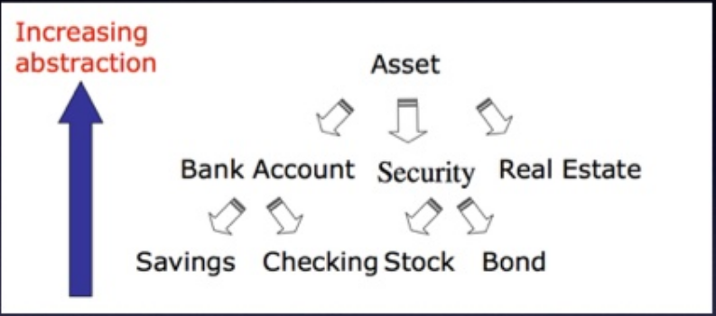
General (II)
Code smells: general
Duplication
Follow the Dry principle (Don’t Repeat Yourself).
Code at Wrong Level of Abstraction
Heritage, polimorphy and encapsulament
Base Classes Depending on Their Derivatives
When we see base classses mentioning the names of their derivatives, we suspect a problem
In general, base clases should know nothing about their derivatives
Too Much Information
Limit what you expose. Well defined modules have very small interfaces that allow you to do a lot with a Little.
Concentrate on keeping interfaces very tight and very small. Help keep coupling low by limiting information
Dead Code
Don’t catch exceptions that will never be thrown or else blocks that will never be reached.
Vertical Separation
For example: All functions declaration before their usage. Or, declare the function right after its first usage.
Inconsistency
Things that have the same meaning should have consistent conventions.
Notes:
String getUser() String findPerson() String retrieveEmployee()// Choose only one naming convention String getUser() String getPerson() String getEmployee() function route1(url, (req, res) => {}) function route2(url, (request, response) => {}) function route3(url, (req, resp) => {})
It is important to créate abstractions that separate highter level general concepts from lower level detailed concepts
Be careful with the conventions you choose, and once chosen, be careful to continue to follow them (req, res), (request, res), (request, result)

Slide 25
General (III)
Code smells: general
Clutter
Variables that aren’t used, functions that are never called, comments that add no information… should be removed
Artificial coupling
Things that don’t depend upon each other should not be artificially couple
Feature Envy
The scope of a class should not include variables or functions from others
Selector Arguments
Booleans bad as parameters
Misplaced Responsibility
Code should be places where a reader would naturally expect it to be
Encapsulate conditionals
Avoid negative Conditionals
Functions should do One thing
Notes:
Encapsulate conditionals
En funciones…
Bad:
if (fsm.state==='fetching'&&isEmpty(listNode)) { // ... }
Good:
functionshouldShowSpinner(fsm, listNode) { returnfsm.state==='fetching'&&isEmpty(listNode); } if (shouldShowSpinner(fsmInstance, listNodeInstance)) { // ... }
In general an artificial coupling is a result of putting a variable, constan or function ina a temporary convenient, thought innapropiate location Take the time to figure out where functions constants and variables outh to be declared
We want code to be as expressive as possible Run-on expressions and magic numbers all obscure the author’s intent

Slide 26
Code smells: general
Use Explanatory Variables
Functions Names should Say What They do
Understand the Algorithm
Take time to understand the code
Make Logical Dependencies Physical
If one module depends upon another… that dependency should be physical, not just local. Ask explicity for the module
Prefer polymorphism* to if/Else or Switch/Case
*Only if you are using OO
Follow Standard Conventions
Where to declare instance variables; how to name classes, methods, and variables; where to put braces… our code should provides examples
Notes:
https://github.com/standard/standard

Slide 27
Code smells: general
Replace Magic Numbers with Named Constants
Be Precise
Structure over Convention
Don’t be arbitrary
Have a reason for the way you structure your code, and make sure that reason is communicated by the structure of the code
Keep configurable data at High Levels
Avoid transitive nativation
A.getB().getC().doSomething()
Notes:
Enforce design decisions with structure over confecntio
For example, switch/cases with nicely names enumerations are inferior to base classes with abstract methods
Negatives are just a bit harder to understand than positives
So, when possible counditionals should be expressed as positives
A method of an object should invoke only the mothods of the following kinds of objects:
Itself
2. its parameters
3. any object it crates7instantiaties
4. its direct component objects

Slide 28
Links of interest

Slide 29
Cheat Sheet https://www.planetgeek.ch/wp-content/uploads/2013/06/Clean-Code-V2.2.pdf
Code Smells https://sourcemaking.com/refactoring/smells
https://es.slideshare.net/KuySengChhoeun/chapter17-of-clean-code
Examples: https://es.slideshare.net/annuvinayak/code-smells-and-its-type-with-example https://github.com/ryanmcdermott/clean-code-javascript/blob/master/README.md

