Slide 1
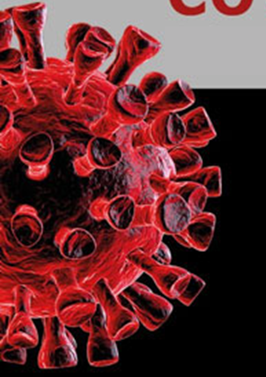

COVID-19 X-ray classification on chest X-ray images based on DL
Biratsi Ada · dit2220dsc
Sofos Dimitrios · dit2213
July 2023

Slide 2

Content Warning:
The following presentation contains material that may remind to some audiences harmful or traumatizing memories...

Slide 3

Content Warning:
The following presentation contains material that may remind to some audiences harmful or traumatizing memories...

Slide 4

Content Warning:
The following presentation contains material that may remind to some audiences harmful or traumatizing memories...

Slide 5

Content Warning:
The following presentation contains material that may remind to some audiences harmful or traumatizing memories...

Slide 6
Outline
Introduction
The proposed Models
Results
Future work

Slide 7

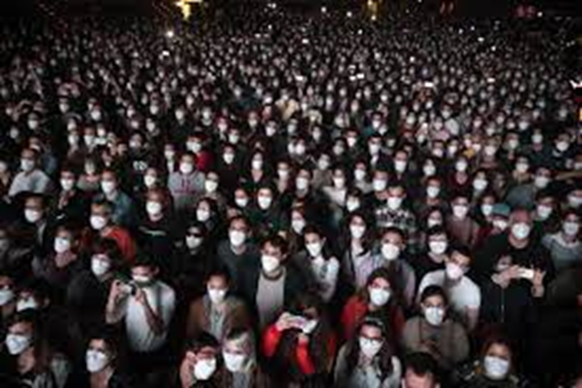
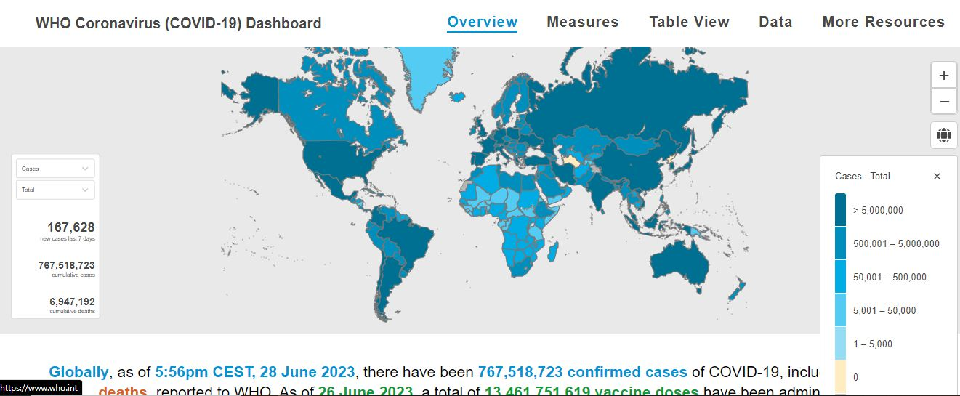
General Introduction
The COVID-19 is a highly contagious disease.

Slide 8
General Introduction
The COVID-19 is a highly contagious disease.
Worldwide totally:

Slide 9
General Introduction
The COVID-19 is a highly contagious disease.
Worldwide totally:
690,976,653 Cases

Slide 10
General Introduction
The COVID-19 is a highly contagious disease.
Worldwide totally:
690,976,653 Cases
6,896,040 Deaths

Slide 11
General Introduction
The COVID-19 is a highly contagious disease.
Worldwide totally:
690,976,653 Cases
6,896,040 Deaths
663,623,403 Recovered

Slide 12
Problem Overview
Classification of X-ray images
COVID-19 diagnosis is generally microbiological
Imaging techniques play an important role in:
supporting the diagnosis,
grading the severity of disease,
guiding treatment,
detecting complications, and
evaluating the response to treatment.

Slide 13


The Dataset
COVID-19 Radiography Database:
A database of chest X-ray images for
COVID-19 positive
Normal
Viral Pneumonia images

Slide 14
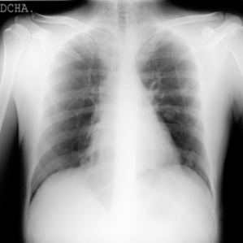
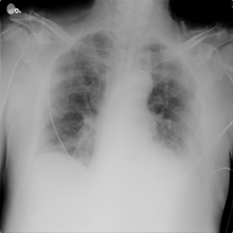
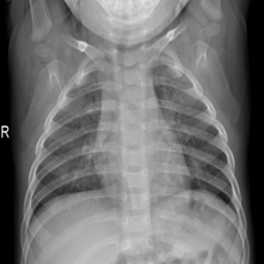
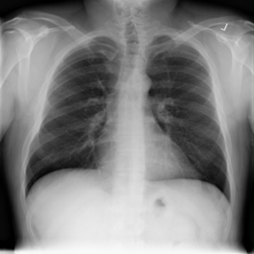
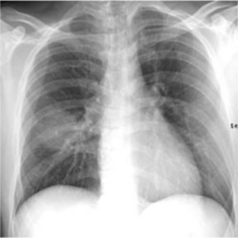
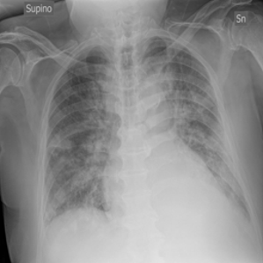
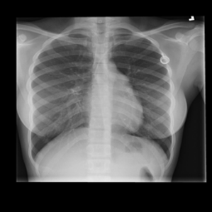
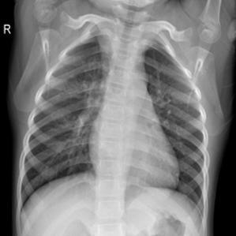
Dataset Sample
X-ray images of COVID-19 chest
X-ray images of Normal chest

Slide 15
Dataset Sample
X-ray images of COVID-19 chest
X-ray images of Normal chest
3.000 images
10.000 images

Slide 16
Dataset Sample
X-ray images of COVID-19 chest
X-ray images of Normal chest
<
3.000 images
10.000 images

Slide 17
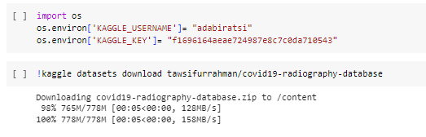
Data Loading and Preprocessing
Load
Have a look at the data
Resize

Slide 18
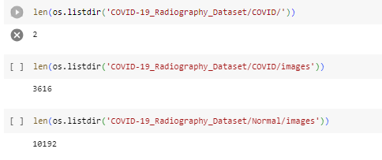
Data Loading and Preprocessing
Load
Have a look at the data
Resize

Slide 19
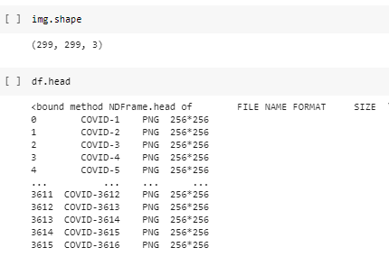
Data Loading and Preprocessing
Load
Have a look at the data
Resize

Slide 20
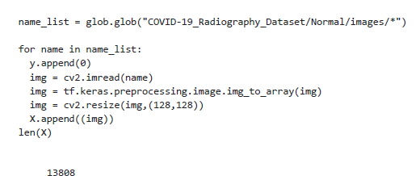
Data Loading and Preprocessing
Load
Have a look at the data
Resize

Slide 21
Data Preparation
Make a list of the images
Balance

Slide 22
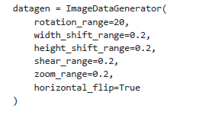
Data Preparation
Make a list of the images
Balance

Slide 23
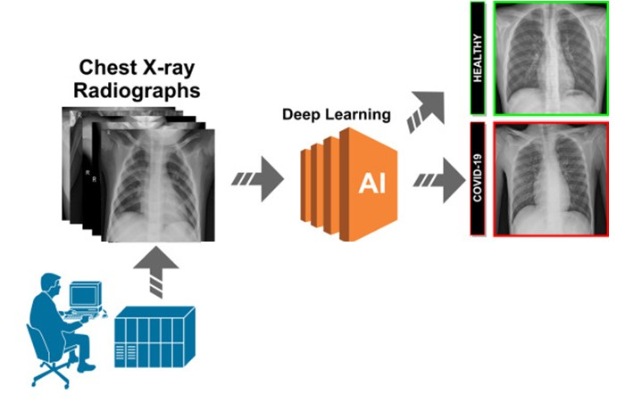
Model Architecture Schema

Slide 24
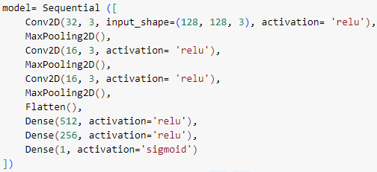
CNN Architecture
CNN architecture used for classification
layers, filters, and activation functions used

Slide 25
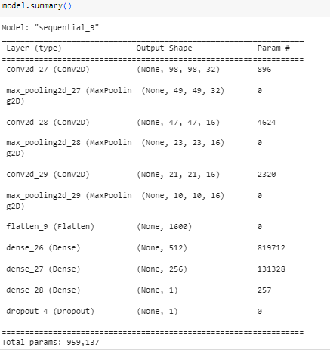
Model Training
How the model was compiled (optimizer, loss function, metrics)
The code for training the model
Batch size and number of epochs used

Slide 26
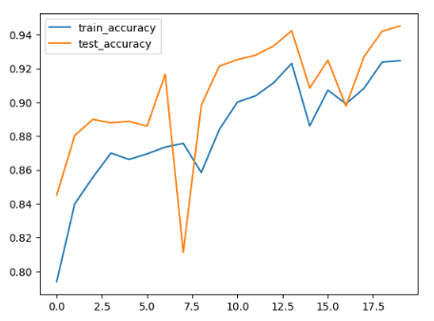
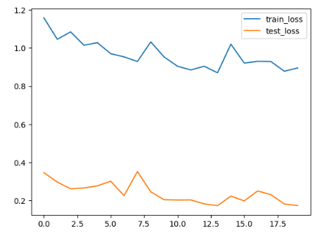
CNN Evaluation
Accuracy and loss curves during training

Slide 27
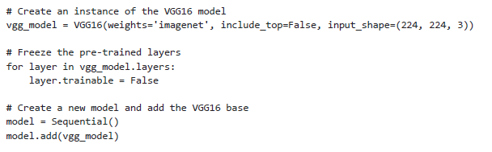
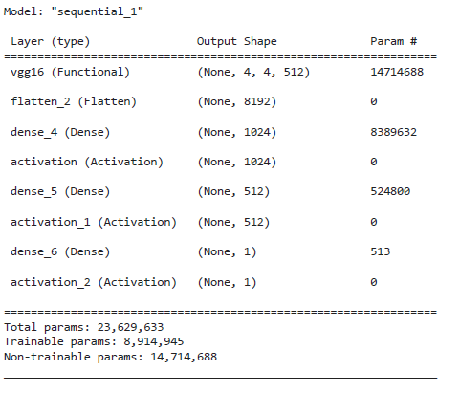
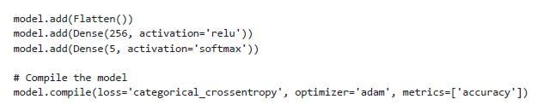
VGG Architecture

Slide 28
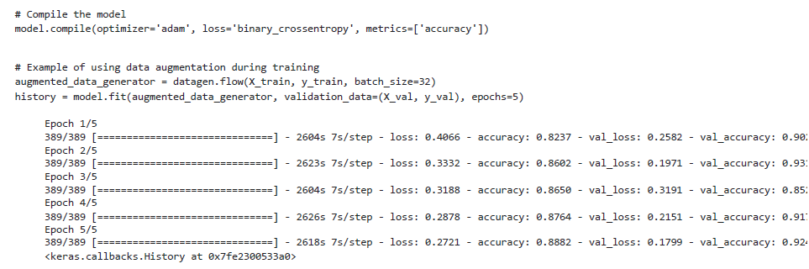
Model Training

Slide 29
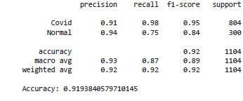
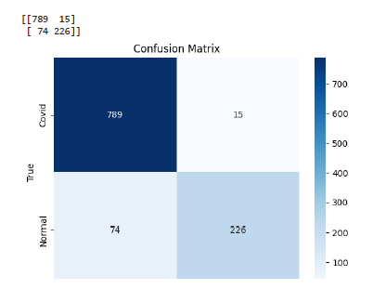
VGG16 Performance Evaluation

Slide 30
Results and Conclusion
Both models performed effectively
DL techniques are quite effective in predictive & follow up medicine
Resources remain a major problem

Slide 31
Future Work
An association with the Pneumonia images could be interesting.
Other models could be tested such as Transfer learnings models.

Slide 32
References
-M.E.H. Chowdhury, T. Rahman, A. Khandakar, R. Mazhar, M.A. Kadir, Z.B. Mahbub, K.R. Islam, M.S. Khan, A. Iqbal, N. Al-Emadi, M.B.I. Reaz, M. T. Islam, “Can AI help in screening Viral and COVID-19 pneumonia?” IEEE Access, Vol. 8, 2020, pp. 132665 - 132676.
-Rahman, T., Khandakar, A., Qiblawey, Y., Tahir, A., Kiranyaz, S., Kashem, S.B.A., Islam, M.T., Maadeed, S.A., Zughaier, S.M., Khan, M.S. and Chowdhury, M.E., 2020. Exploring the Effect of Image Enhancement Techniques on COVID-19 Detection using Chest X-ray Images. arXiv preprint arXiv:2012.02238.

Slide 33


Slide 34


