Slide 1
What is Data Science?

Slide 2
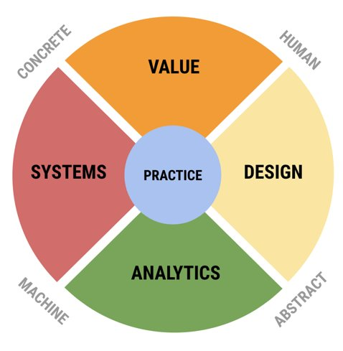
4+1 Model of Data Science
Four Components join to form Practical Applications: Value includes ethics, benefits Design includes data design, communication of ideas and results Analytics uses tools like mathematics and statistics
Systems draws from engineering, computer science

Slide 3
The Data Science Pipeline
Iteration
Ingest Data
Process Data
Extract Features
Visualize, Summarize
Build Model
Validate Evaluate
Communicate
Storytelling

Slide 4
Data Science Promise and Perils
Used properly and carefully, data science can enable great things:
- improving and optimizing systems, quality of life
- lowering costs, increasing benefits - automating difficult and mundane tasks
- creating new products, opportunities
...but without proper care and understanding, it can - amplify unfairness and bias - cause systematic harm across all dimensions

