Slide 1

HDFS
Hadoop Distributed File System

Slide 2
История
2002 – запуск проекта Nutch
2003 – публикация с описанием GFS
2004 – создание NDFS (Nutch Distributed File System)
2004 – публикация Google и MapReduce
2005 – реализация MR в Nutch
2006 – выделение подпроекта Hadoop
2008 – выход Hadoop в лидеры ASF (Apache Software Foundation)

Slide 3
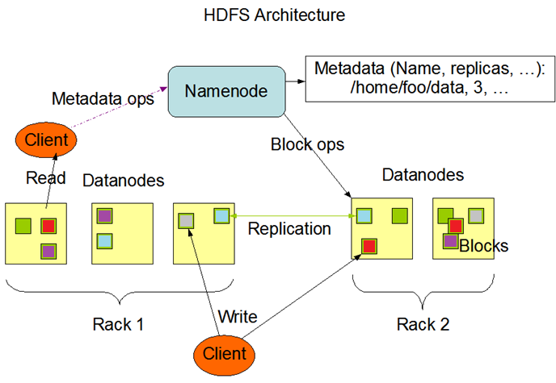
Архитектура HDFS

Slide 4
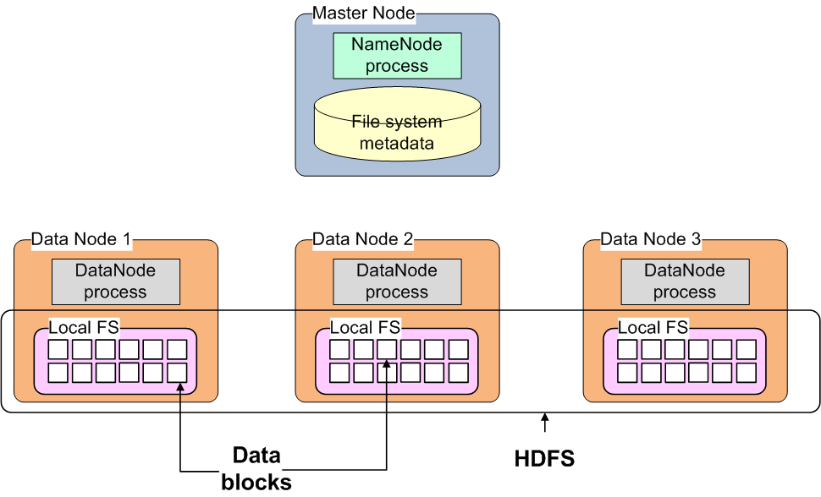
Name Node

Slide 5
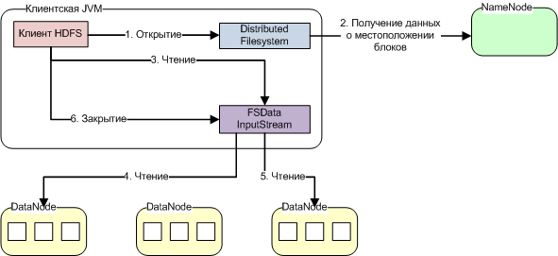
Чтение HDFS

Slide 6
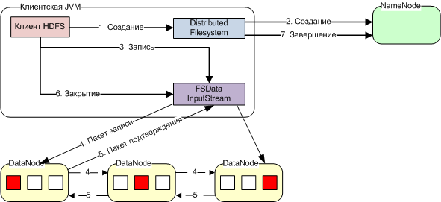
Запись HDFS

Slide 7
Name Node структура хранения
${dfs.name.dir}/
VERSION (информация о версии HDFS)
edits (журнал изменений)
fsimage (контрольная точка метаданных)
fstime (время создания контрольной точки)

Slide 8
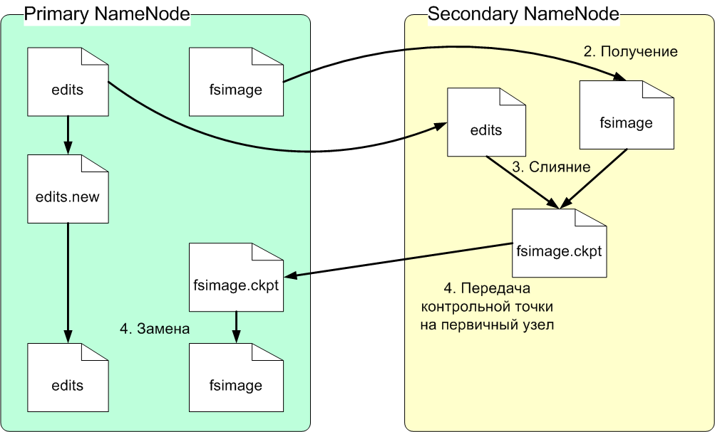
Secondary Name Node

Slide 9
Сведения о блоках файла
[root@hdp-15 ~]# hdfs fsck /user/hive/warehouse/big_cdr_parquet/000000_0 -files -blocks -locations
Connecting to namenode via http://hdp-7:50070
FSCK started by root (auth:SIMPLE) from /192.168.91.141 for path /user/hive/warehouse/big_cdr_parquet/000000_0 at Mon May 18 14:00:22 MSK 2015
/user/hive/warehouse/big_cdr_parquet/000000_0 1133129924 bytes, 9 block(s): OK
0. BP-1972162810-192.168.91.133-1428693610895:blk_1073747244_6432 len=134217728 repl=3 [192.168.91.141:50010, 192.168.91.139:50010, 192.168.91.133:50010]
1. BP-1972162810-192.168.91.133-1428693610895:blk_1073747245_6433 len=134217728 repl=3 [192.168.91.136:50010, 192.168.91.139:50010, 192.168.91.141:50010]
2. BP-1972162810-192.168.91.133-1428693610895:blk_1073747246_6434 len=134217728 repl=3 [192.168.91.142:50010, 192.168.91.136:50010, 192.168.91.141:50010]
3. BP-1972162810-192.168.91.133-1428693610895:blk_1073747247_6435 len=134217728 repl=3 [192.168.91.134:50010, 192.168.91.142:50010, 192.168.91.137:50010]
4. BP-1972162810-192.168.91.133-1428693610895:blk_1073747248_6436 len=134217728 repl=3 [192.168.91.135:50010, 192.168.91.133:50010, 192.168.91.137:50010]
5. BP-1972162810-192.168.91.133-1428693610895:blk_1073747249_6437 len=134217728 repl=3 [192.168.91.140:50010, 192.168.91.137:50010, 192.168.91.142:50010]
6. BP-1972162810-192.168.91.133-1428693610895:blk_1073747250_6438 len=134217728 repl=3 [192.168.91.142:50010, 192.168.91.139:50010, 192.168.91.141:50010]
7. BP-1972162810-192.168.91.133-1428693610895:blk_1073747251_6439 len=134217728 repl=3 [192.168.91.139:50010, 192.168.91.140:50010, 192.168.91.135:50010]
8. BP-1972162810-192.168.91.133-1428693610895:blk_1073747252_6440 len=59388100 repl=3 [192.168.91.141:50010, 192.168.91.137:50010, 192.168.91.135:50010]

Slide 10
Сведения о блоках файла
Status: HEALTHY
Total size: 1133129924 B
Total dirs: 0
Total files: 1
Total symlinks: 0
Total blocks (validated): 9 (avg. block size 125903324 B)
Minimally replicated blocks: 9 (100.0 %)
Over-replicated blocks: 0 (0.0 %)
Under-replicated blocks: 0 (0.0 %)
Mis-replicated blocks: 0 (0.0 %)
Default replication factor: 3
Average block replication: 3.0
Corrupt blocks: 0
Missing replicas: 0 (0.0 %)
Number of data-nodes: 10
Number of racks: 1
FSCK ended at Mon May 18 14:00:22 MSK 2015 in 1 milliseconds

Slide 11
HDFS Erasure Coding

Slide 12
HDFS Erasure Coding

Slide 13
HDFS Erasure Coding

Slide 14
HDFS Erasure Coding
11 nodes (1 NameNode, 9 DataNodes, 1 client node) with 10 GigE network.
client writing a 12GB file to HDFS;
client reading a 12GB file from HDFS

Slide 15
Работа с HDFS (CLI)
Команда | Пример
appendToFile | hdfs dfs -appendToFile localfile /user/hadoop/hadoopfile
cat | hdfs dfs -cat hdfs://nn1.example.com/file1
copyFromLocal copyToLocal | hdfs dfs -copyFromLocal localfile /user/hadoop/data/ hdfs dfs -copyToLocal localfile /tmp/data/ localfile
cp | hdfs dfs -cp [-f] [-p | -p[topax]] URI [URI ...] <dest>
du | hdfs dfs -du -s /tmp/test.data
expunge | hdfs dfs -expunge
get getmerge | hdfs dfs -get /user/hadoop/file localfile hdfs dfs -getmerge <src> <localdst> [addnl]
ls | hdfs dfs -ls /user/hadoop/file1
mkdir | hdfs dfs -mkdir /user/hadoop/dir1 /user/hadoop/dir2
mv | hdfs dfs -mv /user/hadoop/file1 /user/hadoop/file2

Slide 16
Работа с HDFS (CLI)
Команда | Пример
put | hdfs dfs -put localfile /user/hadoop/hadoopfile
rm | hdfs dfs -rm [-f] [-r|-R] [-skipTrash] URI [URI ...]
tail | hdfs dfs -tail pathname
setrep | hdfs dfs -setrep [-R] [-w] <numReplicas> <path>

Slide 17
Права доступа
Команда | Пример
сhmod | hdfs dfs chmod [-R] mode file
chgrp | hdfs dfs chgrp [-R] group file …
chown | hdfs dfs chown [-R] [owner][:[group]] file …
getfacl | hdfs dfs -getfacl /file hdfs dfs -getfacl -R /dir
setfacl | hdfs dfs -setfacl -m user:hadoop:rw- /file
[root@hdp-15 ~]# hdfs dfs -ls /user/hive/000000_0
-rwxr-xr-x 3 hive hive 1133129924 2015-04-23 11:48 /user/hive/000000_0

Slide 18
Квоты
Команда | Пример
setQuota | hdsf dfsadmin -setQuota <N> <directory>...<directory>
clrQuota | hdfs dfsadmin -clrQuota <directory>...<directory>
setSpaceQuota | hdfs dfsadmin -setSpaceQuota <N> <directory>...<directory>
clrSpaceQuota | hdfs dfsadmin -clrSpaceQuota <directory>...<director>
count | hdfs dfs -count -q <directory>...<directory>

Slide 19
Квоты
[hdfs@hdp-15 ~]$ hdfs dfsadmin -setQuota 2 /tmp/tests
[hdfs@hdp-15 ~]$ hdfs dfs -count -q /tmp/tests
2 1 none inf 1 0 0 /tmp/tests
[hdfs@hdp-15 ~]$ hdfs dfs -count -q /tmp/tests/
2 1 none inf 1 0 0 /tmp/tests
[hdfs@hdp-15 ~]$ hdfs dfs -touchz /tmp/tests/test1
[hdfs@hdp-15 ~]$ hdfs dfs -count -q /tmp/tests/
2 0 none inf 1 1 0 /tmp/tests
[hdfs@hdp-15 ~]$ hdfs dfs -touchz /tmp/tests/test2
touchz: The NameSpace quota (directories and files) of directory /tmp/tests is exceeded: quota=2 file count=3
-count –q:
QUOTA REMAINING_QUOTA SPACE_QUOTA REMAINING_SPACE_QUOTA
DIR_COUNT FILE_COUNT CONTENT_SIZE FILE_NAME

Slide 20
Стандартное API
Основная библиотека: hadoop-client
Пример:
private static void ImportDirToHiveTable(Path sourceDir, Path targetDir) throws IOException {
Configuration conf = new Configuration();
FileSystem fs = FileSystem.get(conf);
for (FileStatus fsts : fs.listStatus(sourceDir)) {
FileUtil.copy(fs, fsts.getPath(), fs, targetDir, false, conf);
logger.info(String.format("File %s copied to %s", fsts.getPath().getName(),
targetDir.getName()));
}
}

Slide 21
Web API
Команда
CREATE | Создание и запись данных в файл
APPEND | Дописываение файла
CONCAT | Объединение файлов
OPEN | Открытие и чтение файла
MKDIRS | Создание каталога
RENAME | Переименование файла/каталога
DELETE | Удаление файла/каталога
GETFILESTATUS | Получение информации о файле/каталоге
LISTSTATUS | Просмотр информации о каталоге
…

Slide 22
Web API (пример)
[root@hdp-15 ~]# curl -i "http://192.168.91.139:14000/webhdfs/v1/user/hive?op=LISTSTATUS&user.name=hdfs"
{"FileStatuses":
{"FileStatus":
[{
"pathSuffix":"user.csv",
"type":"FILE",
"length":22628,
"owner":"hive",
"group":"hive",
"permission":"644",
"accessTime":1429262046873,
"modificationTime":1429262048992,
"blockSize":134217728,
"replication":3
}]
}
}

Slide 23
Монтирование HDFS
FUSE (Filesystem in Userspace)
sudo yum install hadoop-hdfs-fuse
mkdir -p <mount_point>
hadoop-fuse-dfs dfs://<NN_hostname>:<NN_port> <mount_point>
export LIBHDFS_OPTS="-Xmx128m“
/etc/fuse.conf – файл конфигурации FUSE

Slide 24

SQOOP
Импорт данных из RDBMS
Экспорт данных в RDBMS
Вся БД / таблица / запрос
Многопоточность
Поддержка Hbase, Accumulo

Slide 25
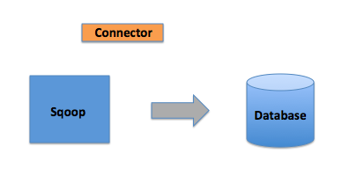

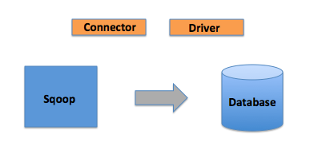
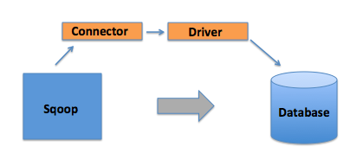
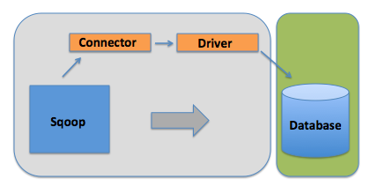
SQOOP

Slide 26

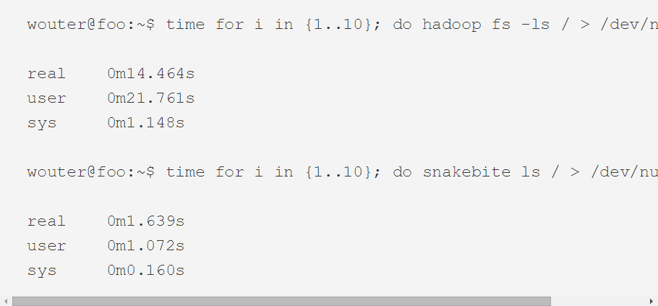
SnakeBite (spotify.com)
Написан на python
Использует ProtoBuf (google.com)

Slide 27

Интеграция с Amazon s3
$HADOOP_HOME/conf/hdfs-site.xml:
<property>
<name>fs.s3n.awsAccessKeyId</name>
<value>AWS-ID</value>
</property>
<property>
<name>fs.s3n.awsSecretAccessKey</name>
<value>AWS-SECRET-KEY</value>
</property>

Slide 28
Интеграция с Amazon s3
$ hadoop jar hadoop-*-examples.jar wordcount s3n://BUCKET-NAME/ s3n://BUCKET-NAME/DIRECTORY-NAME
или
$ hadoop jar hadoop-*-examples.jar wordcount s3n://AWS-ID: AWS-SECRET-KEY@BUCKET-NAME/ s3n:// AWS-ID: AWS-SECRET-KEY@BUCKET-NAME/DIRECTORY-NAME

Slide 29

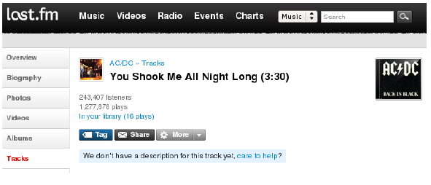
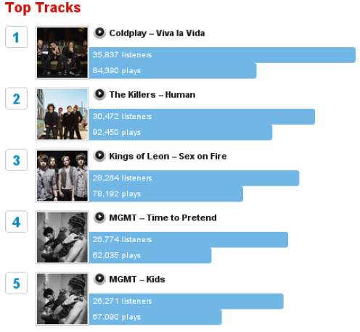
Hadoop в

Slide 30




Hadoop в
UserId | TrackId | Scrobble | Radio | Skip
111115 | 222 | 0 | 1 | 0
111113 | 225 | 1 | 0 | 0
111119 | 223 | 0 | 1 | 1
111115 | 225 | 1 | 0 | 0

Slide 31
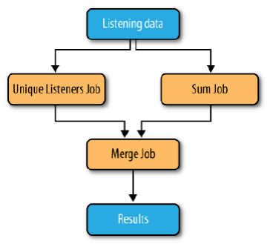
Hadoop в
TrackId | #listeners
IntWritable | IntWritable
222 | 1
223 | 1
225 | 2
TrackId | #listeners | #plays | #scrobbles | #radio | #skips
IntWritable | IntWritable | IntWritable | IntWritable | IntWritable | IntWritable
222 | 1 | 1 | 0 | 1 | 0
223 | 1 | 1 | 0 | 1 | 1
225 | 1 | 2 | 2 | 0 | 0

Slide 32

Дополнительные материалы
http://hadoop.apache.org/docs/stable/
Hadoop. Подробное руководство
http://blog.cloudera.com/blog/
http://hortonworks.com/blog/

