Slide 1
THREE WAYS TO MANAGE ARRIVING FLIGHTS
Air Traffic Control Simulator
Sorted Vector
Lazy Heap
Indexed Heap
Which data structure keeps a changing list of arriving flights fastest?
Tested on 109,781 real flights into Atlanta (ATL), May to August 2026
William Starks • Kyle Penton • Pau Mang • Heidtmann Oppong
CSCI 3110 • MTSU • Fall 2026
TEAM
Notes:
Everyone, 0:10. We tested three ways to keep an airport’s list of arriving flights in order, using real flights into Atlanta.

Slide 2
WHY THIS IS A PRIORITY QUEUE
The problem: flights keep changing
Easy example
Technical terms
A tower must always land the flight due soonest, like a line where the most urgent person goes first. But people keep changing places: flights run early or late, and some are cancelled.
Priority queue: always gives the most urgent item first
Four operations: add, delay (change time), remove, land next
Test sizes: first 1,000, 10,000 and 100,000 flights
109,781
107,500
1,781
500
flights
landed
cancelled
diverted
CSCI 3110 • MTSU • Fall 2026
WILLIAM
Notes:
William, 0:35. Picture a line where the most urgent person goes first. A control tower does that with flights: it always lands the one due soonest. That is a priority queue. But the line keeps changing. Flights run early or late, and some are cancelled. So we need four jobs: add, delay, remove and land. We used 109,781 real flights into Atlanta and tested the first 1,000, 10,000 and 100,000.

Slide 3
AN ORDERED LINE OF FLIGHTS
A. Sorted vector
Easy example
Technical terms
Imagine children standing in height order. The next child is easy to find, but a new child makes everyone else shuffle over.
Sorted vector: an array kept in order, earliest flight at the back
Land next: pop_back, O(1)
Add, delay, remove: shift entries, O(n)
Whole run: O(n²)
Cost per operation (n = flights waiting)
Add | Delay | Remove | Land next
O(n) | O(n) | O(n) | O(1)
At 100,000 flights: changing times took 1,107.5 ms; all landings took only 0.6 ms.
CSCI 3110 • MTSU • Fall 2026
WILLIAM
Notes:
William, 0:30. Picture children in height order. The next child is easy to find, but a new child makes everyone shuffle. That is the sorted vector: a list kept in order, earliest flight at the back. Landing is instant (O(1)). Adding or changing means shuffling (O(n)): the work grows with the list. At 100,000 flights, changing times took over a second. All the landings took half a millisecond.

Slide 4
LEAVE OUTDATED COPIES; SKIP THEM LATER
B. Heap with lazy deletion
Easy example
Technical terms
Imagine keeping the old appointment card when a time changes and writing a new one. You throw the old card away when it comes up. That old card is a stale entry.
std::priority_queue plus a generation number per flight
Delay: push a new copy; the old one goes stale
Land: pop and discard stale copies
Heap grows to about 196,000 entries for 100,000 flights
Cost per operation (n = flights waiting)
Add | Delay | Remove | Land next
O(log n) | O(log n) | O(1) | O(log n) amortized
Cheap updates, but landing is 80% of its time (23.4 of 29.3 ms) clearing stale copies.
CSCI 3110 • MTSU • Fall 2026
KYLE
Notes:
Kyle, 0:30. Picture keeping the old appointment card and writing a new one. The old card is a stale entry; you toss it later. That is the lazy heap. A heap finds the most urgent item fast but can’t find things in the middle, so we skip old copies. A change is quick, O(log n). The cost: old copies pile up. 80% of its time goes to clearing them.

Slide 5
A HEAP WITH A POSITION MAP
C. Indexed heap
Easy example
Technical terms
Imagine a teacher with a seating chart. Instead of searching every desk, the teacher knows exactly where each student sits.
Indexed heap: a heap plus a position array pos[id]
Every swap updates pos, so any flight is found in O(1)
Delay: look up, change time, sift up or down
No stale copies: only waiting flights are stored
Cost per operation (n = flights waiting)
Add | Delay | Remove | Land next
O(log n) | O(log n) | O(log n) | O(log n)
1.8× faster than the lazy heap at 1,000 flights and 2.1× at 100,000. Cost: one extra array.
CSCI 3110 • MTSU • Fall 2026
PAU
Notes:
Pau, 0:40. Picture a teacher with a seating chart. Instead of searching every desk, the teacher knows where each student sits. That is the indexed heap: a heap plus a position array, pos[id], that says where each flight is. So a change goes straight to the flight and moves it up or down: O(log n). There are no old copies. It was 1.8 times faster than the lazy heap at 1,000 flights and 2.1 times faster at 100,000.

Slide 6
A FAIR RACE BETWEEN THREE METHODS
How we tested
1
2
3
Same input
Repeat tests
Check accuracy
All three structures got the same flight schedule.
Each size was run 5 times; we report the average.
30 of 30 unit tests passed. All 107,500 landed flights came out in the real order.
Timed: add, change, remove, land. Not timed: loading the CSV file.
Our prediction: the heaps win at large n, the vector lands fastest, and the vector stays competitive when n is small.
CSCI 3110 • MTSU • Fall 2026
HEIDTMANN
Notes:
Heidtmann, 0:25. A fair race: same flights for all three, 5 runs per size, averages reported. We timed the four jobs, not file loading. Accuracy first: 30 of 30 tests passed and flights landed in the real order. Our prediction: heaps win on big lists, the vector lands fastest, and it stays competitive on small lists.

Slide 7
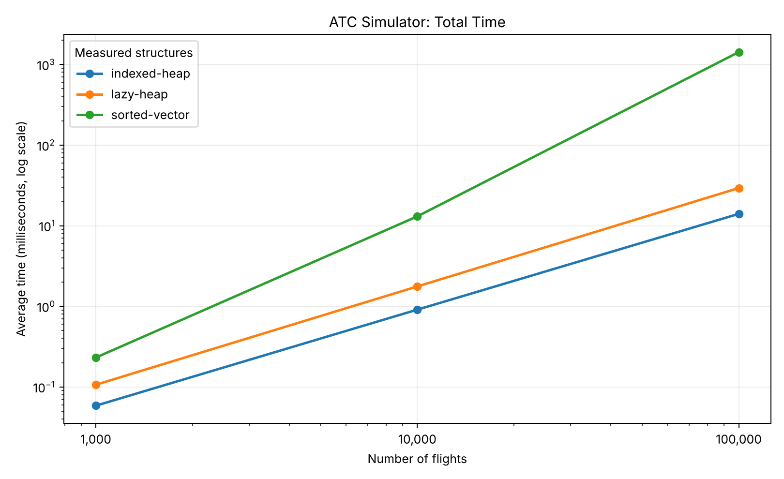
AVERAGE TOTAL TIME, BOTH AXES LOGARITHMIC
Which structure was fastest?
At 100,000 flights
Sorted vector
1,426.5 ms
Lazy heap
29.3 ms
Indexed heap
14.0 ms
Indexed heap: 101.6× faster than the sorted vector and 2.1× faster than the lazy heap. Lower is faster.
CSCI 3110 • MTSU • Fall 2026
HEIDTMANN
Notes:
Heidtmann, 0:40. Both axes use log scales, so each step is ten times bigger. The green line, the sorted vector, climbs steeply. Both heaps climb much more slowly. At 100,000 flights: 1,426.5 ms, 29.3 ms and 14.0 ms (ms means thousandths of a second). The indexed heap is about 100 times faster than the vector and about twice as fast as the lazy heap.

Slide 8
BREAKDOWN AT 100,000 FLIGHTS, IN MILLISECONDS (MS)
Where did the time go?
Structure | Add | Change | Remove | Land | Total
Sorted vector | 303.8 | 1,107.5 | 14.5 | 0.6 | 1,426.5
Lazy heap | 3.3 | 2.6 | 0.01 | 23.4 | 29.3
Indexed heap | 2.2 | 0.9 | 0.05 | 10.9 | 14.0
Sorted vector
Lazy heap
Prediction check
78% of its time is changing flight times (shifting).
80% of its time is landing and clearing stale copies.
The vector was not competitive even at 1,000 flights: 0.231 vs 0.059 ms.
CSCI 3110 • MTSU • Fall 2026
HEIDTMANN
Notes:
Heidtmann, 0:40. This table shows where the time went. The sorted vector spent 78% of its time shuffling to change times, but landed everything in 0.6 ms. The lazy heap spent 80% of its time landing, clearing old copies. One prediction was wrong: the vector was not competitive even at 1,000 flights (0.231 ms against 0.059 ms).

Slide 9
WHAT DID WE LEARN?
Conclusions and limitations
Best overall
Trade-offs
Big-O and limits
Indexed heap: fastest at every size. Best when the list is large and most entries change.
Sorted vector lands fastest but pays O(n) per update. Lazy heap is simpler, but stale entries slow landing.
Big-O predicted the growth; constant factors mattered at small n. One machine, first N flights only.
AI-assisted (Claude, ChatGPT), tested and disclosed in docs/ai-use-log.md.
CSCI 3110 • MTSU • Fall 2026
TEAM
Notes:
Everyone, 0:40. Best overall: the indexed heap, when the list is big and most flights change. The sorted vector lands fastest but is slow to update. The lazy heap is a simpler middle choice. Big-O tells us how fast work grows, but real timings also depend on the details. Limits: one computer, first N flights only. We used Claude and ChatGPT, tested everything and recorded it. Thank you, any questions?

