Slide 1
Robotics Setter Technician Program
Robotic welding, from learning to improvement
Diego Adair de León Márquez
Universidad Politécnica de Aguascalientes | Mechatronics Engineering, 9th term
Plant Tutor: Fernando Robledo
Engineering Department | August 1, 2026 to January 1, 2027
Notes:
• Name, UPA, Mechatronics, 9th term.
• Program: Robotics Setter Technician, since August 1.
• Plant tutor: Fernando Robledo.
• Today: what the program asks, what I learned, the improvement.

Slide 2

THE TENNECO VALUE I IDENTIFY WITH
Win
We must earn the trust of our employees and customers.
For me, winning meant ,Consider ergonomics topics for welder’s team members and ensure the product quality, I strive—as an engineer—optimize the process using robotic systems.
Notes:
• Win: earn the trust of our people and customers.
• Trust is earned on the floor, not given by a title.
• My example: the longest, hardest weld is now on a robot (4M).

Slide 3
Program scope and objective
Robotics Setter Technician | August 1, 2026 to January 1, 2027
OBJECTIVE
FINAL PROJECT
Become a specialist in robotic welding and advanced technical support.
An implemented improvement
In quality, availability or productivity.
Mine: 4M, implemented, with 47% less cycle time.
An updated training process
How the next setters learn.
Mine: study material reviewed, schedule rebuilt.
WHY IT MATTERS
When a welding robot stops, the line stops with it. A setter who can find the root cause and adjust the cell on the spot keeps parts moving and quality under control.
Notes:
• Objective: specialist in robotic welding and technical support.
• Why: when a welding robot stops, the line stops.
• Final project has two halves, and I have both: 4M and the training update.

Slide 4




Four levels, from understanding to improving
The skill path of the program
I
L
U
O
Understands
Does it with support
Does it alone
Improves and teaches
Safety, the welding process, welding procedure (WPS), discontinuities, defects and settings.
Basic robotics and dimensional adjustments, checking settings and changing consumables.
Programming the robot (SKS), creating programs and setting them up.
Troubleshooting, training others, Lean and continuous improvement.
HOW IT WORKS
Each level builds on the one before: first understand, then do, then own it, then improve it.
Notes:
• ILUO: understand, do with support, do alone, improve and teach.
• Same path the plant uses for any skill.
• Each level builds on the one before.

Slide 5
Eight weeks in, fourteen to go
Program timeline
Program start
Today
Level I and L exam
Levels U and O
Program close
August 1, 2026
September 25
October
November to December
January 1, 2027
Notes:
• 8 weeks done, 14 to go.
• Level I exam in October.
• No fixed training hours: I learn while attending real stops.

Slide 6


Level I: understand it before you touch the robot
What I learned
FIVE TOPICS
HOW I LEARNED IT
Safety
Working at the cell without putting anyone at risk, always using LOTOTO (Lockout-Tagout-Tryout) Safety first! .
616
pages of training manual and customer standard, read page by page.
GMAW (gas metal arc welding)
Understanding the elements of a GMAW welding system.
Daily
WPS
Consider controlling all essential variables to ensure the quality of the weld
at the cells, attending failures, adjustments and understanding the root cause.
Discontinuities, Defects and failures
Recognizing weld requirements according customer specifications, NG welds and understanding its cause.
25
Parameters
The settings that shape the weld, and their limits.
questions of a practice exam from previous years, solved.
Notes:
• Five topics, in plain words: safety, GMAW, WPS, defects, parameters.
• WPS = the approved recipe for every weld.
• Learned from 616 pages, a practice exam and daily work at the cells.

Slide 7
Four skills on my own, thirteen in progress
Progress on the 23 skills of the program
I
Understands
ON MY OWN TODAY
9 skills
Changing welding systems consumables
L
With support
5 skills
Adjusting the key welding settings according ranges stablished
U
Alone
3 skills
Closing ANDON calls
O
Improves
6 skills
On my own
In progress
Not started
Level I: exam still pending.
Notes:
• Name the four on my own: consumables, key settings, weld symbols, ANDON.
• Level I studied in full, but the exam is still pending.
• 4M counts as my first step in the improvement skill.

Slide 8


Most of my time goes to industrialization
How my time is split
90% DOC & DPF PROGRAM
THE PROJECT
Industrialization and successful PPAP runs for MY27 Cummins program, together with Engineering.
Industrialization project
WHAT INDUSTRIALIZATION MEANS
40%
Getting a new process ready to run on the floor: equipment, programs, trials and the release to production.
Support at the robotic cells: stops, adjustments and ANDON calls.
Notes:
• 60% of my time: industrialization of the Cummins project.
• Industrialization = getting a new process ready for the floor.
• The other 40% at the cells is where the hands-on learning comes from.

Slide 9
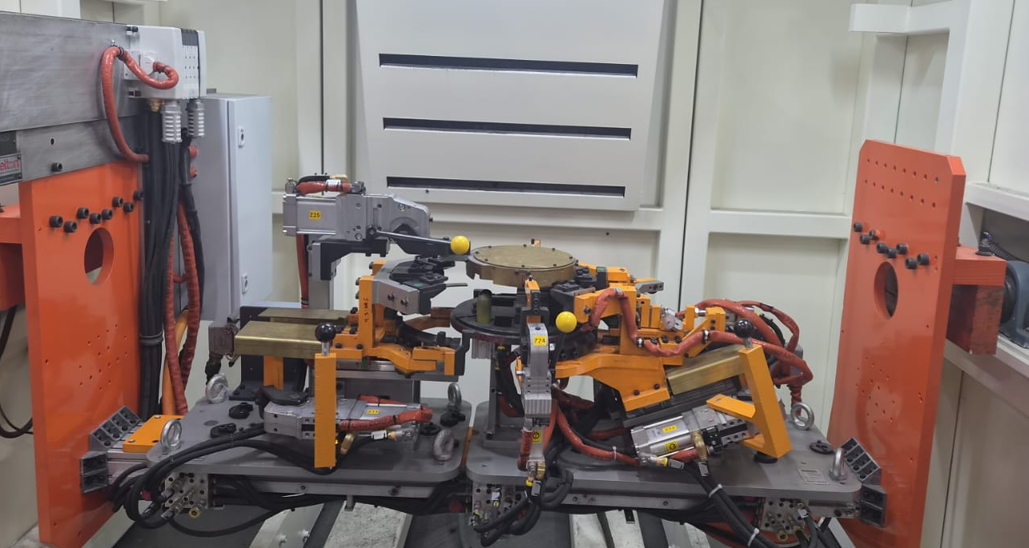
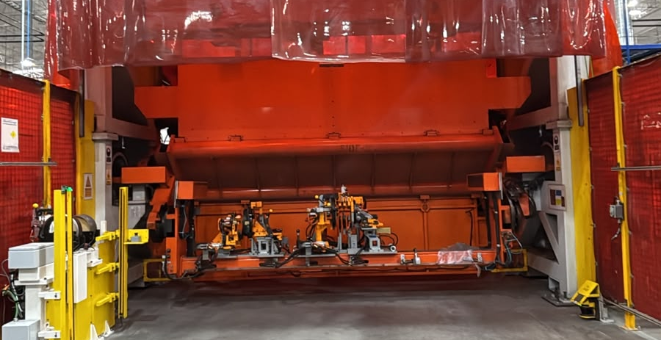
Improvement idea: from a manual booth to the 4M cell
Improvement idea and implementation | Done
THE PROBLEM
Difficulty applying long weld seams while maintaining good manual control (inconfortable positions for welder TM), and cycle time issues: 146 s of welding per part.
PHOTO
Before: manual welding booth
THE IDEA
Move the process to 4M, an automatic robotic cell, with the same fixture.
IMPLEMENTED
Running in 4M today. The robot welds, and the team member only loads and unloads.
Notes:
• Problem: 146 s of welding by hand, in uncomfortable positions.
• Idea: move it to 4M, same fixture.
• Done with my supervisor, and running today.
• The team member now only loads and unloads.

Slide 10


Same part, 47% less cycle time
Improvement | Results, in seconds per part
CYCLE TIME PER PART
−47%
Manual welding process
cycle time, 174 s to 93 s
20
146
8
174 s
−56%
4M robotic cell
welding time, 146 s to 65 s
20
65
8
93 s
81 s
Load and unload
Welding by hand
Welding by robot
saved on every part
Same fixture, so loading and unloading take the same time. The gain is all in the welding.
Notes:
• Cycle time 174 s to 93 s: 47% less.
• Welding 146 s to 65 s: 56% less.
• Load and unload did not change (same fixture), so the gain is all welding.
• 81 s saved on every part, and less strain for the team member.

Slide 11
What I would change in how setters learn
Final project | Training process update, a proposal
01
02
03
Reviewed
Found
Rebuilt
616 pages of training manual and customer standard, page by page, against what Level I asks.
Gaps: topics the exam asks about that the material barely covers, and an error in one key table.
The schedule, in the plant’s own format, so plan and reality can be compared week by week.
PROPOSAL
Use the corrected material and the new schedule with the next group of setters.
Notes:
• It is a proposal, not something already adopted.
• Example gap: 8 of 25 exam questions are TIG, and the matrix never names it.
• The error: the transfer mode table in the manual.
• The new schedule compares plan against reality, week by week.

Slide 12
Next: from knowing it to doing it alone
What comes next, until January
NEXT LEVELS
WHAT I NEED
L
Validate settings and find defects at the cell, with support.
A date for my Level I exam
November
Supervised time programming robots in SKS and miller
U
Create and set up robot programs on my own (SKS, Miller).
December
Your feedback on the training proposal
O
Solve problems, share what I learn, keep improving.
Already started with 4M
Notes:
• L in November, U in December, O already started with 4M.
• Ask clearly: an exam date, supervised SKS time, feedback on the proposal.

Slide 13
Conclusions and next steps
What is in place, and what comes next
IN PLACE
NEXT STEPS
I studied the entire Level I curriculum and practiced the five skills of Level L with the help of my tutor and the technicians.
Pass the Level I exam on wk40.
A manual weld moved to the 4M robotic cell: 47% less cycle time, less strain.
Reach Levels U and O before January.
A reviewed study path, and a schedule that shows plan versus reality.
Keep measuring 4M, and find the next weld or process to automate.
I came to learn robotic welding, and I am already improving it.
Notes:
• Close with the lime line.
• Pause, then open for questions.

Slide 14
Thank you
Diego Adair de León Márquez | Engineering Department
Notes:
• Thank them. Take questions.

