Slide 1
Robotics Setter Technician Program
Robotic welding, from learning to improvement
Diego Adair de León Márquez
Universidad Politécnica de Aguascalientes | Mechatronics Engineering, 9th term
Plant Tutor: Fernando Robledo
Engineering Department | August 1, 2026 to January 1, 2027
Notes:
• Name, UPA, Mechatronics, 9th term.
• Program: Robotics Setter Technician, since August 1.
• Plant tutor: Fernando Robledo.
• Today: what the program asks, what I learned, the improvement.

Slide 2

THE TENNECO VALUE I IDENTIFY WITH
Win
We must earn the trust of our employees and customers.
For me, winning means caring for the ergonomics of our welders while protecting product quality. As an engineer, I do it by optimizing the process with robotic systems.
Notes:
• Win: earn the trust of our people and customers.
• Two things at once: the welder’s ergonomics and the product’s quality.
• My way as an engineer: optimize the process with robots (4M).

Slide 3
Program scope and objective
Robotics Setter Technician | August 1, 2026 to January 1, 2027
OBJECTIVE
FINAL PROJECT
Become a specialist in robotic welding and advanced technical support.
An implemented improvement
In quality, availability or productivity.
Mine: 4M, implemented, with 47% less cycle time.
An updated training process
How the next setters learn.
Mine: study material reviewed, schedule rebuilt.
WHY IT MATTERS
When a welding robot stops, the line stops with it. A setter who can find the root cause and adjust the cell on the spot keeps parts moving and quality under control.
Notes:
• Objective: specialist in robotic welding and technical support.
• Why: when a welding robot stops, the line stops.
• Final project has two halves, and I have both: 4M and the training update.

Slide 4
The plan: four levels, each one validated
My ILUO matrix, paraphrased | 40 hours of formal training
OBJECTIVE Become a specialist in robotic welding and advanced technical support.
LEVEL
WHAT IT COVERS
HOW IT IS VALIDATED
TIME
METHOD
I
Understands
Safety, GMAW equipment, metal transfer, process variables, discontinuities, joints, positions, symbols and control documents.
Theory exam, 8.0 to pass
4 h
Classroom session
L
With support
Basic robotic and dimensional adjustments, checking settings against the WPS, finding defects and changing consumables.
Validation on the floor
8 h
Robotic cell, on the floor (Gemba)
U
Alone
Creating new welding programs in SKS and setting their parameters (SKS and Miller).
Practical exam
8 h
Robotic cell, on the floor (Gemba)
O
Improves and teaches
Training level 2 and 3 staff, improvement ideas, problem solving (8D, Ishikawa, 5W+2H), GD&T, ANDON and Lean.
Implementation and training, validated
20 h
80-hour follow-up: TM, WAVE or PSIF
Notes:
• This is my ILUO matrix, turned into the plan to reach the objective.
• Each level has its own test: exam, floor validation, practical exam, implementation.
• 40 hours of formal training in total; the rest happens at the cells.
• Supervisor’s point: each level is validated before the next one.

Slide 5
Level I exam next, in week 40
Gantt | Technical and practical skills, done and next
August
September
October
November
December
32
33
34
35
36
37
38
39
40
41
42
43
44
45
46
47
48
49
50
51
52
53
Level I, mastered
Safety, GMAW, variables, defects, documents
Level I, in progress
Metal transfer, joints, positions, symbols
Level I exam
Week 40
Theory exam, 8.0 to pass
Level L, floor skills
Settings, defects, consumables
Level U, programming
New programs, SKS and Miller
Level O, improve and teach
ANDON calls and the 4M improvement
Industrialization
MY27 Cummins, DOC and DPF program
Real
Plan
Milestone
Today, Sep 25
Notes:
• Green is what really happened, blue is the plan, same as the Excel.
• Level I: five topics mastered, four still open before the exam.
• Level I exam in week 40. Level L validated on the floor in October.
• U and O in November and December; O already started with 4M.
• Industrialization runs the whole period.

Slide 6


Level I: five topics mastered, four still open
What I learned
MASTERED
STILL OPEN
Safety
Working at the cell without risk, always with LOTOTO (lockout, tagout, tryout).
Metal transfer modes
GMAW equipment
Every part of a GMAW welding system, and how they work together.
Joint geometry
Process variables
Keeping the essential variables under control, because they decide weld quality.
Welding positions
Discontinuities
Reading the customer’s weld requirements, spotting NG welds and finding their cause.
Welding symbols
Control documents
WPS, PQR and parameter sheets: the approved recipe for every weld.
I close them before the exam in week 40.
HOW I LEARNED IT
616 pages of manual and standard, a practice exam, and daily failures at the cells.
Notes:
• Supervisor’s point: be clear that Level I is not complete yet.
• Mastered: safety with LOTOTO, GMAW equipment, variables, discontinuities, control documents.
• Still open: transfer modes, joints, positions, symbols.
• Plan: close the four before the exam in week 40.

Slide 7
Eleven skills achieved, six in progress
Progress on the 23 skills of the program
I
Understands
ON THE FLOOR TODAY
9 skills
Changing welding consumables
L
With support
5 skills
Adjusting the key welding settings within their ranges
U
Alone
3 skills
Closing ANDON calls
O
Improves
6 skills
Achieved
In progress
Not started
Next: Level I exam, week 40.
Notes:
• 11 achieved, 6 in progress, 6 not started, out of 23.
• Level I: 5 of 9. Level L: the five skills practiced with support.
• U and O are mostly ahead; 4M is my first step in O.

Slide 8


Most of my time goes to a program that is 90% ready
My time on the floor, and where the program stands
60%
THE PROJECT
Industrialization and successful PPAP runs of the MY27 Cummins DOC and DPF program, together with Engineering.
of my time: industrialization, with Engineering
PROGRAM PROGRESS
40%
90%
ready to launch
Start of production planned for January 2027.
Support at the robotic cells: stops, adjustments and ANDON calls.
Notes:
• Two numbers, not to be mixed up.
• 60% of my time goes to industrialization, 40% to support at the cells.
• The program itself is 90% ready, with launch planned for January.
• The cells are where most of the hands-on learning happens.

Slide 9
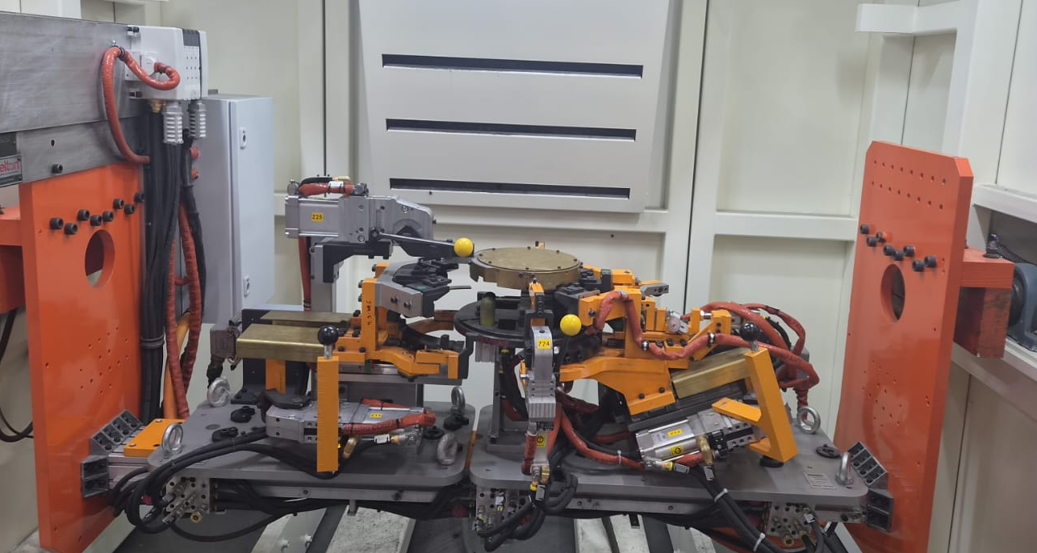
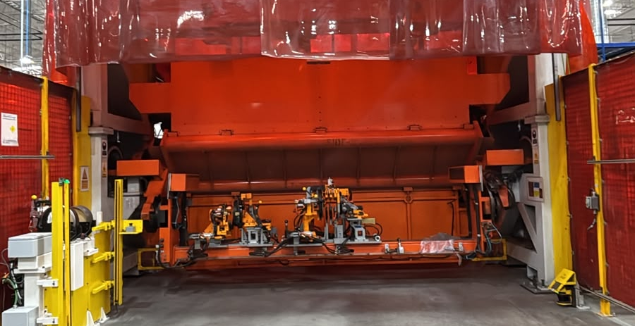
Improvement idea: from a manual booth to the 4M cell
Improvement idea and implementation | Done
THE PROBLEM
Long weld seams were hard to control by hand, the welder worked in uncomfortable positions, and welding alone took 146 s per part.
THE IDEA
Move the process to 4M, an automatic robotic cell, with the same fixture.
IMPLEMENTED
Running in 4M today. The robot welds, and the team member only loads and unloads.
Notes:
• Problem: 146 s of welding by hand, in uncomfortable positions.
• Idea: move it to 4M, same fixture.
• Done with my supervisor, and running today.
• The team member now only loads and unloads.

Slide 10


Same part, 47% less cycle time
Improvement | Results, in seconds per part
CYCLE TIME PER PART
−47%
Manual welding process
cycle time, 174 s to 93 s
20
146
8
174 s
−56%
4M robotic cell
welding time, 146 s to 65 s
20
65
8
93 s
81 s
Load and unload
Welding by hand
Welding by robot
saved on every part
Same fixture, so loading and unloading take the same time. The gain is all in the welding.
Notes:
• Cycle time 174 s to 93 s: 47% less.
• Welding 146 s to 65 s: 56% less.
• Load and unload did not change (same fixture), so the gain is all welding.
• 81 s saved on every part, and less strain for the team member.

Slide 11
What I would change in how setters learn
Final project | Training process update, a proposal
01
02
03
Reviewed
Found
Rebuilt
616 pages of training manual and customer standard, page by page, against what Level I asks.
Gaps: topics the exam asks about that the material barely covers, and an error in one key table.
The schedule, in the plant’s own format, so plan and reality can be compared week by week.
PROPOSAL
Use the corrected material and the new schedule with the next group of setters.
Notes:
• It is a proposal, not something already adopted.
• Example gap: 8 of 25 exam questions are TIG, and the matrix never names it.
• The error: the transfer mode table in the manual.
• The new schedule compares plan against reality, week by week.

Slide 12


Next: from knowing it to doing it alone
What comes next, until January
NEXT LEVELS
WHAT I NEED
L
Validate settings and find defects at the cell, with support.
Level I exam confirmed, week 40
October, validation on the floor
Supervised time programming robots in SKS and Miller
U
Create and set up robot programs on my own (SKS and Miller).
November to December
Your feedback on the training proposal
O
Solve problems, share what I learn, keep improving.
November to December, already started with 4M
Notes:
• L in October, U and O in November and December.
• Ask clearly: the exam in week 40, supervised programming time, feedback on the proposal.

Slide 13
Conclusions and next steps
What is in place, and what comes next
IN PLACE
NEXT STEPS
I studied all of Level I and mastered five of its nine topics, and I practiced the five Level L skills with my tutor and the technicians.
Close the four open Level I topics and pass the exam in week 40.
A manual weld moved to the 4M robotic cell: 47% less cycle time, less strain.
Validate Level L on the floor in October, then reach U and O before January.
A reviewed study path, and a schedule that shows plan versus reality.
Keep measuring 4M, and find the next weld or process to automate.
I came to learn robotic welding, and I am already improving it.
Notes:
• In place: 5 of 9 Level I topics, Level L practiced, 4M running, training proposal.
• Next: exam in week 40, Level L in October, U and O by January.
• Close with the last line. Pause, then questions.

Slide 14
Thank you
Diego Adair de León Márquez | Engineering Department
Notes:
• Thank them. Take questions.

