Slide 1
Machine Learning Tutorial

Slide 2
Outline
Explore different machine learning methods
Classify human activity from sensor data
Segment tissue types from stain image
Classify plant species by sepal and pedal measurements
Explore machine learning capabilities of MATLAB
classificationLearner
Provide resources for further study

Slide 3
Exercises
Classify Human Activity (Classification)
Tissue Segmentation (Clustering)
https://github.com/adairdavid/ais-ml-tut-2016
click ‘Clone or Download’ and ‘Download Zip’
Unzip and open ‘Human_Activity_Learning.m’ with MATLAB
Set working directory in MATLAB console:
cd /Users/bhsc_guest/Downloads/ais-ml-tut-2016-master
http://tinyurl.com/ml-tut-2016-video
Jump to 9:43 (Example 1), follow along
Can you create more accurate models by changing the ‘Advanced’ settings on your “best” model?
Open MATLAB, in console:
clear all; clc;
edit KMeansSegmentationExample.m;
Read the code, running sections until complete.
Plant Classification (Classification)
Open MATLAB, in console:
clear all; clc;
load fisheriris;
D = table(meas, species);
classificationLearner
Play around in classificationLearner
Explore different variables in the scatter plot
Train a variety of models
Evaluate model performance using confusion matrix and ROC
Want to know what a certain function does?
help funcname
Ex: help varfun
Notes:
http://www.mathworks.com/matlabcentral/fileexchange/50232-machine-learning-made-easy?s_iid=ovp_custom1_4136401539001-100694_rr

Slide 4
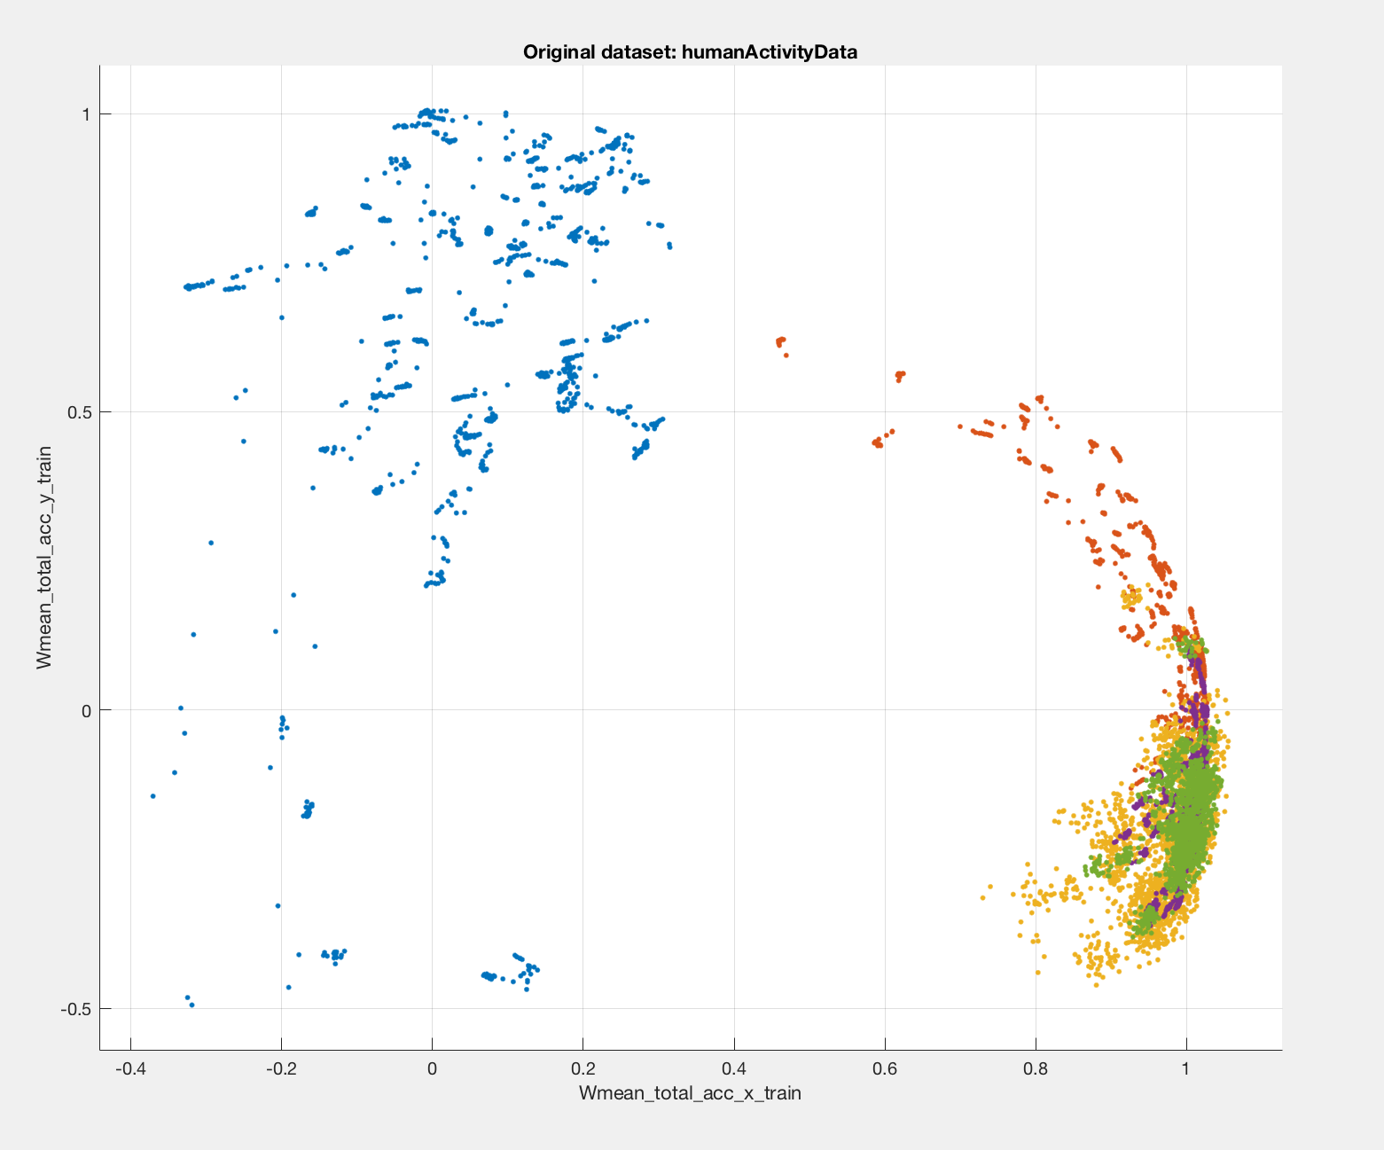
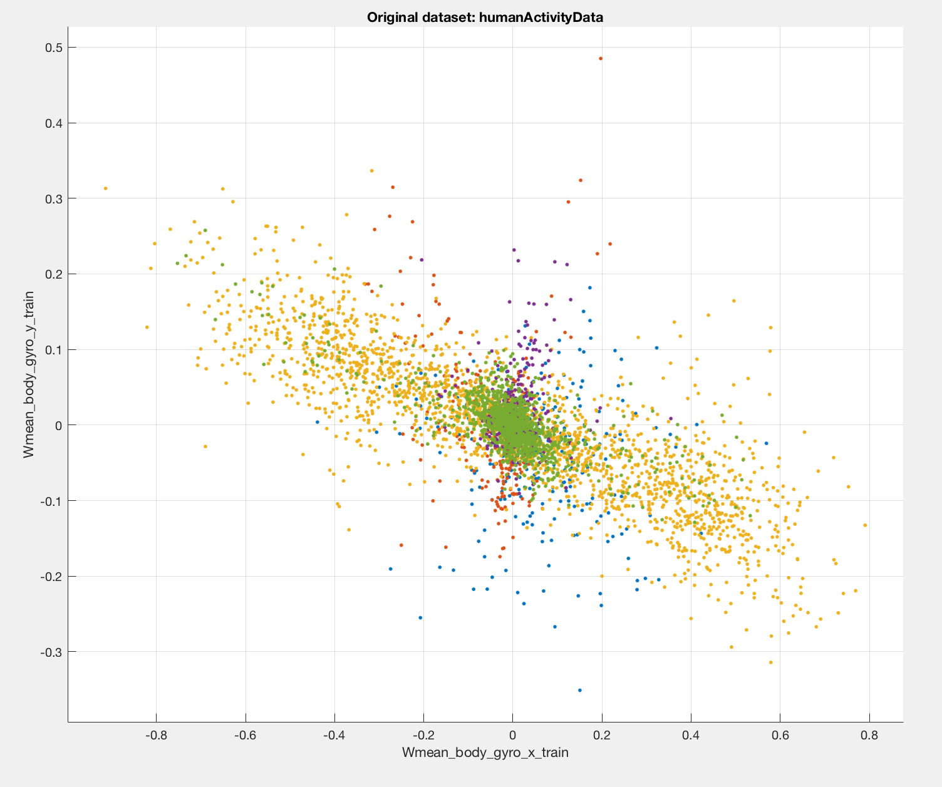

Slide 5
Further Resources
http://www.mathworks.com/videos/predictive-modeling-for-healthcare-94781.html
http://www.mathworks.com/videos/machine-learning-and-computer-vision-for-medical-imaging-applications-108028.html
https://github.com/facebook/iTorch -- LuaJIT machine learning
http://scikit-learn.org/stable/ -- Python machine learning
http://www.mathworks.com/tagteam/87371_92974v00_Machine_Learning_Whitepaper.pdf

