Slide 1
Supervised Learning of Multiplicative Semantic Word Embeddings from Semantic Entailment Data
Ao Liu

Slide 2
Introduction
Natural Language Processing (NLP) tasks rely on word embeddings.
“king” – “man” + “woman” = “queen”
word2vec, GloVe, etc.
Unsupervised
Syntactic: co-occurrence
“like” ≈ “not like”?
Topic oriented

Slide 3
Goal
Add abstract meaning to word embeddings
Improve the performance on semantic entailment task
Why multiplicative?
Ideally, embeddings of negation and degree modifier would be constant vectors, e.g.
“not” * “like” = “dislike” ≠ “like”

Slide 4
Dataset
Stanford Natural Language Inference (SNLI) corpus
570k human-written English sentence pairs
Manually labeled: entailment, contradiction, neutral
Why SNLI?
High quality
Semantics

Slide 5
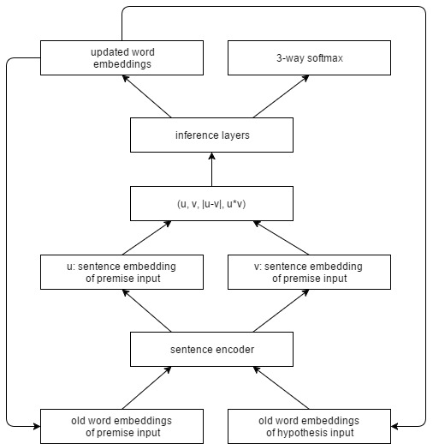
Model

Slide 6
Performance
Model | Dim | Dev | Test
LSTM_sent_encoder | 300/2048 | 81.9 | 80.7
GRU_sent_encoder | 300/2048 | 82.4 | 81.8
BiGRU-last_sent_encoder | 300/4096 | 81.3 | 80.9
BiLSTM-mean_sent_encoder | 300/4096 | 79.0 | 78.2
BiLSTM-max_sent_encoder | 300/4096 | 85.0 | 84.5
Semantic_word_embedding(my work) | 100/200 | 81.6 | 81.1

Slide 7
Conclusions
Strength:
Word embeddings semantically improved
Combine syntactic and semantic information
Limitation:
Slower than unsupervised word embedding training
Corpus is limited comparing to unsupervised training
Future Works:
Transfer to other tasks
Training with higher number of dimension (require computational resources)

Slide 8
References
Yoshua Bengio, Rejean Ducharme, Pascal Vincent, and Christian Jauvin. A neural probabilistic language model. Journal of machine learning research, 3(Feb):1137–1155, 2003.
Ronan Collobert, Jason Weston, Leon Bottou, Michael Karlen, Koray Kavukcuoglu, and Pavel Kuksa. Natural language processing (almost) from scratch. Journal of Machine Learning Research, 12(Aug):2493–2537, 2011.
Tomas Mikolov, Ilya Sutskever, Kai Chen, Greg S Corrado, and Jeff Dean. Distributed representations of words and phrases and their compositionality. In Advances in neural information processing systems, pages 3111–3119, 2013.
Jeffrey Pennington, Richard Socher, and Christopher Manning. Glove: Global vectors for word representation. In Proceedings of the 2014 conference on empirical methods in natural language processing (EMNLP), pages 1532–1543, 2014.
Alexis Conneau, Douwe Kiela, Holger Schwenk, Loic Barrault, and Antoine Bordes. Supervised learning of universal sentence representations from natural language inference data. arXiv preprint arXiv:1705.02364, 2017.
Scott Deerwester, Susan T Dumais, George W Furnas, Thomas K Landauer, and Richard Harshman. Indexing by latent semantic analysis. Journal of the American society for information science, 41(6):391, 1990.
Jia Deng, Wei Dong, Richard Socher, Li-Jia Li, Kai Li, and Li Fei-Fei. Imagenet: A large-scale hierarchical image database. In Computer Vision and Pattern Recognition, 2009. CVPR 2009. IEEE Conference on, pages 248–255. IEEE, 2009.
Samuel R Bowman, Gabor Angeli, Christopher Potts, and Christopher D Manning. A large annotated corpus for learning natural language inference. arXiv preprint arXiv:1508.05326, 2015.
Juri Ganitkevitch, Benjamin Van Durme, and Chris CallisonBurch. Ppdb: The paraphrase database. In HLT-NAACL, pages 758–764, 2013.

