Slide 1
Topic-Enhanced Language Model (Proposal)
Ao Liu
Umass, CICS

Slide 2



Language Models
Joint Probability:
Log-likelihood:
Problem:
hard to learn semantic dependencies (usually long-distance)

Slide 3
Topic Models
LDA, etc
Useful tool to capture hidden semantic structures
Problem:
No Word Ordering

Slide 4
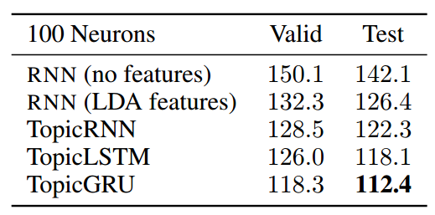
TopicRNN (Dieng et al., 2017)
Latent topic model to capture global semantics
RNNs to capture local syntactic structures
Problem:
Only excludes the effect of stop words
Topic model remains global
Local alternation is ignored

Slide 5
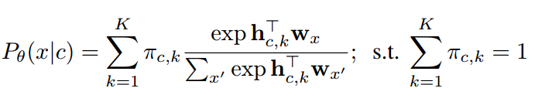
Mixture of Softmax (MoS) (Yang et al., 2018)
View language modeling as a matrix factorization problem
MoS:
Weighted average of K softmax distributions
Allow the probability matrix to have high rank
Model has better expressiveness
Problem:
Hard to interpret the latent states
Semantic dependencies may or may not be learned

Slide 6
Haw-Shiuan’s Previous Work
a b c d e f
s1
s2
s1
s2
≅
Coefficients of bases in s1
Sentences embedding
Average word2vec
Clusters of words
New sentence representation 1
Could be clustered into events
(Haw-Shiuan, presented 2/21/2018)

Slide 7
Proposed Model
Using all seen words in the document to finetune global topic basis
Using seen words in the sentence to predict local topic basis (a subset of global basis)
Predict the next word conditioned on seen words in the sentence and local topic basis

Slide 8
Downstream Tasks
Text Generation
Similar to predictions in the proposed language model
Further changes depend on the specific generation task
Document Ontology Classification and Ranking
Can be either unsupervised or semi-supervised
Features:
Output of language model (last state)
Topic Similarities

