Slide 1
Predict basketball games
Daniel Adalaid Carranza Alvarez - A01270898
Notes:
Good Afternoon to everyone. For my challenge, I decided to predict basketball games.

Slide 2


Why predict the future?
Why in basketball?
Notes:
So, why predict future? Because is essential for us. For many years, humanity tried to predict different aspects of the world, to understand it and react it.
Ok, but why in basketball. Well for many Technical Directors. predict games is very useful to create different trainings, depending of the results of the prediction. And also to win money in sports betting.

Slide 3



How?
Artificial Intelligence
Computational Intelligence
Notes:
but how, how we can predict games. lets see what we have. A bunch of data and a computer.
Merging this we have a branch of the Artificial Intelligence that is Computational Intelligence.
CI is responsible of getting a huge data, process it and make predictions and/or results.

Slide 4
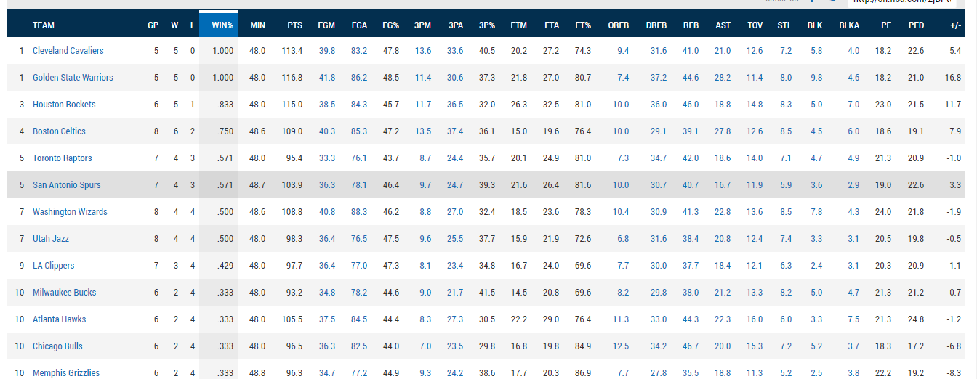
Data
Notes:
After we see all data, we retrieved some important values that was decided is the best option to predict the games
and we have:

Slide 5
Data
The position in the season.
The budget of the team in the season.
Last ten games of the team.
Team is Local.
Last five games against the rival.
The position of the last season.
Notes:
The position in the season that is playoffs season 2017 in this case
The budget of the team for this season
Last ten games of the team, if won or not.
If the team plays as local or not
Las five games against the rival.
And the position of the last season.
And Also the values of each one. We will see how use these values in the algorithm

Slide 6
Algorithm
Function = Sumatory(Probability(i) * Value(i))
Probability = (TeamA(i)/(TeamA(i) + TeamB(i)))
Compare the probabilities.
Notes:
The function that is used is a classic algorithm in Artificial Intelligence. The search system with adversary.
We see “function”, The porcentage of the team to get the victory.
I as the characteristic that is evaluated.
Probability of i
and value of i. This value is the value that we see before.
Also for each characteritic we see more less the same thing. The probability that is team A dividing by teamA plus team b times the value.
At the end we compare the probabilities and we see who will win.

Slide 7
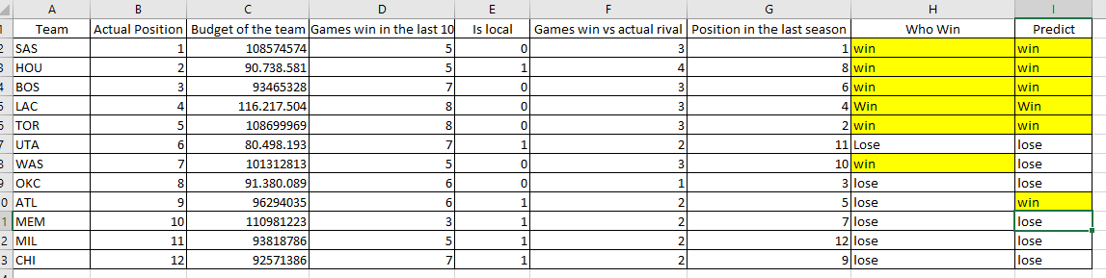
Demo
Notes:
For the first Test I get data of the playoffs of this season. More exactly the first round of the playoffs. Dates between April 27 and 28.
So we run with the first test and let see.
So these are the games, and the result. 6 games 5 were successful and one not. That is the game between Wizards and Hawks.
Lets see test 2.

Slide 8
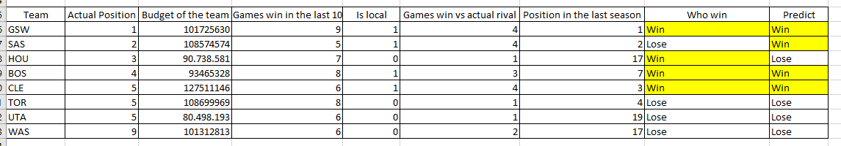
Demo
Notes:
For test 2 are the games between may 1 and 2. Ok I run it and.
For the 4 games 3 were succesful and 1 fail.
Taken this we see that the algorithm fails 1 time. But predictions can be make it. So.

Slide 9
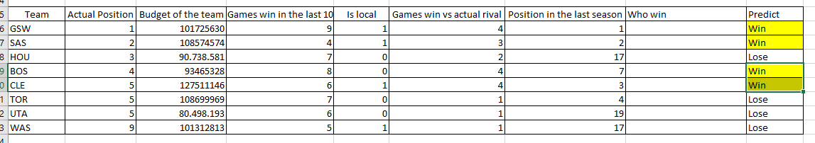
Prediction
Notes:
For the prediction of may 3 and 4 the teams that will won are.

Slide 10
Conclusion
Notes:
The conclusion is that there are some nice results but it still some values that we have to count to make a good prediction, another interested values will be the points, the average height of players and number of international players, to get better results and predict in a better way. but also you don’t forget that is a sport everything can happend in a sport. NBA says where amazing happens so. This is why we played

