Slide 1



Embedding Methodology and Statistics for Inference
XDATA SUMMER CAMP
Sancar Adali
July 29, 2013

Slide 2
Table of Contents
From Data to Statistics
Analytic Capabilities and Implementations
Dataset: Bitcoin
Dataset: Kiva
Dataset: Akamai Traceroute
Dataset: Akamai CIDR

Slide 3
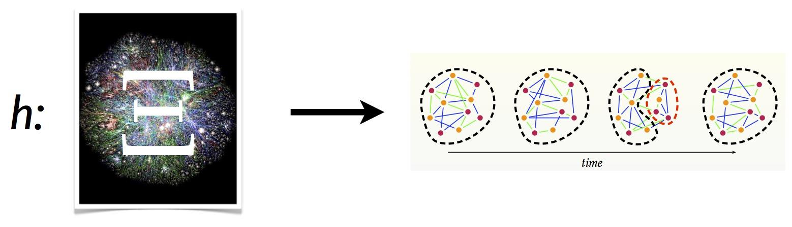
FROM DATA TO STATISTICS
Notes:
Our objective in this summer workshop is to extract statistics that we can use for inference from the vast collection of data. Some of the statistics are also useful for interpretation or visualization. We also want to learn which of these are appropriate for a particular dataset.

Slide 4
CAPABILITIES AND IMPLEMENTATIONS
Compute statistics from time series of graphs (TSG)
Out-of-sample extension for adjacency spectral embedding
Faster Embedding by the use of OOS-embedding
Dissimilarity computation for multivariate time series
Tensor Decomposition for time series data (adj. matrices, multivariate data)
Fast computation of local statistics in very large graphs
Notes:
We have developed various analytic tools based on our methodologies.

Slide 5
CAPABILITIES AND IMPLEMENTATIONS
Software
R packages: ScanStats, AdjMatEmbed, DissTimeSeries
Python: Large-graph invariants , MySQL-igraph for TSG
igraph C/C++ library (devel branch)
Notes:
The tools listed here are available in the xdata git repository.

Slide 6
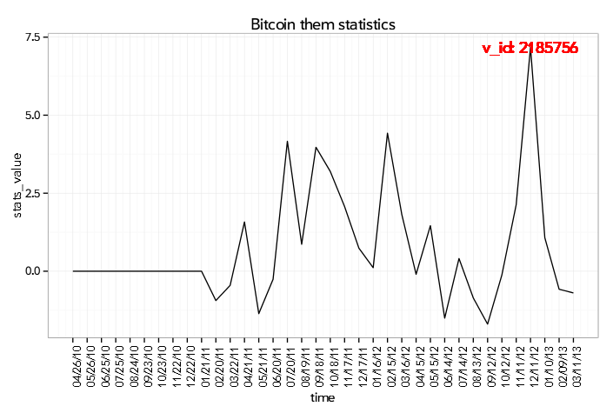
BITCOIN DATA ANALYSIS
BITCOIN
Time
User 1 User 2 ...
Sender | Receiver | Transaction amount | TimeStamp
User 1
User 2
User 3
...
Time Series of Graphs
Time Series of Scan Statistics
Notes:
For bitcoin data, we wanted to compute scan statistics for detection of anomalies. So we went from the transaction list to a time series of graph representation and then computed the local statistics in neighborhoods over the graph. We then summarize these local statistics with scan statistics. We use the scan statistics for detection of anomalies.

Slide 7
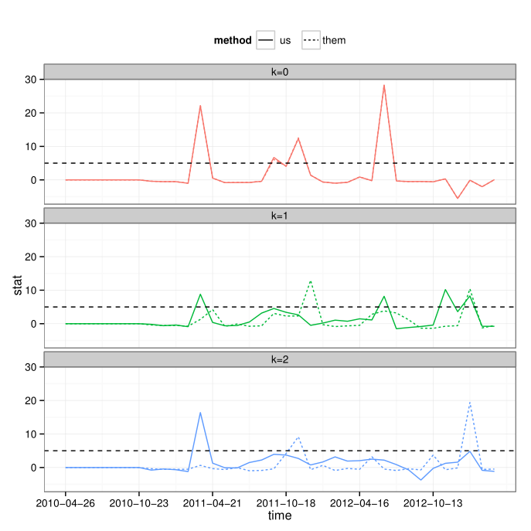
BITCOIN DATA ANALYSIS
BITCOIN
Various anomaly detections using the normalized statistics.
The vertices which are the sources of anomalous activity should be investigated further.
Two variants of scan statistics (us and them) for the Bitcoin data
Notes:
For various neighborhood sizes, and for the two variants of the scan statistics, we have different detections. The vertices which are the sources of the anomalies should be investigated further to see if there is interesting activity in the neighborhoods of those vertices.

Slide 8
EMBEDDING APPROACH
Kiva
Joint embedding of all entities (lender, loan, partner, borrower)
Relationship between entities of different kinds
-> Adjacency matrix of graph (entities -> vertices)
Lender-lender graph: edges mean lent money for the same loan
Lender-loan graph
Partner-loan graph
Notes:
For Kiva dataset, we were interested in the relationship between the entities of different types.

Slide 9
EMBEDDING APPROACH
Fast Embedding via out-of-sample extension
Embed the most active lenders in-sample
Repeat until all entities have been embedded:
  Embed a batch from the remaining entities via out-of-sample extension
Cluster the embedded entities
Notes:
Since the number of entities is so large, we wanted a faster embedding technique by using out-of-sample extensions for embedding methods.
After embedding all the entities, we can run clustering algorithms to see if interesting patterns exist.

Slide 10
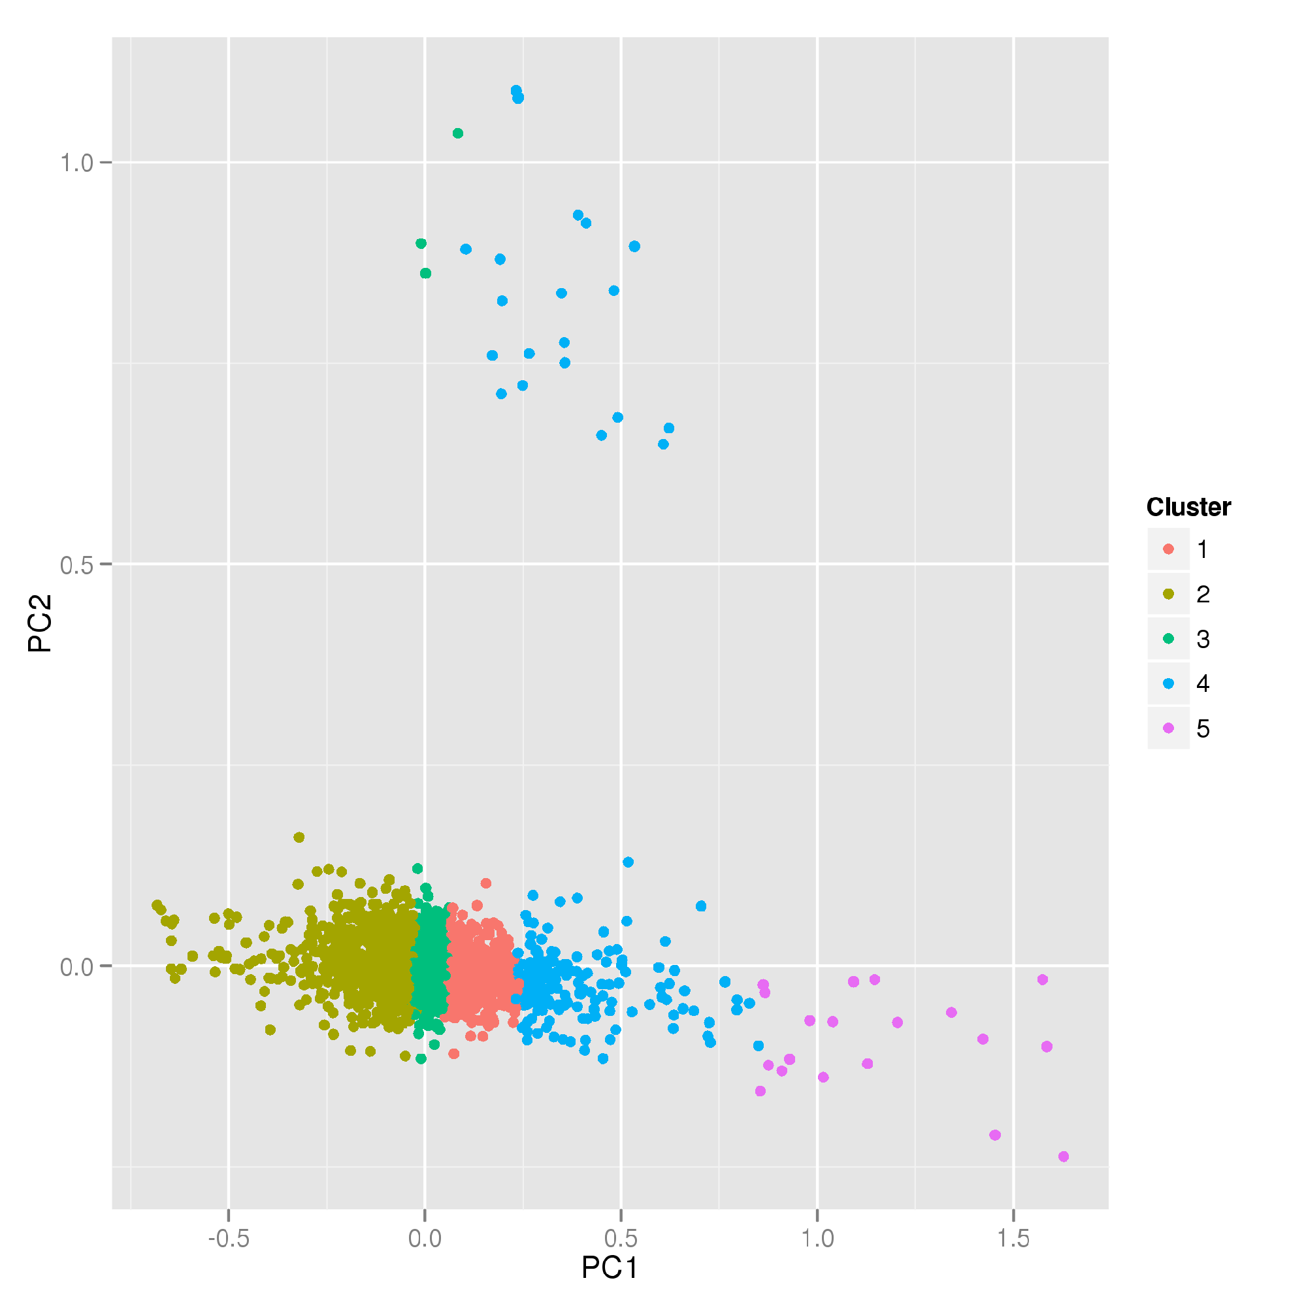
KIVA DATA ANALYSIS
Kiva Entity Embedding
Embedding of 720K Kiva lenders
Other entity types will be OOS embedded
Embedding of Kiva lenders (colored by clusters)
Notes:
For Kiva dataset, we clustered the embedded lenders. Because of the embedding method we employed, a lot of the points were embedded close together, so we did not get a great visualization. We are interested using another embedding method called stochastic neighbor embedding, which might be more appropriate for this data.

Slide 11
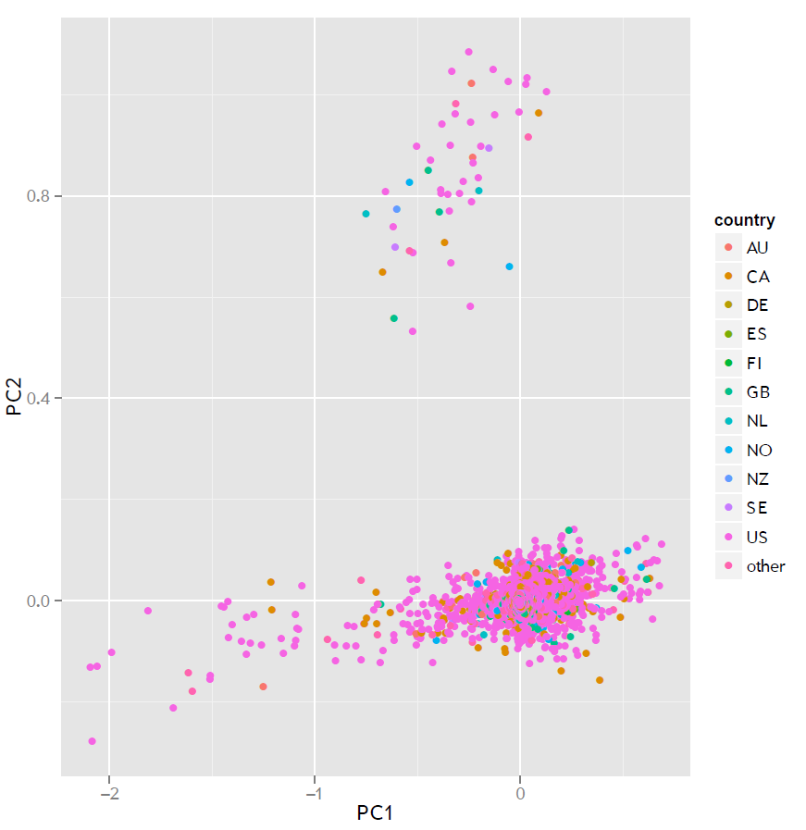
KIVA DATA ANALYSIS
Kiva Entity Embedding
Embedding of 720K Kiva lenders
Other entity types will be OOS embedded
Embedding of Kiva lenders (color coded by country)
Notes:
Here is a slightly different embedding with lenders color coded according to country.

Slide 12
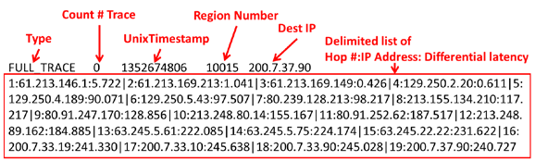
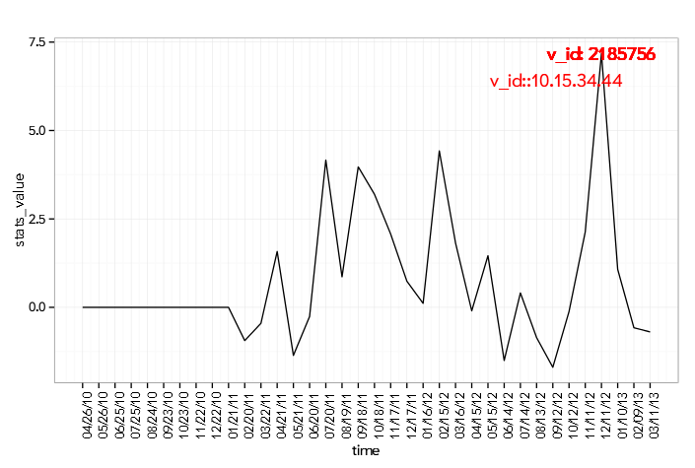
AKAMAI-TRACEROUTE
Scan Statistics for Anomaly Detection
Time
IP1 IP2 IP3 ...
IP1
IP2
IP3
...
Traceroutes
Time Series of Graphs
Time Series of Scan Statistics
Notes:
For Akamai Traceroutes, we computed scan statistics to detect anomalies in the traceroute traffic. .Our hope is that if the excessive amount of traceroutes are routed through a particular neighborhood of IPs, we would be able to detect that.
We ingested the traceroutes to form a timeseries of graphs, where the vertices corresponded to individual IPs

Slide 13
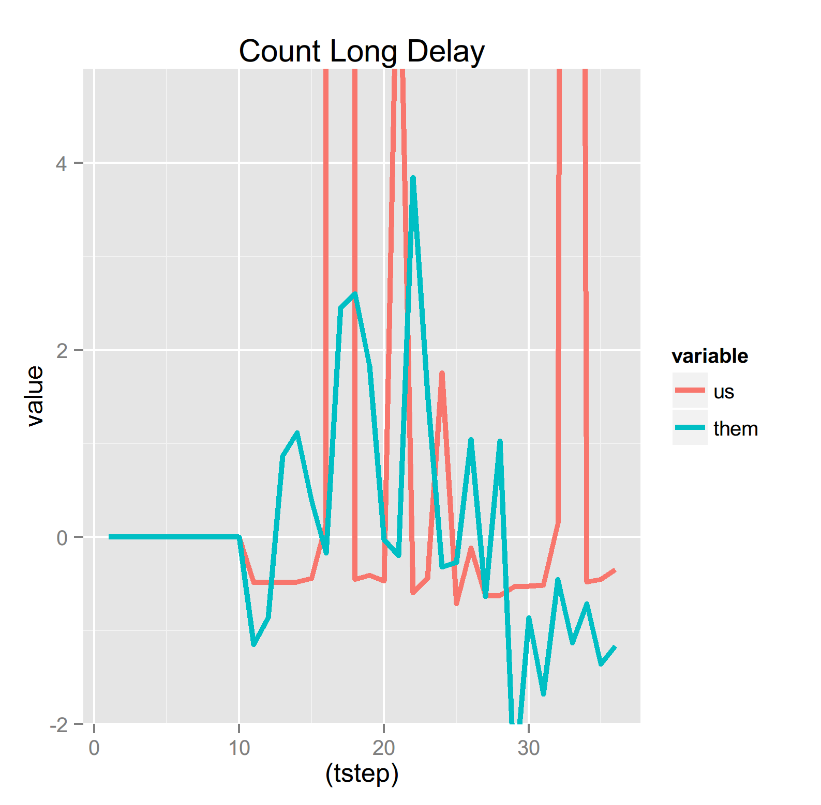
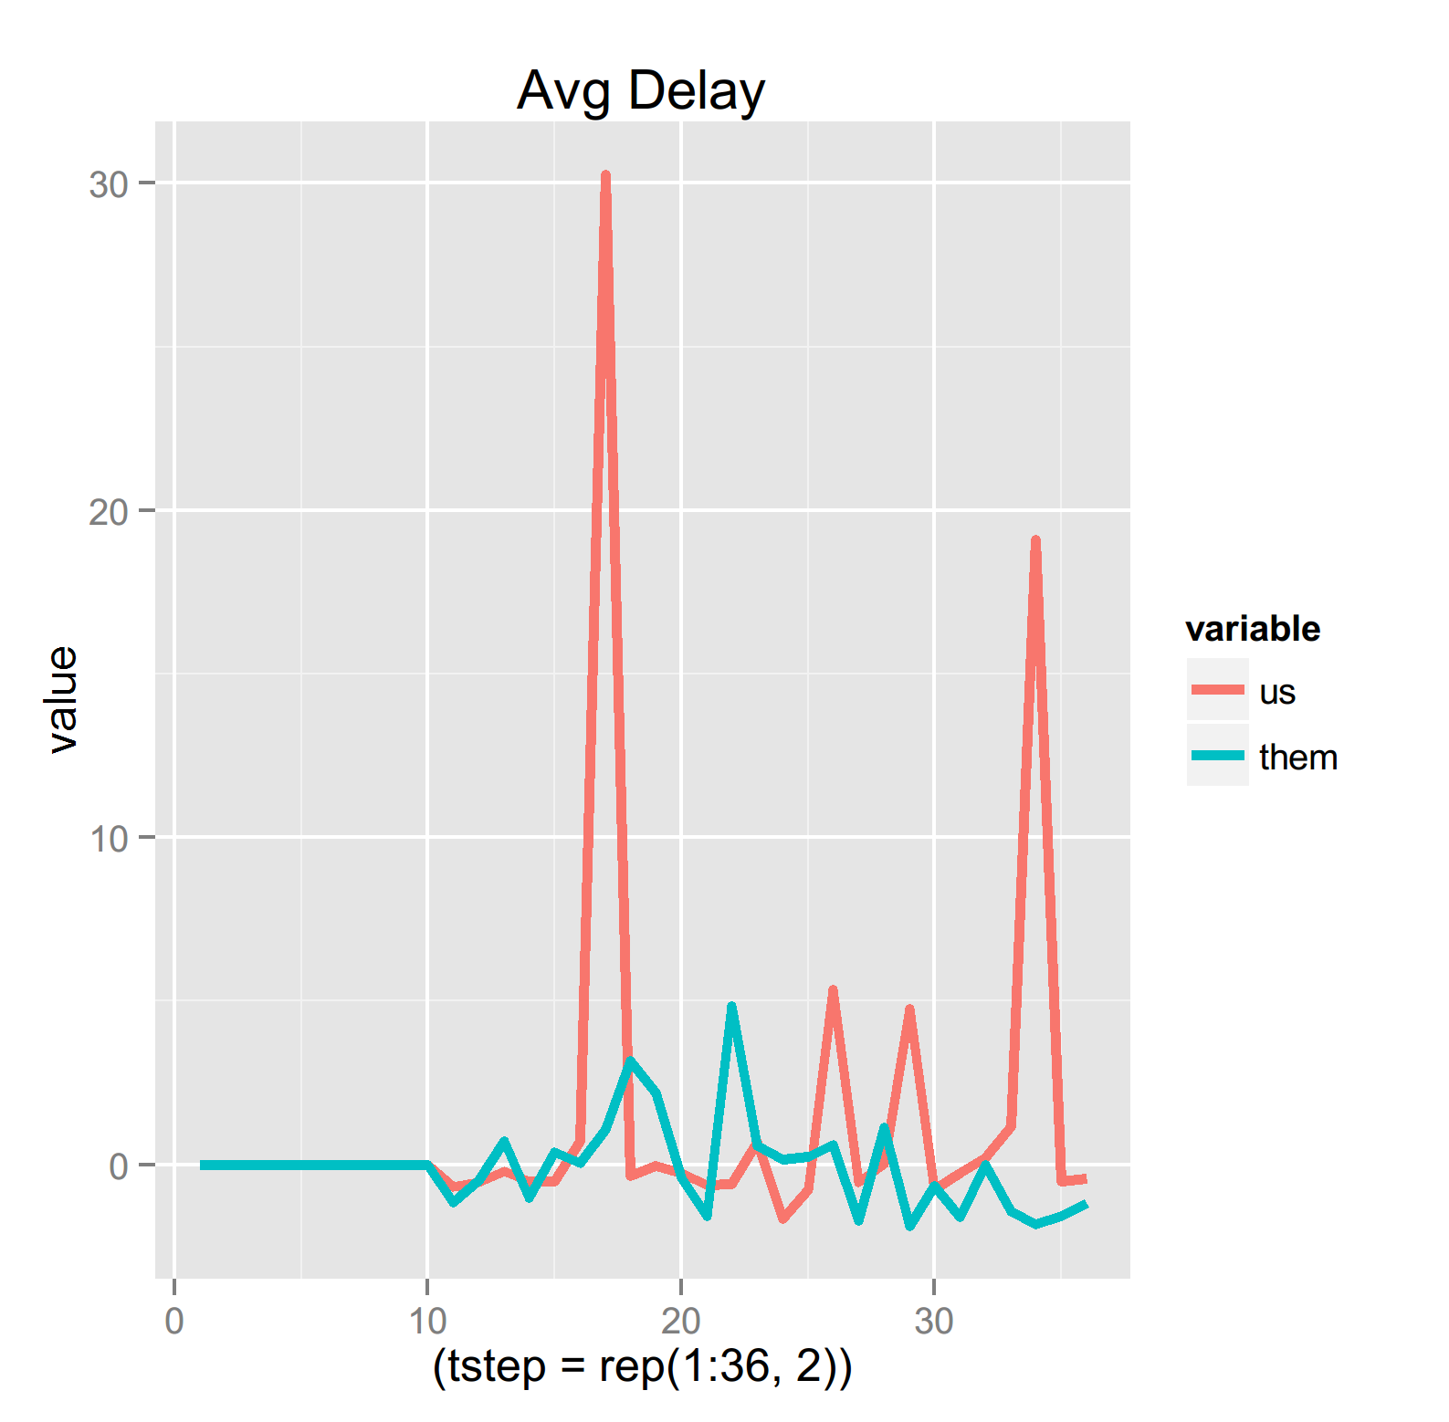
AKAMAI-TRACEROUTE
Scan Statistics for Anomaly Detection
Notes:
The code for that is still running and we will have those results in a few hours.
So I am showing results for an alternative approach, where we aggregate the traceroutes by country. The vertices are countries, The edges are hops between Ips in different countries. For edge weights, we compute average delays, and number of delays>30 in a time interval. We compute scan statistics from those weighted graphs.

Slide 14
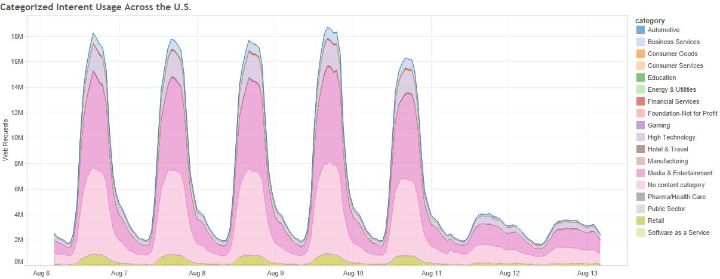
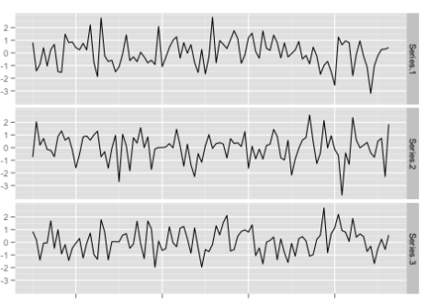
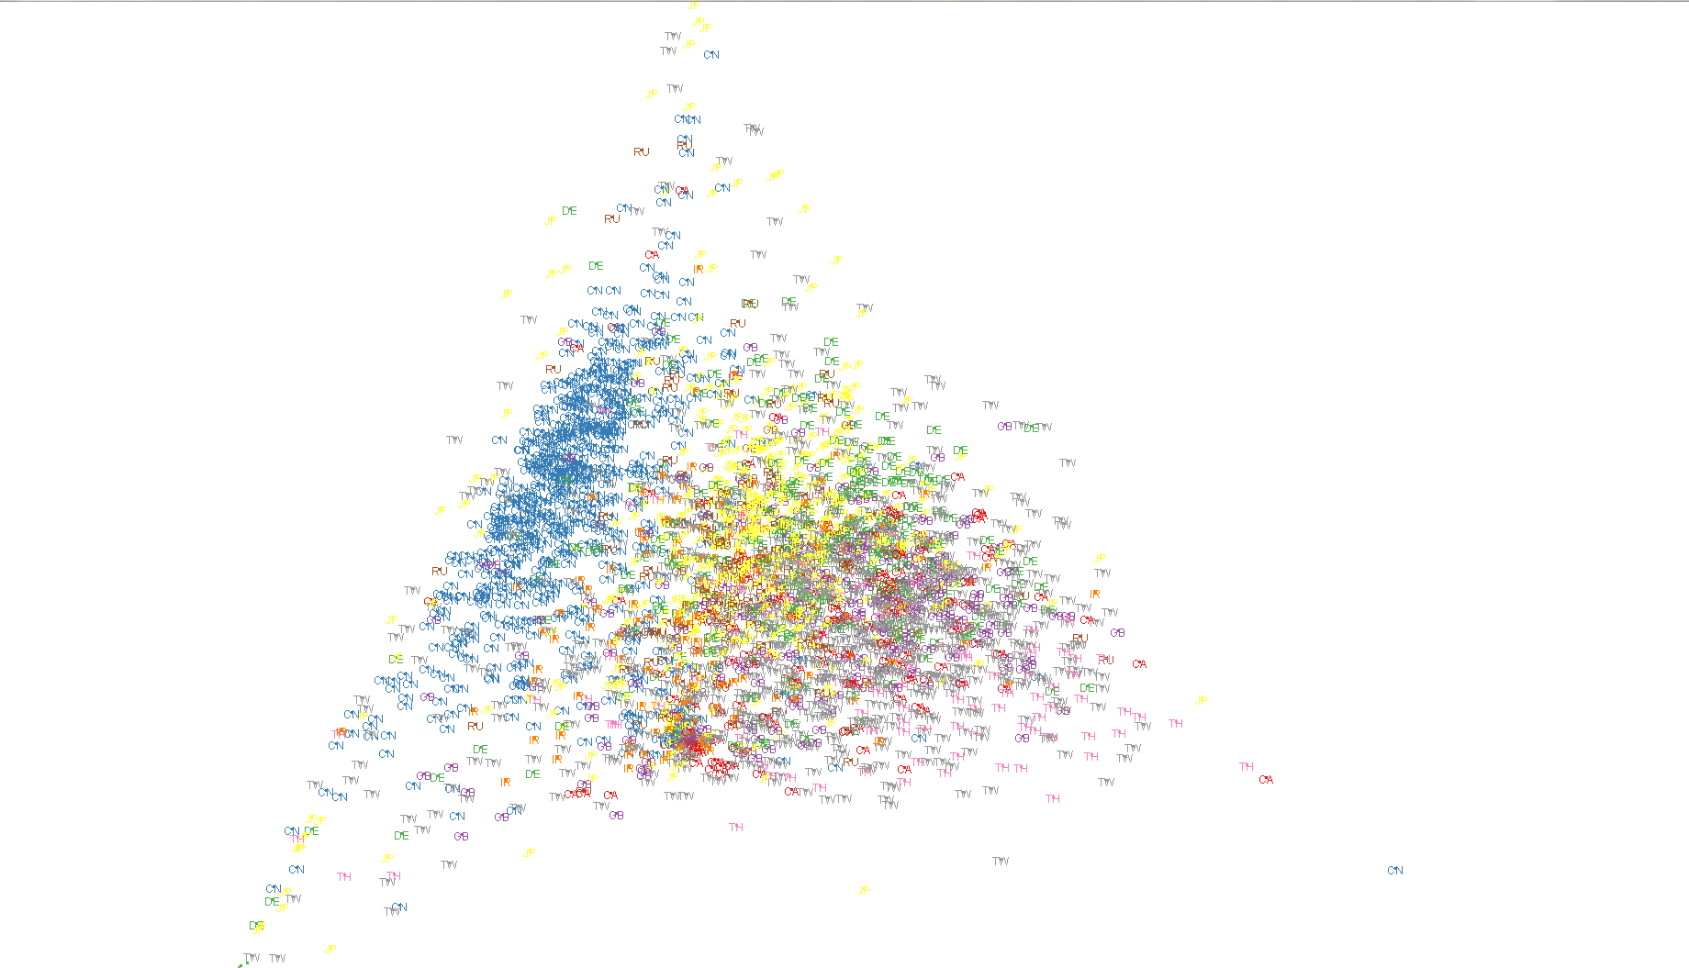
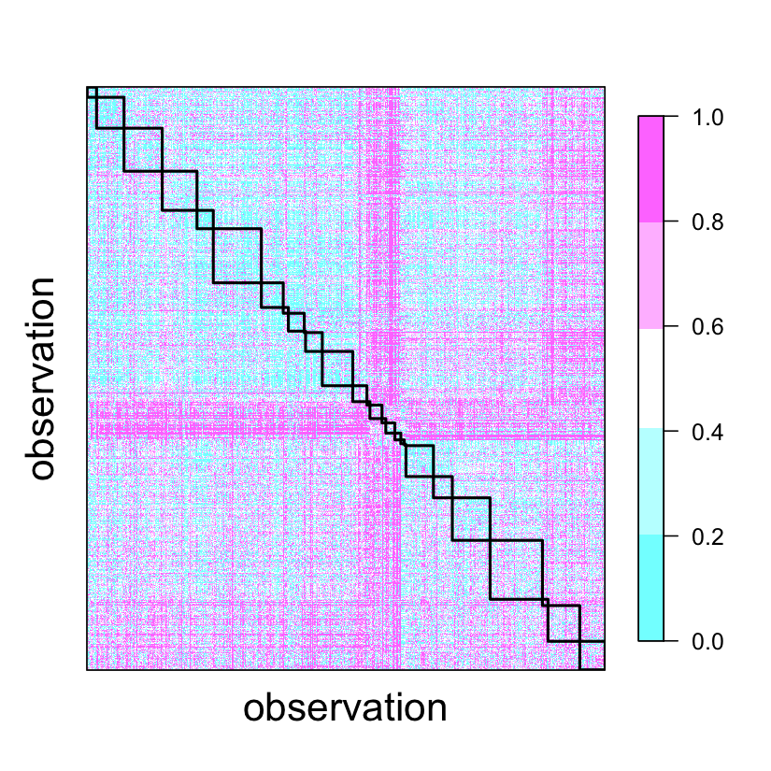
AKAMAI-CIDR
Embedding dissimilarities between CIDR Traffic
Aggregate by summing the traffic for each week
CIDR Hourly Traffic for each category
Multivariate Time Series
Embedding via MDS
Dissimilarity Representation
Notes:
For AKAMAI-CIDR, we took a different approach. We have hourly traffic measured with number of hits and bytes for CIDRs under different categores aggregated the data by summing the traffic for each week, and for each main category. For each CIDR, we then have a multivariate time series of 36 components ( hits and bytes for 18 categories). We then computed dissimilarities between these multivariate time series and embedded the dissimilarities.

Slide 15
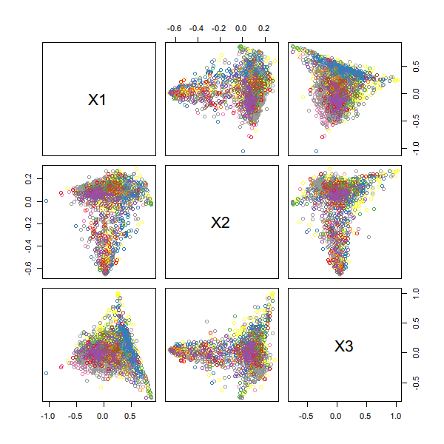
AKAMAI-CIDR
CIDRs based on China (blue) show a clustering pattern
Embedding of ~4K CIDRs (outside US) based on the dissimilarity of traffic patterns (color coded by country)

Slide 16
AKAMAI-CIDR
3D Plot of CIDR Embeding

Slide 17
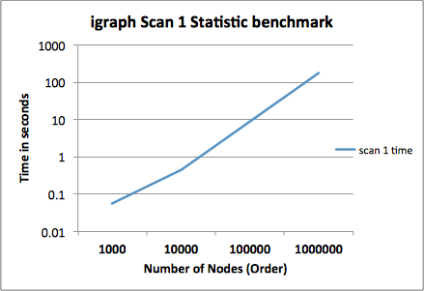
Igraph extensions
Scan 1 Statistic & Spectral Embedding
igraph 0.7 introduces:
Fast implementation of Scan 1 Statistic exact and approximate invariant
Fast spectral embedding of adjacency matrices using ARPACK
Scan 1 Statistic of Erdos Renyi Graphs with average Degree of 100 edges
Notes:
Our last contribution is two additions to igraph library, fast implementations of scan statistics and spectral embedding of adjacency matrices.

Slide 18
COLLABORATORS
PNNL/Stanford/Purdue : Ryan Hafen (Akamai-Traceroute, Akamai-CIDR)
BBN/Raytheon: Walter Andrews (Kiva)
Oculus: Peter Schrettlen (Bitcoin)
Thanks to Peter Wang (Continuum) and Ryan Hafen (PNNL) for providing derived data
Thanks to everybody in DARPA XDATA program for supporting this work.

Slide 19
Contact information:
Thank you.
Sancar Adali
sadali1@jhu.edu
Johns Hopkins University
3400 N. Charles St.
100 Whitehead Hall
Baltimore, MD 21218

