Slide 1
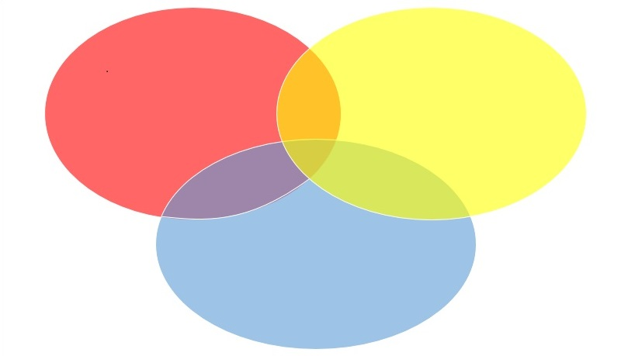
Biostatistics 706 Introduction to the Practice of Statistics II
Elizabeth Hauser
January 10, 2024

Slide 2

Teachers
Introductions
Instructor - Elizabeth Hauser (please call me Beth)
Ripon College, AB, Biology
The Johns Hopkins University School of Hygiene and Public Health, MHS, Epidemiology and Genetic Epidemiology
University of Michigan, School of Public Health, MS, Biostatistics
University of Michigan, School of Public Health, PhD, Biostatistics and Statistical Genetics
Teaching Assistants
Ruolan Li, 1st Year PhD, BIOS706 student
Caroline Falvey, 2nd Year MB, BIOS706 student

Slide 3
Students
Introductions
Students- Who are you?
Where did you grow up?
Where did you go to college and what did you major in?
How did you become interested in Biostatistics?
What was the best thing you learned last semester?
What do you want to learn?
What do you like to do in your free time?

Slide 4
What is this course?
Biostatistics- Using fundamentals of biostatistical knowledge
Applied- Putting this knowledge into action to answer questions
Practice- Practice, practice, practice
Students will do a large amount of speaking, writing, and listening
We will all learn together
Focus on communicating ideas
Understanding collaborators
Understanding data
Providing clear plans and reports
Integrating concepts from all areas of research

Slide 5
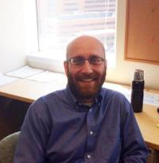

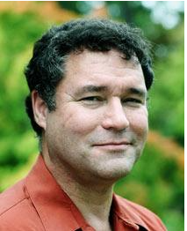
Statistical Theory and Methods
Excellent foundation
Lots to learn!
New developments happen constantly
Understanding developments in this area is a key part of our work
Seminars, meetings and workshops are a great way to stay on top of new developments
Become familiar with statistical journals
Statistical Programming and
Software Tools

Slide 6

Biological and Clinical Knowledge
Always something new to learn!
Working with collaborators provides an opportunity to learn from experts
Don’t be afraid to ask questions!
Attending seminars and meetings are a good way to learn
Many biostatisticians become acknowledged experts in biological and clinical content areas

Slide 7
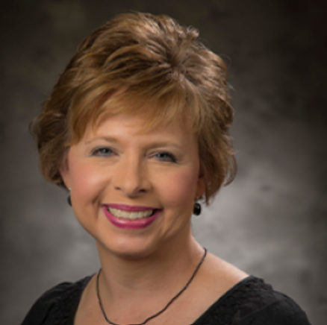
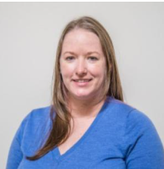
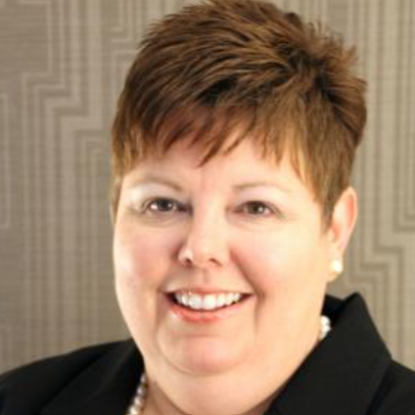
Communications
The basis for combining subject-specific knowledge
Requires constant practice
Writing, speaking, email, presentations, conversations
Listening is a very important skill
Biostatisticians are often the ones talking to all members of the research team
Professionalism (setting expectations and delivering!)

Slide 8
This course is NOT:
Lectures about statistical methods or statistical computation
Use what you know
Concentrate on fundamentals and integration of ideas
You will not be expected to know everything
Important skill to learn- recognize your gaps in knowledge
A cookbook on how to analyze data
Every project is different
Important skill- understanding the problem
There is always more than one way to approach a question
We will see that demonstrated over and over again this semester!

Slide 9
At the end of the course you will
Be prepared for the preliminary exam
Have developed materials and experience for an internship
Have learned about a variety of different research areas
Have heard from biostatisticians about real world experience
Have heard from collaborators at all levels
Have been challenged
Have been intrigued
Have had fun

Slide 10

As a graduate of this program you will be well-prepared to work in many research areas.

Slide 11
Syllabus
In most classes we will follow this general format:
Teams present homework from the previous day
Lecture and Discussion
Prepare homework for the next day
In many classes we will have guests
B&B Faculty (B&B Guest Stars!)
Duke Faculty and Researchers (Investigator Presentations)
Statistician Researchers from research groups (real biostatisticians doing real projects)

Slide 12
Expectations
Attending class in person and participating in class is a MAIN requirement
Team Work: Collaborative not Competitive
Help each other learn
For any project there will be lots of new things to learn
Provide positive feedback and constructive criticism
Will ask for student as well as faculty/TA feedback on presentations
Practice the golden rule- how would you like to receive criticism?
When critiquing others
Highlight positives!
Provide helpful comments for things that need work

Slide 13
Expectations
Team Work- presentations, leading discussions, written documents
Teams are expected to share the work- tasks should be rotated- i.e. not the same person writing each time or the same person doing all coding etc.
Individual work should be done alone without input from others
Midterm
Final Exam
You will show up prepared to present at every class
Please bring your computer to class

Slide 14
Applied Research Projects
Cover a wide variety of topic areas
Clinical Trials
Clinical Investigation
Basic Science
Population Science
Each project is different
Similar elements for each project, e.g. the SAP elements
Require excellent organizational skills
Reproducible research

Slide 15
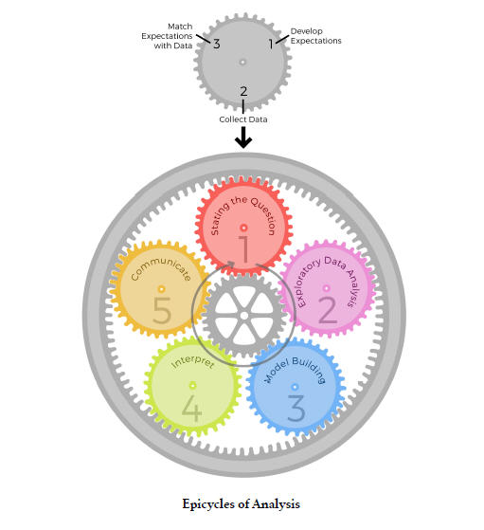
Epicycles of Analysis
From Peng and Matsui, The Art of Data Science
https://leanpub.com/artofdatascience

Slide 16
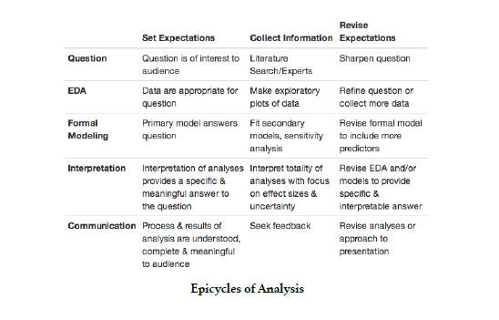
Epicycles of Analysis
From Peng and Matsui, The Art of Data Science
https://leanpub.com/artofdatascience

Slide 17
Epicycles of Analysis
What Biostatisticians DO
From Peng and Matsui, The Art of Data Science
https://leanpub.com/artofdatascience

Slide 18
Epicycles of Analysis
Communicating with investigators
From Peng and Matsui, The Art of Data Science
https://leanpub.com/artofdatascience

Slide 19
Epicycles of Analysis
Working with Study Teams
From Peng and Matsui, The Art of Data Science
https://leanpub.com/artofdatascience

Slide 20
Study Teams and Stakeholders
PI
Co-investigators
Project managers
Research assistants (clinical, laboratory)
Data managers
Database administrator
Computer programmers
Other statisticians
Collaborative study group (e.g. multi-site clinical trial, meta/mega analysis, cooperative studies)
Administrators and policy makers
Governmental agencies
The public

Slide 21
Collaborating Teams
We are starting with 10 teams of 5 people each
Provide lots of opportunities for practice
Share the load
Practice collaborations
Some assignments will be done as a team
Some assignments will be as pairs
Some assignments will be individual (mid-term and final)
Have fun with your team
Can create team names, mascots, logo, advertisement etc.
Your own statistical research group
Each week two to three teams will be selected (mostly at random)
Present homework to the rest of the class and lead the discussion

Slide 22
Communication Skills Need to be Sharp
There may be lots of people involved
Each will have a very different skill set
Reflects well on the whole team
PI and co-Investigators make presentations to funders, policy makers
Additional funding for research
Publications appear in a good journal
Generates citations
Present at scientific meetings
Generates additional collaborations
We will model team science in this class

Slide 23
Homework
Read Kass et al. (2016) Ten Simple Rules for Effective Statistical Practice, Plos Computational Biology
This paper was written for people who want to work with statisticians (and for statisticians, of course)
Each team will get one rule and will write the answers to these questions:
What is the perspective of the researcher?
What does the rule mean for statisticians?
How can we put the rule into practice?
Next class- Teams will discuss their rule

