Slide 1



SmartTuning
Auto-tuning applications based on their workloads
UBC | IBM
Adalberto Junior | Don Bourne
Ivan Beschastnikh | Daryl Maier
 | Vijay Sundaresan

Slide 2
Definitions
SmartTuning tunes an application running in Kubernetes while it runs
Workload is a probability distribution of URLs served by an application in an interval
SmartTuning groups similar workloads into types
Configuration is a set of parameters that can be adjusted in an application
Workloads have the same type if their distribution of requests to the application are similar
Performance is a metrics that SmartTuning monitors to selects the best configuration, i.e., the objective to max/min
?
Observed workload
SmartTuning loop

Slide 3



Problem #1: Teams typically have little time to tune or even learn the most important tuning parameters for every type of runtime they need to deploy and manage. This leads to services being overprovisioned or deployed with an “average” configuration. The problem is compounded by short upgrade cycles for microservices.
# of different
services / runtimes
Time

Slide 4
Problem #2: Teams typically use one configuration for the life of a service/app. This configuration may result in sub-optimal performance when the app is faced with different workloads or needs that change over time. The problem is more pronounced in non-microservice apps where each server handles multiple request types, which are still common for our customers to be porting to Kubernetes.
Expected volume
Observed volume - URL 1
Observed volume - URL 2
Observed volume - URL 3
workload0
workload1
workload2
workload3
workload4
Lack of resources, e.g., long-lived http connections; connections should be short-lived
Wasting resources, e.g., few simultaneous connections; connection pool should be smaller
Request volume
time

Slide 5
Proposed solution: SmartTuning, a tool to automatically tune servers/apps based on the real, and potentially changing conditions seen at runtime
SmartTuning
Monitors applications
Extracts workloads – e.g., URL requests
Tracks app specific metrics – e.g., opened connections
Tracks performance metrics – throughput, CPU consumption
Exposes /metrics
Monitoring
Application
Stack
Analysis
Classifies workloads:
Learns when each workload type is seen during the application run
Recommends the next config to try for the given workload type
Planning
Decides on best action:
Reacts to/Predicts the next workload
Applies the best config
Configures

Slide 6



SmartTuning
Monitors Applications:
Extracts workloads – e.g., URL requests
Tracks app specific metrics – e.g., opened connections
Tracks performance metrics – throughput, CPU consumption
Exposes /metrics
Monitoring
Application
Stack
Analysis
Classifies workloads:
Learns when each workload type is seen during the application run
Recommends the next config to try for the given workload type
Planning
Decides on best action:
Reacts to/Predicts the next workload
Applies the best config
Configures
SmartTuning Overview
?
Observed workload

Slide 7


SmartTuning: Deployment
Search space
max db connections: (min:1, max:200, step:10)
gc policy: ([balanced, metronome, optavgpause, optthruput, gencon])
Production
Pod
Proxy
/metrics/http_requests
/metrics/throughput
/metrics/latency
/metrics | →
search space | →
last config | →
App
/metrics/cpu
/metrics/memory
Config
map
best config
Smart
Tuning
Workloads
+
config
Reloader
← New config
*K8s Operator
Training
Pod
Proxy
/metrics/http_requests
/metrics/throughput
/metrics/latency
App
/metrics/cpu
/metrics/memory
Config
map
new config
* Partially implemented as an operator

Slide 8
SmartTuning: Monitoring
HTTP requests
Throughput
Latency
Application
App warm up
0.0 < w < 1.0
w * t
t – (w * t)
Runtime
t: sampling interval
w: warm up time
CPU
Memory
SmartTuning Monitoring
Infrastructure
E.g.:
Promql: rate(http_requests_total{pod=“production”)[(0.7 * 900)s]
Promql: rate(http_requests_total{pod=“training”)[(0.7 * 900)s]

Slide 9
SmartTuning: Classification
API | W_i | W_i+1
/api/v1/path | 0.17 | 0.43
/api/v1/another/path | 0.13 | 0.2
/api/v1/another/path/again | 0.1 | 0.17
/api/v2/path | 0.2 | 0.03
/ | 0.4 | 0.17
Histogram based classification
Sequential K-means
Workload Classification
(Workload-Y, config, perf_value)
(Workload-Z, config, perf_value)
Workload
Type X
Workload
Type Y
Workload
Type Z
Centroid:
0.07 | 0.4 | 0.03 | 0.25 | 0.25
0.15 | 0.12 | 0.2 | 0.13 | 0.3
0.3 | 0.1 | 0.2 | 0.25 | 0.15

Slide 10
SmartTuning: Optimization
API | W_i | W_i+1
/api/v1/path | 0.17 | 0.43
/api/v1/another/path | 0.13 | 0.2
/api/v1/another/path/again | 0.1 | 0.17
/api/v2/path | 0.2 | 0.03
/ | 0.4 | 0.17
Bayesian Optimization
Workload based
Selects the best config for a given
Workload-type based on perf_value
Config Optimization
Throughput
Throughput / Ram
Latency
…
(Workload-Z, config, perf_value)
Workload
Type X
Workload
Type Y
Workload
Type Z
Centroid:
0.07 | 0.4 | 0.03 | 0.25 | 0.25
0.15 | 0.12 | 0.2 | 0.13 | 0.3
0.3 | 0.1 | 0.2 | 0.25 | 0.15

Slide 11
SmartTuning: Optimization
Waiting for iteration end
Workload
Bayesian Optimization module
new “random” config
Training
Pod
Smart
Tuning
→ Classify workload → Store workload → Sample new config
workload_k
+
config
+
perf_value
Production
Pod
Lookup best config
Workload
Type X
Sample a new config
Wait t
Sample app’s perf + workload
Store (workload, perf, config)
Minimize/Maxmize perf_value

Slide 12
Outcome: At every interval, SmartTuning updates the application to handle a workload type (dashed). Each workload type is similar to the average of all workloads that was grouped. Therefore, whenever a same type repeats its configuration is set again to the application.
Expected volume
Observed volume - URL 1
Observed volume - URL 2
Observed volume - URL 3
workload0
workload1
workload2
workload3
Workload4 ~ workload 1
Request volume
Config 0_e
Config 1_k
Config 2_d
Config 3_b
Config 1_k
time

Slide 13
Preliminary results

Slide 14
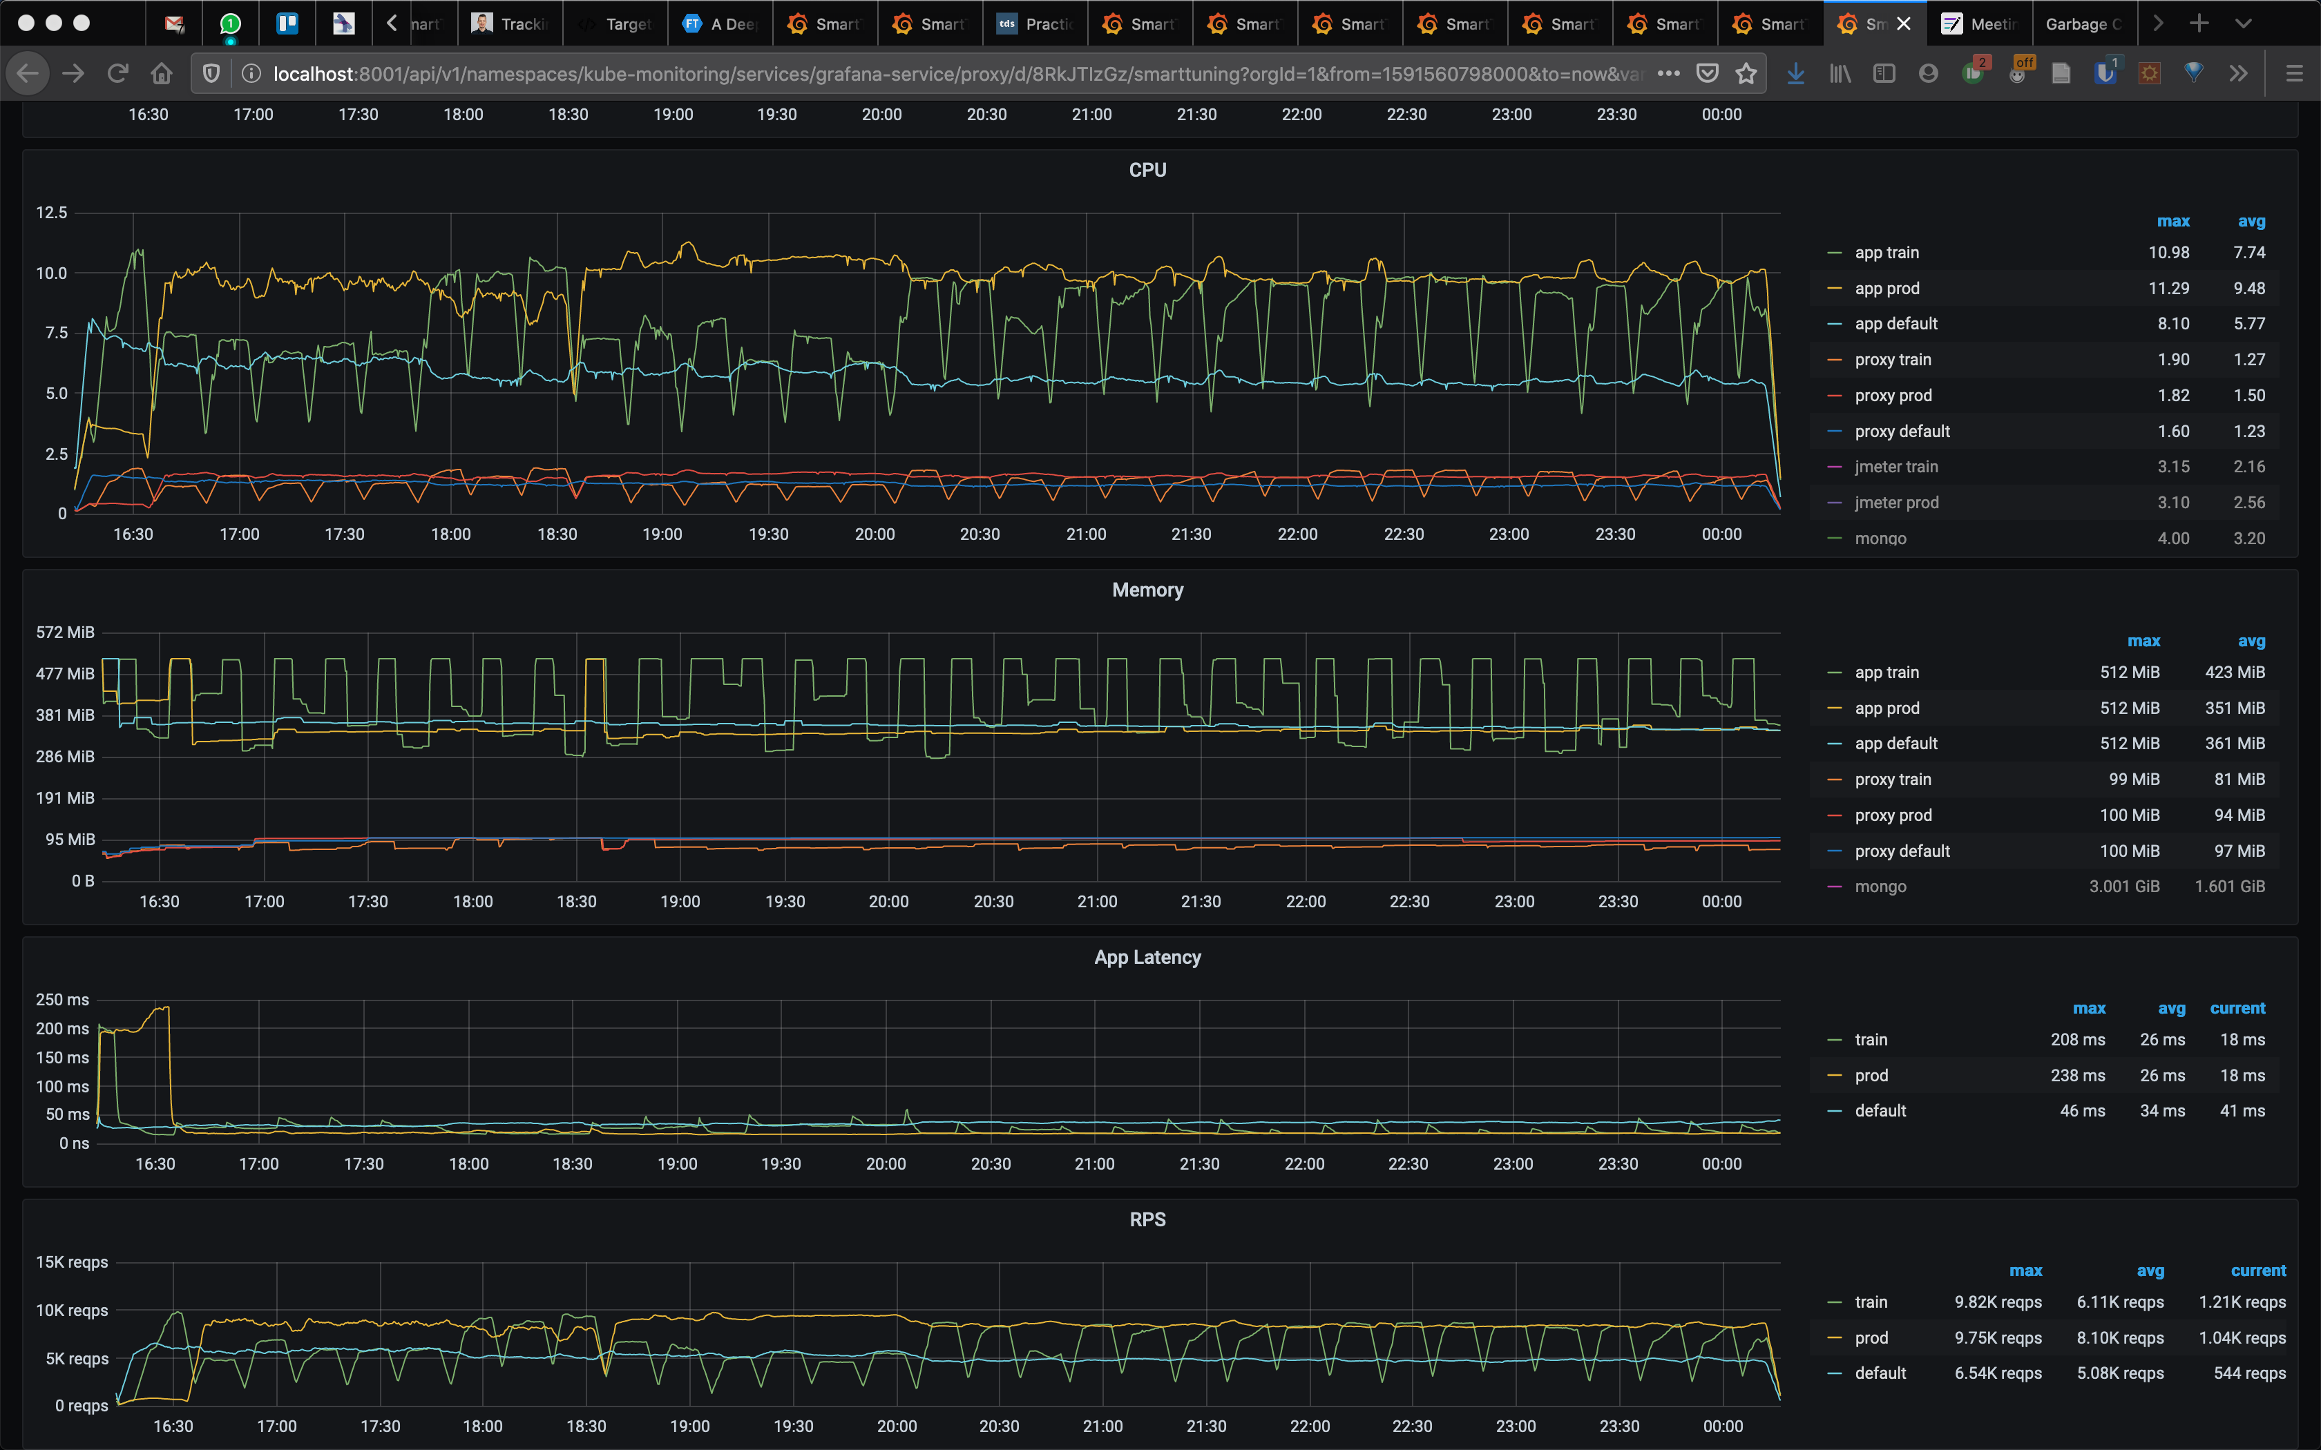
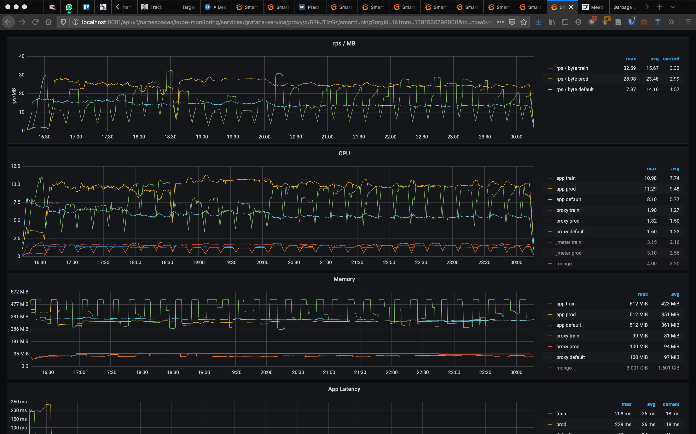
AcmeAir

Slide 15
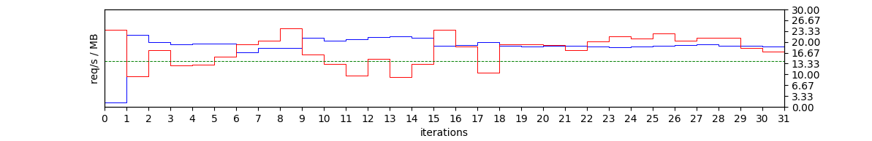
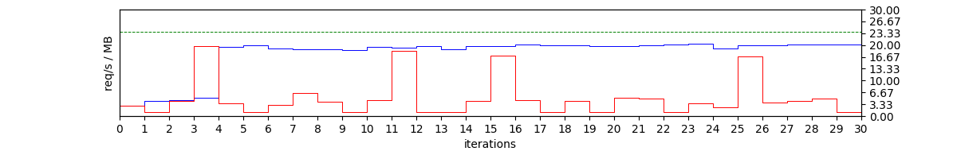
production
tuning
default
Small search space: 3 dimensions ~ 100K combinations
Large search space: 7 dimensions ~ 5M combinations
It is difficulty find out the max global in large search spaces in few iterations.

Slide 16
Conclusion and Future directions
SmartTuning can quickly found suitable configurations for applications in large search spaces. SmartTuning uses statistic analysis (Bayesian Optimization) to find out the best candidates possible for knobs, reducing the application tuning drastically. Finding out the max global is a challenge, though.
Future directions
exploring synergy with Kruize
high dimension search spaces
handle tuning of applications with multiple microservices

