Slide 1
MLOPS Day-1

Slide 2
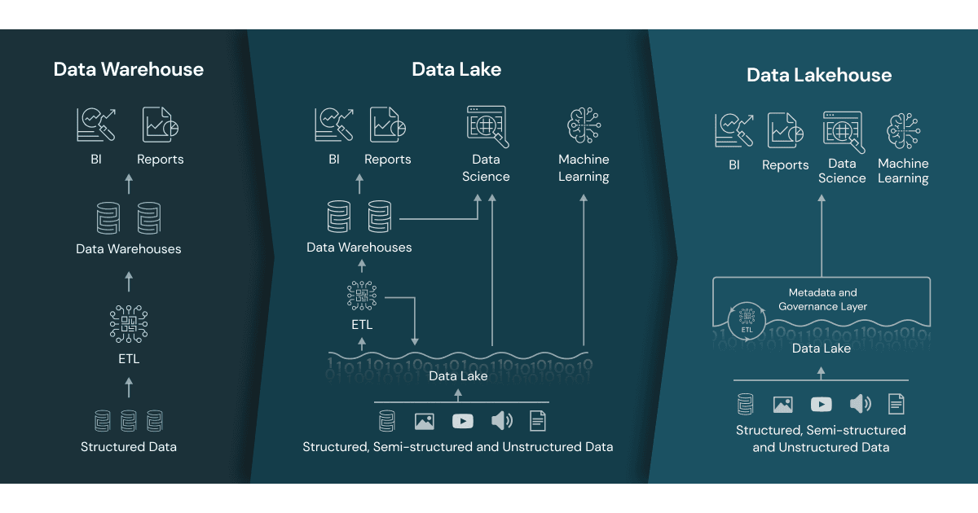
https://www.databricks.com/glossary/data-lakehouse

Slide 3
Key Features
Transaction support
Schema enforcement and governance
Data gouvernance
Bi Support
Decoupled storage from compute
Open storage format
Support for divers workloads and data types
End-to-end streaming

Slide 4
Building blocks
Ingest Stream
Process
Serve
Ingest batch
Store
Monitor and Govern
Data Catalog
DevOps
&
MLops
Keyvault
Authent
Monitor
Orchestrate

Slide 5
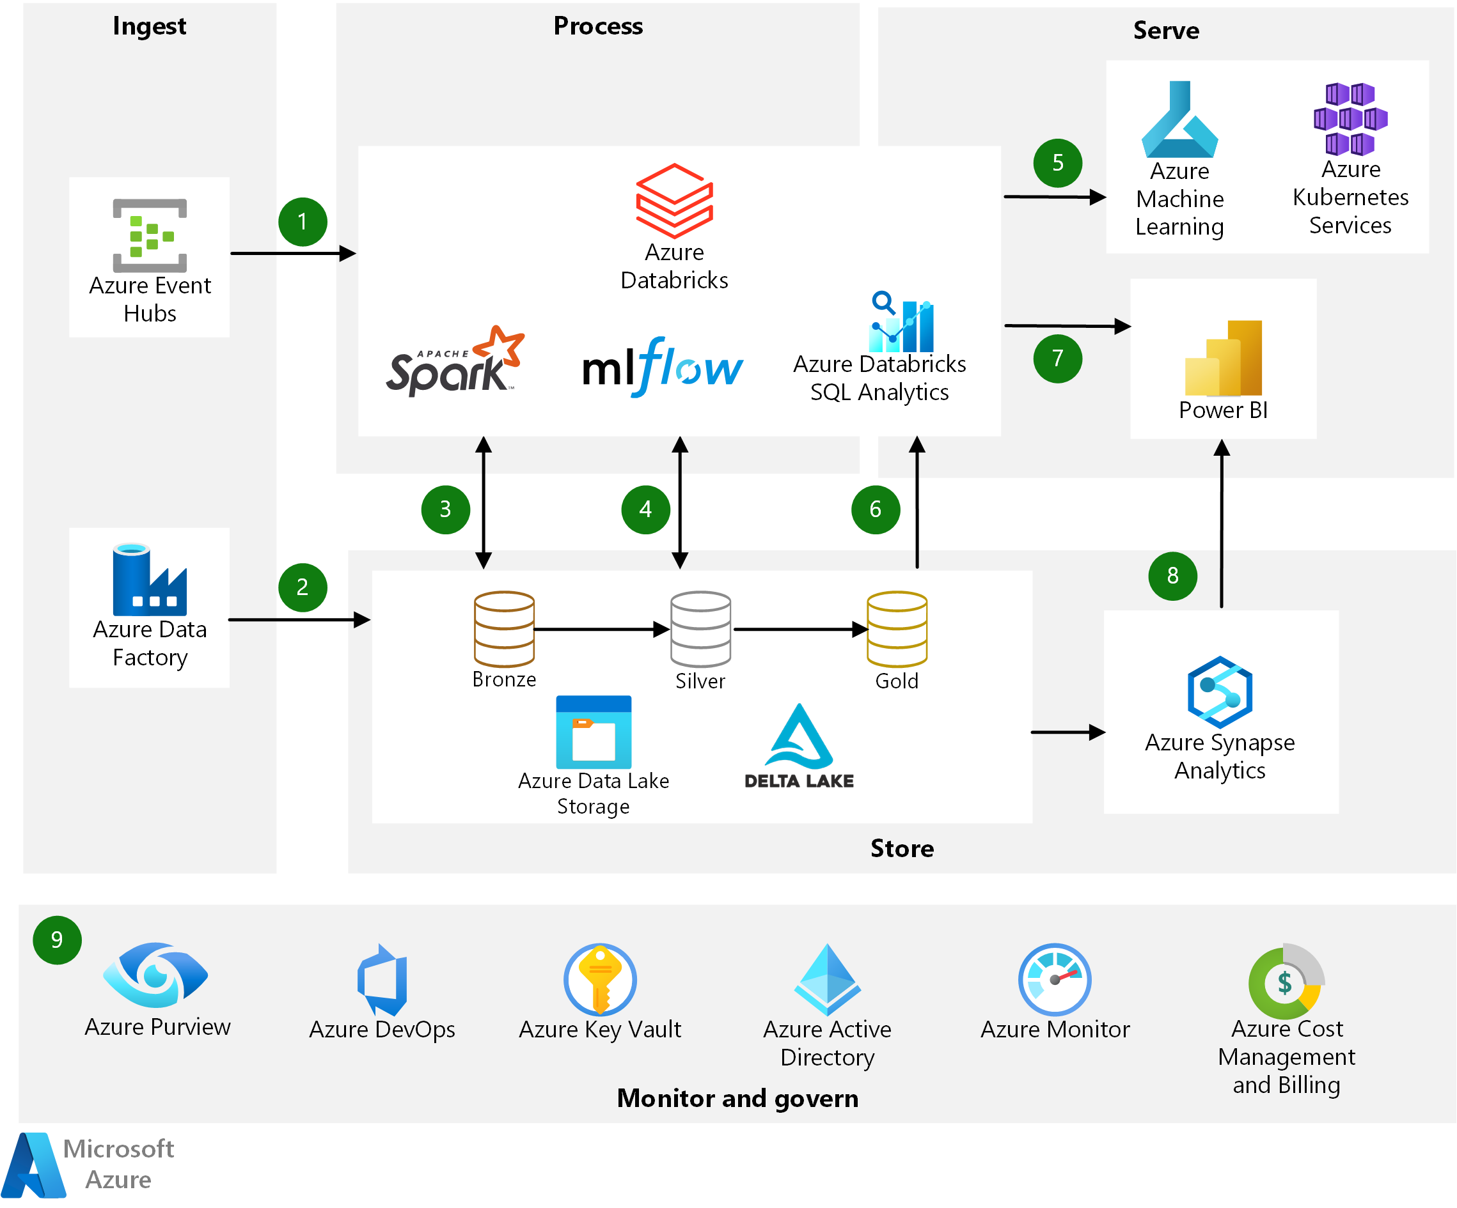
DBX on Azure architecture reference
https://learn.microsoft.com/fr-fr/azure/architecture/solution-ideas/articles/azure-databricks-modern-analytics-architecture

Slide 6
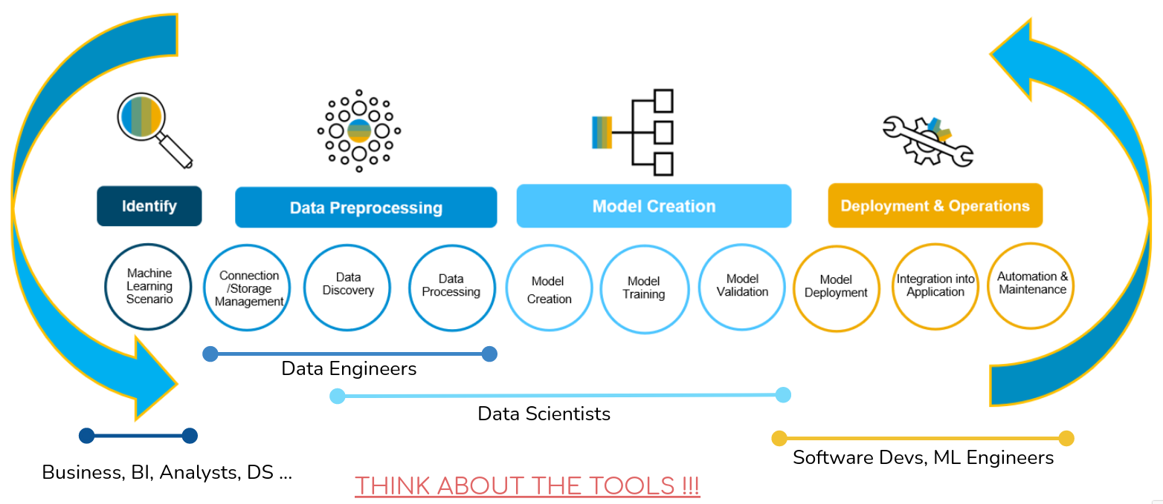
ML Lifecycle and Roles

Slide 7
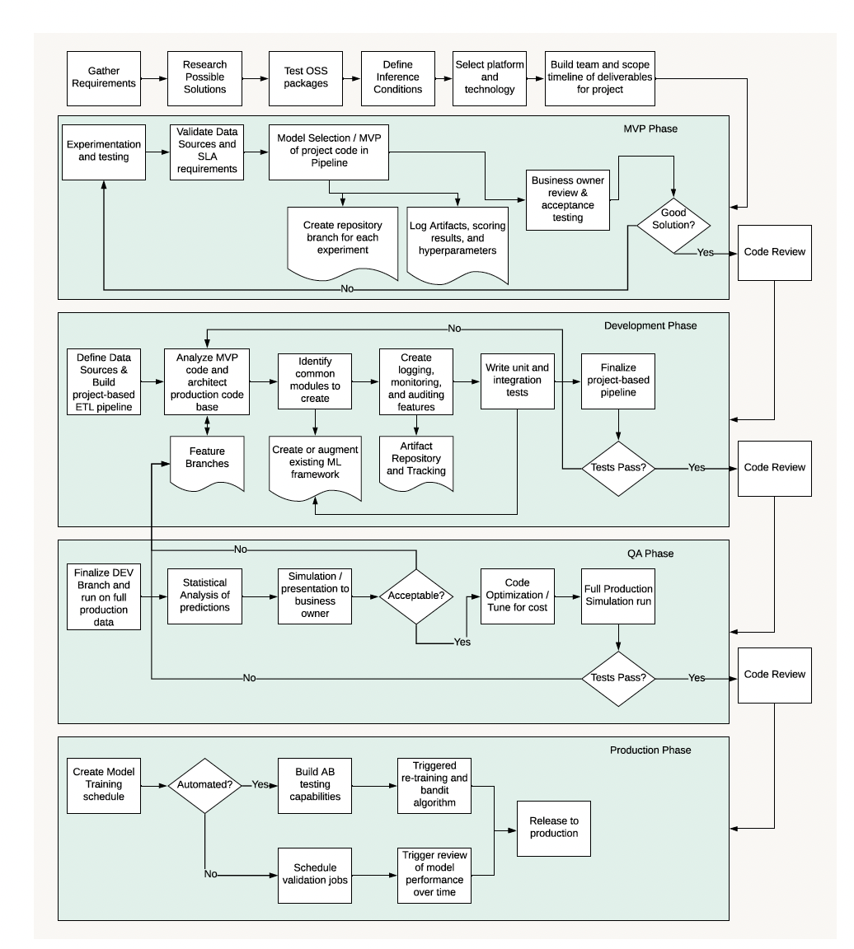
Process
Source : Machine Learning Engineering for the Real World

Slide 8
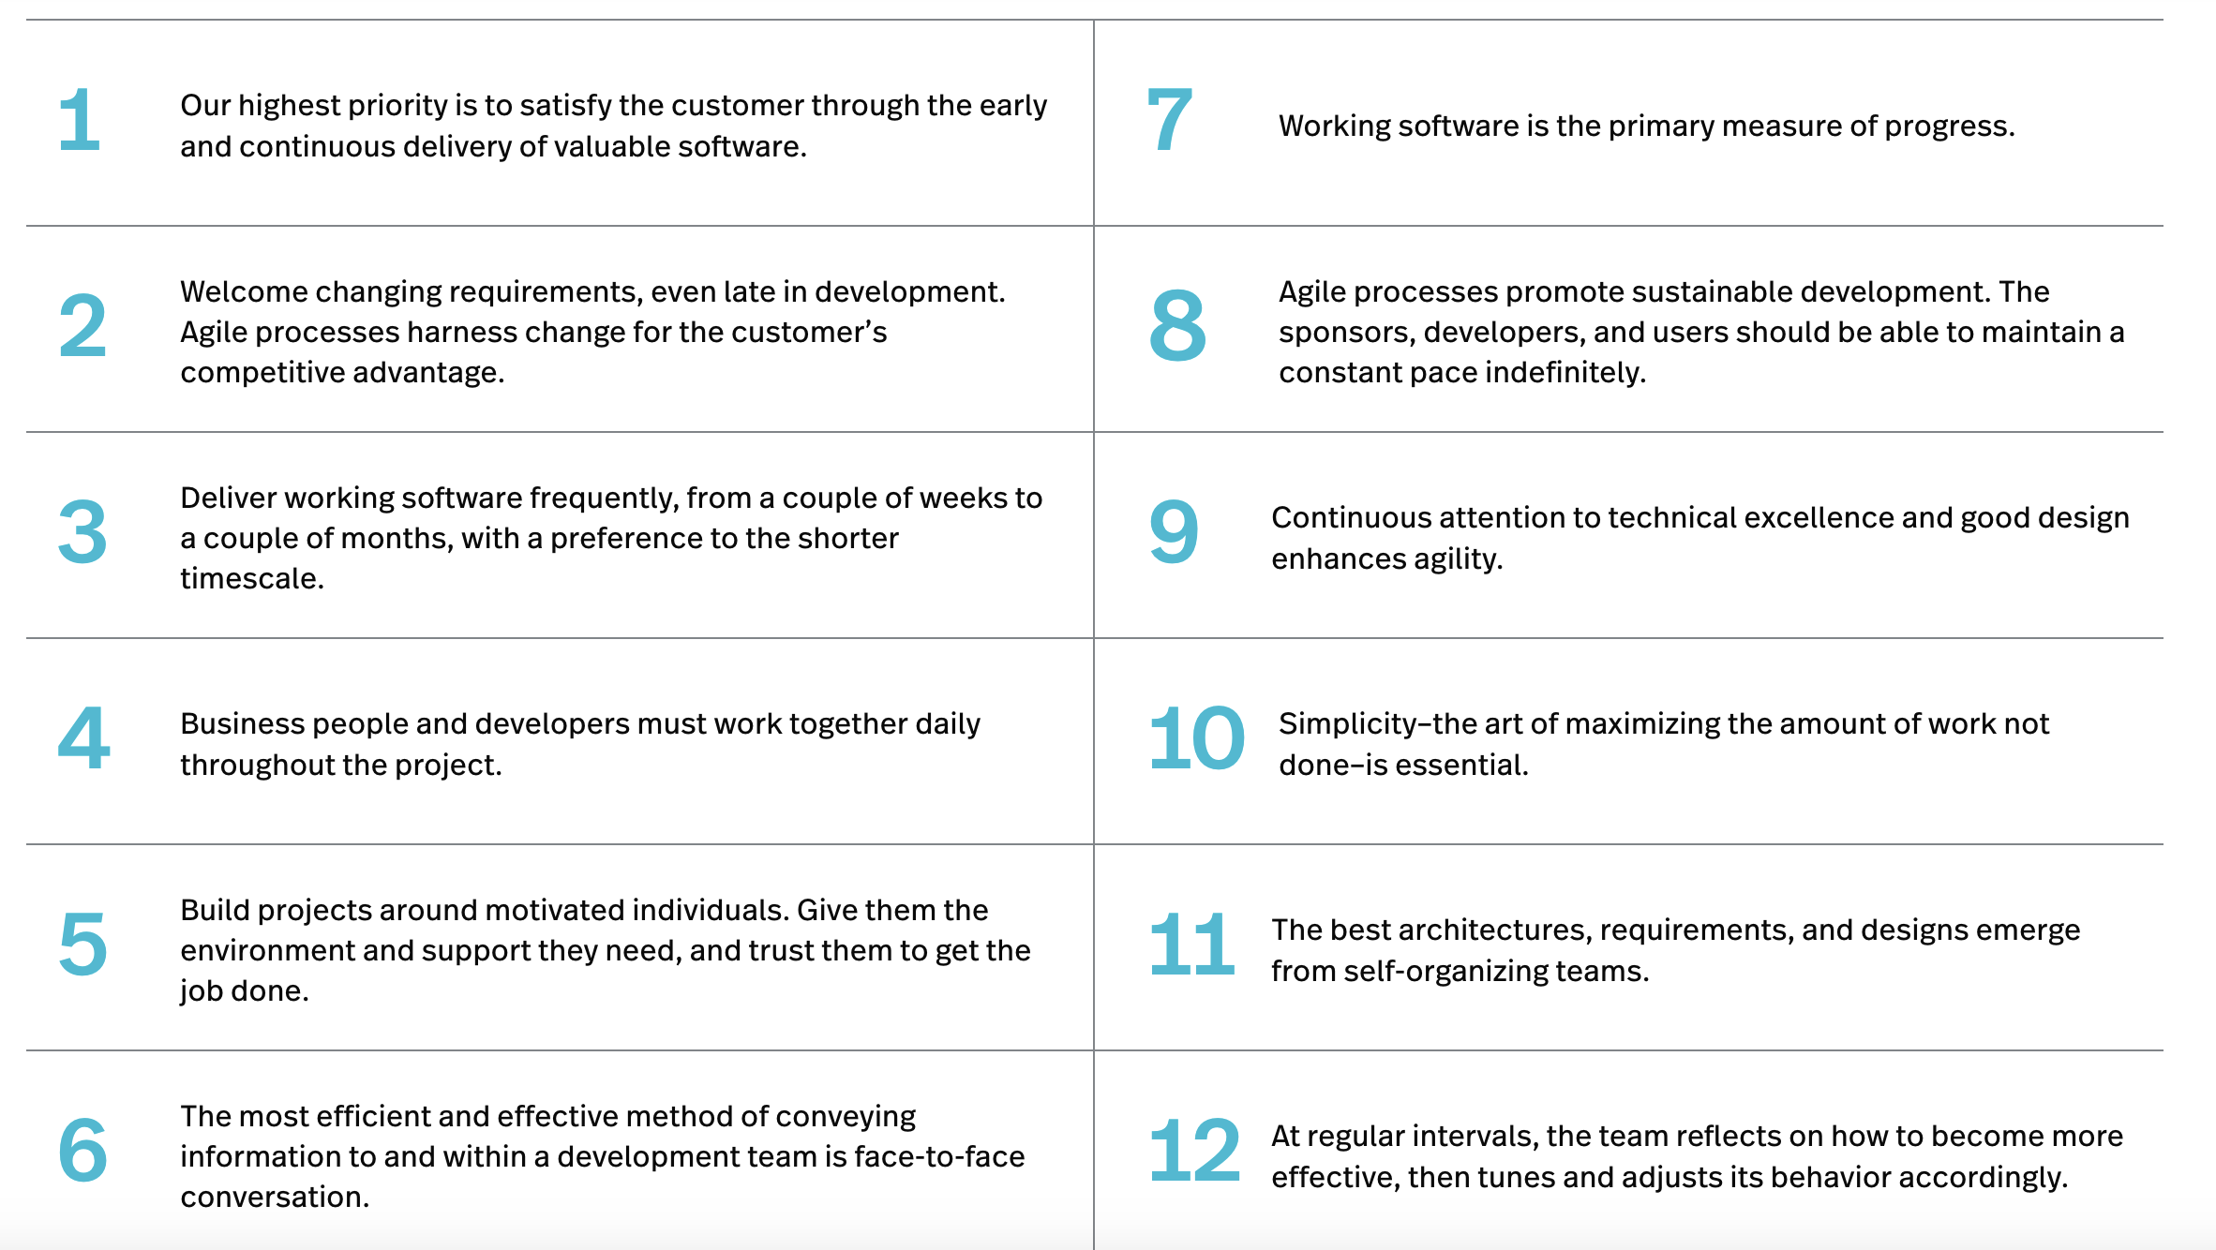
The 12 Principles behind the Agile Manifesto

Slide 9
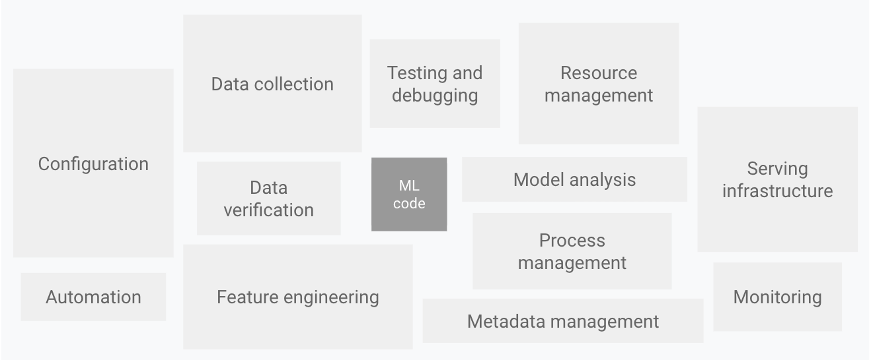
ML Ecosystem

Slide 10
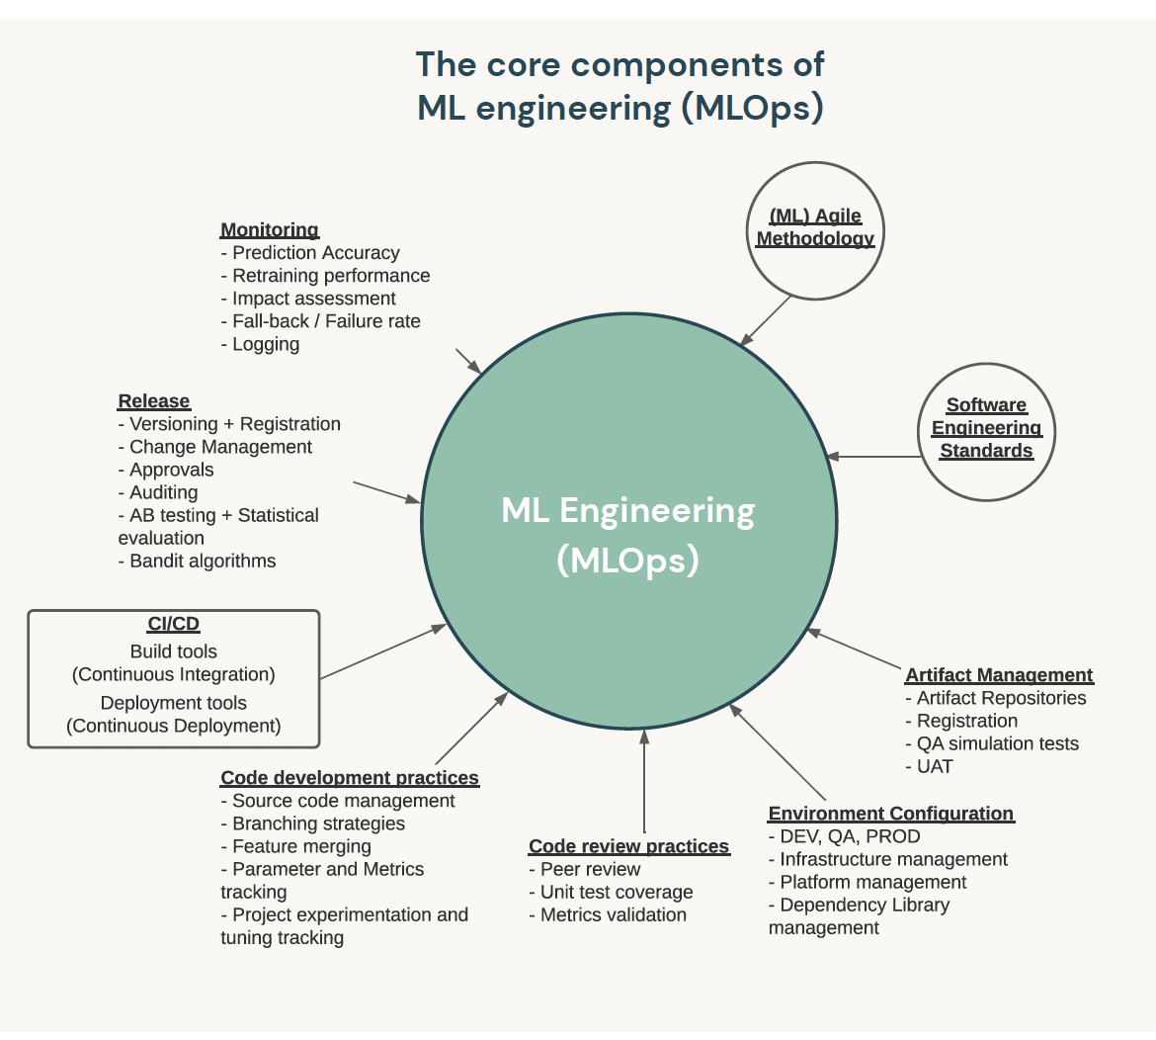
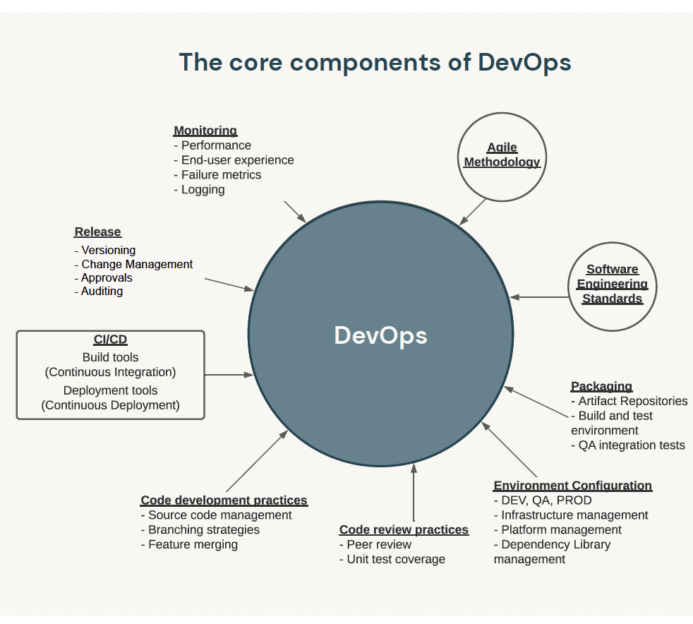
DevOps vs MlOps
set of processes and automation to manage models, data and code to meet the two goals of stable performance and long-term efficiency in ML systems. MLOps = ModelOps + DataOps + DevOps.
artifacts : models, data, code
Source : Machine Learning Engineering for the Real World

Slide 11
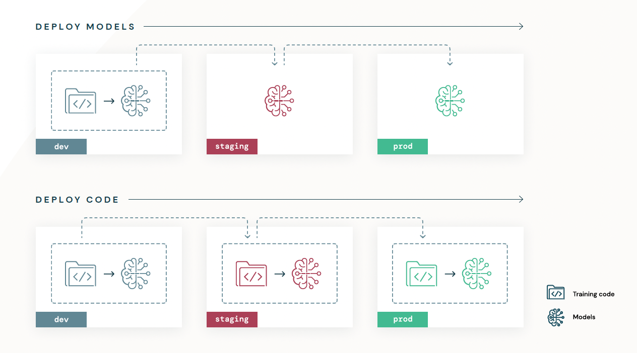
Deployment models

Slide 12
Maturity levels of MLOps systems
Version google
Level 0 - manual
Level 1 - ML pipeline automation
Level 2 - CI/CD pipeline automation
Version Microsoft
https://learn.microsoft.com/en-us/azure/architecture/ai-ml/guide/mlops-maturity-model

Slide 13
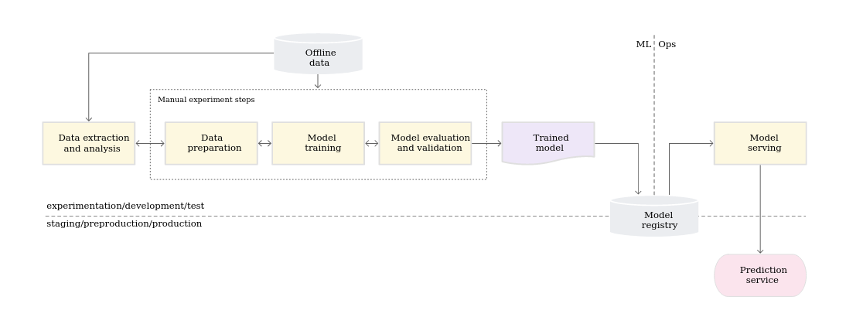
MLOps level 0: Manual process
Manual, script-driven, and interactive process
Disconnection between ML and operations
Infrequent release iterations
No CI
No CD
Deployment refers to the prediction service
Lack of active performance monitoring

Slide 14
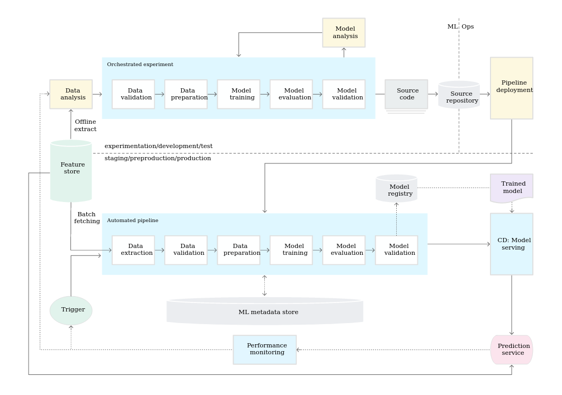
MLOps level 1: ML pipeline automation
Rapid experiment
CT of the model in production
Experimental-operational symmetry
Modularized code for components and pipelines
Continuous delivery of models
Pipeline deployment

Slide 15
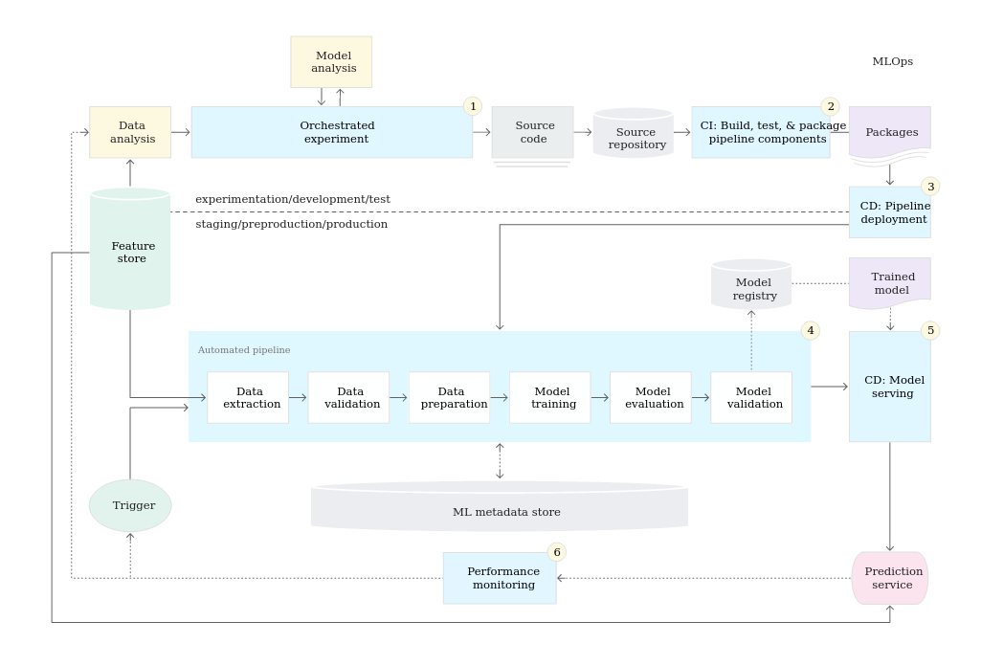
MLOps level 2: CI/CD pipeline automation
Automatically build, test, and deploy the new pipeline components to the target environment
Deployment:
Automated - to the test environment
Semi-automated - to pre-production (triggered by merge)
Manual - to production

Slide 16
Good practices for ML projects
Coding (Software Development)
Clean Code
Code version control (Git)
Testing
Project structure & dev environment
Organize a project repository
Environment dependencies control
Documentation & task tracking
Document your code, experiments and findings
Task tracking

Slide 17
Coding (Software Development)
Organize code into clean reusable units
(functions, classes, modules)
Use Git for code version control
Follow style-guides (i.t. PEP8 in case of Python)
Write comments, docstrings and type annotations
Give functions and variables meaningful names
Make dependencies and requirements explicit
Add requirements.txt and Dockerfile to a project repository
Testing

Slide 18
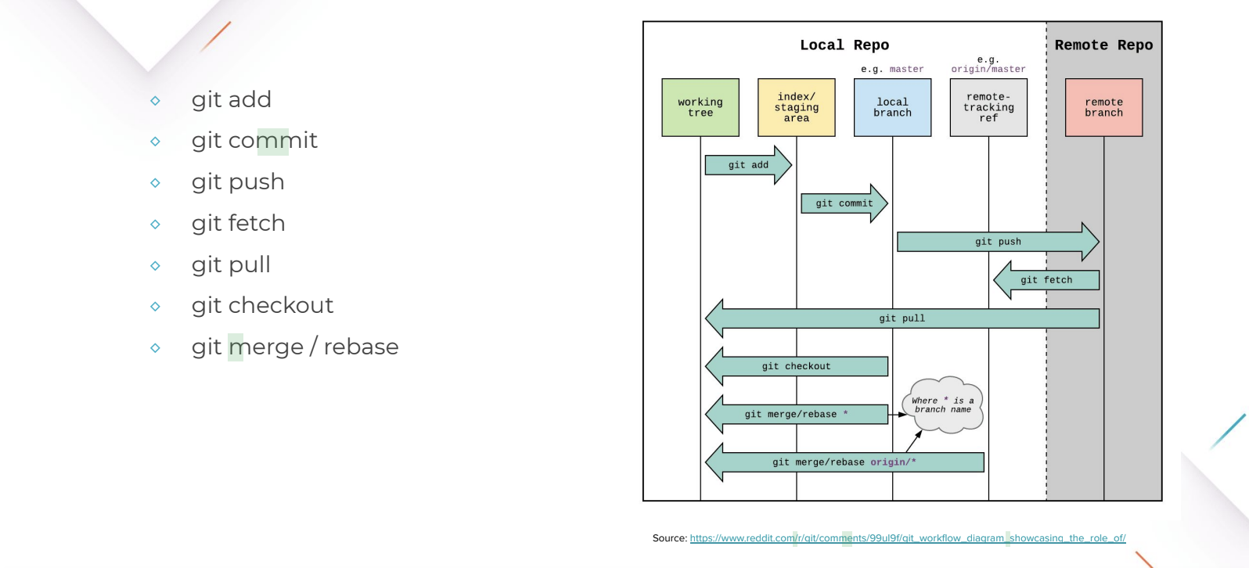
Git Workflow

Slide 19
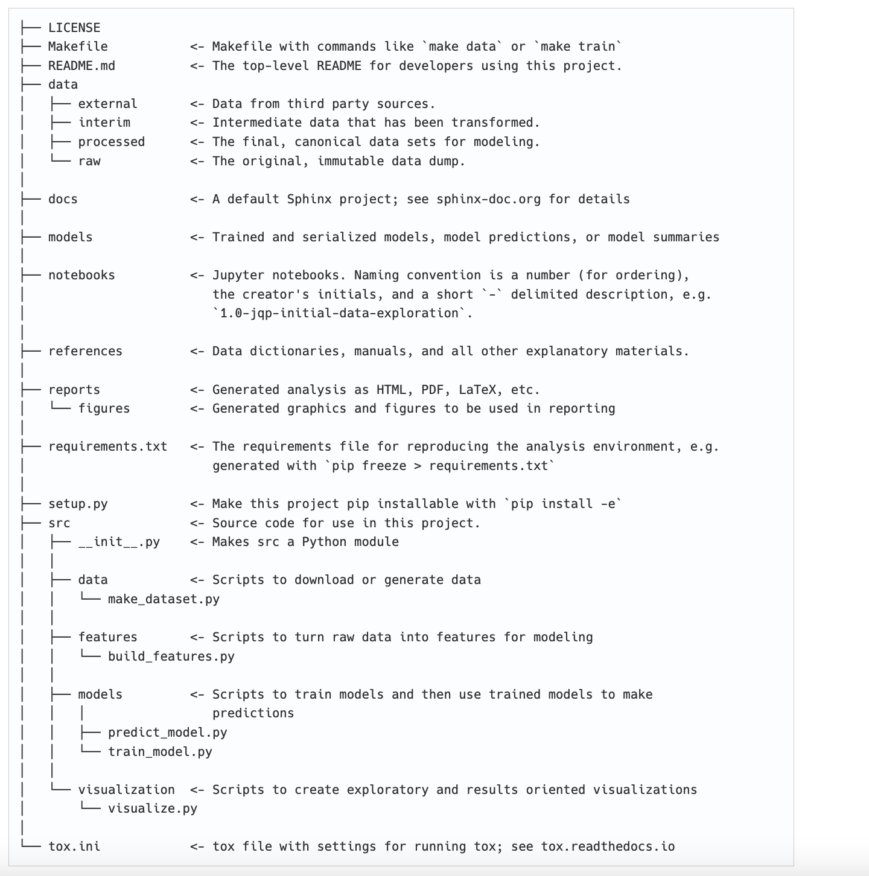
Repo structure
Source: https://drivendata.github.io/cookiecutter-data-science/#requirements

Slide 20
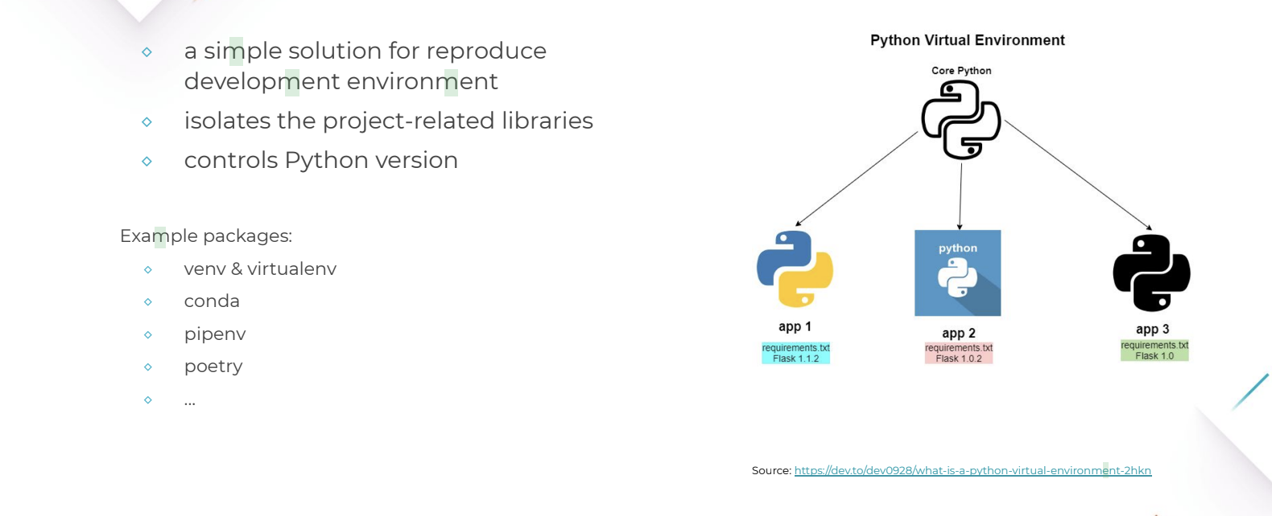
Virtual env

Slide 21
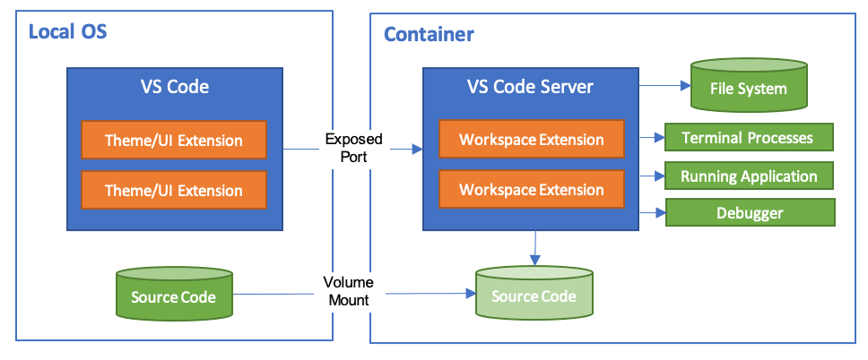
Vscode dev container
https://code.visualstudio.com/docs/devcontainers/containers
https://code.visualstudio.com/docs/containers/quickstart-python

