Slide 1
MLOPS Day-2

Slide 2
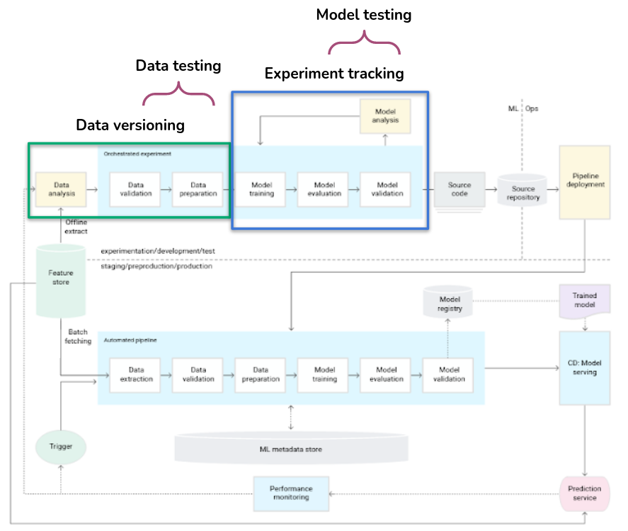
Testing in Mlops

Slide 3
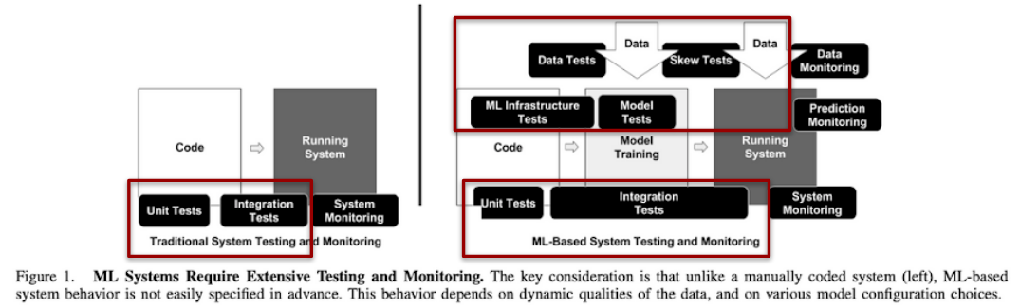
Testing in mlops
https://research.google/pubs/pub46555/

Slide 4
software testing
Unit tests. The program is broken down into blocks, and each element (unit) is tested separately.
Regression tests. They cover already tested software to see if it doesn’t suddenly break.
Integration tests. This type of testing observes how multiple components of the program work together.
https://serokell.io/blog/machine-learning-testing

Slide 5
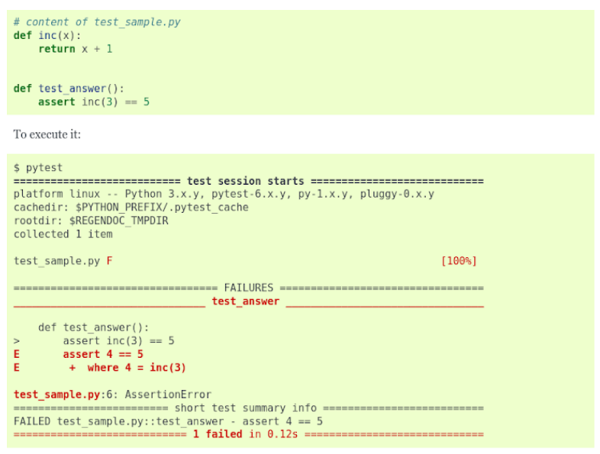
Software testing : pytest
The pytest framework makes it easy to write small tests, yet scales to support complex functional testing for applications and libraries.

Slide 6
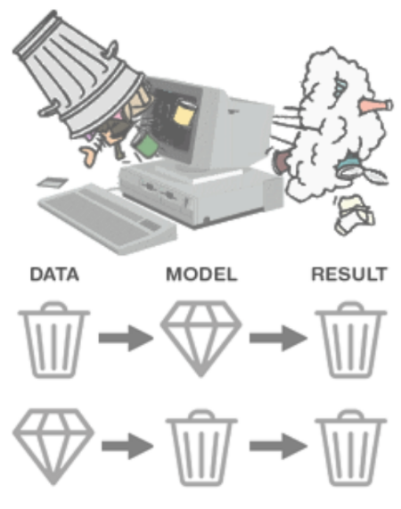
The concept of data quality

Slide 7
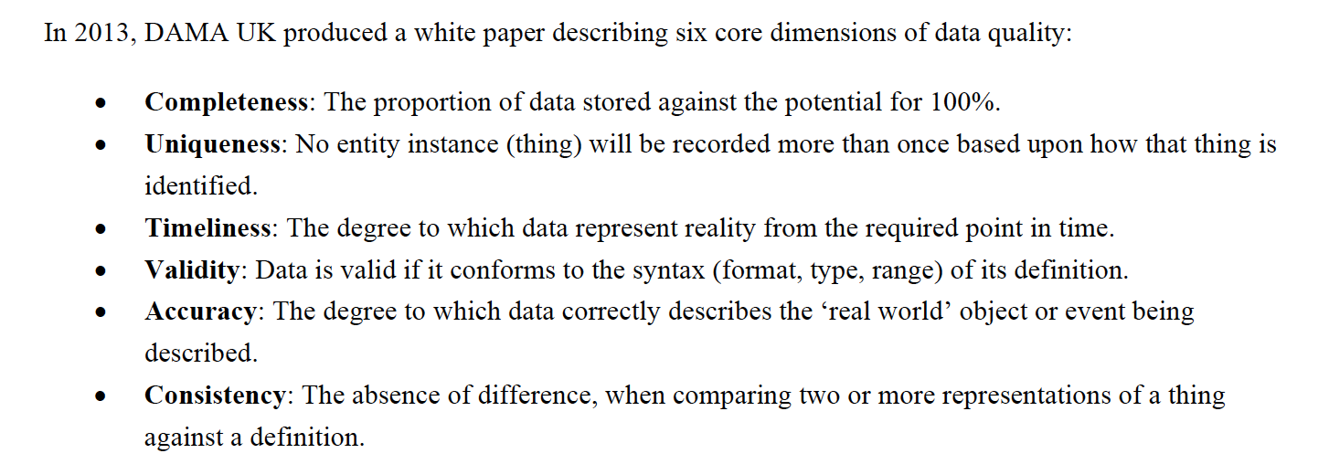
Data quality Dimension

Slide 8
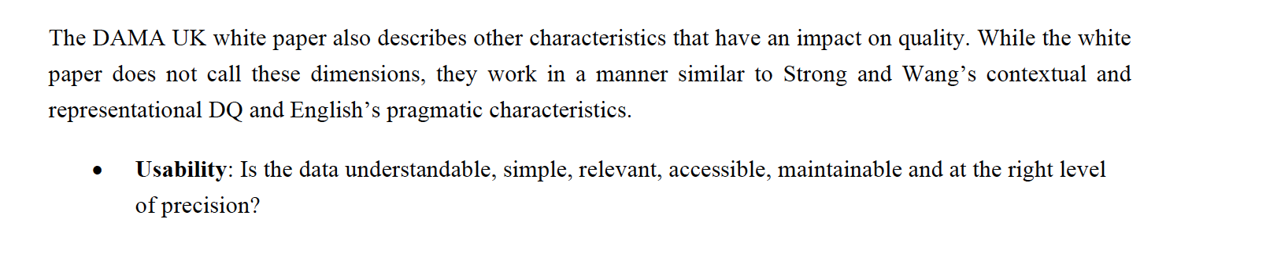
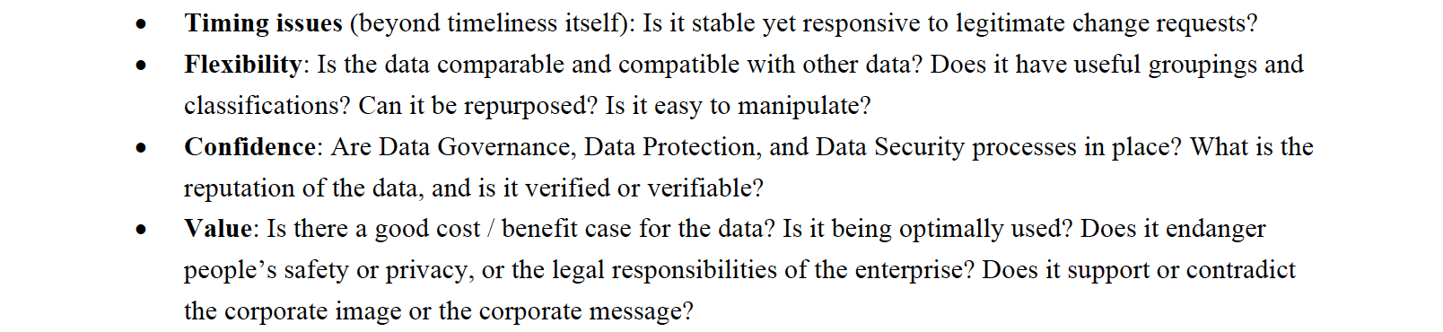
Data quality Dimension

Slide 9
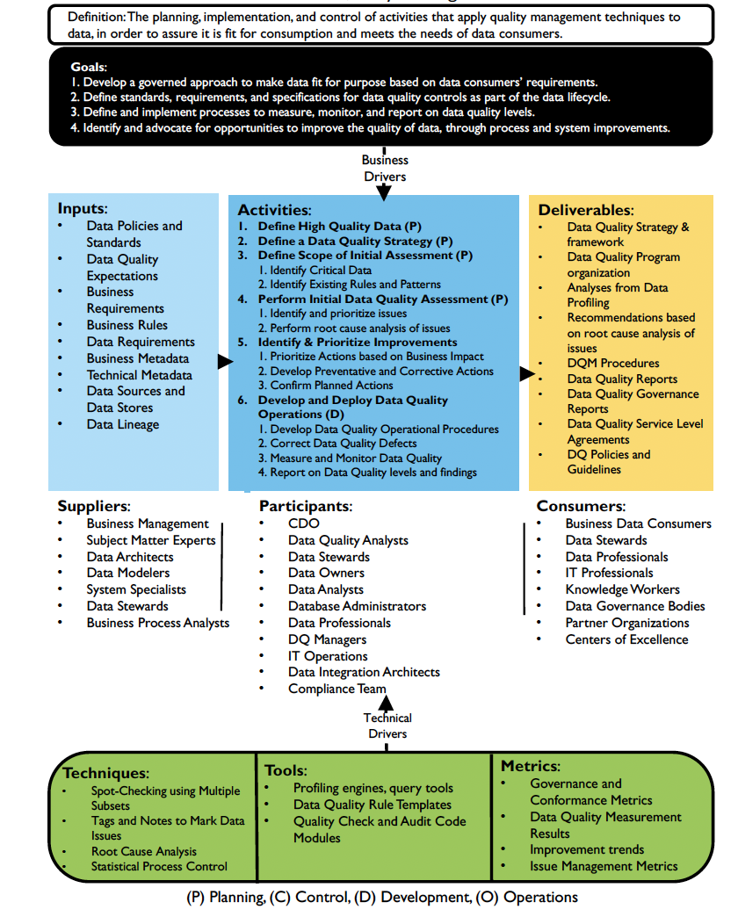
Data quality management

Slide 10
6 Popular Open Source Data Quality Tools
Cucumber
Dbt Core
Deequ
Great Expectations
MobyDQ
Soda Core
https://atlan.com/open-source-data-quality-tools/

Slide 11
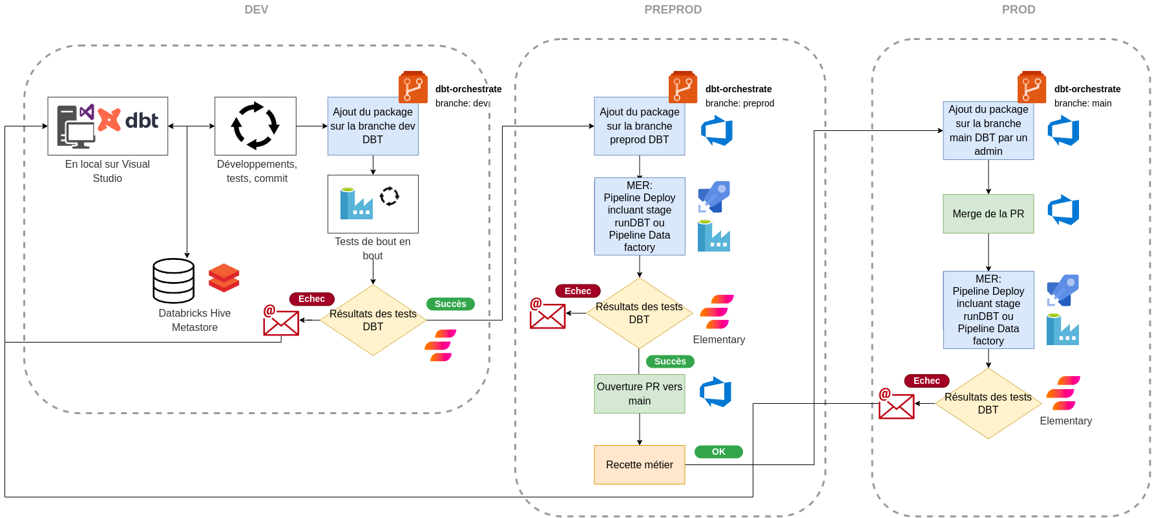
Processus de développement

Slide 12
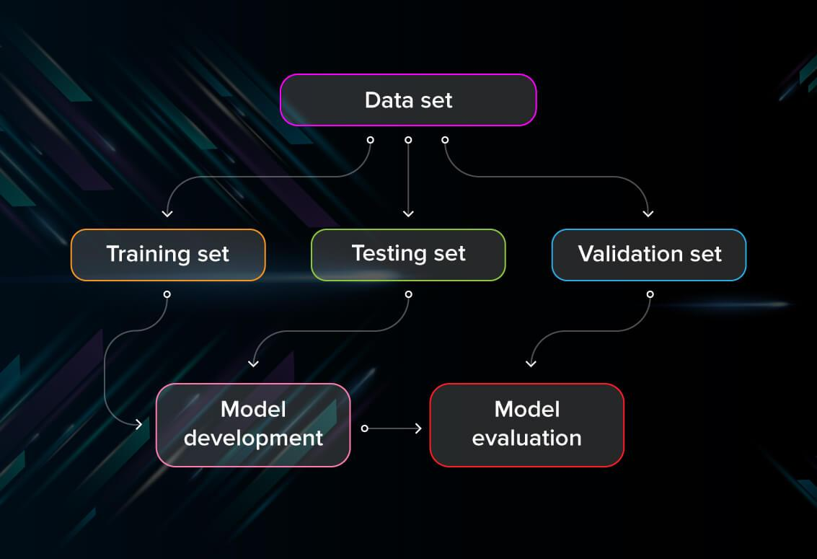
Model testing : Dataset split

Slide 13
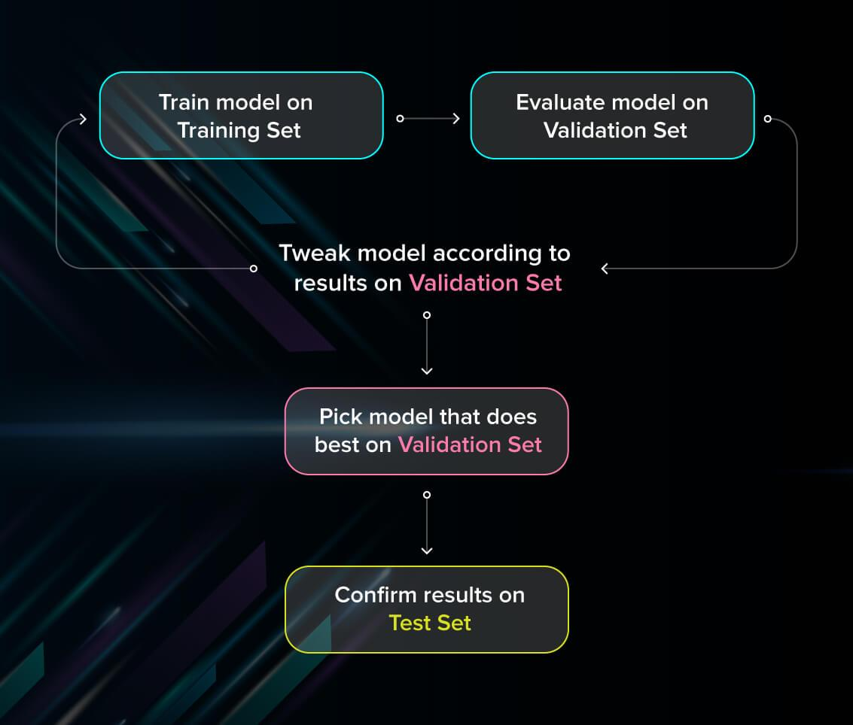
Model Testing : Dataset Split

Slide 14
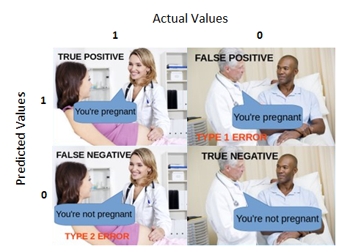

Slide 15
Evaluate models using metrics
Accuracy : From all the classes (positive and negative), how many of them we have predicted correctly.
Precision : from all the classes we have predicted as positive, how many are actually positive.
Recall :from all the positive classes, how many we predicted correctly.
Loss : how bad the model's prediction was on a single example.
area under the ROC curve (AUC) : It tells how much the model is capable of distinguishing between classes
https://developers.google.com/machine-learning/testing-debugging/metrics/metrics
https://serokell.io/blog/machine-learning-testing
https://towardsdatascience.com/understanding-auc-roc-curve-68b2303cc9c5
https://towardsdatascience.com/understanding-confusion-matrix-a9ad42dcfd62

Slide 16
What is CML
CML is a library of functions used inside CI/CD runners to make ML compatible with GitHub Actions and GitLab CI.
Generate informative reports on every Pull/Merge Request with metrics, plots, and hyperparameters changes.
Provision GPU\CPU resources from cloud service providers (AWS, GCP, Azure, Ali) and deploy CI runners using Docker Machine.
Bring datasets from cloud storage to runners (using DVC) for model training, as well as save the resulting model in cloud storage.
https://cml.dev

Slide 17
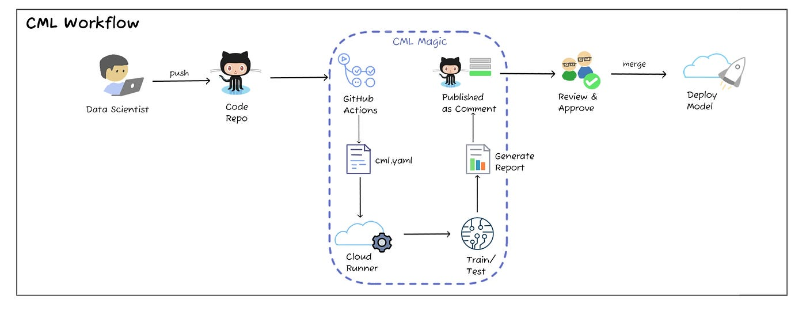
CML Workflow
https://towardsdatascience.com/continuous-machine-learning-e1ffb847b8da

