Slide 1

Data Analysis with
5. Machine Learning
With Spark

Slide 2
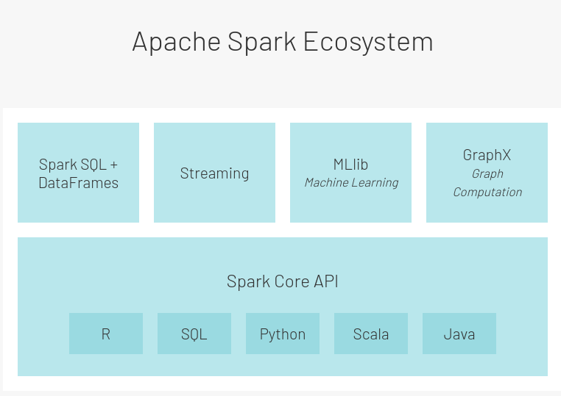
Spark Ecosystem
Data Analysis with Spark - 5. Machine Learning With Spark

Slide 3
Machine Learning With Spark: packages
spark.mllib:
  RDD-based (DF functionalities being added)
  In maintenance since Spark 2.0 (now 3.x)
spark.ml
  Newer
  DataFrames-based
The term MLlib is used for both.
Data Analysis with Spark - 5. Machine Learning With Spark

Slide 4
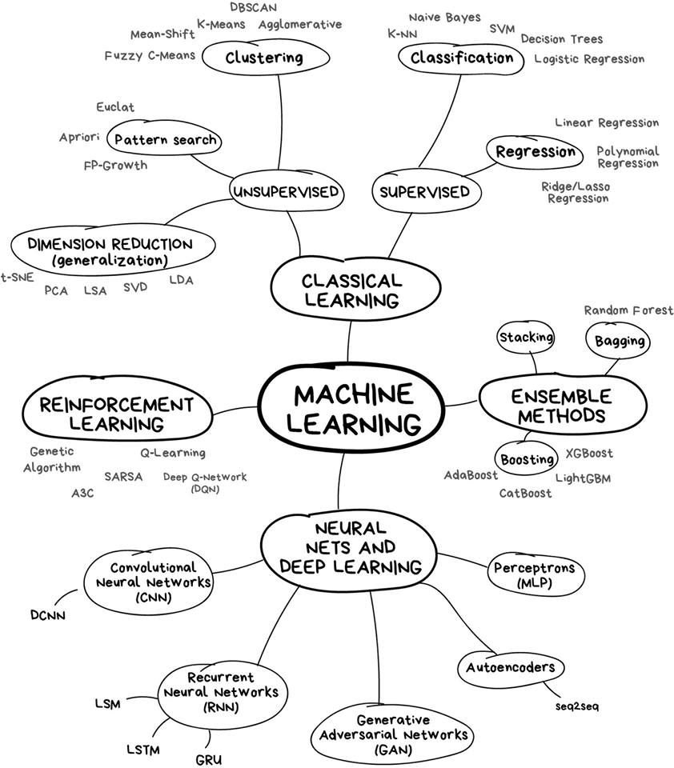
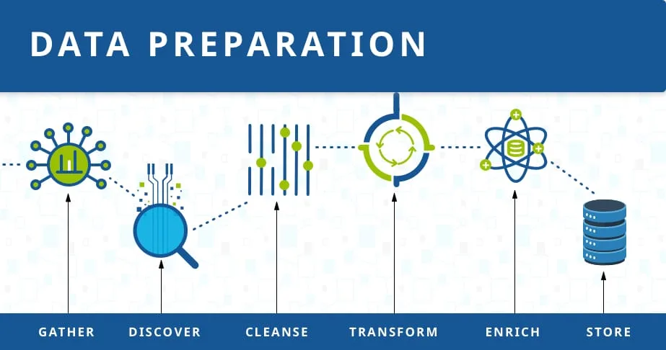
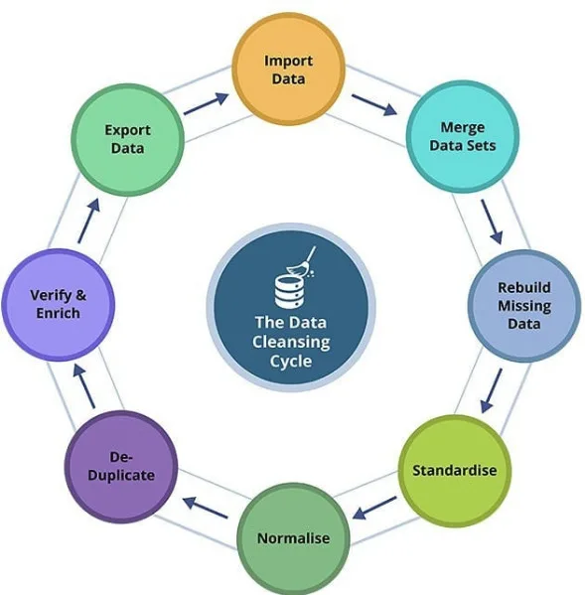
Machine Learning
Data Analysis with Spark - 5. Machine Learning With Spark

Slide 5
MLlib: Functionalities
ML algorithms include:
Classification: logistic regression, naive Bayes,...
Regression: generalized linear regression, survival regression,...
Decision trees, random forests, and gradient-boosted trees
Recommendation: alternating least squares (ALS)
Clustering: K-means, Gaussian mixtures (GMMs),...
Topic modeling: latent Dirichlet allocation (LDA)
Frequent itemsets, association rules, and sequential pattern mining
ML workflow utilities include:
Feature transformations: standardization, normalization, hashing,...
ML Pipeline construction
Model evaluation and hyper-parameter tuning
ML persistence: saving and loading models and Pipelines
Other utilities include:
Distributed linear algebra: SVD, PCA,...
Statistics: summary statistics, hypothesis testing,...
https://spark.apache.org/mllib/
https://spark.apache.org/docs/latest/ml-guide.html
Data Analysis with Spark - 5. Machine Learning With Spark

Slide 6
When do we choose ML with Spark?
Pros:
  We can process big datasets
  One framework from data preparation to modeling
Cons:
  The algorithms need to be re-written for distributed computing
  No visualization natively present in Spark
  Different functionalities with different APIs (e.g. XGBoost only in Scala)
  Not necessarily faster
Data Analysis with Spark - 5. Machine Learning With Spark

Slide 7
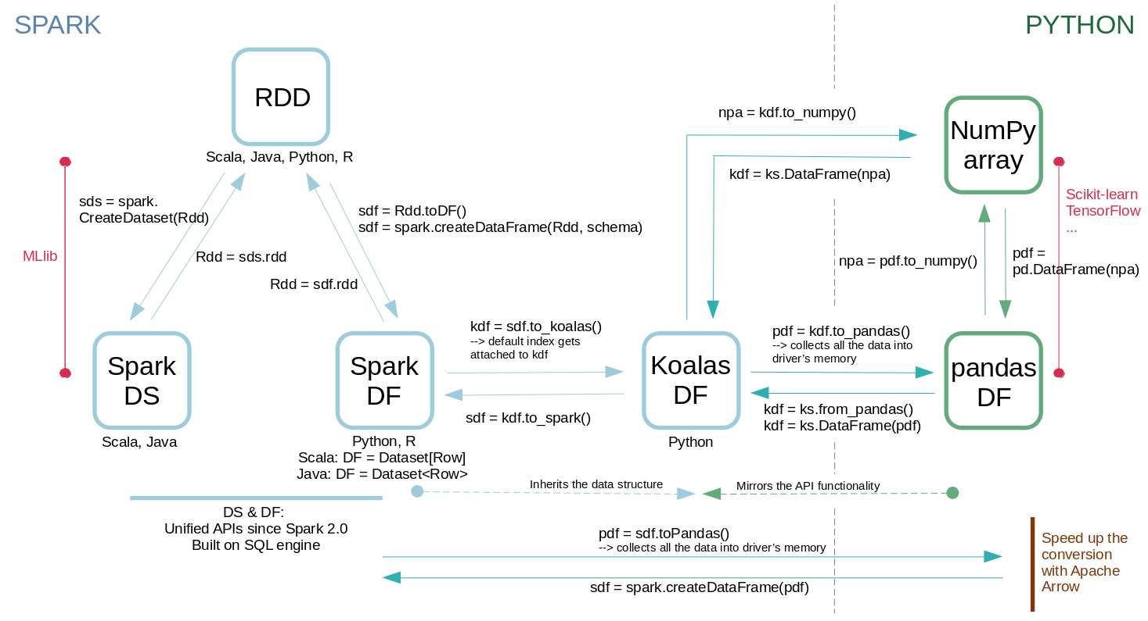
Spark Data Structures and connection to Python
Data Analysis with Spark - 5. Machine Learning With Spark

Slide 8
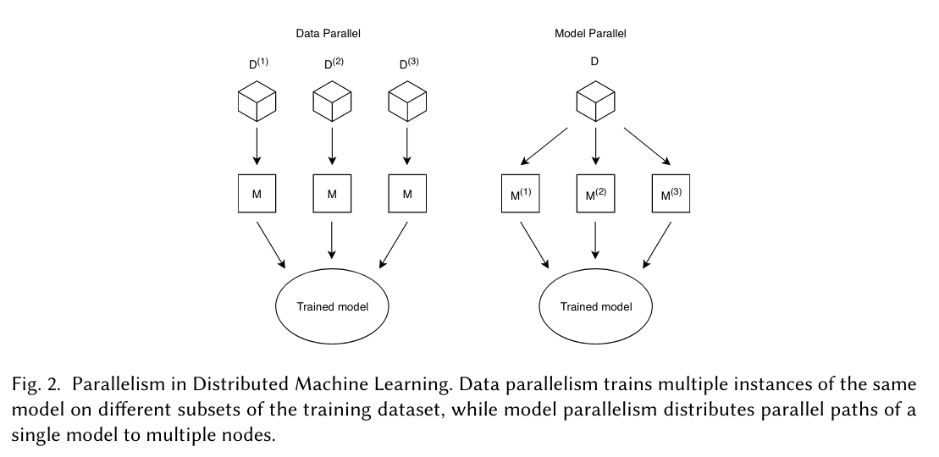
Types of Parallelism
Could be set up:
cv.setParallelism(n).fit()
Spark-scikit ...
Native Spark
https://arxiv.org/pdf/1912.09789.pdf
Data Analysis with Spark - 5. Machine Learning With Spark

Slide 9
ML Terminology (Spark, sklearn…)
Transformer
  Input: DF → output: DF via .transform()
  Apply rule-based transformation, no learning
  Example: One-hot encoding, model
Estimator
  Learns parameters via .fit() method
  Returns a model
Pipeline
  Putting a series of transformers and estimators in a sequence
  Automation
Data Analysis with Spark - 5. Machine Learning With Spark

Slide 10
Steps of a Machine Learning project (1/2)
Dataset preparation (cleaning, feature engineering)
Train/test (train/validation/test) split: 80/20 (60/20/20)
Train the model (on the train data)
  Cross-validation, leave-one-out
Estimate the quality of the model (on the validation data)
Tune the model to improve the performance
  Grid search
Test the final performance on the test data
Data Analysis with Spark - 5. Machine Learning With Spark

Slide 11
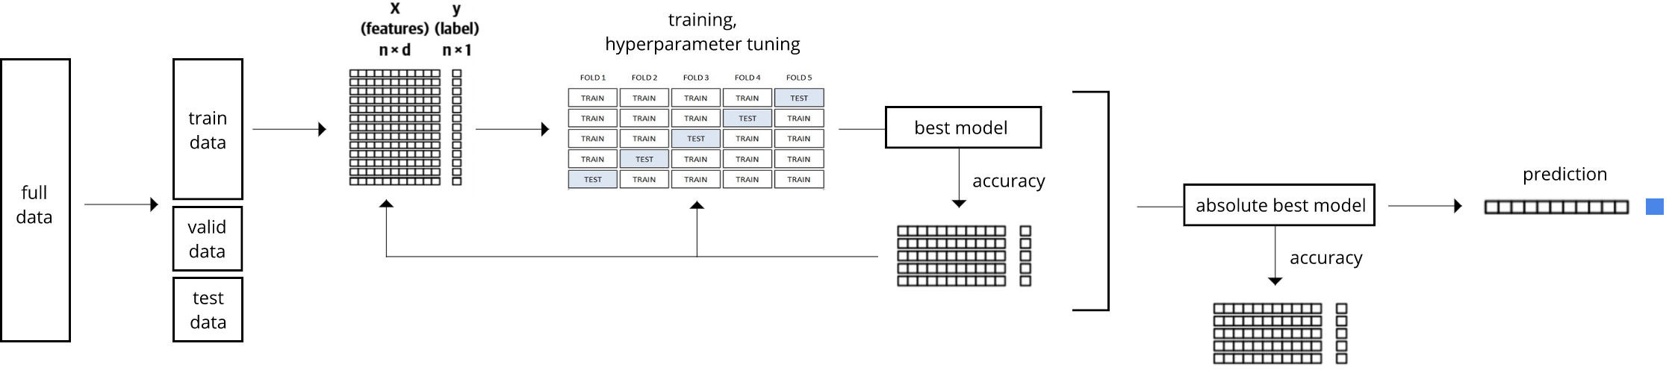
Steps of a Machine Learning project (2/2)
params1: ntrees1, depth1
params2: ntrees2, depth2
…
Include new params
Different algos
…
Data Analysis with Spark - 5. Machine Learning With Spark

Slide 12
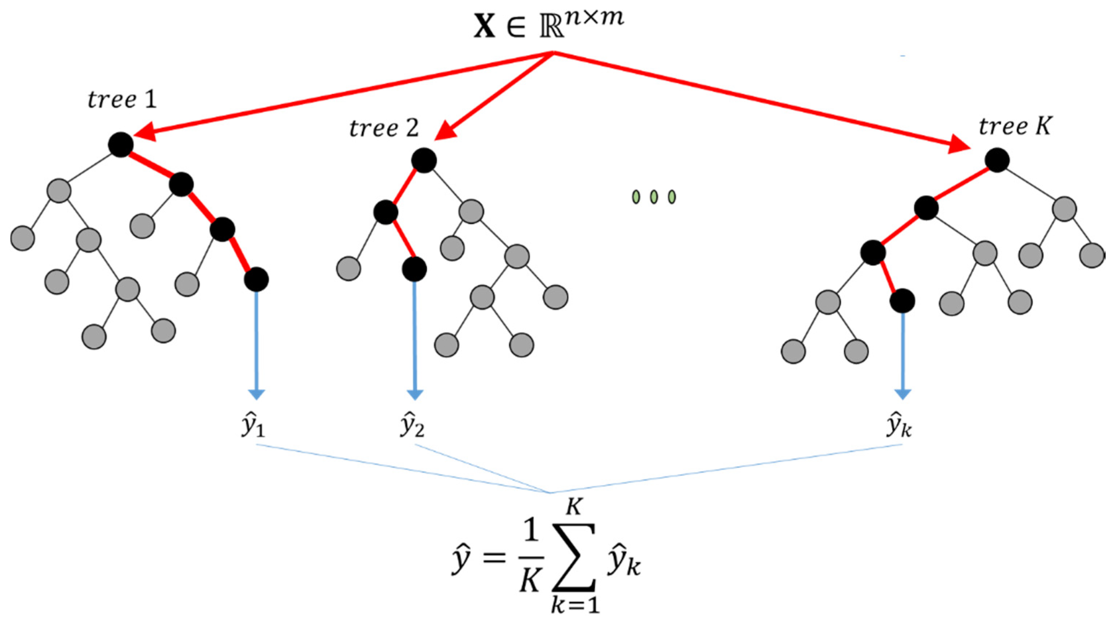
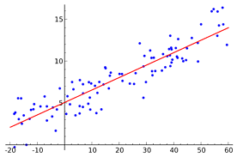
Linear Regression and Random Forest regression
y = kx + n
Data Analysis with Spark - 5. Machine Learning With Spark

