Slide 1

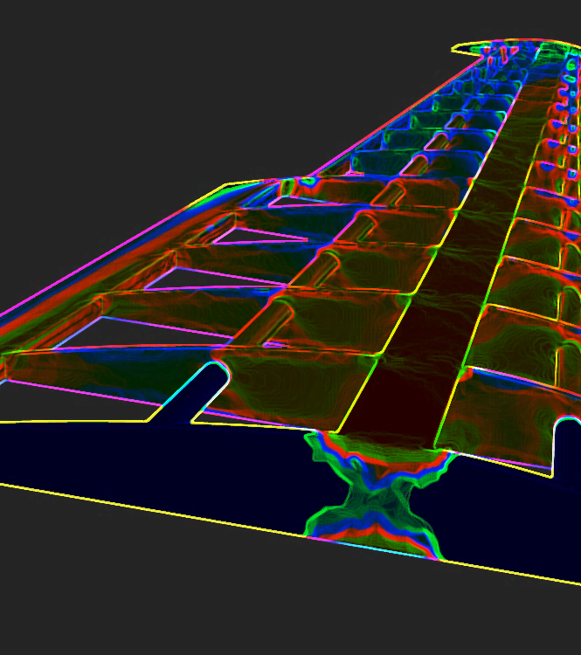

AI for Design and Manufacturing (ADAM)

