Slide 1
FYP PROPOSAL DEFENSE · FAST SCHOOL OF COMPUTING
01 / 10
Metamorph
An agentic metamorphic testing framework for computer vision models.
We can measure a vision model's accuracy on its test set — but we have no way to check it against fog, night, motion blur, glare or occlusion, because those inputs have no labels and no test oracle.
Group 〈Member A〉 · 〈Member B〉 · 〈Member C〉 Supervisor 〈Supervisor〉 Category R&D · ML testing

Slide 2
Problem and users
02 / 10
WHO HAS THE PROBLEM
Any team shipping a trained detector, segmenter or tracker — autonomous driving, ADAS, agriculture, medical imaging, security — plus the ML researchers and QA engineers who must sign off on it.
CURRENT WORKFLOW
Collect & label a dataset
Train the model
Report accuracy / mAP on a held-out split
Robustness? checked ad-hoc — a few hand-picked images, hand-written augmentations, per person, per project
Ship
The gap sits between step 3 and step 5.
WHY IT MATTERS
The held-out test set never contains the weather, lighting and camera conditions the model meets in deployment. Models fail silently and the failures concentrate on vulnerable classes — pedestrians, cyclists — where an error is most costly. There is no standard method, no oracle, and no coverage measure for this today.

Slide 3
Existing solutions and prior-FYP comparison
03 / 10
Capability | Adversarial testing FGSM / PGD | Augmentation libs imgaug · Albumentations | Existing MT for CV fixed 21 MRs | Metamorph
Oracle without new labels | partial | no | yes — fixed | yes — task-aware
Realistic weather / lighting | no | pixel filters | 1 (sunny→snowy) | generative edits
Adapts to the model's domain | no | no | no | LLM-discovered MRs
Checks meaning is preserved | n/a | no | no | CLIP gate
Evidence-guided test selection | no | no | no | closed loop + memory
Coverage & robustness report | no | no | partial | per condition & class
Prior FYP work 〈if any — e.g. "Prior FYP applied the fixed 21 MRs to one classifier; no domain adaptation, no generative transforms, no memory."〉
The gap: no framework combines a label-free task-aware oracle with domain-adaptive MR discovery, generative transforms behind a semantic gate, and adaptive selection.

Slide 4
R&D / recent technical work
04 / 10
SOURCES WE BUILD ON
Metamorphic testing — Chen et al., ACM CSUR 2018: test without an oracle via relations between inputs and outputs.
MT for deep models — DeepTest (ICSE 2018), DeepRoad (ASE 2018): GAN weather for driving models — but hand-fixed relations.
The 21-MR library for image classification — our general-purpose starting set.
InstructPix2Pix — Brooks et al., CVPR 2023: edit an image from a text instruction.
CLIP — Radford et al., ICML 2021: image↔text similarity, used here as the semantic gate.
Tool-using LLM agents — plan-act-observe loops for MR discovery.
WHAT WE TOOK FROM IT
MT turns "no labels" into "a checkable relation" — the right primitive for deployment conditions.
Generative edits look real, but can silently change the scene → a semantic-preservation check is non-negotiable.
A fixed MR set does not transfer across domains → discovery must be driven by a domain description and by evidence collected so far.
The LLM must never decide pass/fail — deterministic transforms and objective oracles do.

Slide 5
Complex computing challenge
05 / 10
No ground truth for the oracle. "Should this transform change the output, and how?" must be synthesised per relation type — invariant, predictable, additive, relational — across classification, detection, segmentation and tracking.
Open-ended relation space. The agent proposes new relations from a domain description and accumulated failures; each must pass schema, task-compatibility, domain, feasibility and semantic checks before it can run.
Generative transforms break silently. An edit can add or remove objects — needs a CLIP gate with a regenerate-or-fallback loop.
Search under budget. transform × image × parameter is a huge space; exhaustive testing is infeasible → adaptive, evidence-guided selection.
Reproducible verdicts from a pipeline that contains a stochastic LLM and a stochastic image editor.
CCP MAPPING
Depth of analysis & abstract reasoning
No standard, off-the-shelf solution
Novel integration: VLM + LLM + editor + CLIP + model + oracle + memory
Conflicting requirements: realism ⟷ semantic fidelity ⟷ coverage ⟷ budget
Systems, ML, program-analysis and HCI concerns in one loop.

Slide 6
Proposed solution and contribution
06 / 10
Bootstrap sweep ~10 images × transform library → testing memory
MAIN MODULES
Model adapter · Bootstrap sweep · MR Discovery Agent · MR Validator · Adaptive Selection Agent · Transformation Engine (InstructPix2Pix + deterministic) · Semantic Validator (CLIP) · Task-aware Oracle · Failure Analyzer · Orchestrator
1 Pick image from the dataset
2 Describe vision model → text caption
3 Plan relation LLM + memory — may invent a new MR
4 Transform InstructPix2Pix if generative · code otherwise
5 Semantic check CLIP: is the meaning preserved?
6 Run model only if the check passed
CONTRIBUTION
A domain-adaptive agentic MT framework that (1) discovers and validates new metamorphic relations from a plain-language domain description and accumulated failure evidence, (2) executes them with realistic generative or deterministic transforms behind a CLIP semantic gate, (3) judges them with task-aware oracles across four CV tasks, and (4) selects tests adaptively in a closed evidence-driven loop — producing an interpretable robustness and coverage report.
7 Verify task-aware oracle — relation held?
8 Update memory store image · transform · verdict
↻ memory feeds step 3 — the loop repeats under a fixed test budget, then compiles the robustness & coverage report.

Slide 7
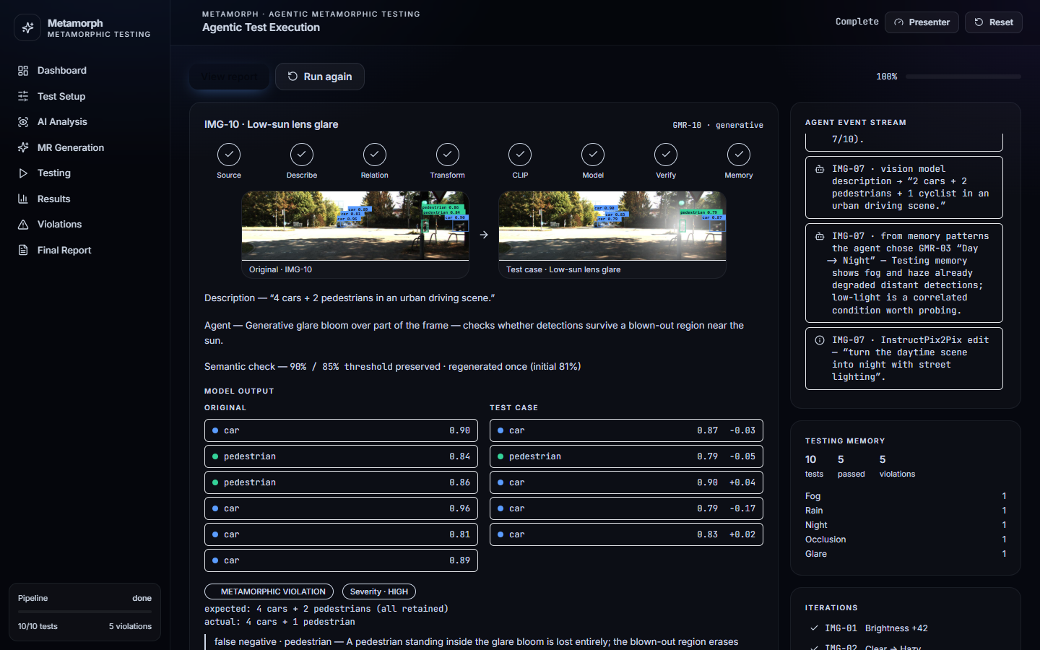
POC-lite / feasibility evidence
07 / 10
RISK EXPERIMENT — WHAT IT FOUND
0.91
BASELINE MAP@0.5
5 / 10
RELATIONS VIOLATED
pedestrian
MOST AFFECTED CLASS
28%
ROBUSTNESS · NIGHT & OCCL.
Violations concentrated under fog, rain, night, occlusion and glare — exactly the untested conditions — and produced a per-condition robustness profile.
Full MVP not required — this proves the workflow, the data path and that the hardest risks are addressable.
PROTOTYPE — ONE ITERATION OF THE LOOP, LIVE
10 real KITTI street scenes + ground-truth boxes from Hugging Face; deterministic + generative-style transforms (fog · rain · night · dusk · haze · glare · motion blur · occlusion · rotation · insertion) generated offline with detection overlays. The full pipeline runs end-to-end, including a CLIP regenerate case.

Slide 8
Evaluation plan and risks
08 / 10
Risk | Mitigation
LLM proposes invalid relations | validator + human-in-the-loop gate
Generative edit changes content | CLIP gate → regenerate → deterministic fallback
Compute cost of image editing | cache · batch · budget · smaller editor
Dataset licensing (KITTI = non-commercial) | research use only; swap-in dataset interface
Scope across 4 CV tasks | detection first; others via the adapter
HOW SUCCESS IS MEASURED
Oracle validity — verdicts vs human judgement on a labelled sample ≥ 90% agreement
MR discovery quality — % of proposed relations that pass the validator and expert review
Semantic gate — CLIP precision/recall vs human "did the meaning change?" labels
Fault-finding power — real violations surfaced vs a manual audit and vs the fixed-21-MR baseline
Coverage — relation-type and condition coverage reached within budget
Reproducibility — identical inputs → identical verdicts
TOOL / API / GENAI BOUNDARY
GenAI is used to propose relations and edit images — every output is validated and can be rejected. The oracle, the metrics and every pass/fail decision are deterministic code. Third-party, all open / research-licensed: HF datasets, an LLM, InstructPix2Pix, CLIP. Our work: the agents, validators, oracles, orchestration and UI.

Slide 9
Work division and iteration plan
09 / 10
OWNERSHIP
〈Member A〉 — model adapters · bootstrap sweep · deterministic transformation engine · detection oracle
〈Member B〉 — MR Discovery Agent · MR Validator · Adaptive Selection Agent · testing memory · LLM integration
〈Member C〉 — generative transform service (InstructPix2Pix) · CLIP semantic validator · failure analyzer · reporting UI
Shared — orchestrator · evaluation harness · report write-up
ITERATIONS
It 1 · FYP-1 — adapter + bootstrap sweep + deterministic transforms + detection oracle + memory + demo on KITTI
It 2 · FYP-1 — MR Discovery Agent + Validator + CLIP gate + rule-based adaptive selection + robustness report
It 3 · FYP-2 — generative transform service + regenerate loop + LLM planning from memory
It 4 · FYP-2 — segmentation & tracking oracles via the adapter + evaluation study + hardening
Milestones aligned to the handbook — Proposal Defense wk 4 · Mid wk 8 (It 1) · Poster wk 13 · Final FYP-1 wk 15 (It 2, ≥ 45% implementation).

Slide 10
DEI, ethics and legal
10 / 10
DEI
The framework's purpose is equity in ML reliability. It deliberately surfaces failures on under-represented classes and conditions — pedestrians at night, darker skin tones under low light, regional weather — and reports per class and per condition, so disparities are visible instead of hidden in an average. Test scenes and domain descriptions span geographies, lighting and appearance.
ETHICS
No human-subjects data collection. Public research images with visible faces are handled per dataset terms (blurred on export where required). We never claim "production ready" — the report always states coverage and remaining budget, so results cannot be cherry-picked into a safety claim.
LEGAL
Datasets under their licences — KITTI: CC BY-NC-SA 3.0, non-commercial research only. Model weights (CLIP, InstructPix2Pix) and the LLM under their own terms. All third-party components isolated behind interfaces; the framework, agents, oracles and UI are the group's own work. Testing memory stores only image ids, transform parameters and verdicts — no PII.

