Slide 1


A theory of financial media
Eitan Goldman, Jordan Martel, Jan Schneemeier
JFE | July 2022

Slide 2



Agenda
WSU
Authors
Motivation & Unique Contribution
The Model
Equilibrium Manipulation
Empirical Implications
Conclusions & Further Research

Slide 3



The Authors
WSU
Eitan Goldman
Harry C. Sauvain Chair
Corporate Governance, Political Economy of Finance
Jordan Martel
Information Economics
Adverse Selection
Jan Schneemeier
Information Acquisition in Market
Corporate Finance

Slide 4
Authors’ Motivation
WSU
Motivation & Unique Contribution
“Overall, our paper helps to answer questions such as what kind of news should be reported by the financial media? How does the medias’ presence alter the firm’s incentive to manipulate information? Are individual investors better off with media reporting?”
This paper fills a gap in recent empirical research (Tetlock, 2011;Peress, 2014; Garcia, 2013) involving financial journalists’ effect on trading, financial markets, and the formation of stock prices.
Here, a financial journalist is explicitly modeled (analyzing 10-K SEC filings) while playing two roles
She considers each firm announcement and focusses on announcements that yields the greatest benefit to her readers.
If she chooses to report on a firm, she tries to debias the announcement as thoroughly as possible to minimize their readers’ exposure to biased announcements.

Slide 5
Compared to ‘Game On’
WSU
Motivation & Unique Contribution
Both Financial Media & Game On:
Operate in a discrete time space
Analyze the interaction between retail investors and market sentiment
Information Asymmetry
Both make presumptions about boundedly rational, naïve readers of market information
Unique to A theory of financial media:
3 Important Assumptions,
Authors consider a journalist who does not pander to firms but instead makes a reporting decision based on how her report will impact her readers’ ability to trade.
Authors do not assume that the journalist creates new information (e.g., investigative reporting).
Authors presume readers as partially informed investors similar to ‘strategic retail investors.’
Unique to Game On:
Naïve
Long-term
Fanatic
Short-term

Slide 6
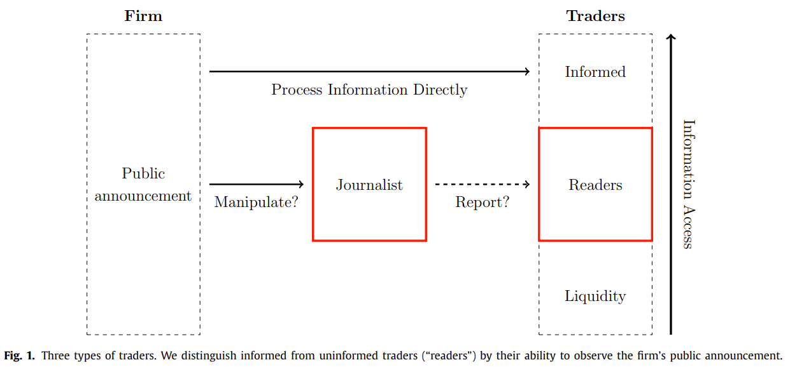
The Model
WSU
The Model
Only 3 traders
One directional and discrete time series
All investors are presumed rational
Traders are presumed only to be ‘informed’ or ‘uninformed’

Slide 7
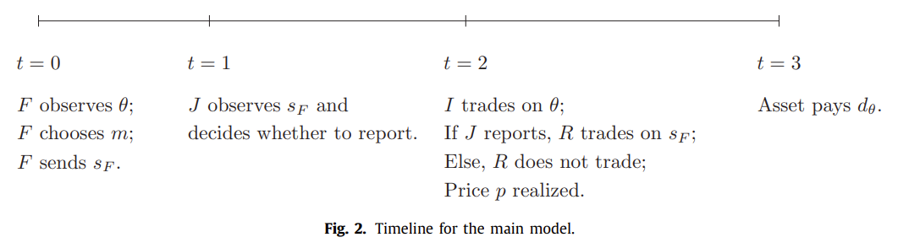
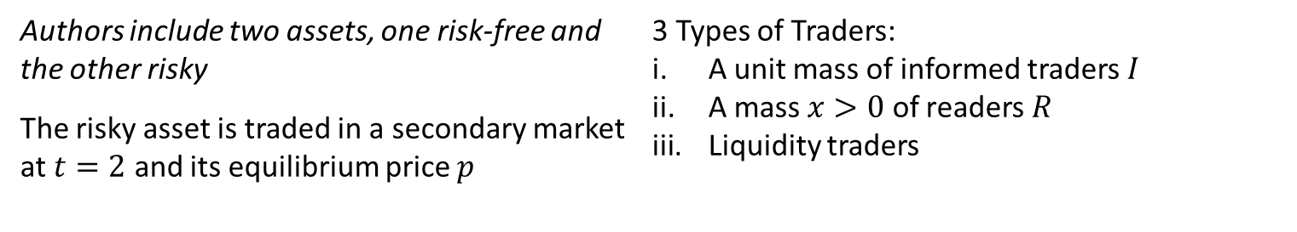
A Timeline
WSU
The Model
$$The firm^{′}s "liquidating dividend^{"}d_{θ} is paid at t=3$$
$$θ takes on values L and H with equal probability, such that{ d}_{H}>d_{L}$$
Authors include two assets, one risk-free and
the other risky
The risky asset is traded in a secondary market at $t=2$ and its equilibrium price $p$
3 Types of Traders:
A unit mass of informed traders $I$
A mass $x>0$ of readers $R$
Liquidity traders

Slide 8


Firm Manager
WSU
The Model
At $t=0$, the firm’s manager observes a fundamental shock $θ$ and issues a public signal $s_{F}∈\{L,H\}$
The manager only has incentive to issue $s_{F}≠θ$ if the fundamental is low,
$$ℙ\left(s_{F}=H|θ=H\right)=1$$
If shock is low, $s_{F}$ depends on intensity of manipulation, $m∈[0,1]$
$$ℙ\left(s_{F}=H|θ=L\right)=m$$
$$ℙ\left(s_{F}=L|θ=L\right)=(1−m)$$
The manager chooses to maximize firm’s expected stock price p, net of a private manipulation cost $C(m)$
$$\max_{m∈[0,1]}{𝔼}\left[p | θ=L\right]−C(m)$$
$s_{F}=L$ is perfectly informative about the firm’s fundamental shock
Conversely, $s_{F}=H$ could result from either the fundamental being high $θ=H$ or the manager’s successful manipulation of a low fundamental signal $θ=L$.

Slide 9
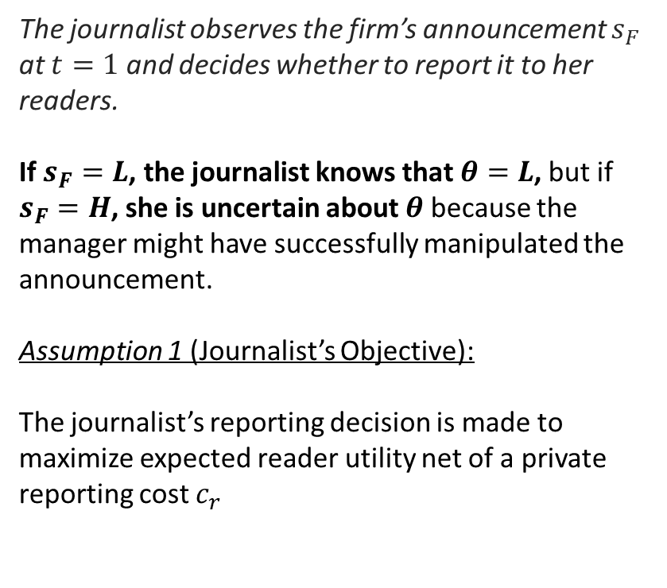
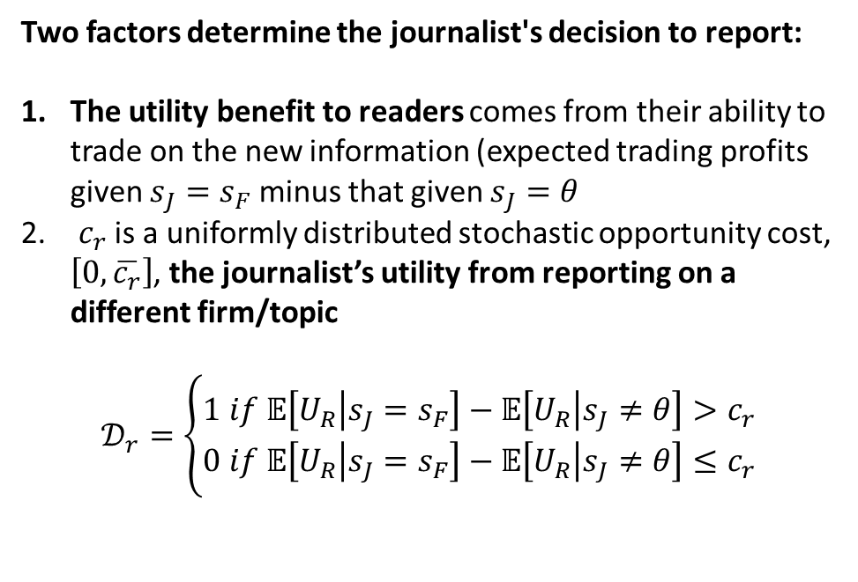
The Journalist
WSU
The Model
The journalist observes the firm’s announcement $s_{F}$ at $t=1$ and decides whether to report it to her readers.
If $s_{F}=L$, the journalist knows that $θ=L$, but if $s_{F}=H$, she is uncertain about $θ$ because the manager might have successfully manipulated the announcement.
Assumption 1 (Journalist’s Objective):
The journalist’s reporting decision is made to maximize expected reader utility net of a private reporting cost $c_{r}$
Two factors determine the journalist's decision to report:
The utility benefit to readers comes from their ability to trade on the new information (expected trading profits given $s_{J}=s_{F}$ minus that given $s_{J}=θ$
$c_{r}$ is a uniformly distributed stochastic opportunity cost, $\left[0,\overline{c_{r}}\right]$, the journalist’s utility from reporting on a different firm/topic
$$𝒟_{r}=\left\{\begin{aligned}1 if 𝔼\left[U_{R} | s_{J}=s_{F}\right]−𝔼\left[U_{R} | s_{J}≠θ\right]>c_{r} \\ 0 if 𝔼\left[U_{R} | s_{J}=s_{F}\right]−𝔼\left[U_{R} | s_{J}≠θ\right]≤c_{r}\end{aligned}\right.$$

Slide 10

Readers and Informed Traders
WSU
The Model
At $t=2$, informed traders and readers submit asset demand schedules $x_{i}$ where $i∈\{I,R\}$
$$U_{i}=x_{i}\left(d_{θ}−p\right)−\frac{K}{2}x_{i}^{2}$$
K is part of the quadratic trading cost (Pouget et al., 2017)
Meanwhile, $Ω_{i}$ denotes type i’s information set where $Ω_{I}=\{θ,p\}$ and $Ω_{R}=\{s_{J},p\}$
$$x_{I}=K^{−1}\left(𝔼\left[d_{θ} | Ω_{I}\right]−p\right)$$
$$x_{R}=K^{−1}(𝔼\left[d_{θ} | Ω_{R}\right]−p)$$
Assumption 2 (Readers’ observed signals):
Readers observe the firm’s signal only if it is reported by the journalist. If the signal is reported, they supplement the firm’s signal with stock price information.
Assumption 3 (No-reporting benchmark):
Readers do not trade in the absence of a report.

Slide 11
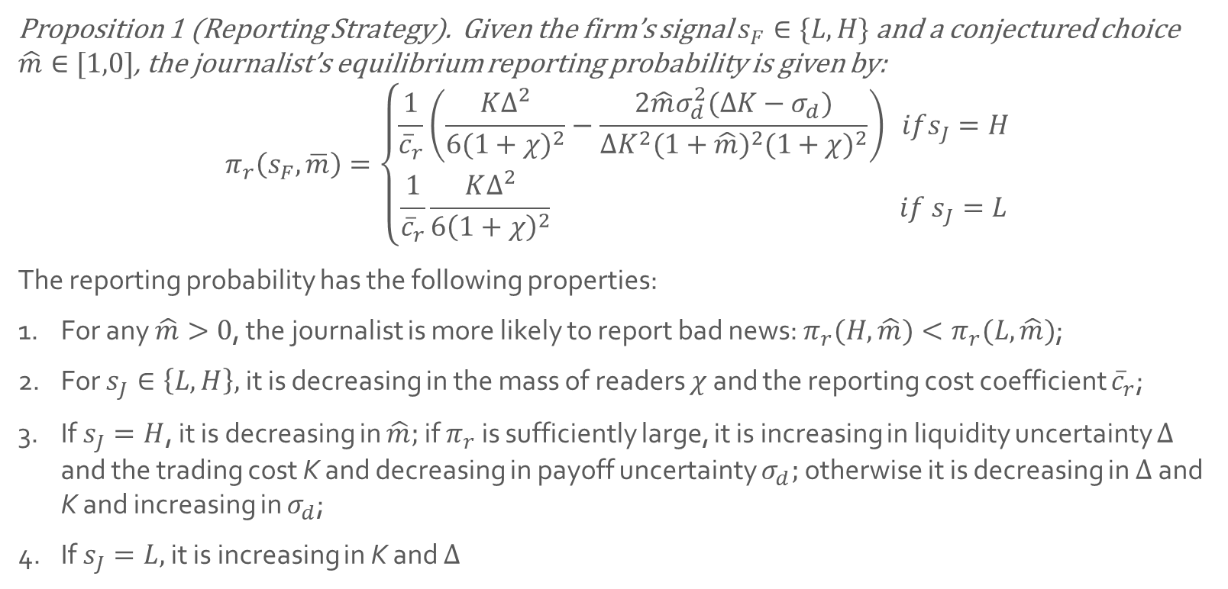
Proposition 1
WSU
Equilibrium Manipulation
Proposition 1 (Reporting Strategy). Given the firm’s signal $s_{F}∈\{L,H\}$ and a conjectured choice $\hat{m}∈[1,0]$, the journalist’s equilibrium reporting probability is given by:
$$π_{r}\left(s_{F},\overline{m}\right)=\left\{\begin{aligned}\frac{1}{{\overline{c}}_{r}}\left(\frac{K∆^{2}}{6{(1+χ)}^{2}}−\frac{2\hat{m}σ_{d}^{2}(∆K−σ_{d})}{∆K^{2}{(1+\hat{m})}^{2}{(1+χ)}^{2}}\right)& ifs_{J}=H \\ \frac{1}{{\overline{c}}_{r}}\frac{K∆^{2}}{6{\left(1+χ\right)}^{2}} if{ s}_{J}=L\end{aligned}\right.$$
The reporting probability has the following properties:
For any $\hat{m}>0$, the journalist is more likely to report bad news: $π_{r}(H,\hat{m})<π_{r}(L,\hat{m})$;
For $s_{J}∈\left\{L,H\right\},$ it is decreasing in the mass of readers $χ$ and the reporting cost coefficient ${\overline{c}}_{r}$;
If $s_{J}=H$, it is decreasing in $\hat{m};$ if $π_{r}$ is sufficiently large, it is increasing in liquidity uncertainty $∆$ and the trading cost K and decreasing in payoff uncertainty $σ_{d};$ otherwise it is decreasing in $∆$ and K and increasing in $σ_{d}$;
If $s_{J}=L,$ it is increasing in K and $∆$

Slide 12
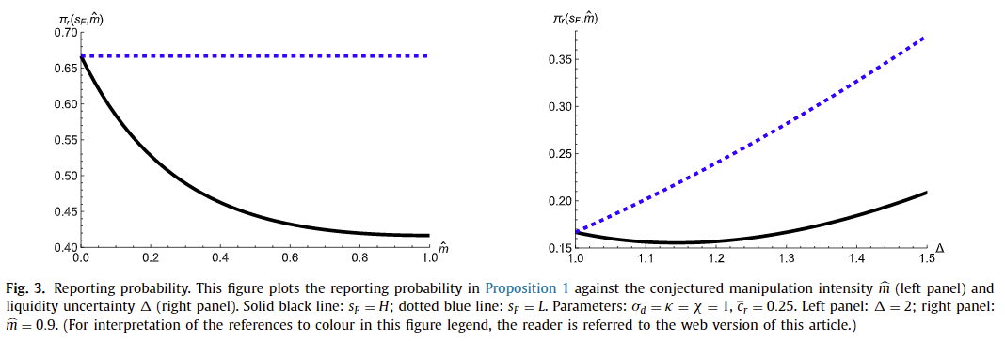
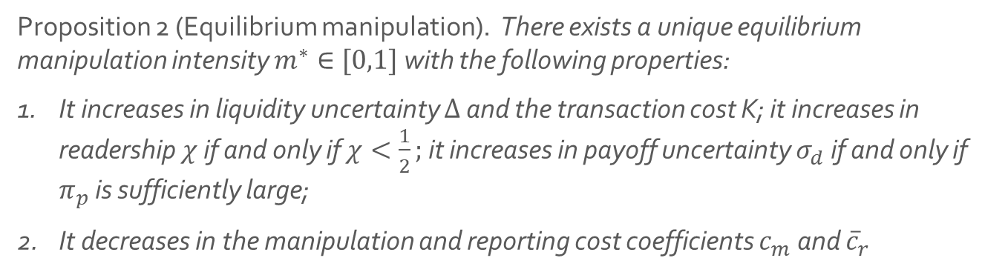
Proposition 2
WSU
Equilibrium Manipulation
Proposition 2 (Equilibrium manipulation). There exists a unique equilibrium manipulation intensity $m^{∗}∈[0,1]$ with the following properties:
It increases in liquidity uncertainty $Δ$ and the transaction cost K; it increases in readership $χ$ if and only if $χ<\frac{1}{2};$ it increases in payoff uncertainty $σ_{d}$ if and only if $π_{p}$ is sufficiently large;
It decreases in the manipulation and reporting cost coefficients $c_{m}$ and ${\overline{c}}_{r}$

Slide 13
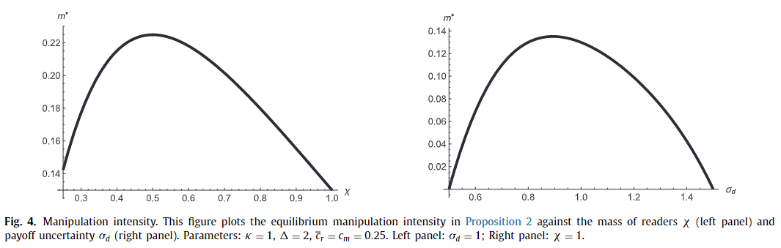
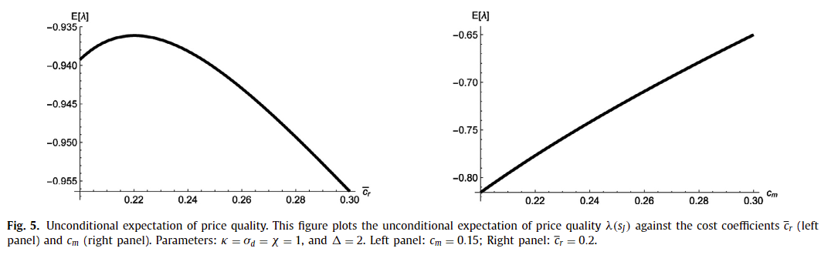
Manipulation & Price
WSU
Equilibrium Manipulation

Slide 14
Firm Manipulation
WSU
Empirical Implications
The first set of predictions relates to firm managers and their incentives to manipulate corporate announcements.
Prediction 1. Manipulation increases following an exogenous increase in media coverage. The effect is stronger when (i) a greater fraction of traders are readers and (ii) stock prices are less informative.
The firm manager is more likely to manipulate an announcement when the journalist is more likely to report it.
Prediction 2. Firms that have yet to receive media coverage manipulate less than those that have already received media coverage.
Because reporting on these firms is already costly, the firm’s announcement must contain little manipulation.
Prediction 3. Manipulation is lower when the journalist covering the firm is more skilled or her opportunity cost is higher.
Consequently, the firm manager’s anticipated marginal benefit of manipulation is lower.

Slide 15
Media Reporting
WSU
Empirical Implications
This set of predictions relates to the equilibrium choice of the journalist on what firm announcements to cover.
Prediction 4. Negative announcements are more likely to be reported than positive ones.
Negative announcements are inherently more accurate to readers.
Prediction 5. Announcements that are more manipulated are less likely to be reported.
For example, earnings announcements (more easily manipulated) are predicted to by less covered and heavily tilted toward negative news.
Prediction 6. Announcements are more likely to be reported if the journalist is more skilled.
This is an extension of the baseline model and allows for investigative reporting.

Slide 16
Stock Prices
WSU
Empirical Implications
This set of predictions relates to the relationship between media coverage and asset prices.
Prediction 7. An exogenous increase in media coverage leads to an increase in the magnitude of the post-announcement drift.
This effect is stronger when (1) the news is positive and (2) a greater share of traders are readers.
Prediction 8. Media coverage leads to a positive correlation in the orders by retail traders and institutional traders. This correlation is stronger for negative news.
In this model, readers trade more aggressively if the journalist reports negative news because this signal is more accurate.
Empirically, this could be measured by the correlation between trades of retail traders and institutional traders.

Slide 17


Conclusions
WSU
Financial journalists are a part of the ecosystem of agents that disseminate information to retail investors
These journalists can have immediate and sharp impacts on investor behavior and stock prices
The resulting equilibrium demonstrates the type of news that a strategic journalist will choose to report
A number of these predictions can be directly applied in empirical research

