Slide 1


Managerial Discretion and Optimal Financing Policies
René M. Stulz
JFE | 1990

Slide 2
Motivation
WSU
Adding to the literature on the importance of managerial objectives and asymmetric information, Stulz investigates how financing policies can be used to restrict management’s ability to pursue its own objectives when it has information that shareholders do not have.
Optimal financing policies reduce the costs shareholders bear if management tends to overinvest (subject to cash flows and NPV)
Stulz considers a firm with atomistic shareholders who observe neither the firm’s cash flow nor the management’s investment decisions

Slide 3
The Problem
WSU
Management’s perquisites increase with investment even when the firm invests in negative NPV projects
When cash flow is high, they invest in negative NPV projects rather than pay out cash
Information asymmetry leads to inefficient investment when cash flow is low because management cannot credibly convince shareholders that cash flow is insufficient to take advantage of all positive NPV opportunities (because they always say this)
Debt payments force managers to pay out cash flows, reducing investment in all states of the world (both positive and negative to shareholders)
Slack – shareholders giving management more resources to decrease the probability that a good project will not be undertaken – may be beneficial (Myers and Majluf, 1984)

Slide 4
The Setup
WSU
The firm’s debt-equity ratio depends critically on the probability distribution of cash flow and on the firm’s investment opportunities
Negative free cash flow + poor investment opportunities → issue debt so management will control fewer resources
Positive free cash flow + good investment opportunities → want management to raise more funds to decrease the probability that some positive NPV investment opportunities will be left unexploited
Diversification across project reduces the agency costs of managerial discretion because it makes cash flow more predictable

Slide 5
The Model
WSU
0
1
2
Firm’s assets in place at date 0 yield a random non-negative cash flow R at date 1 that managers can either invest in new projects or pay out
The firm can raise funds at dates 0 and 1
Firm has investment opportunities at date 1 that managers and shareholders want to exploit
Funds available to management at date 0 can only be invested riskless, zero-NPV securities
Funds to be invested at date 1 in addition to R are raised at date 1
N is the firm’s net financing at date 1 (cash raised – cash paid out at that date)

Slide 6
The Model
WSU
0
1
2
If N > 0, the firm pays back debt issued at date 0 (or dividend)
If firm liquidates at date 1, R is liquidation value of the firm
If firm does not default at date 1, it liquidates at date 2
Firm never issues debt unless it has some advantage that offsets (very minimal) default cost
R (cash flow from assets) has a cumulative distribution function G(R)
Investment at firm projects at date 1 is I
Neither I nor R is observable by outside investors at date 1

Slide 7
The Model
WSU
0
1
2
Date 2 expected payoff (net of perquisites) is Z per unit for the first I* units invested and Y per unit in excess of I*
For simplicity, Stulz requires Z > 1 (good project) and Y < 0 (bad project)
If N < 0, management pays out funds at date 1; here, N is the face value of debt
Raising funds to invest more than I* hurst existing shareholders because the new investors buy securities at their fair market price and investment in excess of I* has a negative NPV
Managers always raise all the investment funds they are allowed to, irrespective of the realized cash flow at date 1

Slide 8
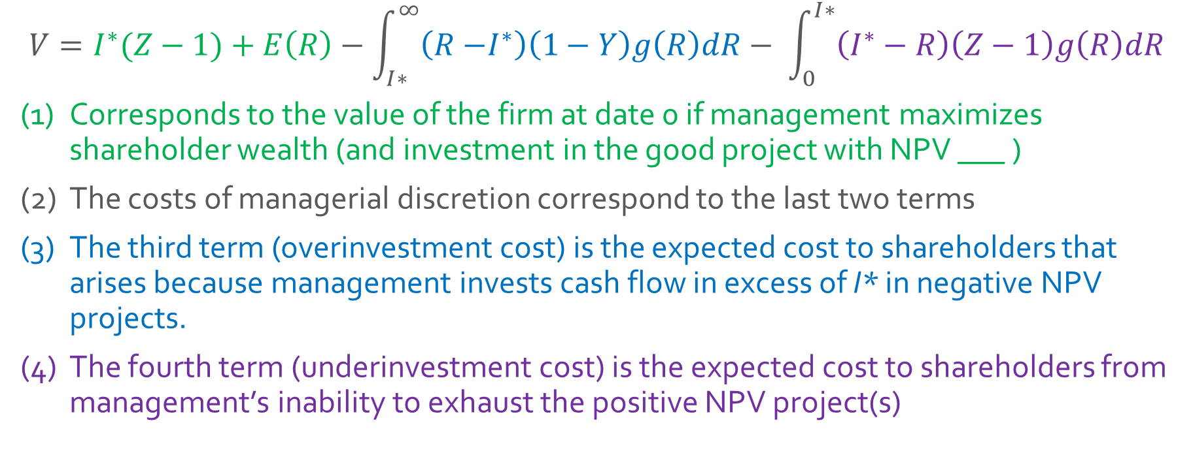
The Model
WSU
$$V=I^{∗}(Z−1)+E\left(R\right)−\int_{I∗}^{∞}{\left(R{−I}^{∗}\right)\left(1−Y\right)g\left(R\right)dR− \int_{0}^{I∗}{\left(I^{∗}−R\right)\left(Z−1\right)g\left(R\right)dR}}$$
Corresponds to the value of the firm at date 0 if management maximizes shareholder wealth (and investment in the good project with NPV ___ )
The costs of managerial discretion correspond to the last two terms
The third term (overinvestment cost) is the expected cost to shareholders that arises because management invests cash flow in excess of I* in negative NPV projects.
The fourth term (underinvestment cost) is the expected cost to shareholders from management’s inability to exhaust the positive NPV project(s)

Slide 9
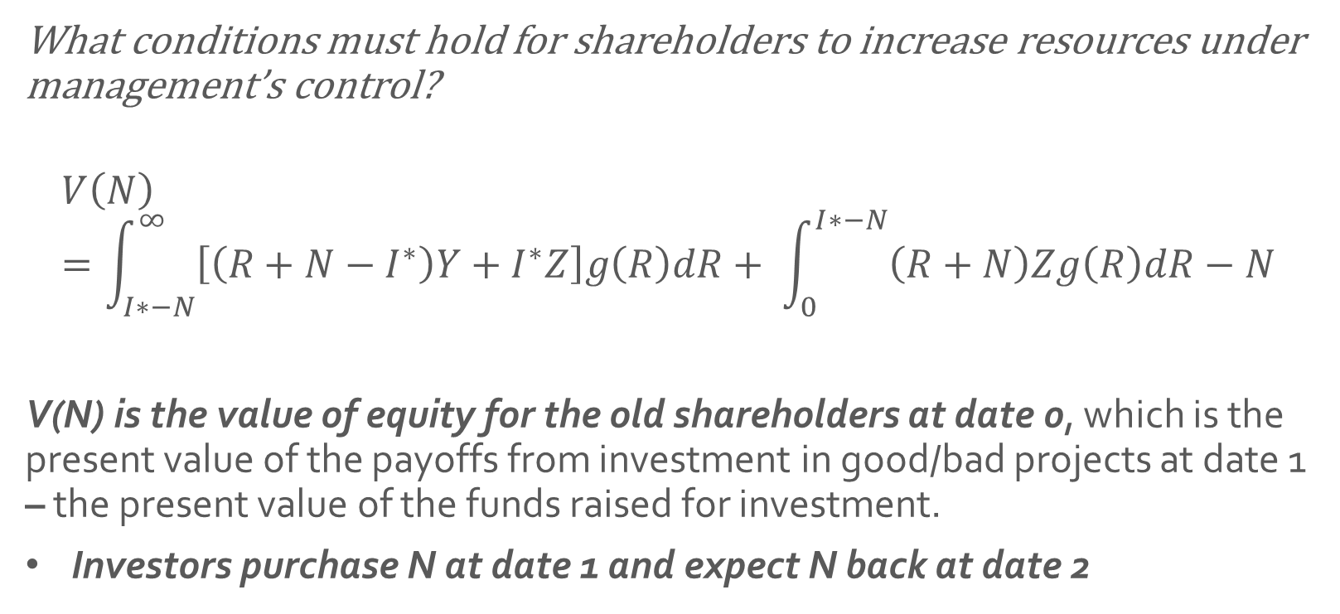
With Positive Net Financing
WSU
What conditions must hold for shareholders to increase resources under management’s control?
$$V\left(N\right)=\int_{I∗−N}^{∞}{\left[\left(R+N−I^{∗}\right)Y+I^{∗}Z\right]g\left(R\right)dR+ \int_{0}^{I∗−N}{\left(R+N\right)Zg\left(R\right)dR−N}}$$
V(N) is the value of equity for the old shareholders at date 0, which is the present value of the payoffs from investment in good/bad projects at date 1 – the present value of the funds raised for investment.
Investors purchase N at date 1 and expect N back at date 2

Slide 10
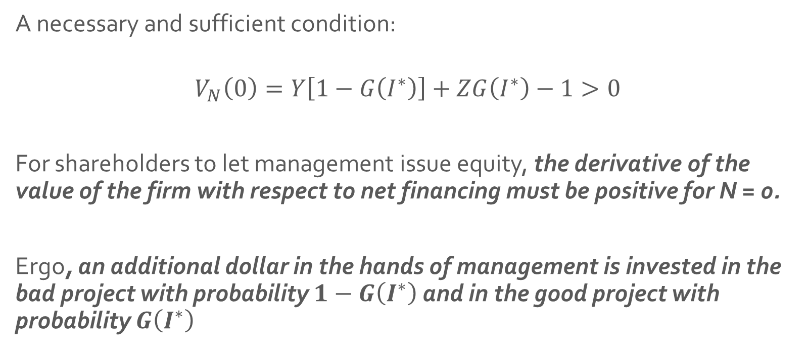
Subject To..
WSU
A necessary and sufficient condition:
$$V_{N}\left(0\right)=Y\left[1−G\left(I^{∗}\right)\right]+ZG\left(I^{∗}\right)−1>0$$
For shareholders to let management issue equity, the derivative of the value of the firm with respect to net financing must be positive for N = 0.
Ergo, an additional dollar in the hands of management is invested in the bad project with probability $1−G\left(I^{∗}\right)$ and in the good project with probability $G\left(I^{∗}\right)$

Slide 11
Result 1
WSU
“An improvement in the investment opportunity set or a decrease in the probability that management will be able to exhaust the positive NPV investments leads to an increase in the funds management can raise if condition (3) holds.”
If eq.(3) holds, the amount of equity management is allowed to raise is unique and, for any distribution of cash flow:
It increases with the marginal product of the firm’s investment opportunities and with the maximum amount that can be invested in the good project.
It increases if the probability that the firm will have free cash flow decreases.

Slide 12
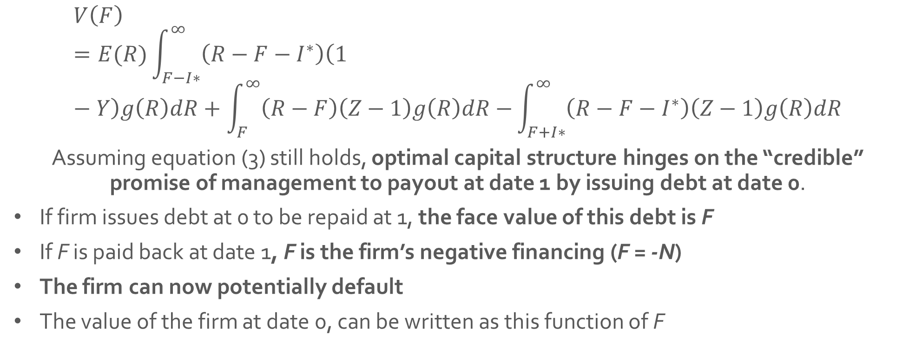
Optimal Capital Structure
WSU
“Since management prefers to have no outstanding debt that matures at date 1, it issues the optimal amount of debt only if forced to do so.”
$$V\left(F\right)=E(R)\int_{F−I∗}^{∞}{\left(R−F−I^{∗}\right)\left(1−Y\right)g\left(R\right)dR+\int_{F}^{∞}{\left(R−F\right)\left(Z−1\right)g\left(R\right)dR−}\int_{F+I∗}^{∞}{\left(R−F−I^{∗}\right)\left(Z−1\right)g\left(R\right)dR}}$$
Assuming equation (3) still holds, optimal capital structure hinges on the “credible” promise of management to payout at date 1 by issuing debt at date 0.
If firm issues debt at 0 to be repaid at 1, the face value of this debt is F
If F is paid back at date 1, F is the firm’s negative financing (F = -N)
The firm can now potentially default
The value of the firm at date 0, can be written as this function of F

Slide 13
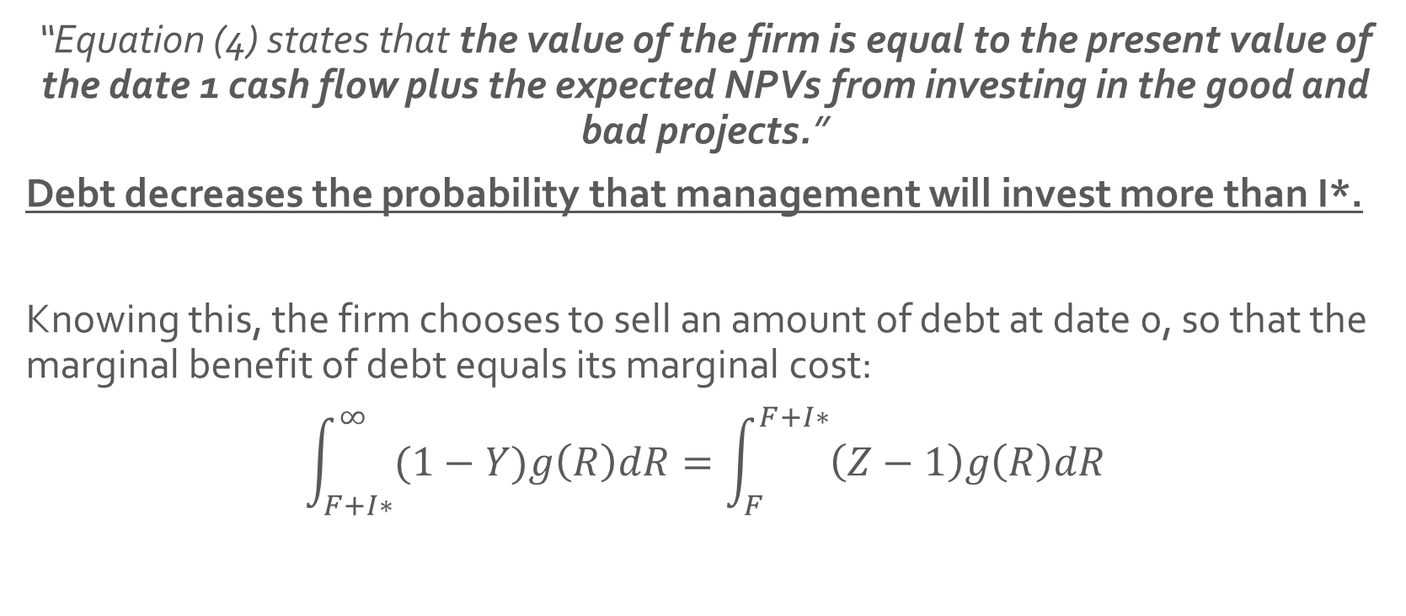
Marginal Benefit
WSU
“Equation (4) states that the value of the firm is equal to the present value of the date 1 cash flow plus the expected NPVs from investing in the good and bad projects.”
Debt decreases the probability that management will invest more than I*.
Knowing this, the firm chooses to sell an amount of debt at date 0, so that the marginal benefit of debt equals its marginal cost:
$$\int_{F+I∗}^{∞}{(1−Y)g\left(R\right)dR}=\int_{F}^{F+I∗}{\left(Z−1\right)g\left(R\right)dR}$$

Slide 14
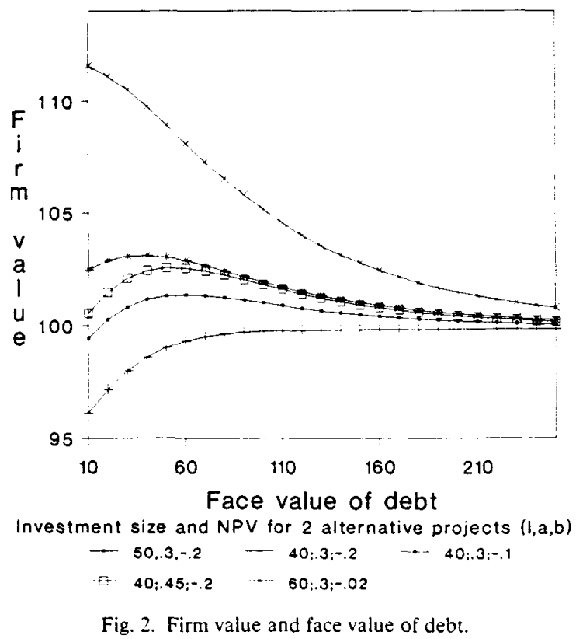
Result 2
WSU
If managers are not allowed to issue equity for investment at date 1, there is at most one finite face value of debt F* to be paid at date 1 that maximizes the date 0 value of the firm and is chosen by managers. The proceeds of the date 0 debt issue with F* are paid out to shareholders as a dividend or used to finance the assets in place.
This figure plots the value of the firm as a function of the face value of the debt maturing at date 1.

Slide 15
Cash-flow Volatility
WSU
While the previous two results demonstrate that an optimal financing policy can reduce the costs of managerial discretion, this policy may dictate either increasing or decreasing resources under managerial control.
Thus far, cash flow volatility has been taken as a given
Since cash flow can be affected by firm policies, how do changes in cash flow volatility affect the effectiveness of financing policies?
From the model, we know that V* is the value of the firm’s positive NPV investment opportunity plus the present value of the firm’s cash flow (value of the firm if managers maximize shareholder wealth)

Slide 16
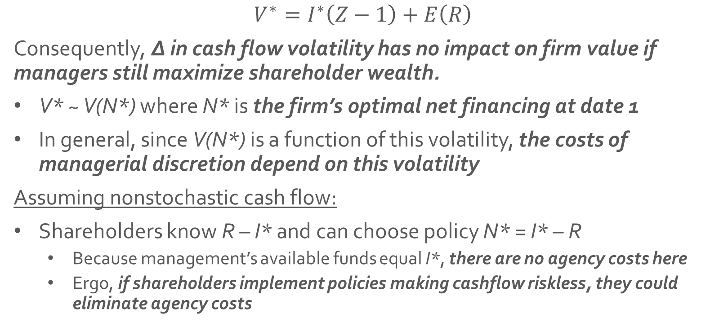
Cash-flow Volatility
WSU
$$V^{∗}=I^{∗}\left(Z−1\right)+E\left(R\right)$$
Consequently, ∆ in cash flow volatility has no impact on firm value if managers still maximize shareholder wealth.
V* ~ V(N*) where N* is the firm’s optimal net financing at date 1
In general, since V(N*) is a function of this volatility, the costs of managerial discretion depend on this volatility
Assuming nonstochastic cash flow:
Shareholders know R – I* and can choose policy N* = I* – R
Because management’s available funds equal I*, there are no agency costs here
Ergo, if shareholders implement policies making cashflow riskless, they could eliminate agency costs

Slide 17
Result 3
WSU
For any distribution of cash flow G(R):
If the firm issues equity, the costs of managerial discretion fall if G(R) is replaced by a distribution that dominates G(R) in the sense of second-order stochastic dominance.
If the firm issues debt, the costs of managerial discretion fall if G(R) is replaced by a distribution that dominates G(R) in the sense of second-order stochastic dominance, provided that the present value of the investment in the positive NPV project either increases or does not fall too much with the decrease in the dispersion of cash flow.

Slide 18
Under Observation
WSU
Previously, it was assumed that investors know neither the firm’s cash flow nor its investment – but the main results hold in a simple case where shareholders observe both cash flow and investment (but do not know the firm’s investment opportunity set).
Here, H(I*) is the cumulative distribution function for I* and h(I*) is the associated density function where h(I*) > 0 for strictly positive but finite values of I*
In this setting, management always wants to invest too much
If I* is small, management invests in excess of I*
If R is large in relation to the mean of I*, shareholders want management to pay out funds at date 1

Slide 19
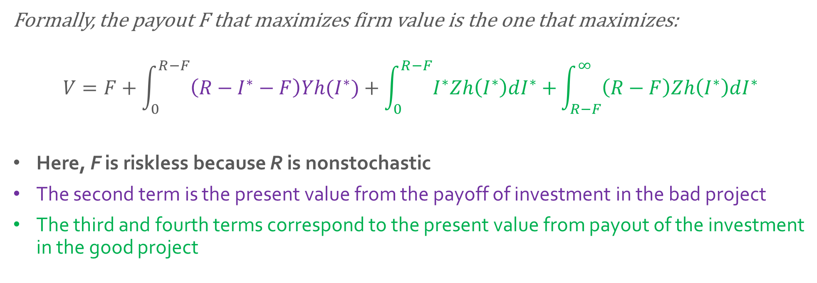
Under Observation
WSU
Formally, the payout F that maximizes firm value is the one that maximizes:
$$V=F+\int_{0}^{R−F}{\left(R−I^{∗}−F\right)Yh(I^{∗})+\int_{0}^{R−F}{I^{∗}Zh\left(I^{∗}\right)dI^{∗}+}\int_{R−F}^{∞}{\left(R−F\right)Zh\left(I^{∗}\right)dI^{∗}}}$$
Here, F is riskless because R is nonstochastic
The second term is the present value from the payoff of investment in the bad project
The third and fourth terms correspond to the present value from payout of the investment in the good project

Slide 20
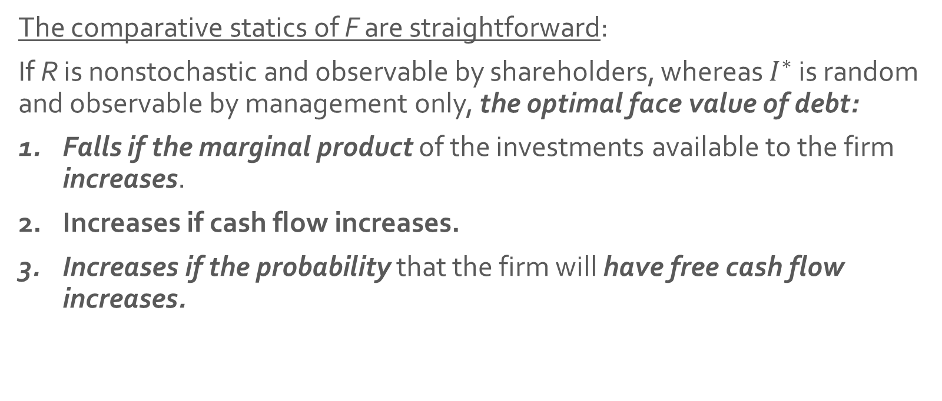
Result 4
WSU
The comparative statics of F are straightforward:
If R is nonstochastic and observable by shareholders, whereas $I^{∗}$ is random and observable by management only, the optimal face value of debt:
Falls if the marginal product of the investments available to the firm increases.
Increases if cash flow increases.
Increases if the probability that the firm will have free cash flow increases.

Slide 21



Conclusions
WSU
Financing policy matters because it reduces the agency costs of managerial discretion.
These costs exist when management values investment more than shareholders do and has information that shareholders do not have.
2 Costs
An overinvestment cost (too much invested)
An underinvestment cost (lack of credibility)
Much of the finance literature focuses on the present value of cash flows, this paper shows that the distribution of cash flows matters period by period, because shareholders want to optimize resources under managerial control each period to maximize their wealth → this approach could be used to develop a theory of the optimal maturity of a firm’s debt.

