Slide 1


Too Much Investment: A Problem of Asymmetric Information
David De Meza
David C. Webb
The Quarterly Journal of Economics, 1987

Slide 2



Today’s Agenda
WSU
Following Stiglitz and Weiss
Investment in Excess
The Basic Model
Comparison with Stiglitz and Weiss
Equilibrium Methods in Finance
Conclusions

Slide 3
Following Stiglitz-Weiss
WSU
“Stiglitz and Weiss (1981) examine credit market equilibrium when entrepreneurs with projects requiring the same investment K, but with different risks, seek outside financing.”
The risk-versus-safe project framework in the Stiglitz and Weiss model underpinned a tremendous amount of work in economics (even beyond De Meza and Webb)
Their model presents a type of moral hazard in which borrowers have an incentive to invest in risky projects over safer ones
This incentive is at odds with the interests of lenders, who would prefer borrowers to invest in safer projects to increase the probability of loan repayment
The difference here, is that while in Stiglitz and Weiss all projects have the same expected return, but the dispersion of returns is different, De Meza and Webb’s expected returns differ between projects.

Slide 4
Investment in Excess
WSU
“Using a simple competitive model, we show that, under certain reasonable assumptions about the distribution of project returns, the inability of banks to discover the characteristics of entrepreneurs’ projects leads to more investment than is socially efficient.”
This is in direct contrast to Stiglitz and Weiss (1981), Jaffee and Russell (1976), and Ordover and Weiss (1981) on credit rationing that results from asymmetric information
Ultimately, De Meza and Webb show that, paradoxically, the underinvestment problem in the Sitglitz-Weiss model is more sever when their credit market clears (to show their results are not due to the market clearing)
The authors show that the assumptions which yield the overinvestment result support debt as the equilibrium method of finance.
This is in contrast to the Stiglitz-Weiss assumptions, where equity rather than debt is shown to be the equilibrium method of finance.

Slide 5
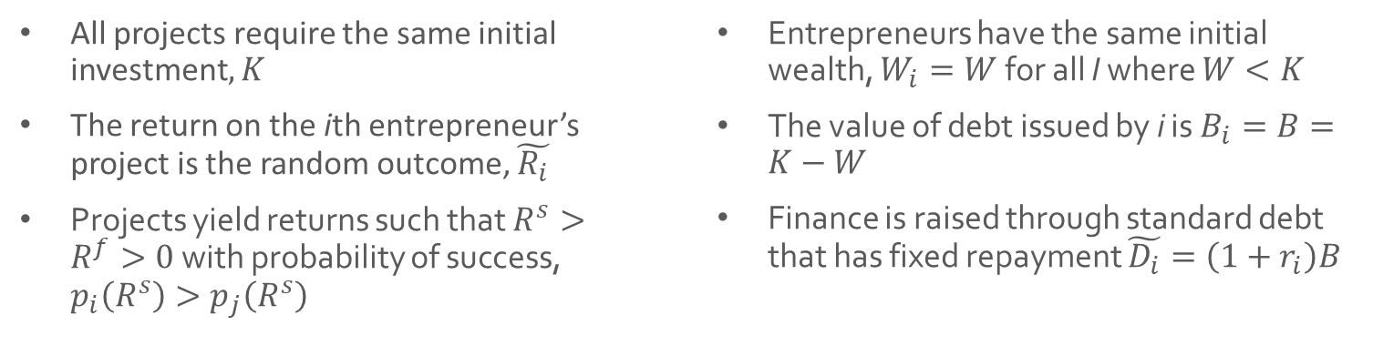
The Basic Model
WSU
All projects require the same initial investment$, K$
The return on the ith entrepreneur’s project is the random outcome, $\tilde{R_{i}}$
Projects yield returns such that $R^{s}>R^{f}>0$ with probability of success, $p_{i}\left(R^{s}\right)>p_{j}\left(R^{s}\right)$
Entrepreneurs have the same initial wealth, $W_{i}=W$ for all I where $W<K$
The value of debt issued by i is $B_{i}=B=K−W$
Finance is raised through standard debt that has fixed repayment $\tilde{D_{i}}=\left(1+r_{i}\right)B$
*If the entrepreneur is risk-neutral, he wishes to maximize expected profit given by (2) and he will accept the project if (3) holds

Slide 6
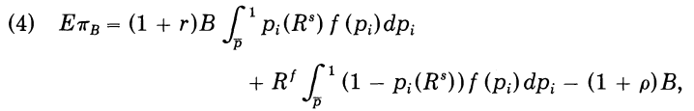
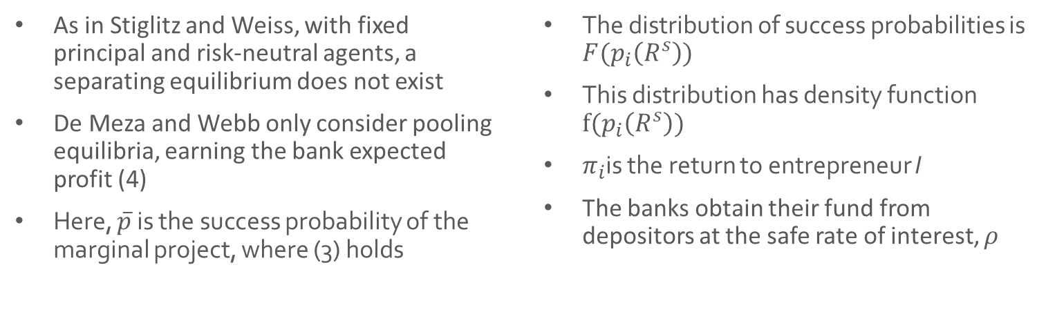
Banks & Market Clearing
WSU
As in Stiglitz and Weiss, with fixed principal and risk-neutral agents, a separating equilibrium does not exist
De Meza and Webb only consider pooling equilibria, earning the bank expected profit (4)
Here, $\overline{p}$ is the success probability of the marginal project, where (3) holds
The distribution of success probabilities is $F(p_{i}\left(R^{s}\right))$
This distribution has density function $f(p_{i}\left(R^{s}\right))$
$π_{i}$is the return to entrepreneur I
The banks obtain their fund from depositors at the safe rate of interest, $ρ$

Slide 7
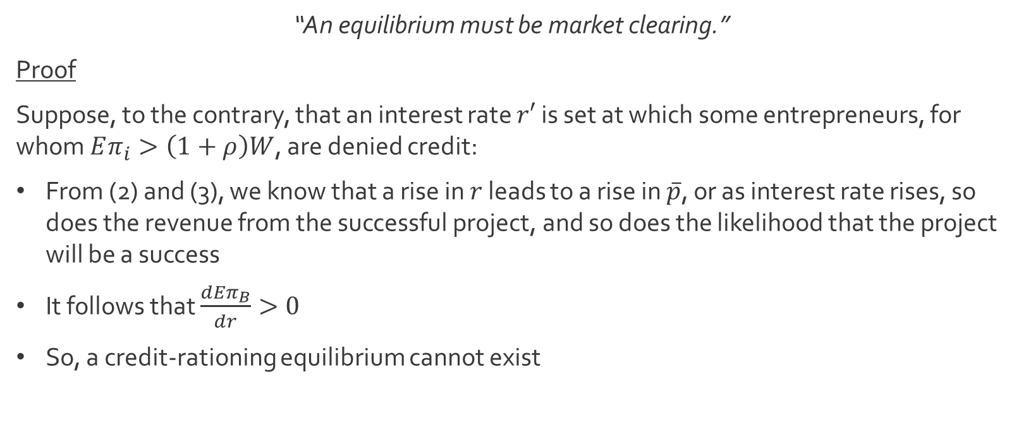
Proposition 1
WSU
“An equilibrium must be market clearing.”
Proof
Suppose, to the contrary, that an interest rate $r′$ is set at which some entrepreneurs, for whom $Eπ_{i}>\left(1+ρ\right)W$, are denied credit:
From (2) and (3), we know that a rise in $r$ leads to a rise in $\overline{p}$, or as interest rate rises, so does the revenue from the successful project, and so does the likelihood that the project will be a success
It follows that $\frac{dEπ_{B}}{dr}>0$
So, a credit-rationing equilibrium cannot exist

Slide 8
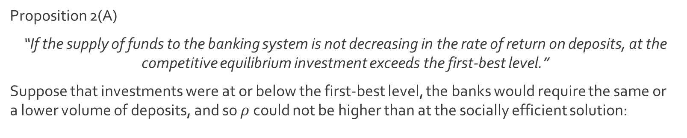
Proposition 2
WSU
Proposition 2(A)
“If the supply of funds to the banking system is not decreasing in the rate of return on deposits, at the competitive equilibrium investment exceeds the first-best level.”
Suppose that investments were at or below the first-best level, the banks would require the same or a lower volume of deposits, and so $ρ$ could not be higher than at the socially efficient solution:
Consequently, for the worst project in the proposed competitive equilibrium,
This marginal project earns the entrepreneur a zero expected profit and thus,
According to (8), a bank would expect to make profits on the marginal project.

Slide 9
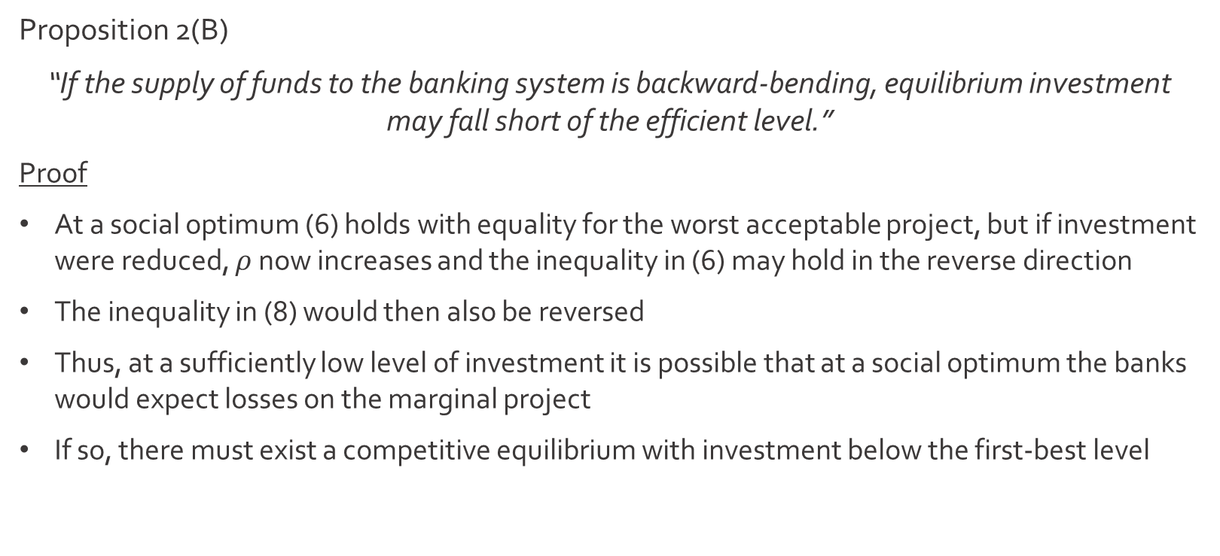
Proposition 2
WSU
Proposition 2(B)
“If the supply of funds to the banking system is backward-bending, equilibrium investment may fall short of the efficient level.”
Proof
At a social optimum (6) holds with equality for the worst acceptable project, but if investment were reduced, $ρ$ now increases and the inequality in (6) may hold in the reverse direction
The inequality in (8) would then also be reversed
Thus, at a sufficiently low level of investment it is possible that at a social optimum the banks would expect losses on the marginal project
If so, there must exist a competitive equilibrium with investment below the first-best level

Slide 10
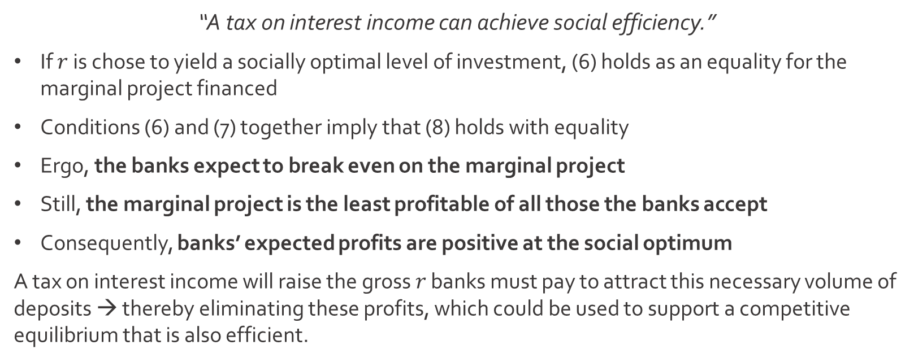
Proposition 3
WSU
“A tax on interest income can achieve social efficiency.”
If $r$ is chose to yield a socially optimal level of investment, (6) holds as an equality for the marginal project financed
Conditions (6) and (7) together imply that (8) holds with equality
Ergo, the banks expect to break even on the marginal project
Still, the marginal project is the least profitable of all those the banks accept
Consequently, banks’ expected profits are positive at the social optimum
A tax on interest income will raise the gross $r$ banks must pay to attract this necessary volume of deposits → thereby eliminating these profits, which could be used to support a competitive equilibrium that is also efficient.

Slide 11
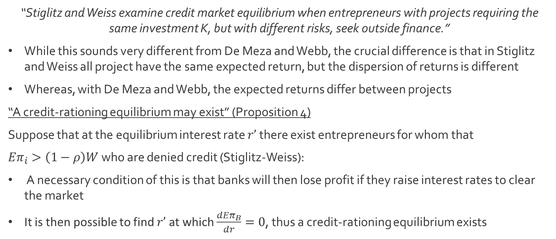
Comparison w/Stiglitz-Weiss
WSU
“Stiglitz and Weiss examine credit market equilibrium when entrepreneurs with projects requiring the same investment K, but with different risks, seek outside finance.”
While this sounds very different from De Meza and Webb, the crucial difference is that in Stiglitz and Weiss all project have the same expected return, but the dispersion of returns is different
Whereas, with De Meza and Webb, the expected returns differ between projects
“A credit-rationing equilibrium may exist” (Proposition 4)
Suppose that at the equilibrium interest rate $r’$ there exist entrepreneurs for whom that
${Eπ}_{i}>\left(1−ρ\right)W$ who are denied credit (Stiglitz-Weiss):
A necessary condition of this is that banks will then lose profit if they raise interest rates to clear the market
It is then possible to find $r’$ at which $\frac{{dEπ}_{B}}{dr}=0$, thus a credit-rationing equilibrium exists

Slide 12
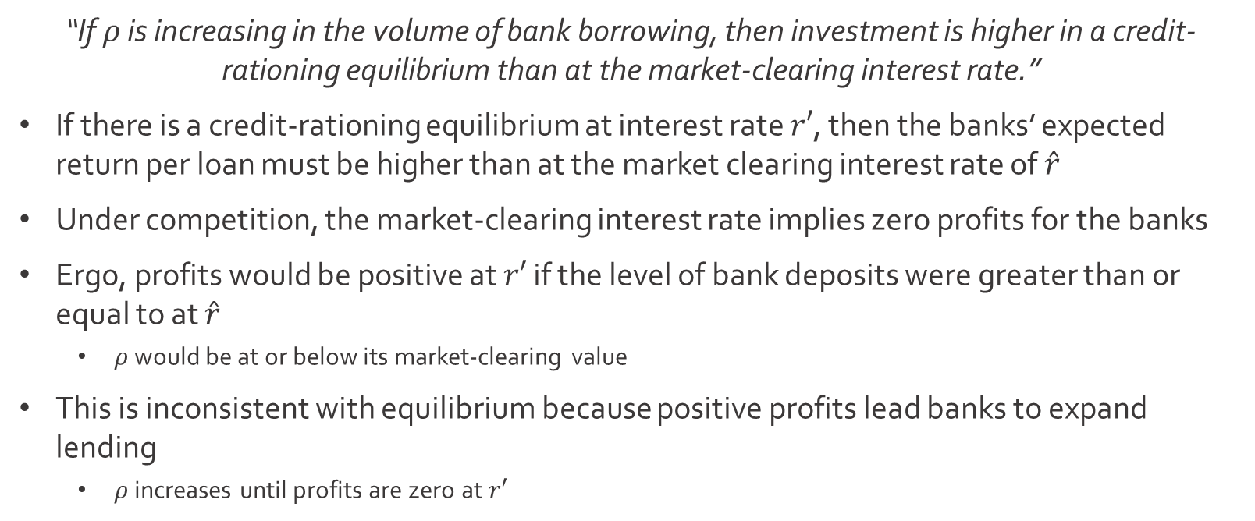
Proposition 7
WSU
“If $ρ$ is increasing in the volume of bank borrowing, then investment is higher in a credit-rationing equilibrium than at the market-clearing interest rate.”
If there is a credit-rationing equilibrium at interest rate $r′$, then the banks’ expected return per loan must be higher than at the market clearing interest rate of $\hat{r}$
Under competition, the market-clearing interest rate implies zero profits for the banks
Ergo, profits would be positive at $r′$ if the level of bank deposits were greater than or equal to at $\hat{r}$
$ρ$ would be at or below its market-clearing value
This is inconsistent with equilibrium because positive profits lead banks to expand lending
$ρ$ increases until profits are zero at $r′$

Slide 13
Corollary 1
WSU
Propositions (5) and (7) imply:
“Prohibiting credit rationing yields an efficiency loss.”
For both the Stiglitz-Weiss model and De Meza-Webb model, equilibrium involves entrepreneurs with high-success probabilities subsidizing low-success probability investments. (With one critical difference)
With De Meza-Webb, the marginal project financed has the lowest success probability of those financed, but in Stiglitz-Weiss model, it has the highest
This explains the asymmetry in the relationship of the respective equilibrium levels of investment to the respective first-best levels

Slide 14
The Form of Contracts
WSU
“So far it has been assumed that entrepreneurs put up as much finance themselves as they can and raised outside finance by selling debt.”
This assumption is easily justified:
In both models, asymmetric information means that in equilibrium cross-subsidization takes place
In De Meza-Webb, better projects subsidize poorer projects
In Stiglitz-Weiss, low-risk projects subsidize high-risk projects
In both models, entrepreneurs with higher-than-average success probabilities can supply finance to themselves on better terms than they can obtain in the market and hence will put up W
Banks realize this → require maximum self-financing
Failure of entrepreneurs to put up W would signal that their projects are worse than average and hence disqualify them from the contract

Slide 15
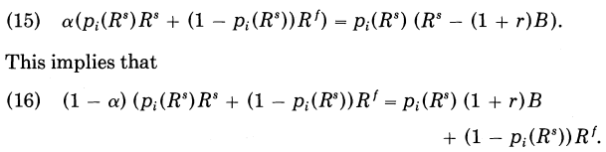

Proposition 8
WSU
“For the model of Section I, equilibrium requires that all firms are debt financed.”
Proof
Let $α$ be the proportion of equity retained by entrepreneurs who finance with equity and$(B,r)$the debt contract for entrepreneurs who finance with debt
In equilibrium, there must exist an entrepreneur who is indifferent between debt and equity, $\hat{p}$, it follows then that for $p_{i}=\hat{p}:$
“It can be shown that if all firms choose debt finance, there can be no gain to a bank from offering to buy equity…All projects being debt financed is thus consistent with equilibrium.”

Slide 16


Conclusions
WSU
“In the presence of asymmetric information, the financial structures of firms and the efficiency properties of the level of investment depend upon the distribution of project returns.”
If all projects offer the same expected returns but differ in risk(s), then equity is the favored means of finance.
If the expected returns on projects differ, then debt is the equilibrium financial contract, and a socially excessive level of investment results.
This overinvestment possibility is novel – in contrast to the usual view that if the credit market fails, the investment falls short of the socially efficient level.

