Slide 1


Capital Structure and the Informational Role of Debt
Milton Harris & Artur Raviv
Journal of Finance | 1990

Slide 2
Motivations
WSU
“We contend that, in general, managers do not always behave in the best interests of their investors and therefore need to be disciplined.”
How do investors solve this issue?
Debt serves as a disciplining device
Default allows the creditors the option to force the firm into liquidation
Debt generates information that investors use to evaluate major operating decisions (including liquidation)
The informal consequences of debt:
The mere ability of the firm to make contractual payments provides information
In default, management must placate creditors (informal negotiations or formal bankruptcy filings)
(This process, although costly, disseminates considerable information to investors.)
This paper studies “the role of debt” less capital structure theory

Slide 3



Two Models
WSU
Determinants of liquidation vs. reorganization.
Static
Dynamic
Considers a “once-and-for-all” choice of debt level.
The debt level, market value of debt, firm value, debt-to-value ratio, and promised bond yield all increase with increases in liquidation value and decrease with increases in default costs
Probability of default increases with liquidation value, decreases with default costs
Probability of reorganization given default decreases with liquidation value and is independent of default costs
Examines the evolution of capital structure and net payments to debtholders over time.
Debt levels relative to expected income and default probabilities are constant over time, except when “endgame” considerations are important
Expected debt coverage ratios increase and default probabilities decrease following reorganization

Slide 4


Results for the Static Model
WSU
Static Model
The debt level, market value of debt, firm value, debt-to-value ratio, and promised bond yield all increase with increases in liquidation value (decrease with increases in default costs)
The probability of default increases with liquidation value (decreases with default cost), but is independent of firm size
The expected debt coverage ratio decreases with liquidation value (increases with default costs)
Probability of reorganization given default decreases with liquidation value and is independent of default costs
Leverage-increasing changes in capital structure that are caused by increases in liquidation value, are accompanied by increases in firm value
More highly levered firms will also offer larger promised yields, and have lower probability of reorganization after default

Slide 5
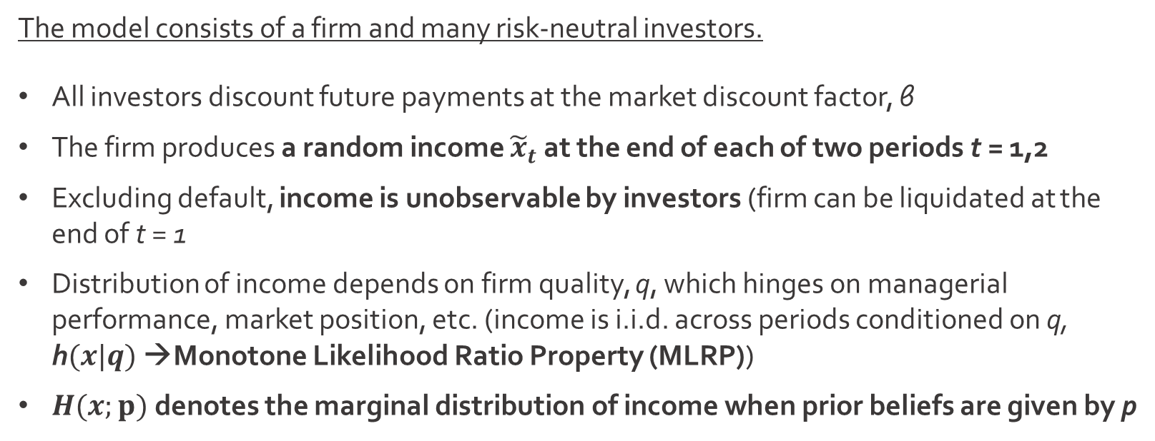
Assumptions
WSU
Static Model
Investor
Investor
Investor
The Firm
The model consists of a firm and many risk-neutral investors.
All investors discount future payments at the market discount factor, β
The firm produces a random income ${\tilde{x}}_{t}$ at the end of each of two periods t = 1,2
Excluding default, income is unobservable by investors (firm can be liquidated at the end of t = 1
Distribution of income depends on firm quality, q, which hinges on managerial performance, market position, etc. (income is i.i.d. across periods conditioned on q, h$(x|q)$ →Monotone Likelihood Ratio Property (MLRP))
$H(x;p)$ denotes the marginal distribution of income when prior beliefs are given by p

Slide 6
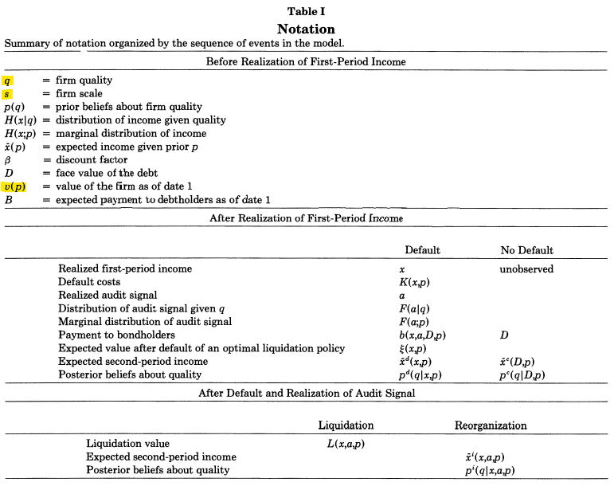
Notation
WSU
Static Model

Slide 7
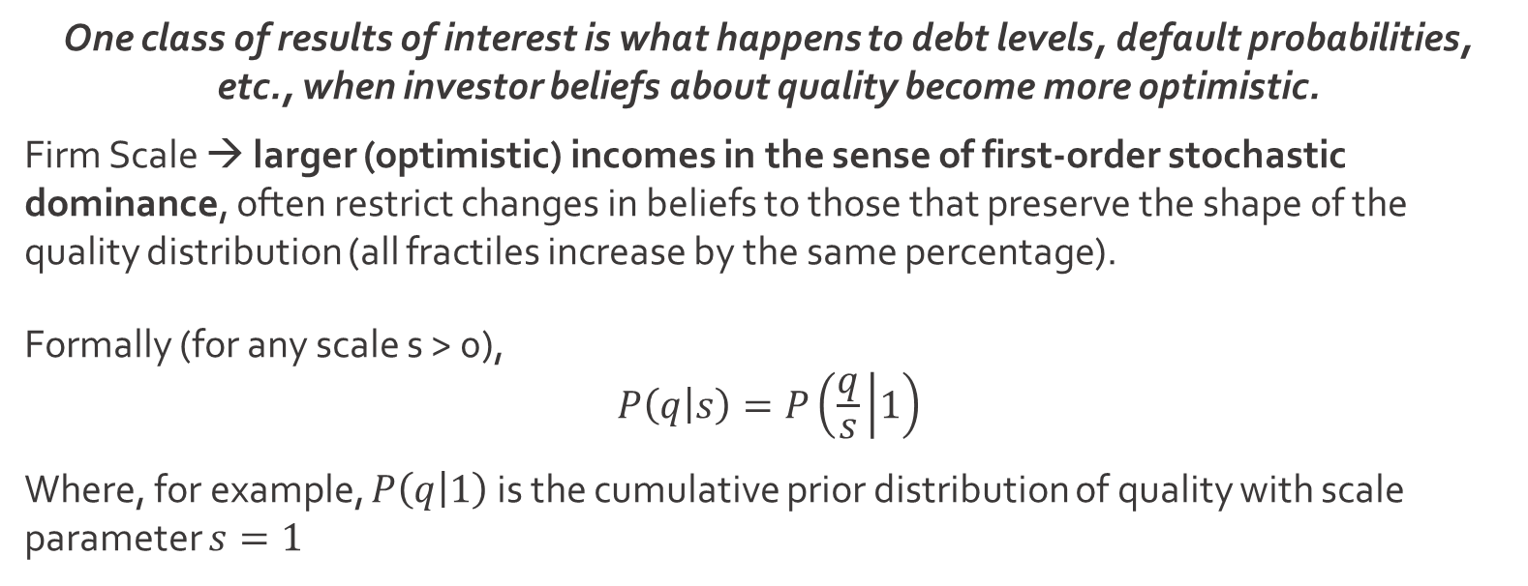
Quality (s)
WSU
Static Model
One class of results of interest is what happens to debt levels, default probabilities, etc., when investor beliefs about quality become more optimistic.
Firm Scale → larger (optimistic) incomes in the sense of first-order stochastic dominance, often restrict changes in beliefs to those that preserve the shape of the quality distribution (all fractiles increase by the same percentage).
Formally (for any scale s > 0),
$$P\left(q | s\right)=P\left(\frac{q}{s} | 1\right)$$
Where, for example, $P\left(q | 1\right)$ is the cumulative prior distribution of quality with scale parameter $s=1$

Slide 8
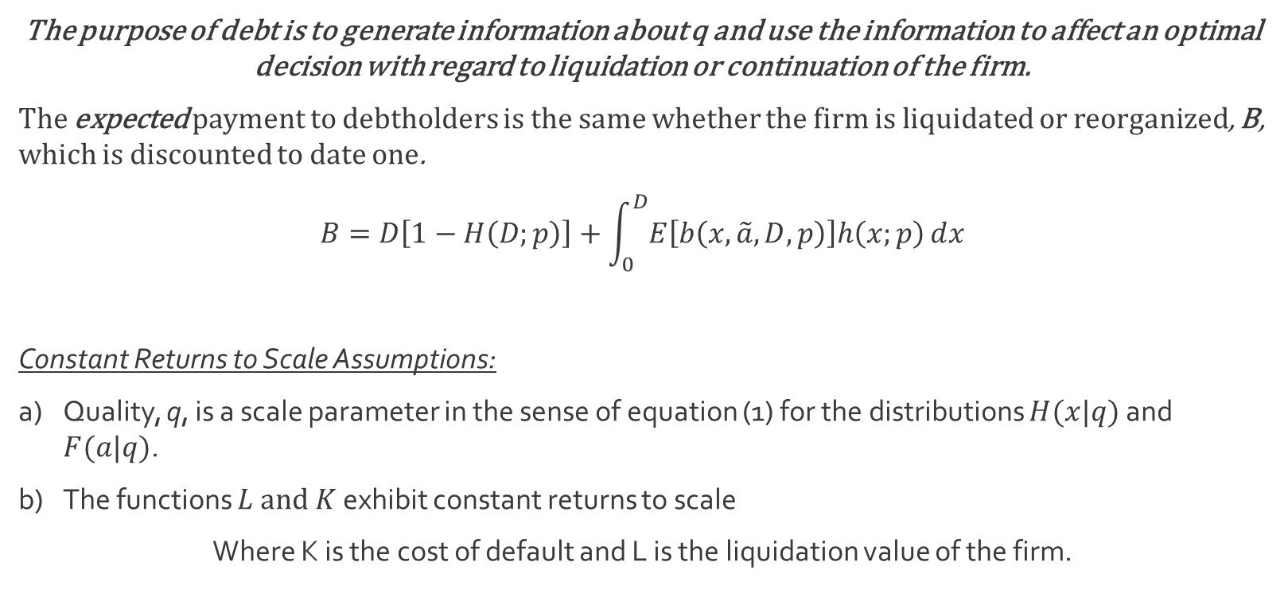
Promised Payment
WSU
Static Model
The purpose of debt is to generate information about q and use the information to affect an optimal decision with regard to liquidation or continuation of the firm.
The expected payment to debtholders is the same whether the firm is liquidated or reorganized, B, which is discounted to date one.
$$B=D\left[1−H\left(D;p\right)\right]+\int_{0}^{D}{E\left[b\left(x,\tilde{a},D,p\right)\right]h\left(x;p\right)ⅆx}$$
Constant Returns to Scale Assumptions:
Quality, q, is a scale parameter in the sense of equation (1) for the distributions $H(x|q)$ and $F(a|q)$.
The functions $L and K$ exhibit constant returns to scale
Where K is the cost of default and L is the liquidation value of the firm.

Slide 9
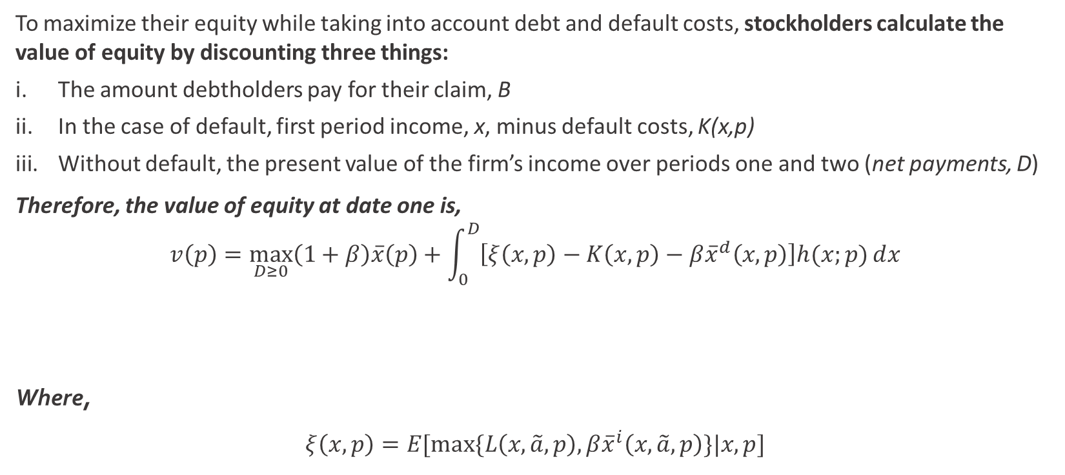

Stockholders’ Maximization
WSU
Static Model
To maximize their equity while taking into account debt and default costs, stockholders calculate the value of equity by discounting three things:
The amount debtholders pay for their claim, B
In the case of default, first period income, x, minus default costs, K(x,p)
Without default, the present value of the firm’s income over periods one and two (net payments, D)
Therefore, the value of equity at date one is,
$$v\left(p\right)=\max_{D≥0}\left(1+β\right)\overline{x}\left(p\right)+\int_{0}^{D}{\left[ξ\left(x,p\right)−K\left(x,p\right)−β{\overline{x}}^{d}\left(x,p\right)\right]h(x;p)ⅆx}$$
Where,
$$ξ\left(x,p\right)=E[max⁡\{L\left(x,\tilde{a},p\right),β{\overline{x}}^{i}\left(x,\tilde{a},p\right)\}|x,p]$$
PV of future income under the optimal policy
PV of unconditional continuation
The expected gain in form value due to an optimal continuation policy
The present value of expected income $\overline{x}\left(p\right)$
Default costs

Slide 10
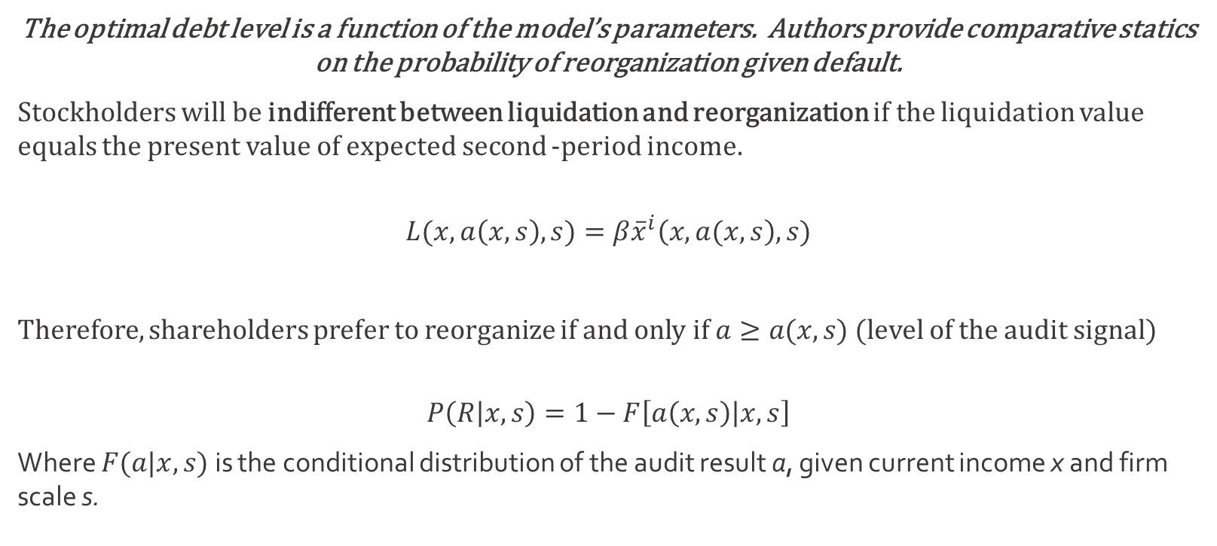
Comparative Statics
WSU
Analysis of the Static Model
The optimal debt level is a function of the model’s parameters. Authors provide comparative statics on the probability of reorganization given default.
Stockholders will be indifferent between liquidation and reorganization if the liquidation value equals the present value of expected second -period income.
$$L(x, a\left(x,s\right),s)=β{\overline{x}}^{i}\left(x,a(x,s\right),s)$$
Therefore, shareholders prefer to reorganize if and only if $a≥a(x,s)$ (level of the audit signal)
$$P\left(R | x,s\right)=1−F\left[a\left(x,s\right) | x,s\right]$$
Where $F(a|x,s)$ is the conditional distribution of the audit result a, given current income x and firm scale s.

Slide 11
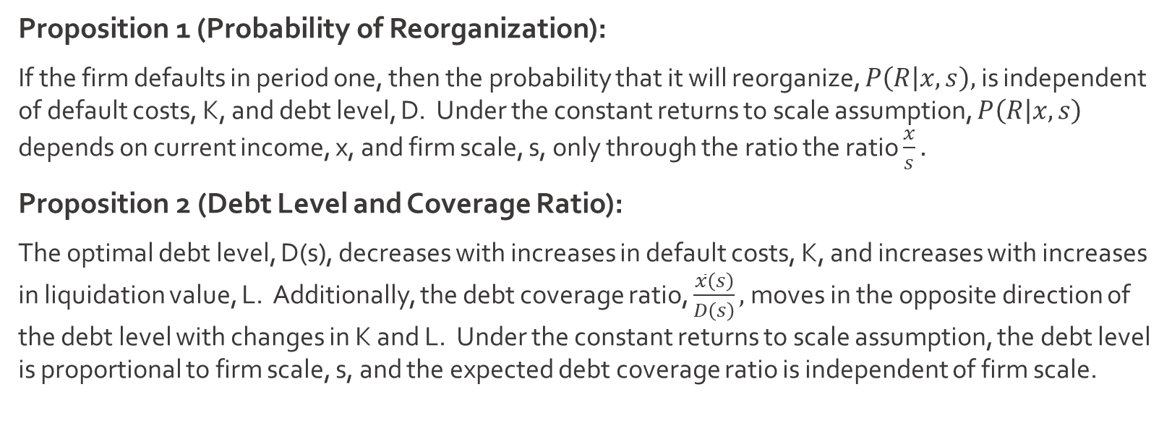
Comparative Statics
WSU
Analysis of the Static Model
Proposition 1 (Probability of Reorganization):
If the firm defaults in period one, then the probability that it will reorganize, $P\left(R | x,s\right),$ is independent of default costs, K, and debt level, D. Under the constant returns to scale assumption, $P\left(R | x,s\right)$ depends on current income, x, and firm scale, s, only through the ratio the ratio $\frac{x}{s}.$
Proposition 2 (Debt Level and Coverage Ratio):
The optimal debt level, D(s), decreases with increases in default costs, K, and increases with increases in liquidation value, L. Additionally, the debt coverage ratio, $\frac{\overline{x}\left(s\right)}{D\left(s\right)},$moves in the opposite direction of the debt level with changes in K and L. Under the constant returns to scale assumption, the debt level is proportional to firm scale, s, and the expected debt coverage ratio is independent of firm scale.

Slide 12
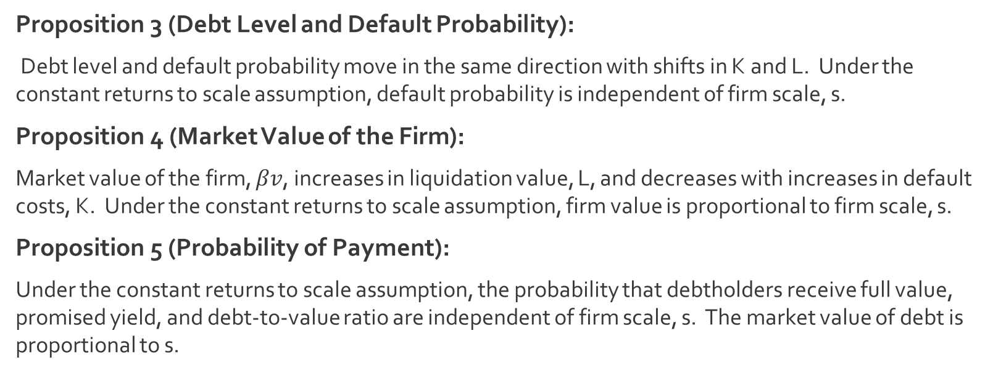
Comparative Statics
WSU
Analysis of the Static Model
Proposition 3 (Debt Level and Default Probability):
Debt level and default probability move in the same direction with shifts in K and L. Under the constant returns to scale assumption, default probability is independent of firm scale, s.
Proposition 4 (Market Value of the Firm):
Market value of the firm, $βv$, increases in liquidation value, L, and decreases with increases in default costs, K. Under the constant returns to scale assumption, firm value is proportional to firm scale, s.
Proposition 5 (Probability of Payment):
Under the constant returns to scale assumption, the probability that debtholders receive full value, promised yield, and debt-to-value ratio are independent of firm scale, s. The market value of debt is proportional to s.

Slide 13
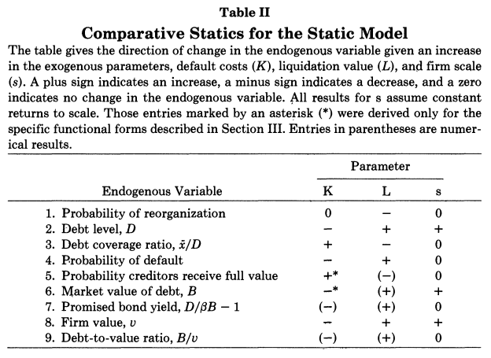
Empirical Implications
WSU
Analysis of the Static Model
How does the stock market react?
“Our results are therefore consistent with the empirical regularity that leverage-increasing changes in capital structure result in increases in stock prices, and vice versa”
Suppose the firm experiences an unanticipated change in one if its basic parameters, Table II implies that debt level and firm value will move in the same direction.
If L increases, the firm will issue debt in exchange for equity and firm value will increase

Slide 14
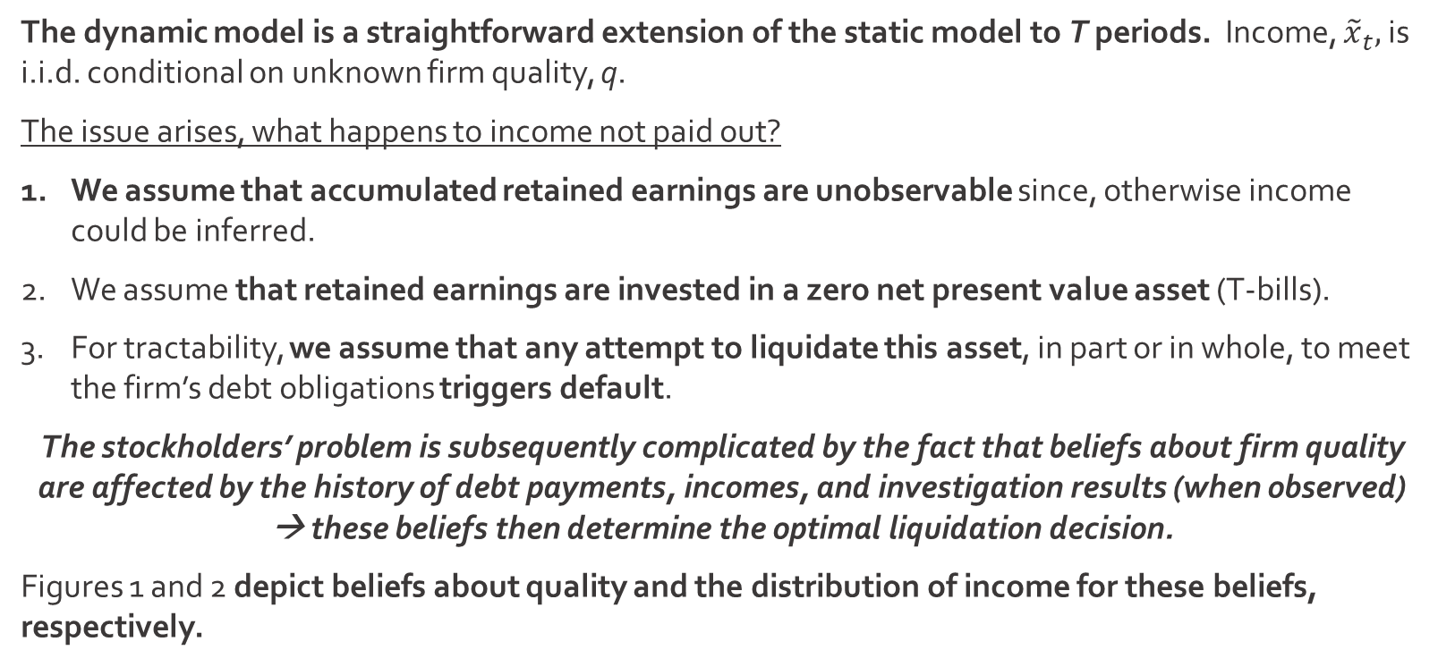
Specific Functional Forms
WSU
The Dynamic Model
The dynamic model is a straightforward extension of the static model to T periods. Income, ${\tilde{x}}_{t},$ is i.i.d. conditional on unknown firm quality, q.
The issue arises, what happens to income not paid out?
We assume that accumulated retained earnings are unobservable since, otherwise income could be inferred.
We assume that retained earnings are invested in a zero net present value asset (T-bills).
For tractability, we assume that any attempt to liquidate this asset, in part or in whole, to meet the firm’s debt obligations triggers default.
The stockholders’ problem is subsequently complicated by the fact that beliefs about firm quality are affected by the history of debt payments, incomes, and investigation results (when observed) → these beliefs then determine the optimal liquidation decision.
Figures 1 and 2 depict beliefs about quality and the distribution of income for these beliefs, respectively.

Slide 15
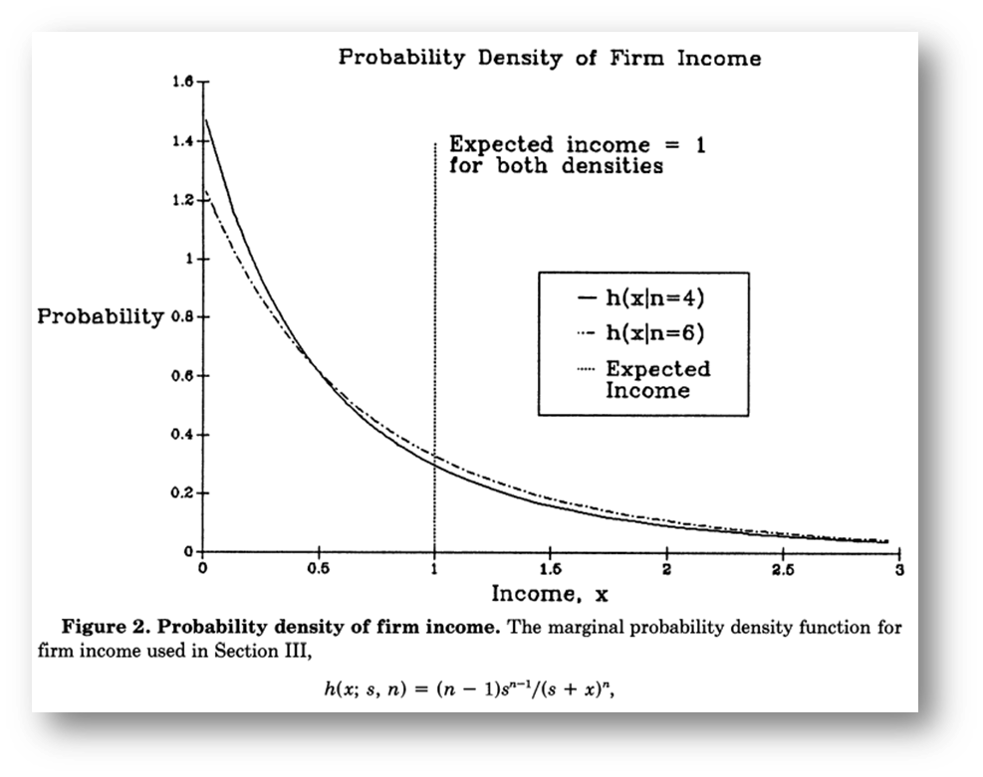
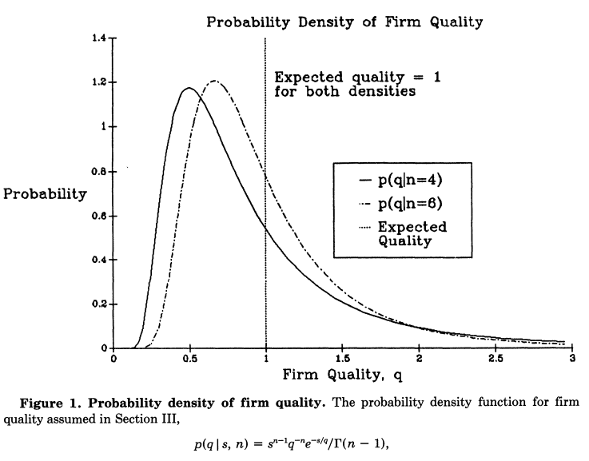
Firm Income vs Quality
WSU
The Dynamic Model

Slide 16
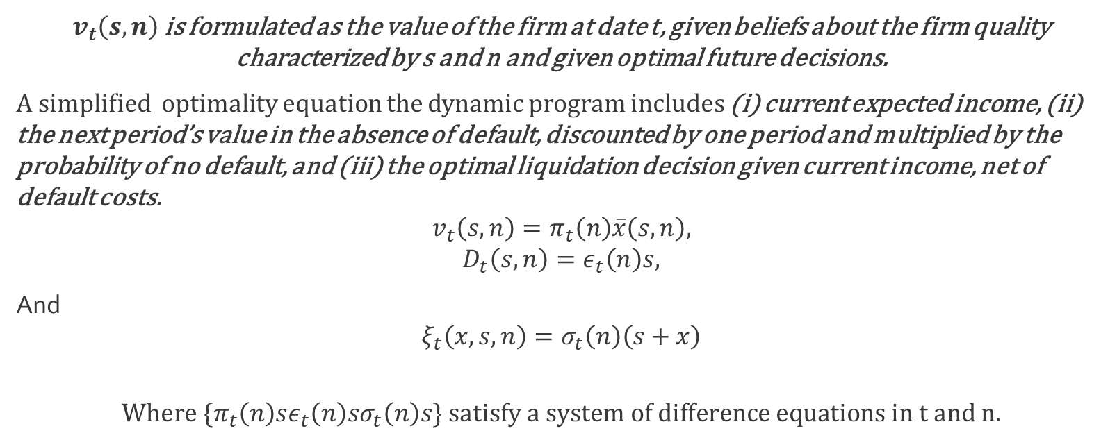
Analysis & Results
WSU
The Dynamic Model
$v_{t}\left(s,n\right)$ is formulated as the value of the firm at date t, given beliefs about the firm quality characterized by s and n and given optimal future decisions.
A simplified optimality equation the dynamic program includes (i) current expected income, (ii) the next period’s value in the absence of default, discounted by one period and multiplied by the probability of no default, and (iii) the optimal liquidation decision given current income, net of default costs.
$$v_{t}\left(s,n\right)=π_{t}\left(n\right)\overline{x}\left(s,n\right),$$
$$D_{t}\left(s,n\right)=ε_{t}\left(n\right)s,$$
And
$$ξ_{t}\left(x,s,n\right)=σ_{t}\left(n\right)\left(s+x\right)$$
$$Where{ \{π}_{t}\left(n\right)sε_{t}\left(n\right)sσ_{t}\left(n\right)s\} satisfy a system of difference equations in t and n.$$

Slide 17
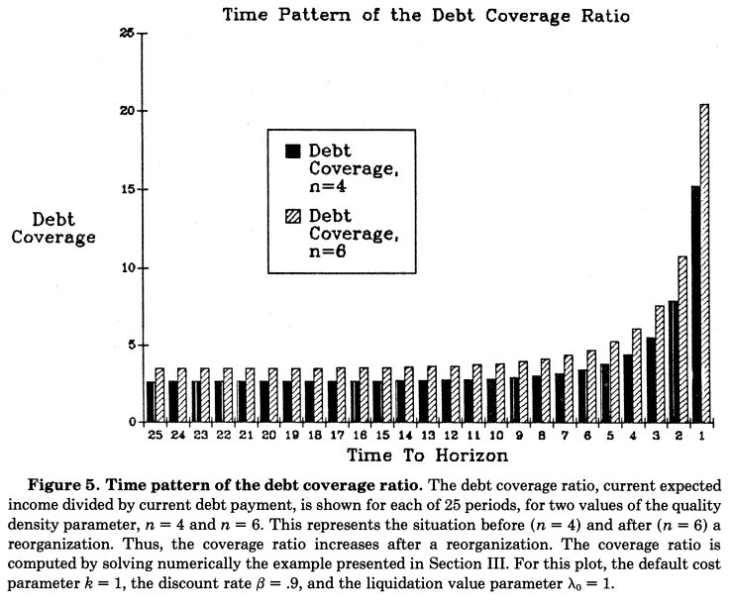
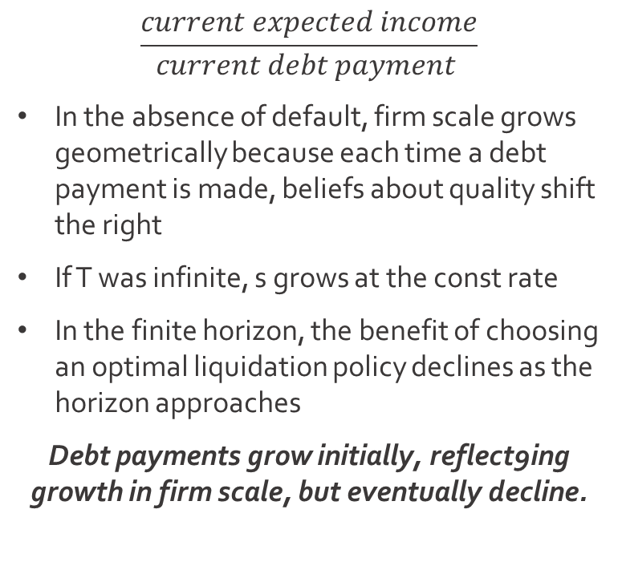
Debt Coverage Ratio
WSU
The Dynamic Model
$$\frac{current expected income}{current debt payment }$$
In the absence of default, firm scale grows geometrically because each time a debt payment is made, beliefs about quality shift the right
If T was infinite, s grows at the const rate
In the finite horizon, the benefit of choosing an optimal liquidation policy declines as the horizon approaches
Debt payments grow initially, reflect9ing growth in firm scale, but eventually decline.

Slide 18



Conclusions
WSU
Jensen (1989) recognized, at least in part, that the role of debt may be responsible for the then recent increase in corporate debt levels
The trade off between debt advantages and the costs of default leads to the optimal capital structure
This theory allows predictions regarding default probabilities and the likelihood of reorganization rather than liquidation
This model is limited in so far as it makes specific distributional assumptions and relies on numerical solutions for some comparative statics results. This steep learning process is still inherent in the informational aspect of debt and its importance.

