Slide 1
Machine Vision
Feature detection

Slide 2
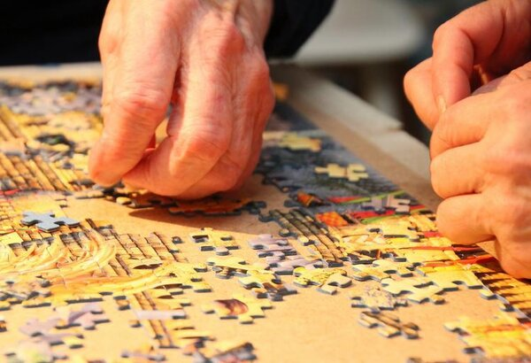
What is a Feature detection?
Feature detection in computer vision is like finding the key pieces in a puzzle.
Just like some puzzle pieces have unique shapes that connect them together, feature detection looks for distinct patterns in an image, like corners, edges, or blobs.
These features act like the corner pieces of the puzzle - they hold important information about the overall image and can be used to solve bigger problems.

Slide 3
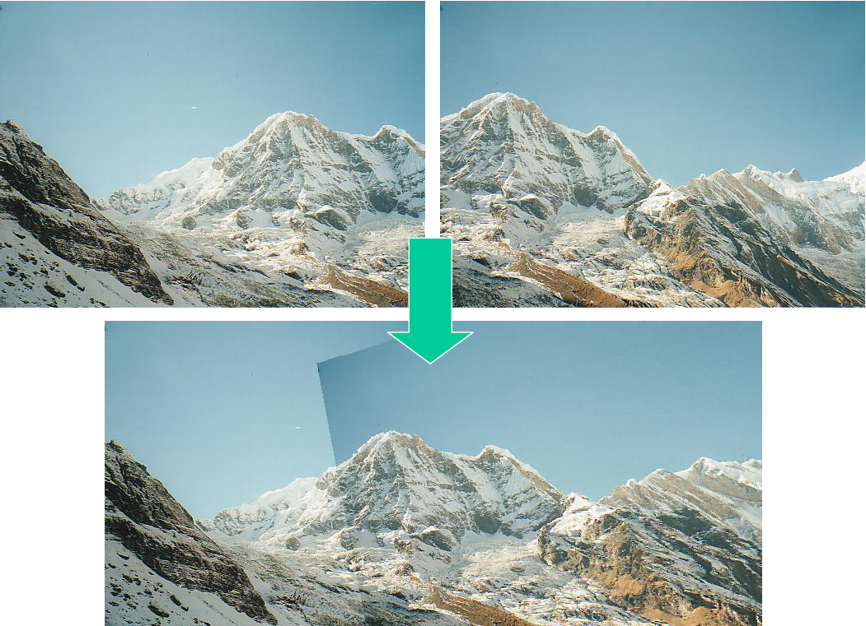
Applications of feature detection
Image registration: Feature detection helps in aligning multiple images of the same scene. By matching features between images, algorithms can stitch them together to create panoramas or compensate for camera motion.

Slide 4
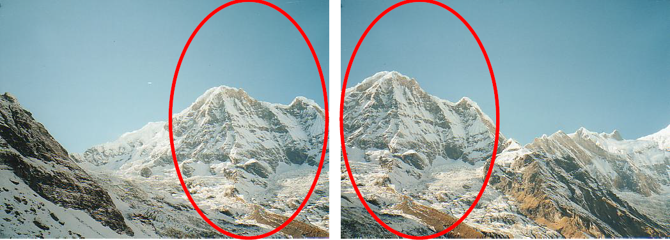
Suppose you want to create a panorama
https://courses.cs.washington.edu/courses/cse455/09wi/Lects/

Slide 5
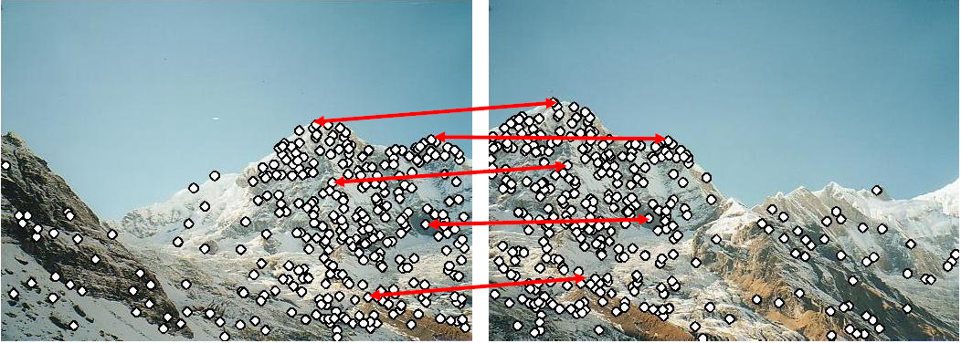
Suppose you want to create a panorama
https://courses.cs.washington.edu/courses/cse455/09wi/Lects/

Slide 6
Suppose you want to create a panorama
https://courses.cs.washington.edu/courses/cse455/09wi/Lects/

Slide 7
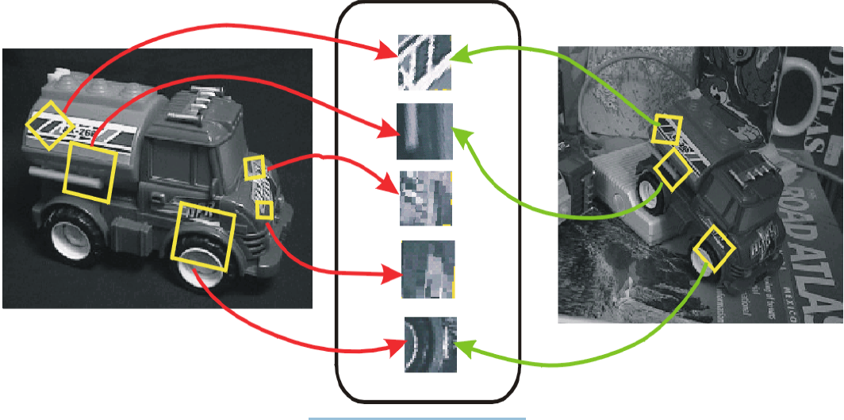
Features can also be used for object recognition
https://courses.cs.washington.edu/courses/cse455/09wi/Lects/

Slide 8
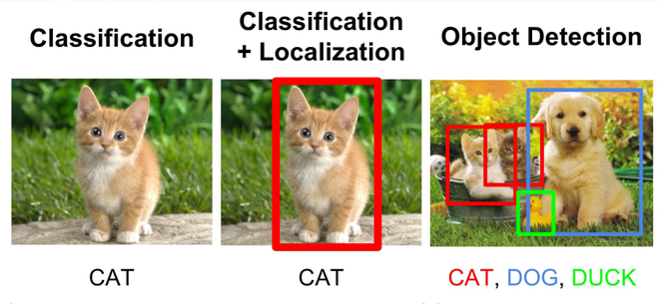
Applications of feature detection
Image recognition and object detection: Feature detection is crucial for recognizing objects in images and videos. By identifying distinctive points like corners, edges, or blobs, algorithms can establish correspondences between images and recognize the objects they contain. This is essential for applications like self-driving cars, facial recognition, and image classification.

Slide 9
Applications of feature detection
Object tracking: Feature detection allows us to track objects across multiple video frames. By following the identified features, algorithms can understand how objects move and interact with their environment. This has applications in surveillance systems, motion analysis in sports, and augmented reality.

Slide 10
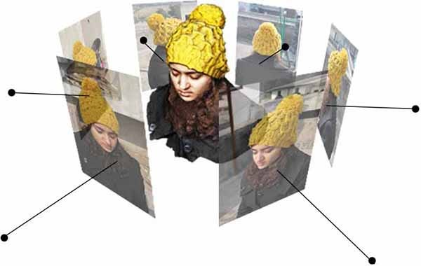
Applications of feature detection
3D reconstruction: Feature detection plays a role in reconstructing 3D models from images. By identifying corresponding features in multiple images of an object, algorithms can determine its depth and create a 3D representation.

Slide 11
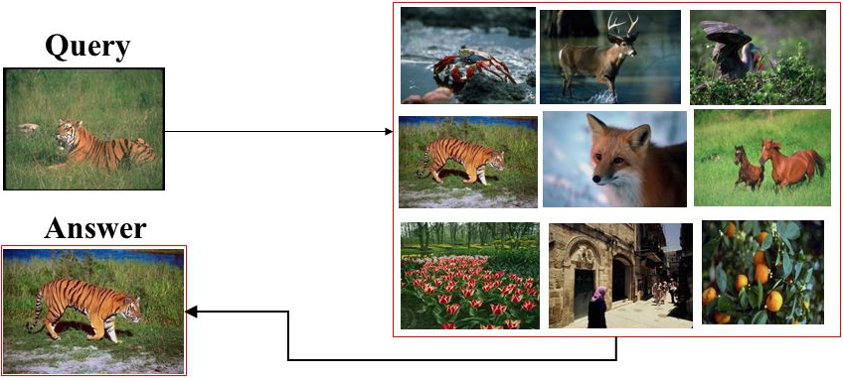
Applications of feature detection
Content-based image retrieval (CBIR): Feature detection enables searching for images based on their content. By extracting features from a query image and comparing them to features in a database, algorithms can retrieve images with similar visual elements.

Slide 12
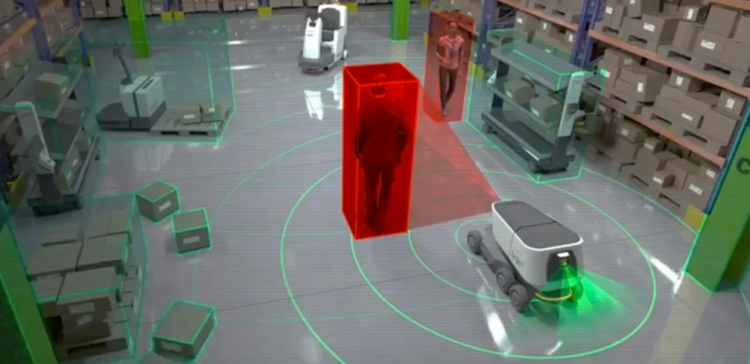
Applications of feature detection
Other applications: Feature detection also finds use in defect inspection in manufacturing, medical image analysis, and robot navigation, where identifying specific features in an image is crucial for performing the desired task.

Slide 13
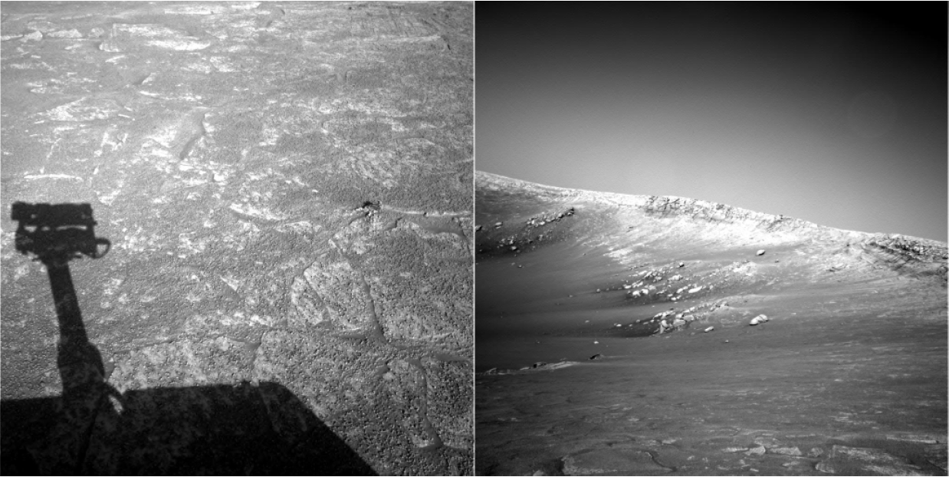
e.g. to locate NASA Mars Rover images
https://courses.cs.washington.edu/courses/cse455/09wi/Lects/

Slide 14
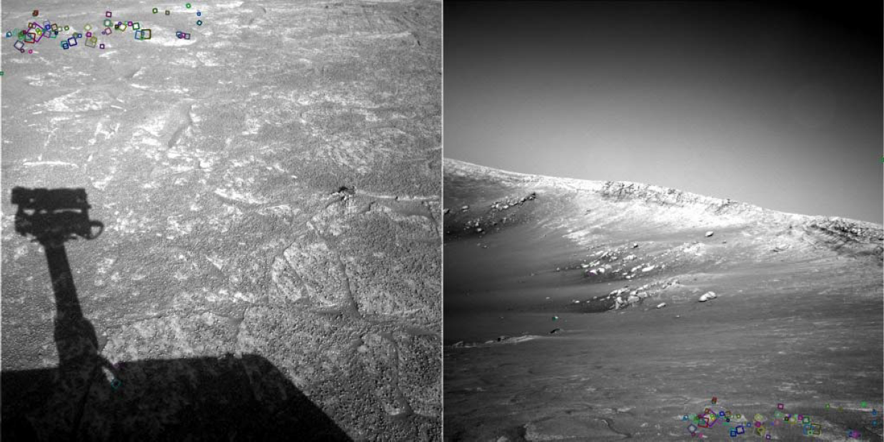
e.g. to locate NASA Mars Rover images
Look for tiny colored squares… (SIFT feature matches)
https://courses.cs.washington.edu/courses/cse455/09wi/Lects/

Slide 15
Good features for feature detection in computer vision
…are like good puzzle pieces:
Distinctive: They should stand out from the rest of the image, like a uniquely shaped puzzle piece. This makes them easy to identify and reliable for matching.
Informative: They should reveal important information about the image content. Imagine a puzzle piece with a clear chunk of sky or a specific detail on an object.
Repeatable: Ideally, they should be consistently detectable under different lighting conditions or slight changes in perspective. Just like a good puzzle piece should fit even if the picture is a little blurry.
Localized: They should pinpoint specific points in the image, allowing for precise matching and analysis. A good puzzle piece has a defined edge, not a fuzzy cloud-like shape.

Slide 16
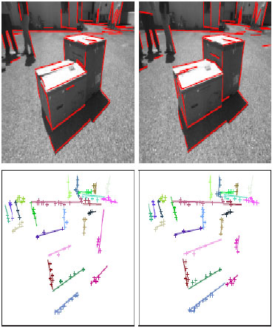
Good features for feature detection in computer vision
Some examples:
Corners: They are distinctive, informative (revealing changes in direction), and often repeatable under various conditions.
Line Ends: These line endings mark the end of an object or boundary and can be informative features.
High-contrast Edges: Good feature detection focuses on high-contrast edges where intensity changes sharply, indicating a clear separation between objects or regions.
Blobs: These well-defined regions (blobs) are good features if they represent a specific object part or unique element.

Slide 17
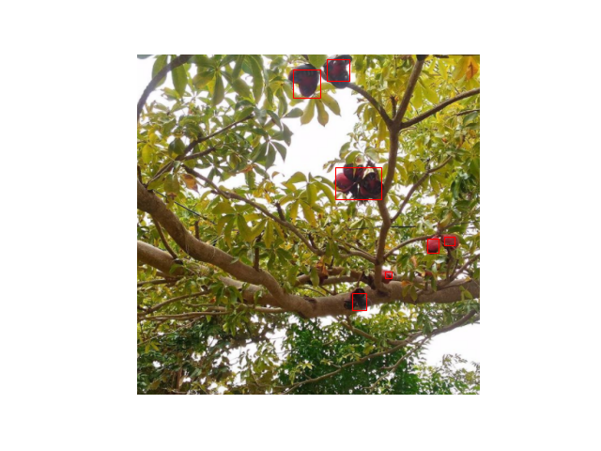
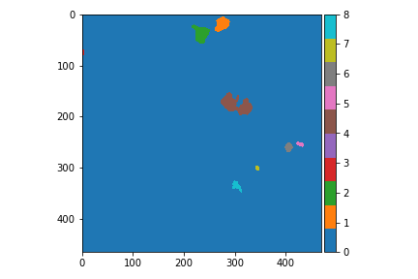
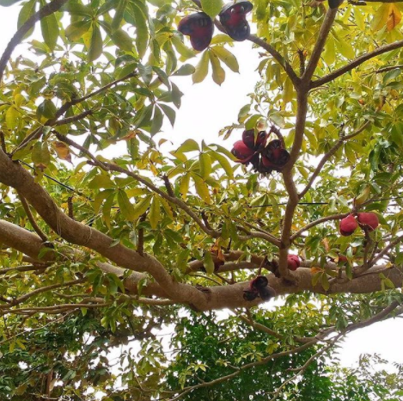
Good features for feature detection in computer vision
Blobs: These well-defined regions (blobs) are good features if they represent a specific object part or unique element.
Laughing Tree
The different blobs in the image
Filtered Bounding Boxes
https://towardsdatascience.com/image-processing-with-python-blob-detection-using-scikit-image-5df9a8380ade

Slide 18
Features: detection, description, matching.
Step.1
Step.2
Step.3
Feature Detection:
Feature detection involves identifying specific points, regions, or structures in an image that are significant and can be used as references for further analysis.
Harris Corner Detection.
Shi-Tomasi Corner Detection.
Canny Edge Detection
Blob Detection.
Scale-Invariant Feature Transform (SIFT)
Feature Description:
Once relevant features are detected, the next step is to describe these features in a way that allows for efficient matching and recognition. The goal is to create a representation of the features that captures their distinctive characteristics while being resistant to variations that might occur in real-world images.
Histogram of Oriented Gradients (HOG)
Scale-Invariant Feature Transform (SIFT)
Speeded-Up Robust Features (SURF)
Local Binary Pattern (LBP)
Binary Robust Invariant Scalable Keypoints (BRISK)
Feature Matching: After detecting and describing features in multiple images, feature matching involves finding correspondences between the features in different images. This step is crucial for tasks like object recognition, image alignment, and 3D reconstruction.
Nearest Neighbor Matching
Ratio Test
https://sumit-kr-sharma.medium.com/feature-detection-and-description-in-computer-vision-657171e43d19

Slide 19
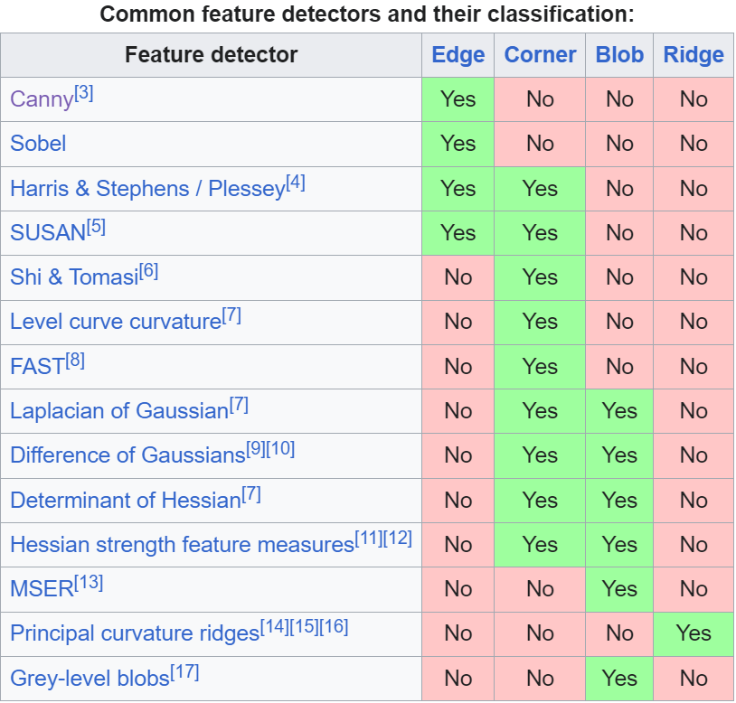
Features: detection, description, matching.
Common Techniques for Feature Detection:
Harris Corner Detection: Detects corners in an image by analyzing changes in intensity in different directions.
Shi-Tomasi Corner Detection: An improvement over Harris corner detection, it selects the best corners based on a corner response measure.
Canny Edge Detection: Detects edges in an image by finding areas of rapid intensity change.
Blob Detection: Identifies regions in an image with a relatively uniform intensity.
Scale-Invariant Feature Transform (SIFT): Detects keypoints that are invariant to scale and rotation changes.
https://sumit-kr-sharma.medium.com/feature-detection-and-description-in-computer-vision-657171e43d19

Slide 20

Code : 01 Harris Corner Detection.py 02 Good Features to Track.py 03 Scale-Invariant Feature Transform – SIFT.py 04 features detection.py
Mystery of Object Detection
https://dudeperf3ct.github.io/object/detection/2019/01/07/Mystery-of-Object-Detection/

Slide 21
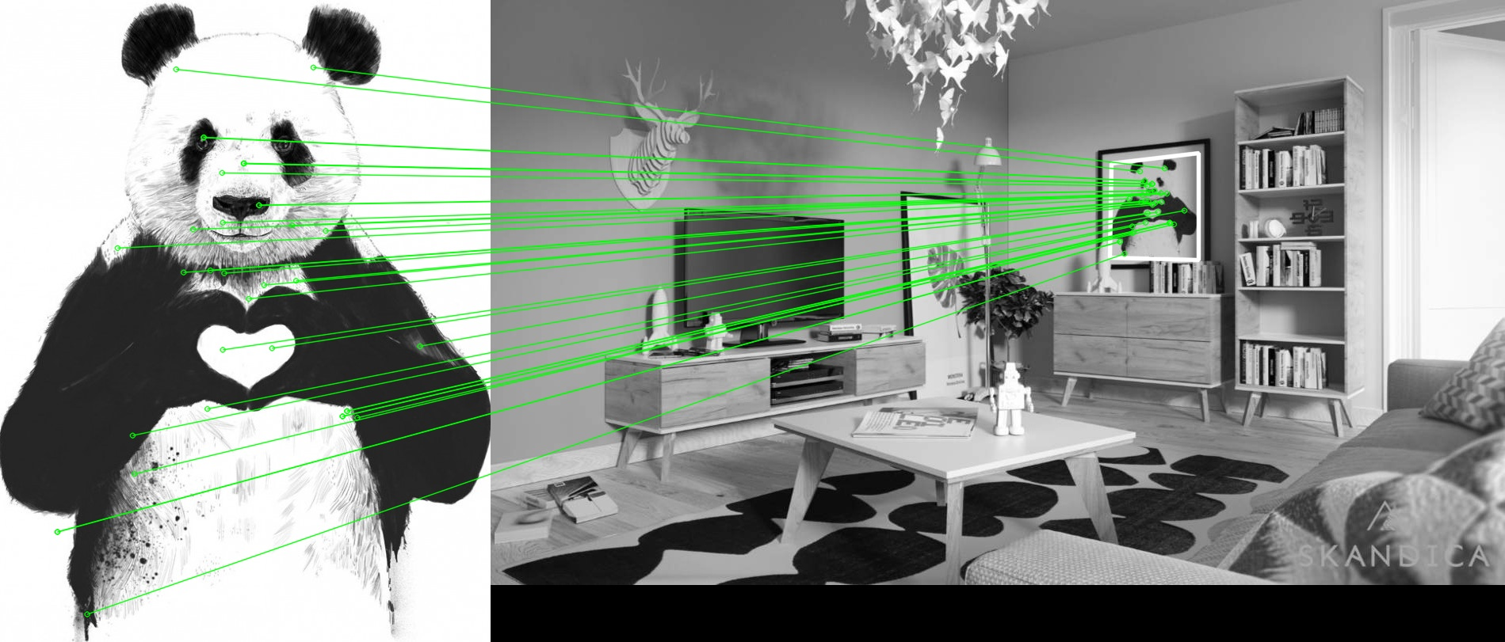
Features: detection, description, matching.
Feature Description:
Once relevant features are detected, the next step is to describe these features in a way that allows for efficient matching and recognition. The goal is to create a representation of the features that captures their distinctive characteristics while being resistant to variations that might occur in real-world images.
Feature Matching: After detecting and describing features in multiple images, feature matching involves finding correspondences between the features in different images. This step is crucial for tasks like object recognition, image alignment, and 3D reconstruction.

Slide 22

Code : 05 Brute-Force Matching with SIFT Descriptors and Ratio Test.py 06 FLANN Matching with SIFT Descriptors and Ratio Test.py 07 matching and homography.py
https://medium.com/@madstreetden/what-is-computer-vision-really-4fb5a4c7dd8c

Slide 23
Project 3 - feature matching (total 12 points)..
Project 3 - feature matching (total 12 points).
Write programs:
Program 1: import photo_1.jpg and: find and show only 4 strongest corners using Haris Corner Detection (2 points), then find and show key points using SIFT method (2 points).
Program 2 : import photo_2_query.jpg and photo_2_train.jpg, perform and show feature matching with homography drawing lines (4 points).
Program 3: import photo_3_query.jpg and video_3_train.mp4, perform feature matching with homography, and track the object by drawing a rectangle around it (4 points).
We defend the project in person, we upload it to task via Microsoft Teams .

