Slide 1
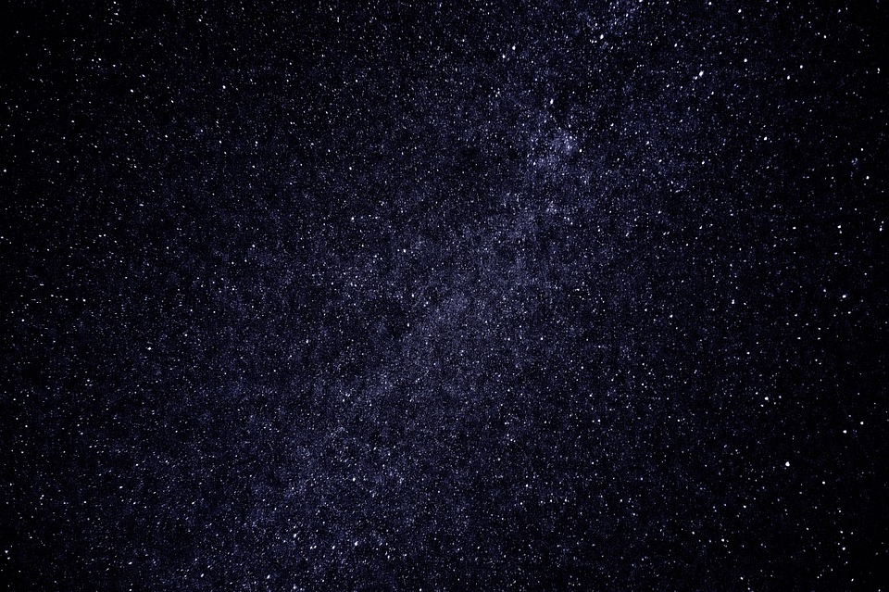
Axions as Cold Dark Matter
Clara Gatius Oliver, Jeannine de Kuijper, Pablo Enrique Guillem Fernandez
Notes:
I don’t like it yet but this is just a rough outline of what I had in mind

Slide 2
Contents
Neutron electric dipole moment
Strong CP problem
Solutions
Axion
Axion Production
Cold dark matter conditions
Axion as cold dark matter
Experiments
Further searches

Slide 3

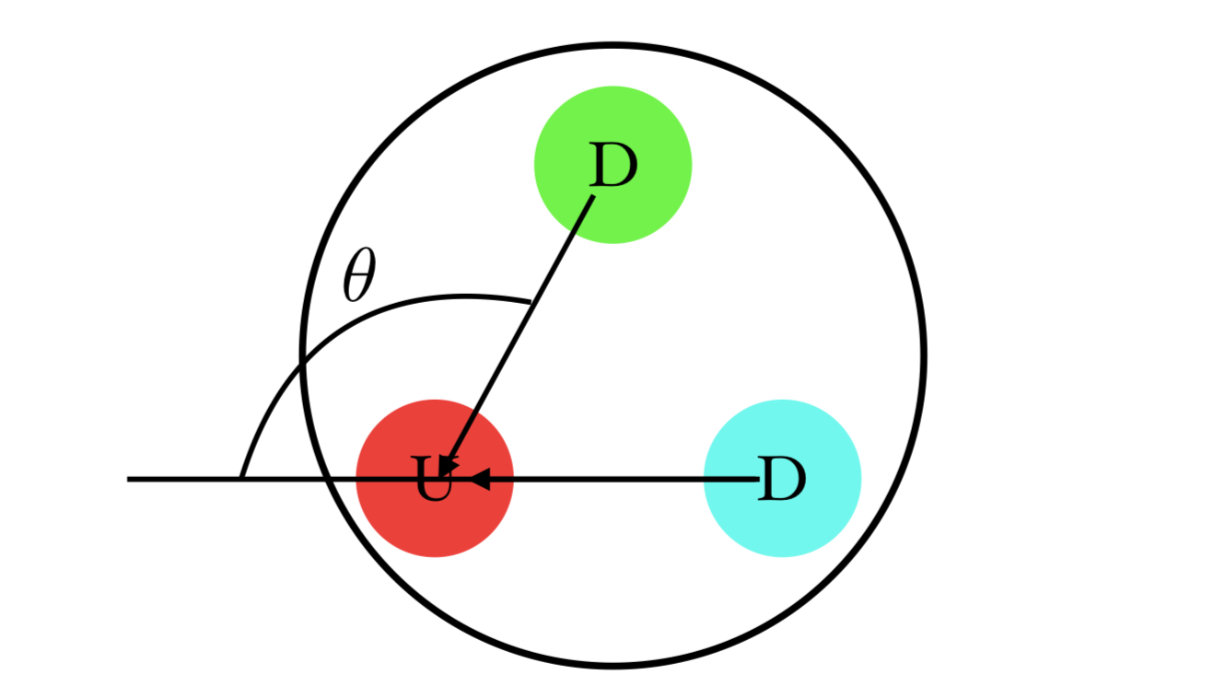
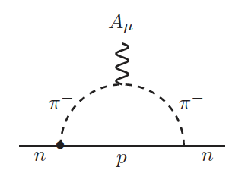
Neutron Electric Dipole Moment
𝜽 ≤ 10⁻¹¹

Slide 4
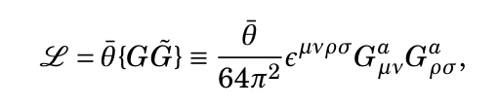
Strong CP Problem
‘t Hooft instantons
Peccei & Quinn

Slide 5
Solutions
Massless up quark
Ruled out through experimental evidence
RG running of 𝜽
7 loops
Axions

Slide 6
Axions
Pseudo Nambu-Goldstone boson
Neutral
Low mass
Types:
Peccei-Quinn-Weinberg-Wilczek (PQWW)
Kim-Shifman-Vainstein-Zakharov (KSVZ)
Dine-Fischler-Srednicki-Zhitnitskii (DFSZ)
Notes:
KSVZ and DFSZ axions include a scalar field where the KSVZ includes a heavy quark

Slide 7
Axion Production
Primakoff effect:
Photons → axions when in the presence of magnetic field
Nucleon-nucleon bremsstrahlung:
N N → N N a
Present in neutron stars, supernovae, the Sun (Solar Axions)

Slide 8
Cold Dark Matter Conditions
Collisionless
Enough non-relativistic particles to get the correct dark matter density

Slide 9
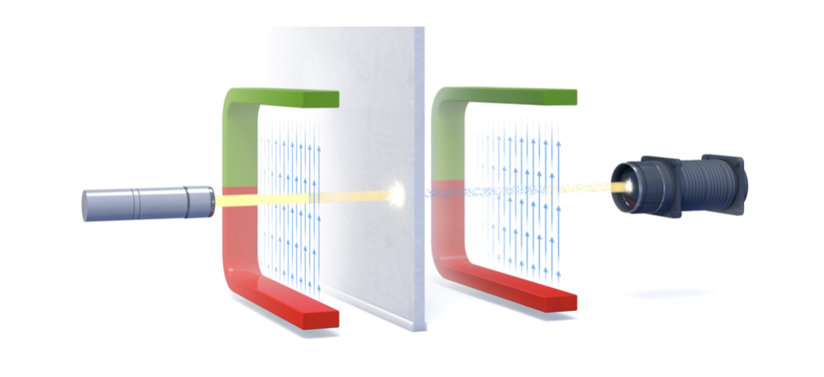
Light Shining Through Walls
Primakoff effect
One of few laboratory experiments

Slide 10
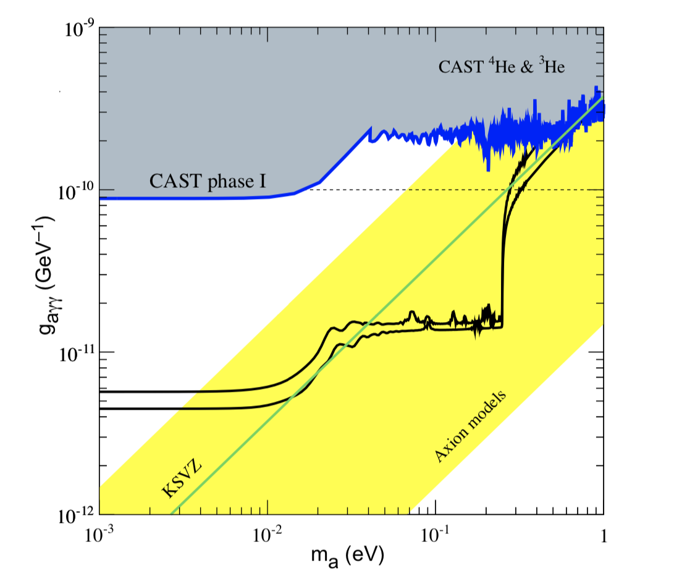
CAST - CERN Axion Solar Telescope
Search for solar axions
Dipole magnet with focusing mirror and x-ray detector
Fig … limits on the coupling as function of axion mass (Graham P.W., 2016)

Slide 11
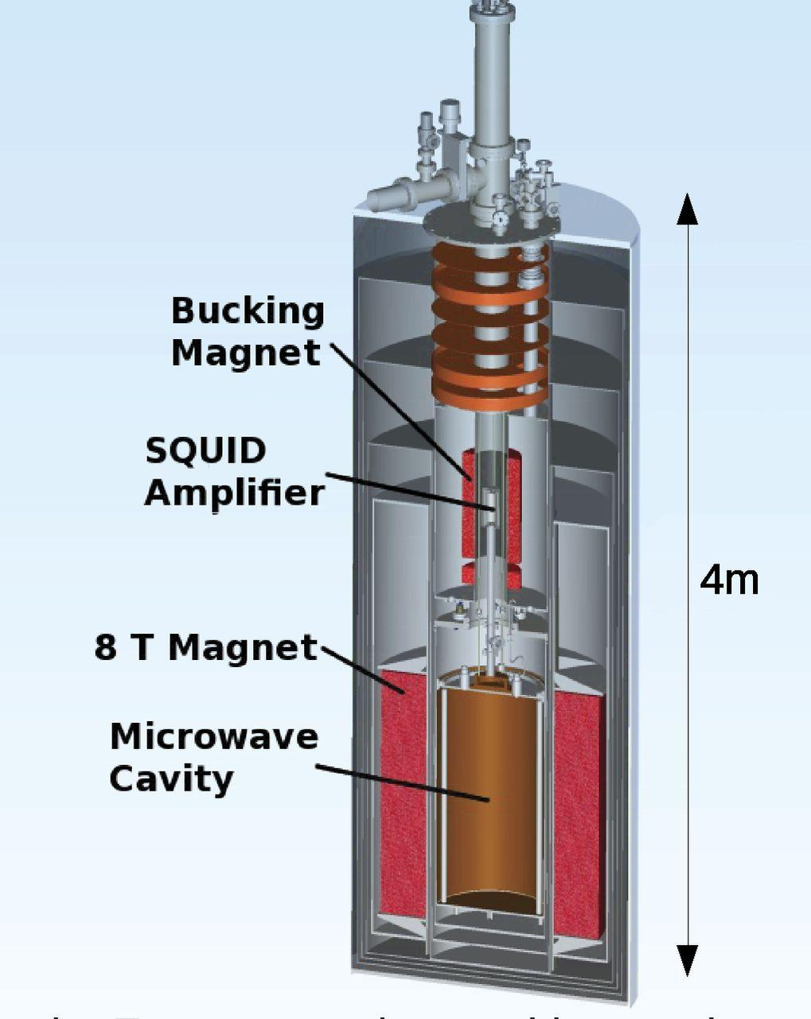
ADMX - Axion Dark Matter eXperiment
Two tuning rods finding resonant frequency
Signal amplified by SQUID
Designed to find KSVZ axions in galactic halo
With dilution refrigerator also sensitive to DFSZ axions
Notes:
A cavity is placed within a superconducting magnet - enables the production of axions into photons as the axions scatter off the magnetic field
Uses two tuning rods to scan the cavity, trying to find the resonant frequency
Signal amplified by Superconducting Quantum Interference Devide (SQUID)
If a narrow peak from a flow of axions is produced in the spectrum of microwave photons, it can tell us about the structure of the Mily Way

Slide 12
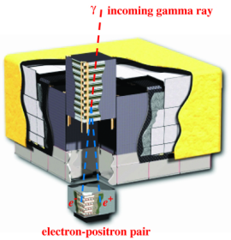
Fermi LAT - Large Area Telescope
Nucleon - nucleon Bremsstrahlung
Axions decay into gamma-rays
Notes:
As gamma-rays cannot be reflected or refracted, the LAT converts the gamma-rays into electron positron pairs
LAT then measures the tracks of the electron and positron from the electromagnetic shower

Slide 13
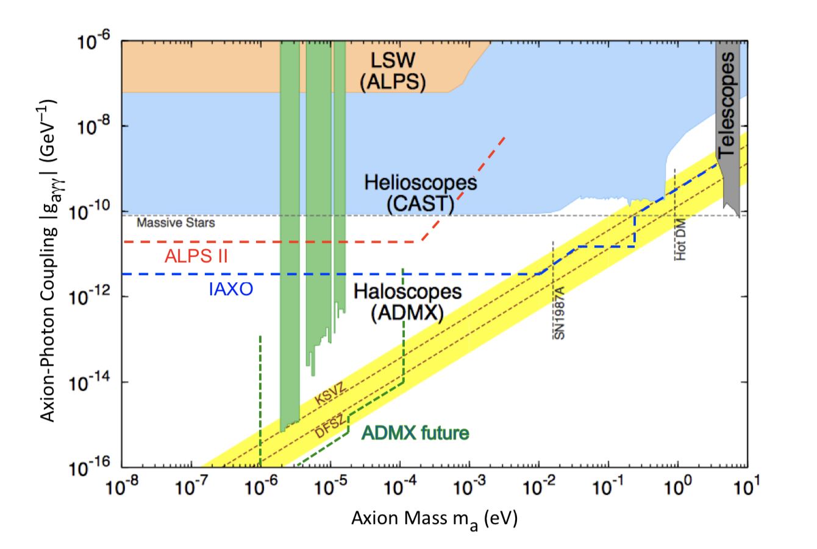
Fig….
(Graham P.W., 2016)
Notes:
Overview of experiments present at this moment and the limits on the coupling as a function of the axion mass

