Slide 1
Quantitative single-cell imaging
reveals insulation of
morphogenic signal transduction
2014.07.18 | Adam Coster
Altschuler/Wu Lab
Dissertation Defense

Slide 2
Today's talk
1. Cell signaling
2. Single-cell image analysis
3. Disentangling signaling from
transcriptional crosstalk
in morphogenic pathways
4. Summary

Slide 3
On cell signaling

Slide 4
Some talk-specific definitions
Signaling
The transfer of information from the environment to a cell

Slide 5
Some talk-specific definitions
Signaling
The transfer of information from the environment to a cell
Processing
The transfer of information from one molecular state to another

Slide 6
Some talk-specific definitions
Signaling
The transfer of information from the environment to a cell
Processing
The transfer of information from one molecular state to another
Signal transduction ('transduction')
The transfer of extracellular information to the nucleus

Slide 7
Some talk-specific definitions
Signaling
The transfer of information from the environment to a cell
Processing
The transfer of information from one molecular state to another
Signal transduction ('transduction')
The transfer of extracellular information to the nucleus
Transcriptional processing ('transcription')
The set of protein-protein and protein-chromatin interactions within the nucleus that result in changes to expression

Slide 8
Some talk-specific definitions
Signaling
The transfer of information from the environment to a cell
Processing
The transfer of information from one molecular state to another
Signal transduction ('transduction')
The transfer of extracellular information to the nucleus
Transcriptional processing ('transcription')
The set of protein-protein and protein-chromatin interactions within the nucleus that result in changes to expression
Decision-making
The collapse of all possible outcomes into a subset of outcomes

Slide 9
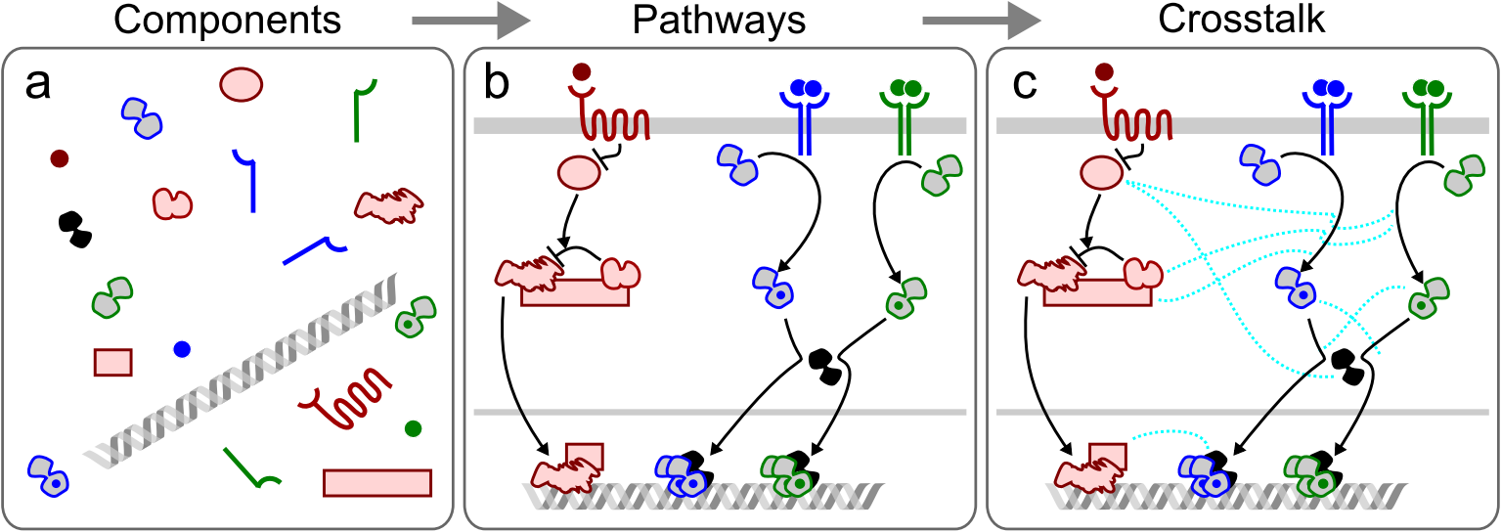
How we define cell signaling pathways
Dissertation Fig. 1.1

Slide 10
How we define cell signaling pathways
Dissertation Fig. 1.1
  Time often missing;
  Ambiguous arrows;
  Summarizes many experiments.

Slide 11
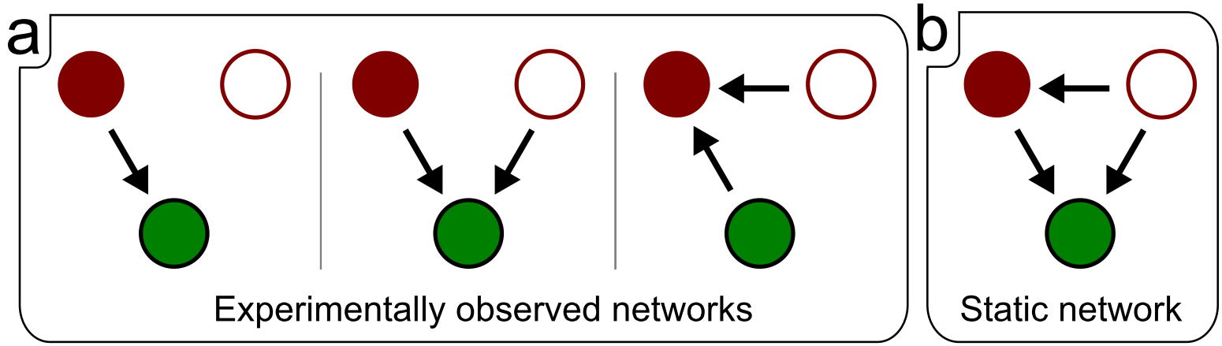
But! Static signaling networks may not reveal true networks
Dissertation Fig. 1.2
e.g. Polarity in neutrophils,
and the later case study

Slide 12
On single-cell imaging

Slide 13
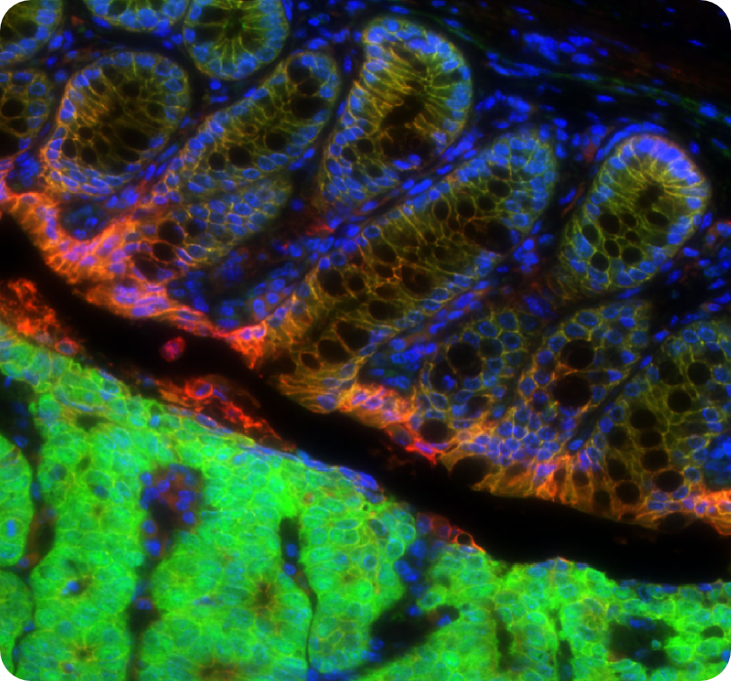
Why imaging? (besides the beauty?)
Image courtesy C. Thorne and M. Ramirez (A/W Lab) DNA,β-catenin,E-cadherin

Slide 14
Why imaging?
  Single-cell and sub-cellular resolution
  (cells are not homogeneous!)
  High data dimensionality
  (can measure 10²-10³ single-cell properties)
  High throughput
  (can rapidly obtain data from many perturbations)

Slide 15
But there are problems...
  Single-cell and sub-cellular resolution
  (artifacts and heterogeneity are hard to interpret)
  High data dimensionality
  (what should we even measure? WHAT DOES IT MEAN?)
  High throughput
  (how do we deal with all the data?)
Mis-interpretation is easy
So how do we extract meaningful, believable data?

Slide 16
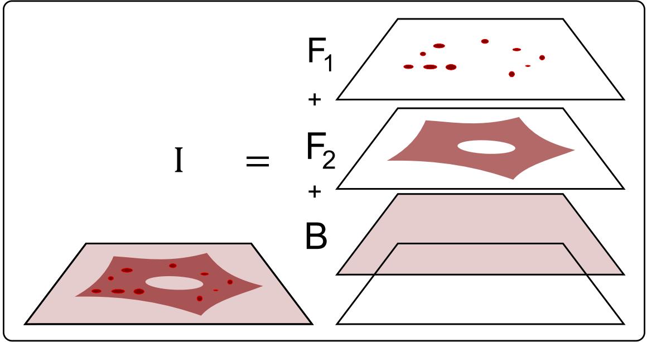
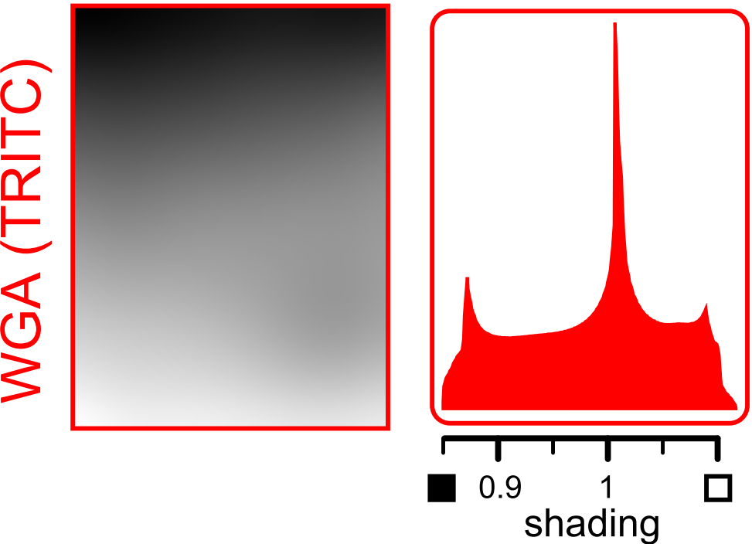
First step: removing non-Foreground
Dissertation Figs. 4.1 and 4.4
Nature Methods (2014). 11(6), 602.

Slide 17
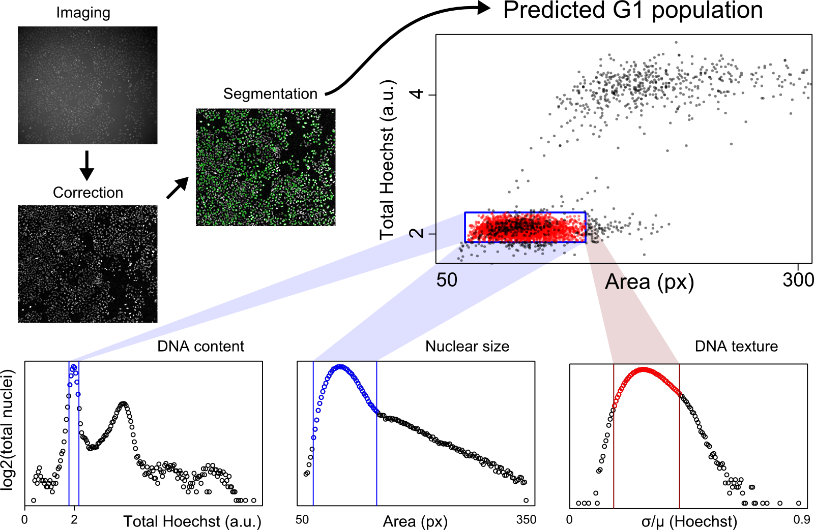
Second step: finding single cells
(Schematic – Images and plots from different experiments.)

Slide 18
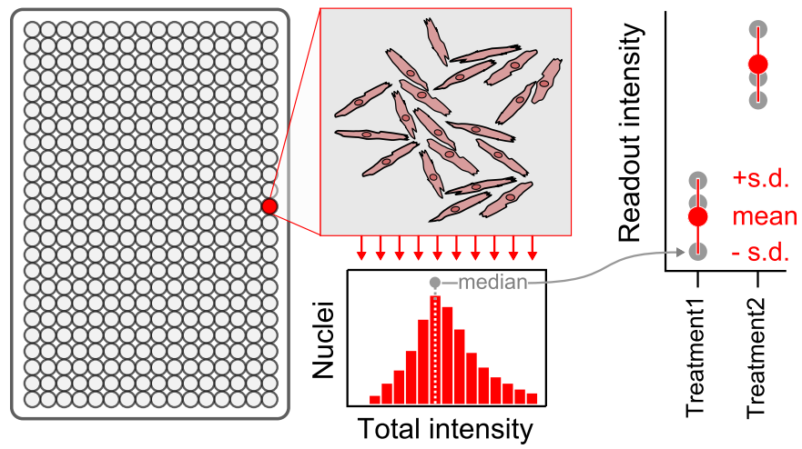
Third step: simplifying the data
Dissertation Fig. 3.3

Slide 19
Disentangling signaling
from transcriptional crosstalk
in morphogenic pathways
(a case study of Wnt, TGFB, and BMP)

Slide 20
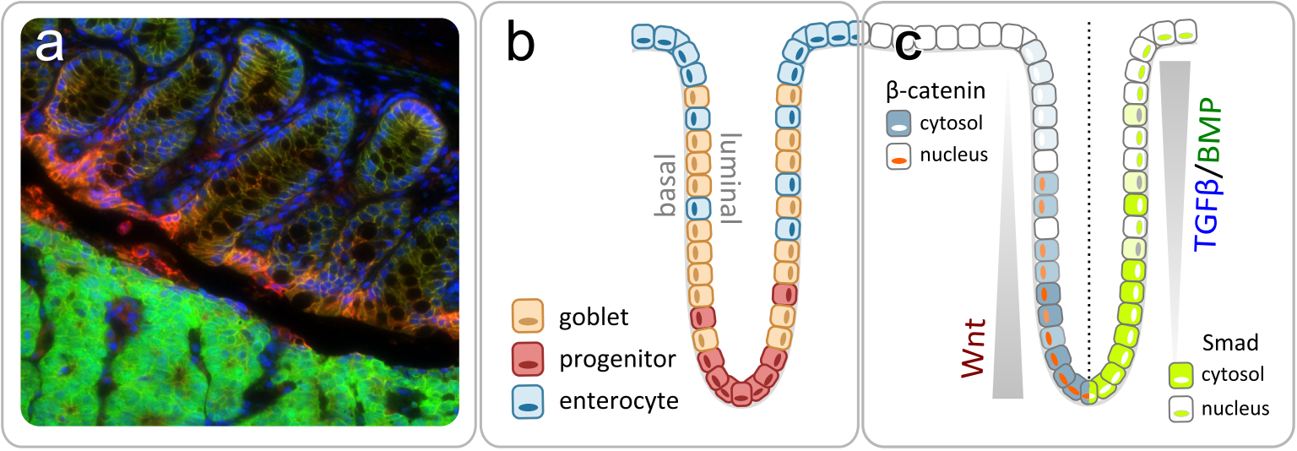
Motivation: TGFB, BMP, and Wnt are essential to tissue
homeostasis and misregulated in many diseases
Dissertation Fig. 2.5. Image and cartoon of colonic crypts.
How do cells integrate these signals to make decisions?

Slide 21
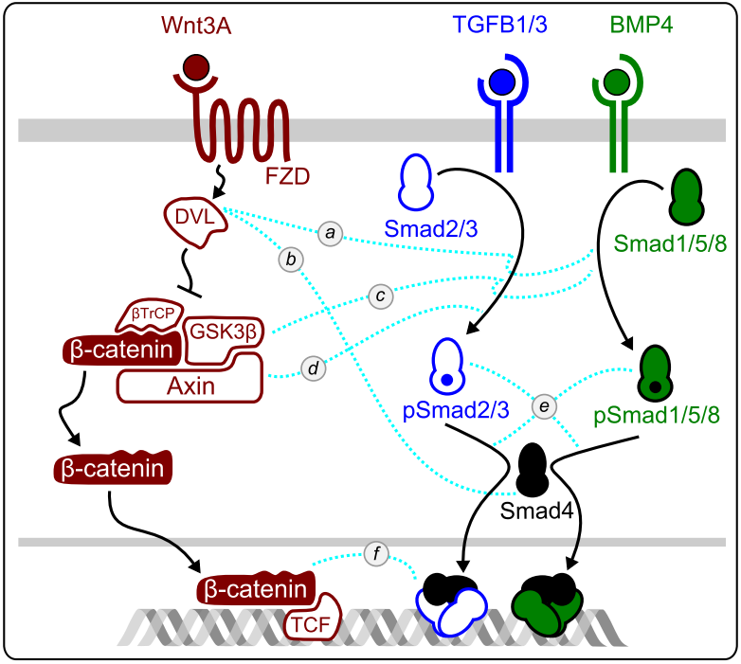
Overview of putative Wnt/TGFB/BMP transduction crosstalk
Dissertation Fig. 2.6

Slide 22
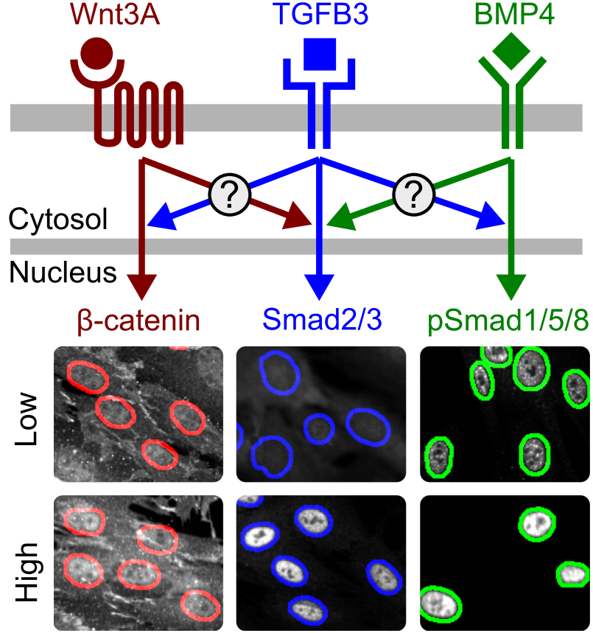
Are signals really integrated during transduction?
Dissertation Fig. 3.2

Slide 23
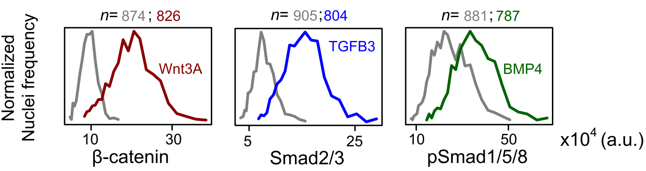
The experiment

Slide 24
Take a breath...
Things are about to get REALly data-dense

Slide 25
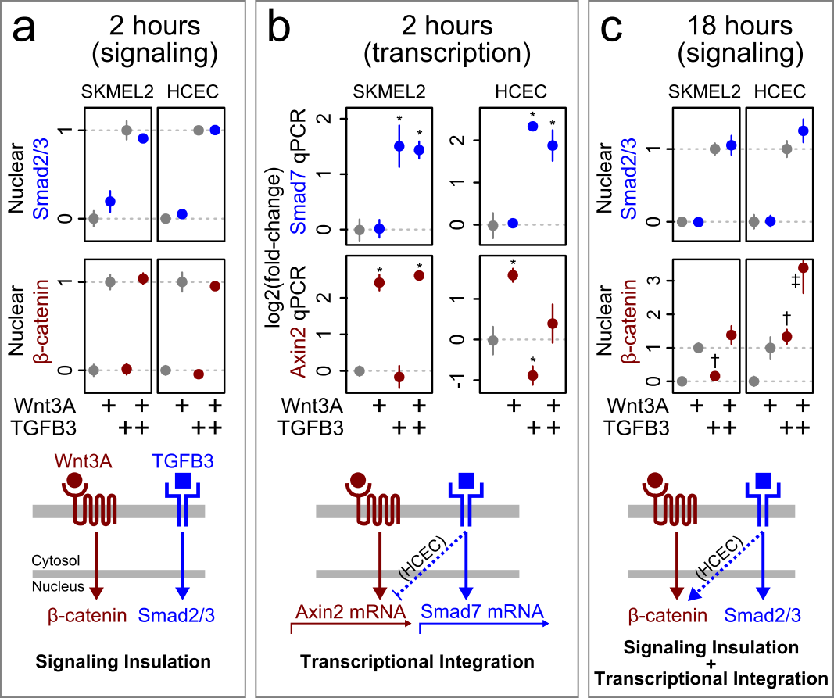
Insulation of Wnt3A/TGFB3 during signal transduction
Dissertation Fig. 3.12

Slide 26
Crosstalk of Wnt3A/TGFB3 during transcription
Dissertation Fig. 3.12

Slide 27
Biasing of Wnt3A by long-term TGFB3 treatment
Dissertation Fig. 3.12

Slide 28
Therefore:
  Wnt/TGFB may be generally insulated
  during transduction
  Wnt/TGFB are idiosyncratically integrated
  during translation
  By conflating transduction/translation
  we may infer complete idiosyncrasy!

Slide 29
Reminder...
Dissertation Fig. 2.6

Slide 30
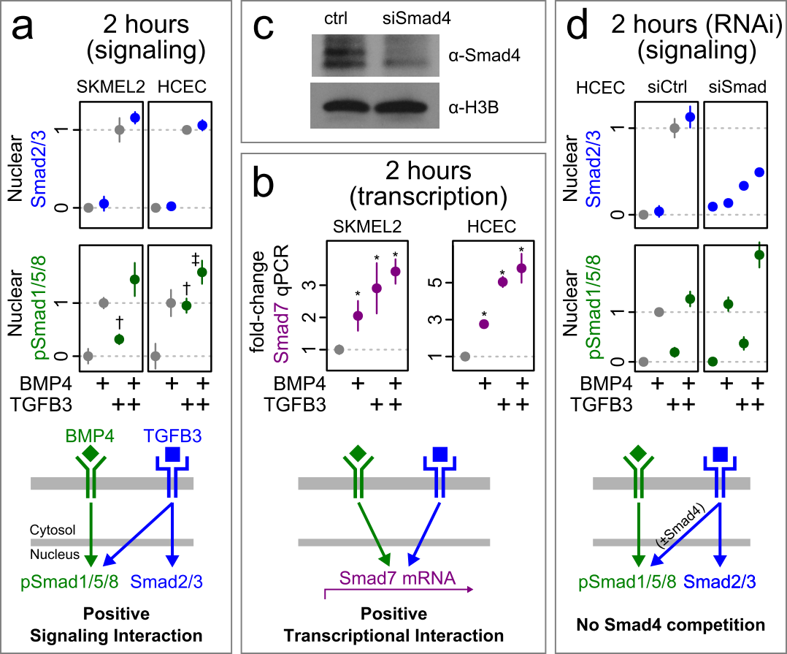
Non-negative BMP4/TGFB3 signal integration
Dissertation Fig. 3.15

Slide 31
Non-negative BMP4/TGFB3 signal integration
Dissertation Fig. 3.15

Slide 32
BMP4/TGFB3 do not compete for Smad4
Dissertation Fig. 3.15

Slide 33
Therefore:
  BMP4/TGFB interact positively or not at all
  during transduction
  Smad4 levels do not change the interaction;
  BMP4/TGFB do not compete for Smad4;
  As before, long-term idiosyncracies may be due to
  conflation with transcription!

Slide 34
Summary

Slide 35
Single-cell imaging
  Reveals dramatic heterogeneity in single-cell behaviors
  Can be robust, quantitative, and meaningful
  Lacks standard methods and controls
  for interpretation of single-cell features.
Morphogenic signaling insulation
  TGFB/Wnt do not interact during transduction
  TGFB/BMP do not negatively interact during transduction
  Morphogenic transduction interactions may be sparse!
Future directions
  Are we missing general features of cell signaling?
  Is concentration the appropriate encoding for TGFB/Wnt?
  How common is pathway insulation?

Slide 36
THANKS!
Altschuler & Wu Lab
Curtis Thorne
Charles Hsu
Dhruba Deb
Elizabeth Zhang
Jackie Njoroge
Jayant Avva
Joey Steininger
Jungseog Kang
Marion Langen
Mike Ramirez
Nicholas Norris
Pearl Wichaidit
Satwik Rajaram
Shanshan Liu
Yue Deng
Thesis Committee
Steve & Lani (mentors)
Rama Ranganathan
James Amatruda
Neal Alto (chair)
Support
CPRIT (Lani Wu)
CMB (Melanie Cobb)
MoD/HHMI (Helen Yin)
Reagents
Jerry Shay (HCECs)

Slide 38
Supplemental Slides

Slide 39
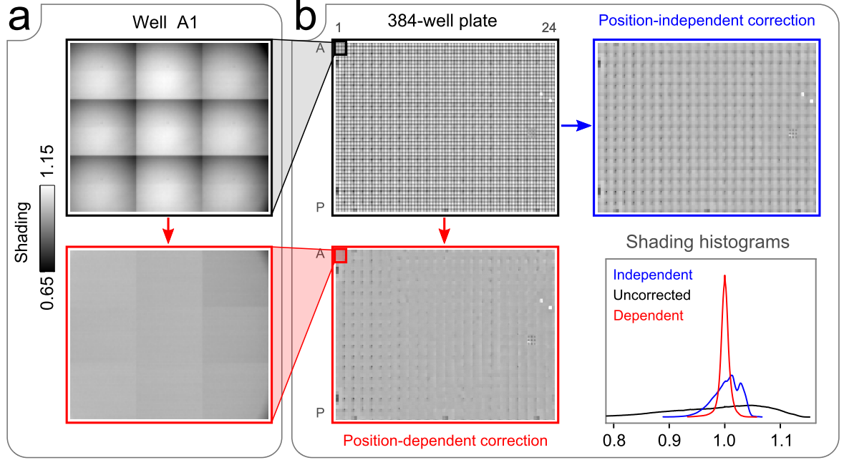
Positional microwell plate image correction
Dissertation Fig. 4.7

Slide 40
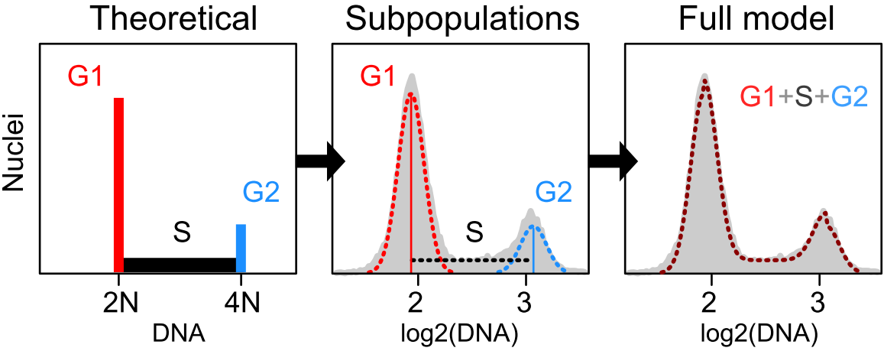
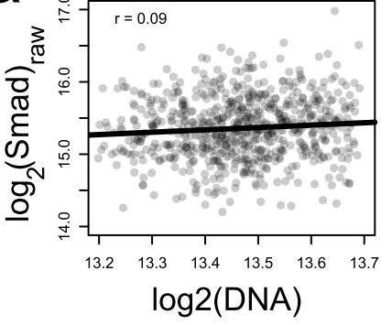
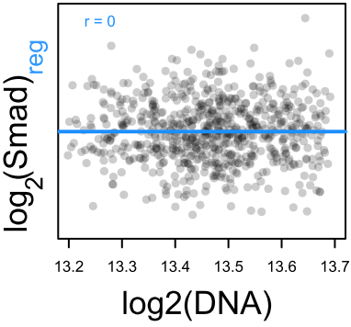
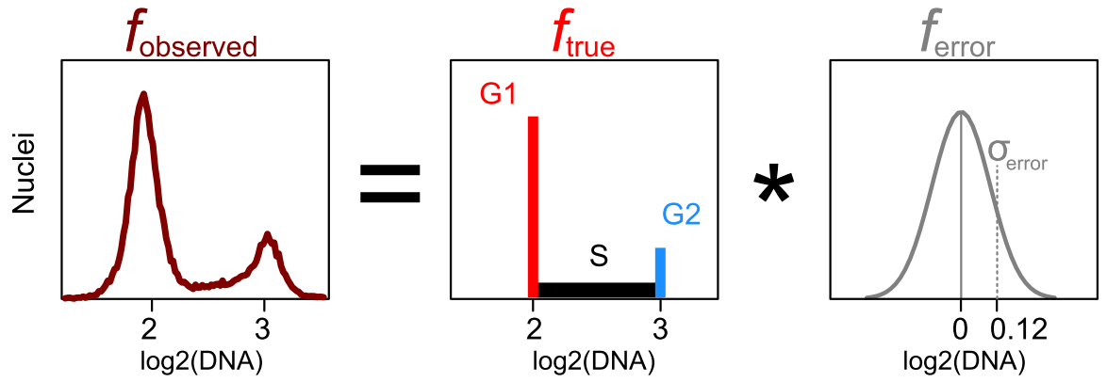
Single-cell correction using cell cycle and Hoechst staining
Dissertation Figs. 4.12 and 4.15

Slide 41
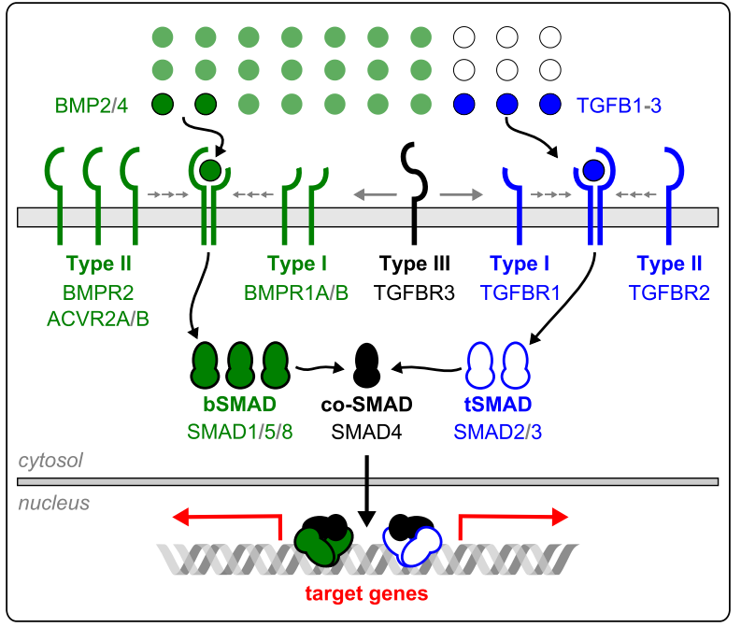
TGFB/BMP pathway overview
Dissertation Fig. 2.1

Slide 42
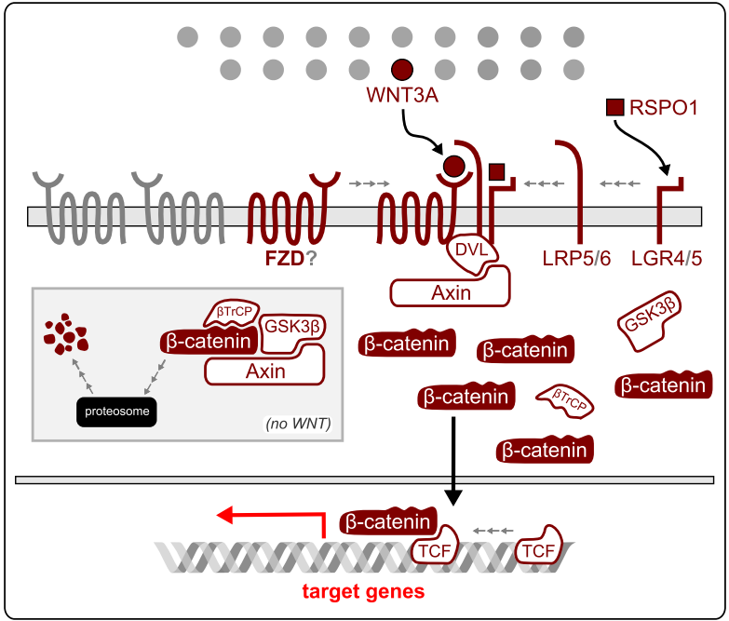
Wnt/B-catenin pathway overview
Dissertation Fig. 2.3

Slide 43
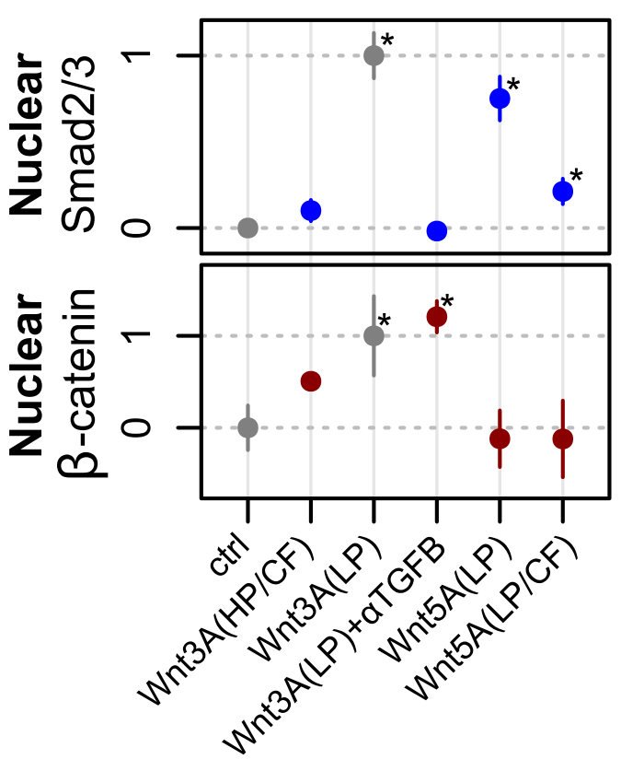
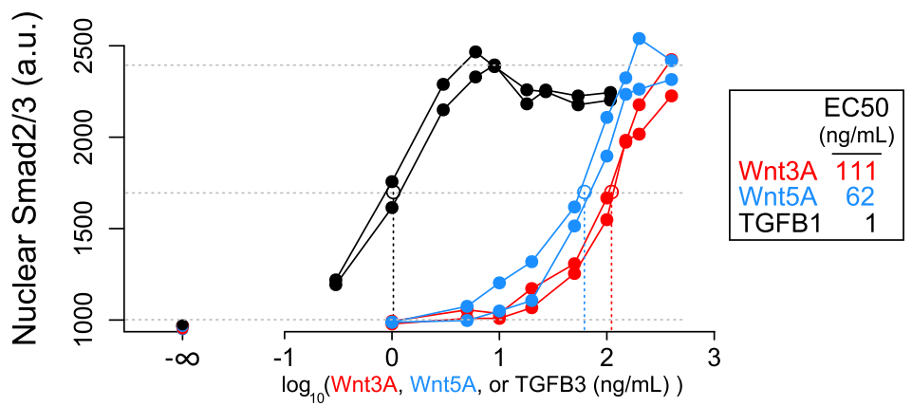
Low-purity Wnts (R&D Biosystems) contain TGFB

Slide 44
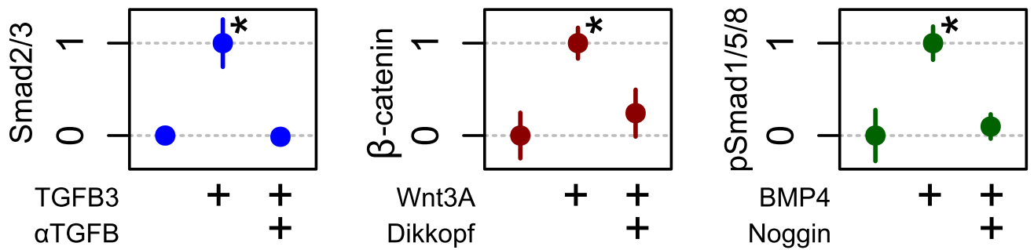
Ligand responses are probably real

Slide 45
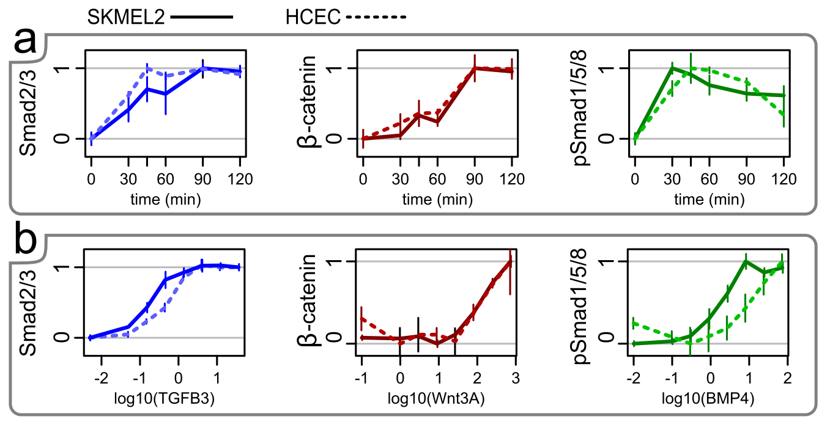
Dose-responses and timecourses

Slide 46
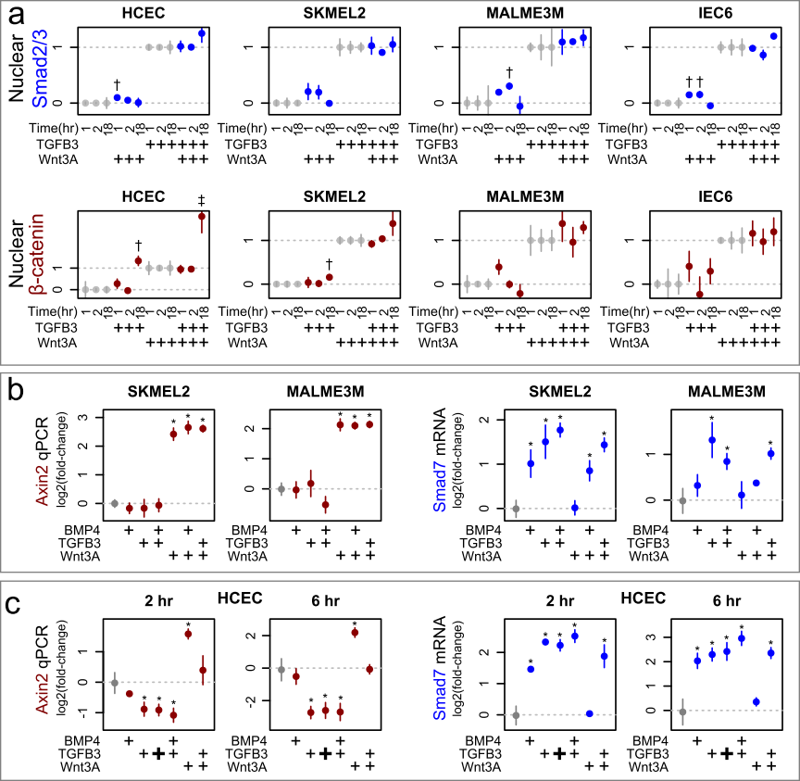
Insulation of TGFB/Wnt (4 cell types)

Slide 47
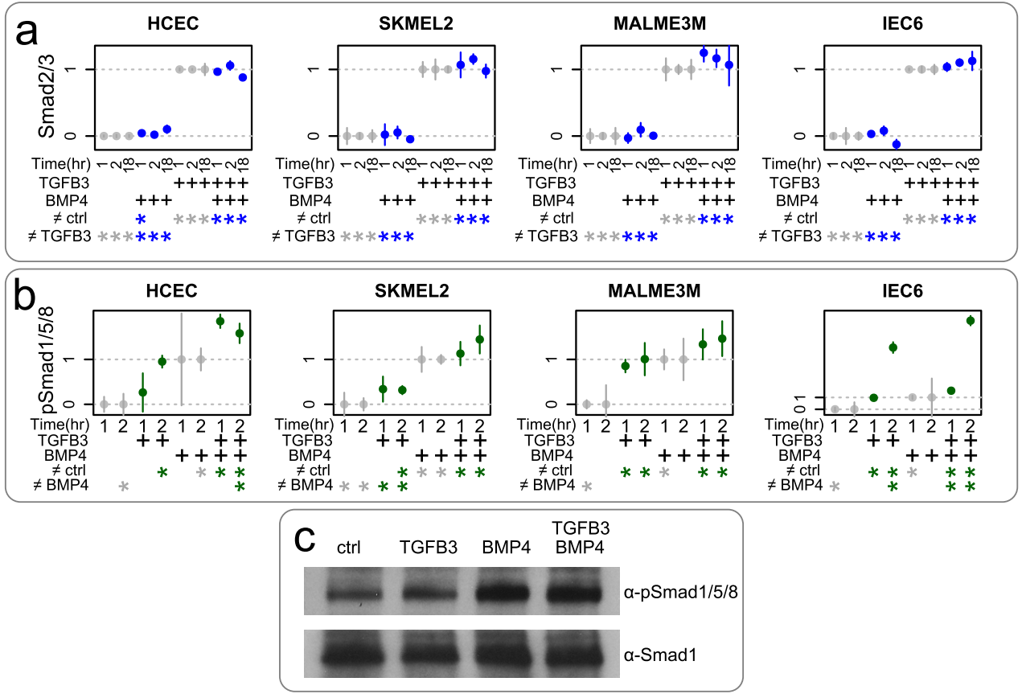
BMP4/TGFB3 do not compete for Smad4
Dissertation Fig. 3.14

Slide 48
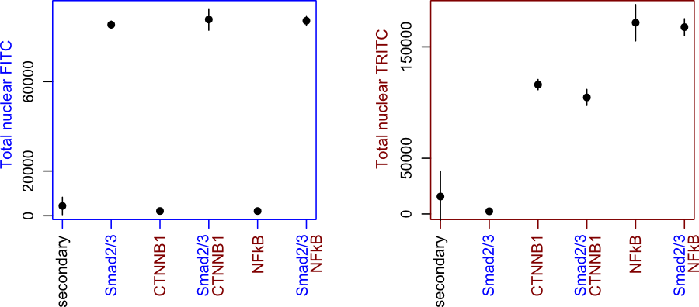
Negative control: Primary antibodies are independent
60min treatment, SKMEL2. Points, average total nuclear total over triplicate samples.
Colors indicate channel. FITC and TRITC secondary antibodies were used in all cases.
Error bars, S.D.

Slide 49
Overview of putative Wnt/TGFB/BMP signaling crosstalk
(citations)
  Warner et al. (2003). FEBS Letters, 539(1-3), 167–173.
  Warner et al. (2005). Orthodontics & Craniofacial Research, 8(2), 123–30.
  Liu et al. (2006). The Journal of Biological Chemistry, 281(25), 17156–63.
  Mamidi et al. (2012). Cell Death and Differentiation, 19(10), 1689–97.
  Fuentealba et al. (2007). Cell, 131(5), 980–93.
  Guo et al. (2008). Genes & Development, 22(1), 106–20.
  Furuhashi et al. (2001). Molecular and Cellular Biology, 21(15), 5132–5141.
  Guo et al. (2008). Genes & Development, 22(1), 106–20.
  Liu et al. (2006). The EMBO Journal, 25(8), 1646–58.
  Candia et al. (1997). Development, 124(22), 4467–80.
  Zeng et al. (2008). PloS One, 3(12), e3893.

