Slide 1
BIGTECHCOMPANY
Financial Overview
Adam El Harouchi

Slide 2
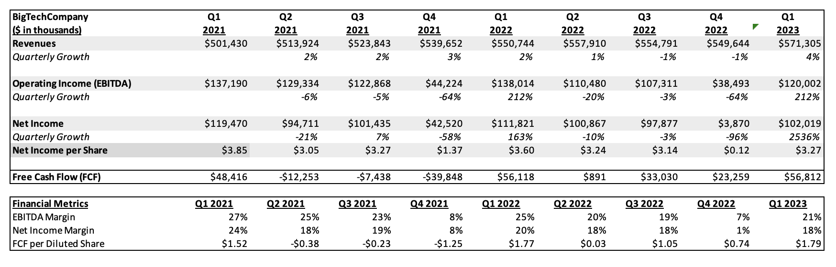
QUARTERLY PERFORMANCE

Slide 3
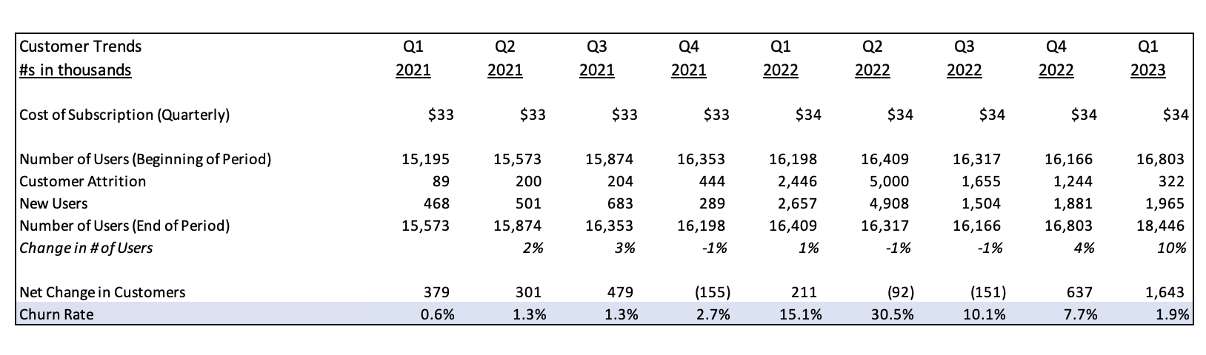
CUSTOMER TRENDS
In the key takeaways section, write 2-3 bullets with takeaways from the table. For example, how did the price increase affect customer attrition? What can we derive from the company’s churn rate? Are customer numbers trending positively or negatively?
Delete this box once this step is completed.
Key Takeaways:
Churn spiked after price increase in early 2022, peaking at 30.5%, then steadily declined to 1.9% by Q1 2023.
Customer growth rebounded in Q1 2023 with a net gain of 1.6M users—the strongest quarter shown.
Price sensitivity evident: The $1 subscription increase aligned with a sharp rise in attrition and churn.
Insert Customer Trends (Output 2) Here
Delete this box once this step is completed.

Slide 4
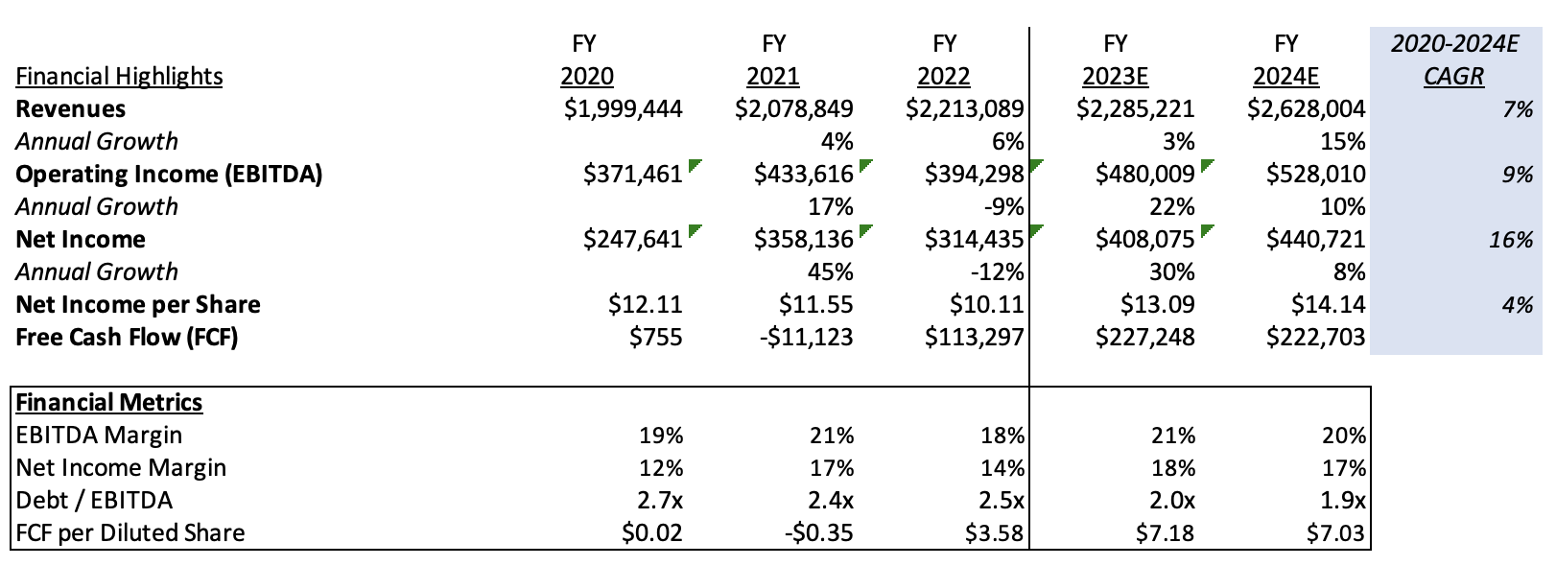
PROJECTIONS

Slide 5
CONCLUSIONS
For company highlights, please compose bullets on the following:
The company’s historical and future revenue trends.
The company’s cash flows.
The company’s debt/EBITDA in comparison to the industry average (4.0x) – Note a low debt/EBITDA ratio is considered healthy.
Any other positives from the company’s financials.
For areas of concern, please compose bullets on the following:
The regularity of the company’s earnings – are they steady, decreasing, increasing, or volatile every quarter?
The company’s expenses and if there were any quarters where expenses were abnormally high in comparison to other quarters.
The company’s EBITDA margin in comparison to the industry average of 39%. Note, the higher the EBITDA margin, the better.
For the recommendation, write 1-2 bullets on if they should develop a relationship with Stargaze. Also include any areas that you should clarify with the company. For example, “We should ask the company to provide an explanation for the increase in revenues during this period.”
Delete this box once this step is completed.
Company Highlights
Revenue is growing steadily quarter-over-quarter, with customer growth rebounding strongly in Q1 2023.
Churn rate has improved significantly from a peak of 30.5% to just 1.9%, signaling better customer retention.
Cost control efforts appear effective, with expenses holding relatively stable despite user growth.
Areas of Concern
Earnings are somewhat volatile—Q2 and Q3 2022 saw negative net customer changes and high attrition.
The spike in churn in early 2022 (up to 30.5%) suggests price sensitivity and a potential retention risk if pricing changes recur.
No EBITDA margin provided—unable to assess profitability vs. industry average of 39%.
Recommendation
Recommend proceeding with a potential partnership or continued engagement, pending clarification on EBITDA margin and pricing strategy impacts.
Suggest requesting detailed breakdowns of customer retention initiatives and cost forecasting assumptions for 2023.

