Slide 1
AEROSHIELD
Operations Portfolio
Mid-Term Client Challenge
HULT
International
Business School
Adam, Nacer, Daniella, Ana Laura, Ansar
1. Polar Diagram · Operational Performance
2. Process Map & 4Vs Analysis
3. Throughput & Cycle Time Calculations
4. Process Type Classification
5. Technology Recommendations
Operations Management
Spring 2026

Slide 2
Company Overview · AeroShield
EXECUTIVE SUMMARY
COMPANY OVERVIEW
STRATEGIC POSITION
What: Manufacturer of aerogel-insulated glass units (IGUs) for high-performance building windows
Mission: Deliver energy-efficient, aesthetically transparent thermal barriers at commercial scale
Stage: Scaling from R&D pilot (Waltham, 66 sqft/week) → full industrial production (5,600 sqft/week)
Product: Patio-size aerogel IGUs | 60 units per vessel run | 2 IGUs per aerogel
Market: Premium commercial construction (B2B, make-to-order); long-term contracts
Volume
HIGH (Scaling)
Waltham pilot → 5,600 sqft/wk target; 60 gels/vessel run
Variety
LOW
Single product line (Patio IGU); rigid, standardized workflow
Variation
LOW–MEDIUM
Batch-cycle schedule; predictable demand; 4–5 runs/week
Visibility
LOW
Back-office chemical mfg.; no customer contact during production
AeroShield · Operations Portfolio · Hult International Business School 2026

Slide 3
Volume · Variety · Variation · Visibility
4Vs OPERATIONAL ANALYSIS
HIGH — Scaling
↑ VOLUME
LOW
≡ VARIETY
Waltham pilot: 66 sqft/week (≈3,015 sqft/yr)
Scale-up target: 5,600 sqft/week
Molding: 65–75 gels per 12h shift
60" vessel: 60 patio gels per run
Standardized output: Patio-size IGU only
Fixed process: Mold → CPD → Anneal → Composite → IGU
Core inputs fixed: glass, aerogel, argon, sealant
Minimal customization in current phase
→ Enables specialization, capital-intensive automation, and higher resource utilization.
→ Drives lower unit cost and process consistency; limits addressable market in short term.
LOW–MEDIUM (Predicted)
~ VARIATION
LOW
◎ VISIBILITY
Batch-cycle schedule: 4–5 vessel runs/week
Capacity designed for sustained peak (≥2 weeks)
MTO triggers prevent excess inventory
Low demand volatility due to contract-based B2B model
Zero customer contact during transformation
Production in controlled hazmat rooms (H2, Process Room)
Significant lead-time gap: 56h+ end-to-end
Customers receive finished IGU only
→ Predictable scheduling enables high equipment utilization; batch failures create all-or-nothing risk.
→ Low visibility supports high staff utilization and standardized workflow; proprietary process protected.
AeroShield · Operations Portfolio · Hult International Business School 2026

Slide 4
Operational Performance Objectives · Scale 1–5
POLAR DIAGRAM
Quality 5/5
Highest priority. Multi-stage defect risk — casting, curing, cutting. No tolerance for failure in building materials.
Dependability 4/5
Construction timelines are strict. Long curing cycles (30h+) mean delays compound rapidly.
Flexibility 3/5
Scaling to 5,600 sqft/wk may require handling diverse sizes — relevant but secondary.
Cost 3/5
Important at scale but must not compromise quality during growth phase.
Speed 2/5
CPD process cannot be accelerated without damaging aerogel structure. Not a competitive lever.
AeroShield · Operations Portfolio · Hult International Business School 2026

Slide 5
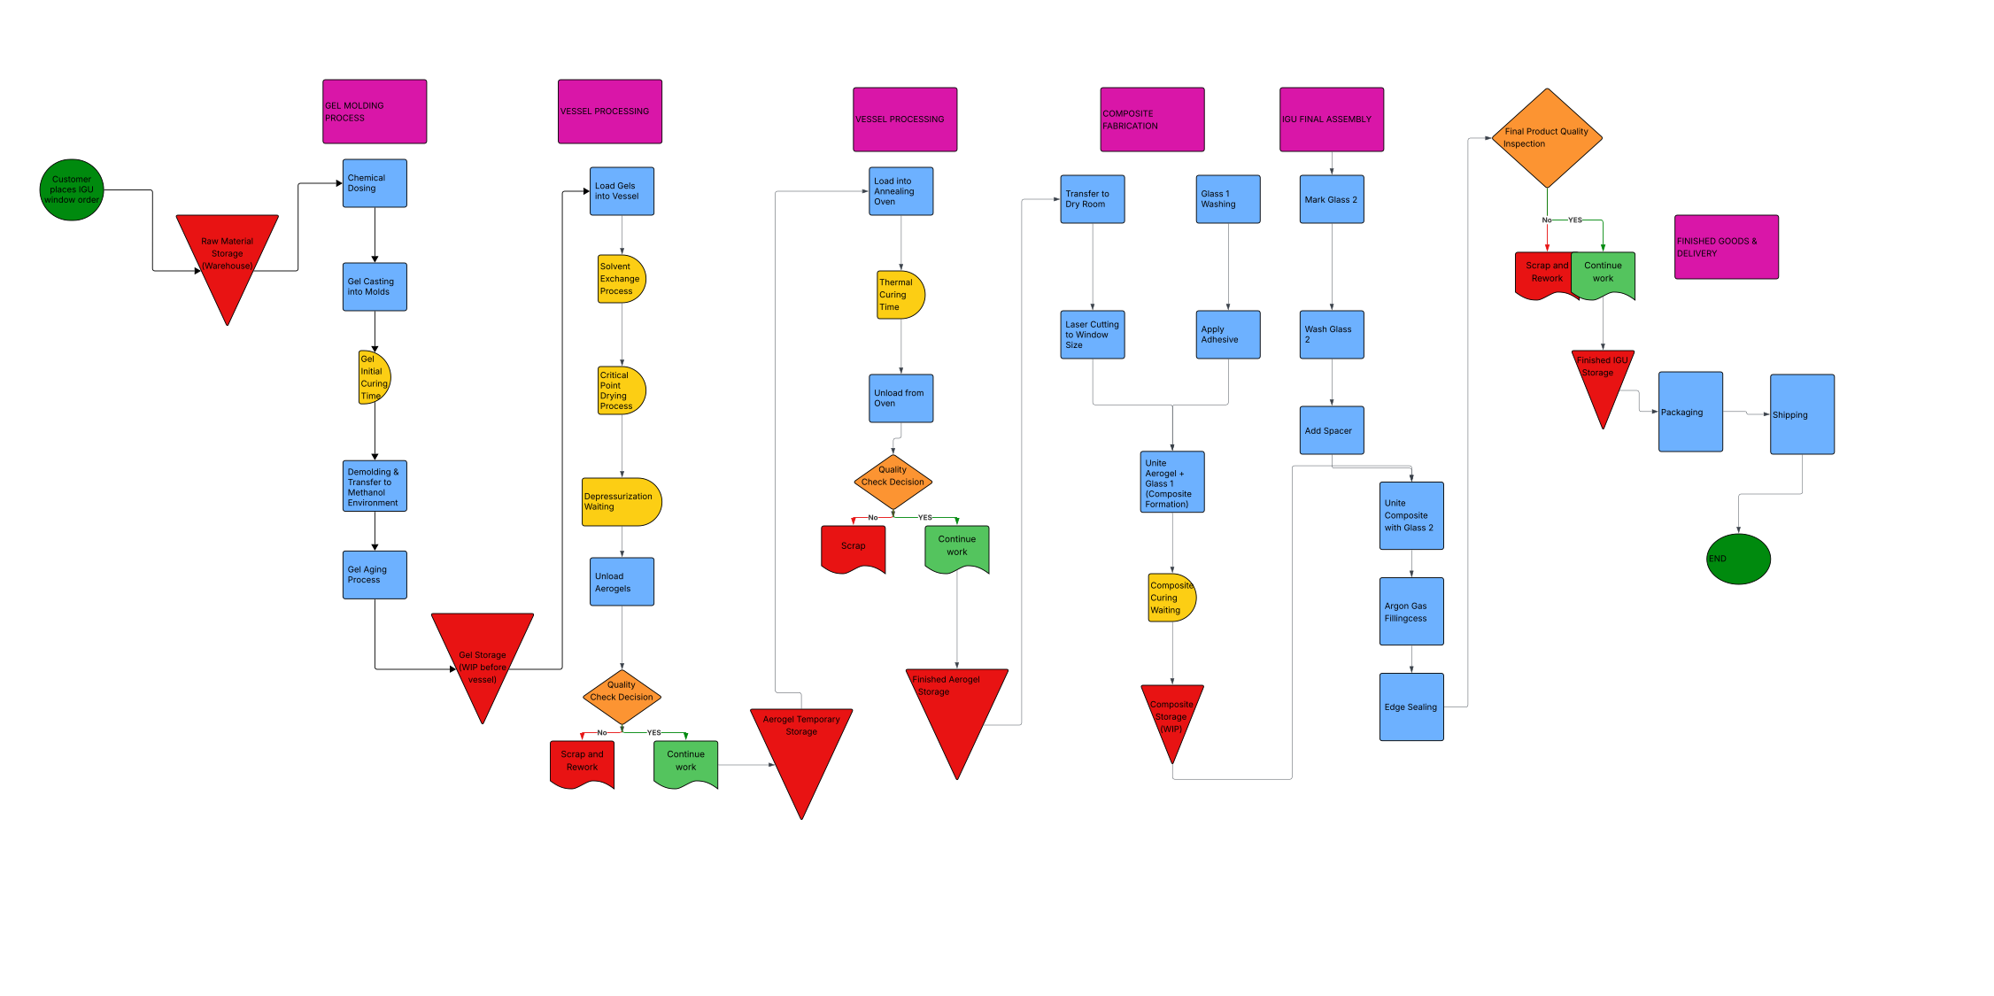
Phase 0 → Phase 3 · End-to-End Workflow
PROCESS MAP & TYPE CLASSIFICATION
AeroShield · Operations Portfolio · Hult International Business School 2026

Slide 6
Phase 1 & Phase 1.1 · Critical Path
THROUGHPUT TIME ANALYSIS
KEY CONCEPT: Throughput time = total elapsed time per unit/batch through each stage | Critical path (aerogel route) dominates | Glass washing runs PARALLEL — not additive
# | Sub-Process | Process Type | Min | Hrs | Path | Bottleneck?
1 | Chemical Dosing | Batch — Preparation | 30 | 0.5 | Sequential | No
2 | Gel Casting (12h shift) | Batch — Manufacturing | 720 | 12.0 | Sequential | No
3 | Gel Initial Curing | Time-Based Wait | 60 | 1.0 | Sequential | No
4 | Demolding & Transfer | Batch — Handling | 20 | 0.3 | Sequential | No
5 | Gel Aging (pre-vessel) | Time-Based Wait / WIP | 60 | 1.0 | Sequential | No
6 | Load Gels → Vessel | Batch — Handling | 30 | 0.5 | Sequential | No
7 | Solvent Exchange | Batch — Chemical | 900 | 15.0 | Sequential | No
8 | Critical Point Drying | Batch — Capital Intensive | 900 | 15.0 | Sequential | YES ← BOTTLENECK
9 | Depressurization Wait | Time-Based Wait | 30 | 0.5 | Sequential | No
10 | Unload Aerogels | Batch — Handling | 20 | 0.3 | Sequential | No
11 | QC Grading (post-vessel) | Decision Gate | 120 | 2.0 | Sequential | No
12 | Load → Annealing Oven | Batch — Handling | 15 | 0.25 | Sequential | No
13 | Thermal Curing (22h) | Time-Based Wait | 1320 | 22.0 | Sequential | No
14 | Unload + QC | Batch / Decision Gate | 30 | 0.5 | Sequential | No
15 | Finished Aerogel Storage | WIP Buffer | 30 | 0.5 | Sequential | No
16 | Glass Washing | Batch — PARALLEL | 7 | 0.1 | PARALLEL | No (Parallel)
17–28 | Composite + IGU Steps | Assembly / Batch | 153 | 2.55 | Sequential | No
TOTAL | End-to-End Critical Path | Aerogel Path + Composite | 4,438 | ~74h | Critical Chain | CPD = Bottleneck
AeroShield · Operations Portfolio · Hult International Business School 2026

Slide 7
Phase 1 vs Phase 1.1 · Bottleneck Identification
CYCLE TIME CALCULATIONS
FORMULA: Cycle Time (min/unit) = [Shifts/week × Hours/shift × 60] ÷ Units/week | Bottleneck = process with HIGHEST cycle time
PHASE 1 | 60" Commissioning — 4 vessel runs/week
Process / Station | Shifts or Runs / Week | Working Hrs / Shift | Avail. Time (min/wk) | Units / Week | CT (min/unit) | CT (hrs/unit) | Bottleneck?
Gel Casting / Molding | 4 | 12 | 2,880 | 264 | 10.9 | 0.18 | No
Vessel — Solvex + CPD | 4 | 24 | 5,760 | 240 | 24.0 | 0.40 | YES ← SYSTEM BOTTLENECK
Grading / QC (post-vessel) | 4 | 2 | 480 | 240 | 2.0 | 0.03 | No
Annealing — Thermal Curing | 4 | 22 | 5,280 | 240 | 22.0 | 0.37 | No (tied to vessel batch rate)
Glass Washing (parallel) | 5 | 7 | 2,100 | 300 | 7.0 | 0.12 | No — PARALLEL
Composite Formation (press) | 5 | 7 | 2,100 | 240 | 8.75 | 0.15 | No
IGU Assembly + Argon Fill | 5 | 7 | 2,100 | 240 | 8.75 | 0.15 | No
Edge Sealing + Final QC | 5 | 7 | 2,100 | 240 | 8.75 | 0.15 | No
PHASE 1.1 | 60" Operational — 5 vessel runs/week (Δ from Phase 1 highlighted)
Process / Station | Runs/wk | Hrs/Shift | Avail.(min/wk) | Units/wk | CT(min/u) | CT(hrs/u) | Bottleneck? | Δ vs Phase 1
Gel Casting / Molding | 5 | 12 | 3,600 | 330 | 10.9 | 0.18 | No | ↑ +1 shift/week
Vessel — Solvex + CPD | 5 | 24 | 7,200 | 300 | 24.0 | 0.40 | YES ← BOTTLENECK | ↑ +1 run (+60 aerogels/wk)
Grading / QC (post-vessel) | 5 | 2 | 600 | 300 | 2.0 | 0.03 | No | No change
Annealing — Thermal Curing | 4 | 22 | 5,280 | 240 | 22.0 | 0.37 | ⚠ Monitor | Unchanged — may need +1 run
Glass Washing (parallel) | 5 | 7 | 2,100 | 300 | 7.0 | 0.12 | No — PARALLEL | No change
Composite Formation | 5 | 7 | 2,100 | 300 | 7.0 | 0.12 | No | CT improved vs. P1
IGU Assembly + Argon Fill | 5 | 7 | 2,100 | 300 | 7.0 | 0.12 | No | CT improved vs. P1
Edge Sealing + Final QC | 5 | 7 | 2,100 | 300 | 7.0 | 0.12 | No | CT improved vs. P1
★ KEY FINDING: Vessel CPD cycle time = 24.0 min/unit in BOTH phases. Phase 1.1 adds a 5th run for +25% volume — it does NOT remove the bottleneck.
AeroShield · Operations Portfolio · Hult International Business School 2026

Slide 8
Phase 1 vs Phase 1.1 · KPIs & Operational Implications
PRODUCT DELIVERY STRATEGY
240
300
~74h
CPD
Weekly Aerogels
(Phase 1)
Weekly Aerogels
(Phase 1.1)
Throughput Time
(per unit)
System
Bottleneck
units/week
units/week (+25%)
unchanged P1 → P1.1
24 min/unit both phases
DELIVERY STRATEGY DIMENSIONS | Phase 1 vs. Phase 1.1
Dimension | Phase 1 (4 runs/wk) | Phase 1.1 (5 runs/wk) | Operational Implication | Key Risk / Recommendation
Production Strategy | MTO — Order triggers production | MTO — No change to trigger | Units produced vs. confirmed orders only; no speculative inventory | Explore MTO/MTS hybrid for standard sizes to cut lead time
Batch Size | 60 aerogels/run (66 cast w/ 10% buffer) | 60 aerogels/run; 5 runs/week | Fixed by 60" CPD vessel capacity | Single batch failure = 60-unit loss → in-process QC critical
End-to-End Lead Time | ~56 hours (casting → ship) | ~56 hours (same per unit) | Customer waits 56h from order confirmation | Pre-position aerogel WIP buffer for priority/repeat orders
WIP Buffers | 3 decoupling buffers (pre-vessel, post-CPD, composite) | Same 3 buffers at higher volume | Buffers protect throughput at capital steps | Size each buffer to hold ≥1 full vessel run (60 aerogels min.)
Vessel Utilisation | ~71% (30h run in 42h window) | ~89% (5×30h/week) | Asset utilisation improves significantly | ≤10% slack must be preserved for maintenance & rework
Quality Gates | 2 gates: post-CPD grading + final IGU QC | Same gates at higher volume | Pass/fail decisions critical; failed batches go to scrap | Implement SPC charts + statistical sampling at both gates
AeroShield · Operations Portfolio · Hult International Business School 2026

Slide 9
Proposed Changes to Unlock Throughput & Reduce Risk
TECHNOLOGY RECOMMENDATIONS
CRITICAL — Removes Bottleneck
01 Second CPD Vessel
HIGH — Improves Molding Speed
02 Automated Gel Cassette System
WHY:
The Vessel (CPD) is the system bottleneck in BOTH Phase 1 and 1.1 (24 min/unit CT). A second vessel would double aerogel capacity without changing any other process.
WHY:
Current gel casting: ~10.9 min/gel per 12h shift. Upgrading to a fully automated cassette injection system can reduce cycle time to sub-8 min/gel and reduce human error.
IMPACT:
Weekly output: 240 → 480+ aerogels/week | Vessel utilisation: 89% → ~45% (healthy) | Eliminates single-point-of-failure risk
IMPACT:
Molding CT: 10.9 → ~7.5 min/gel (+30% throughput) | Reduces labor dependency | Better batch consistency
FEASIBILITY:
High capital cost (~$250K–$500K range). ROI justified at Phase 1.1 volumes when vessel utilisation exceeds 85%.
FEASIBILITY:
Medium investment. AeroShield has begun transition to cassette system — full automation is the logical next step.
HIGH — Quality & Yield Control
03 In-Line Process Sensors + SPC
MEDIUM — Planning & Scheduling
04 Digital Twin / MES Platform
WHY:
Both QC gates (post-CPD grading + final IGU inspection) are manual and time-consuming. Optical sensors and Statistical Process Control (SPC) can catch defects earlier.
WHY:
With 5 vessel runs/week and multiple parallel lines, scheduling complexity grows. A Manufacturing Execution System (MES) or digital twin enables real-time capacity planning.
IMPACT:
Reduce scrap rate from ~10% toward 5% | Earlier detection = lower rework cost | Replaces 2h manual grading with real-time monitoring
IMPACT:
Reduce scheduling errors | Optimize WIP buffer sizing dynamically | Enable predictive maintenance on CPD vessel
FEASIBILITY:
Moderate cost; integrates with existing vessel + oven controls. IoT sensor packages widely available.
FEASIBILITY:
Cloud-based MES solutions (e.g., Tulip, Plex) available at $20K–$80K/yr. Low implementation risk.
AeroShield · Operations Portfolio · Hult International Business School 2026

Slide 10
KEY TAKEAWAYS
Operational Diagnostic Summary
1
Quality is king
Multi-stage aerogel production has zero tolerance for defect propagation. Quality = competitive advantage.
2
CPD is the bottleneck
24.0 min/unit cycle time in both phases. All scaling efforts must address this before targeting 5,600 sqft/week.
3
Phase 1.1 = volume, not speed
+25% weekly output via a 5th vessel run. Per-unit throughput time unchanged at ~74 hours.
4
Second vessel is the #1 technology priority
Removes the rate-limiting constraint, halves utilisation risk, and enables target production levels.
5
AeroShield's 4Vs profile is clear
High Volume · Low Variety · Low Variation · Low Visibility → optimise for flow, not flexibility.

