Slide 1
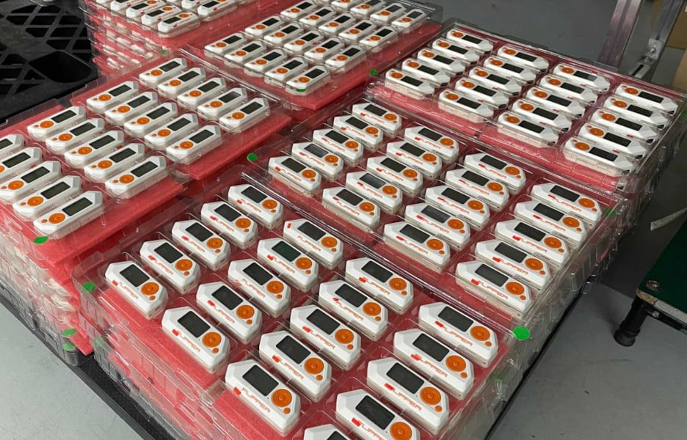
Pen-testing
Multitool Project
By Adam Fitzpatrick

Slide 2

Who is it for?
Penetration testers
Red-teamers
Anyone with an interest in offensive security

Slide 3
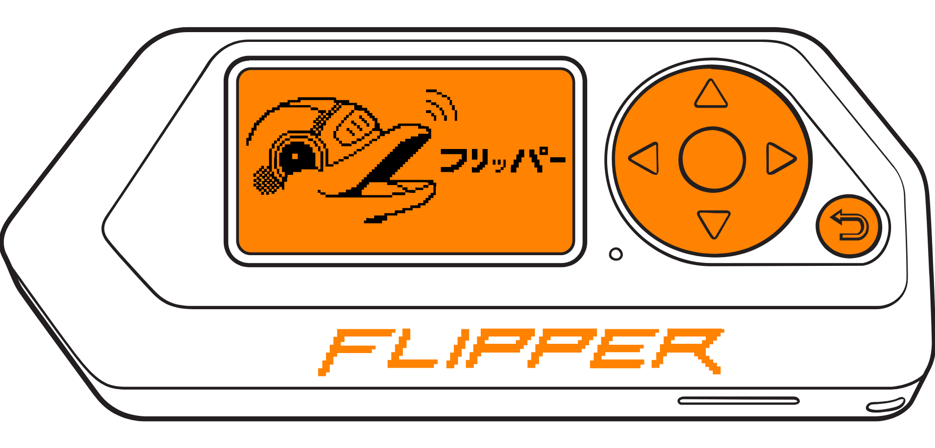
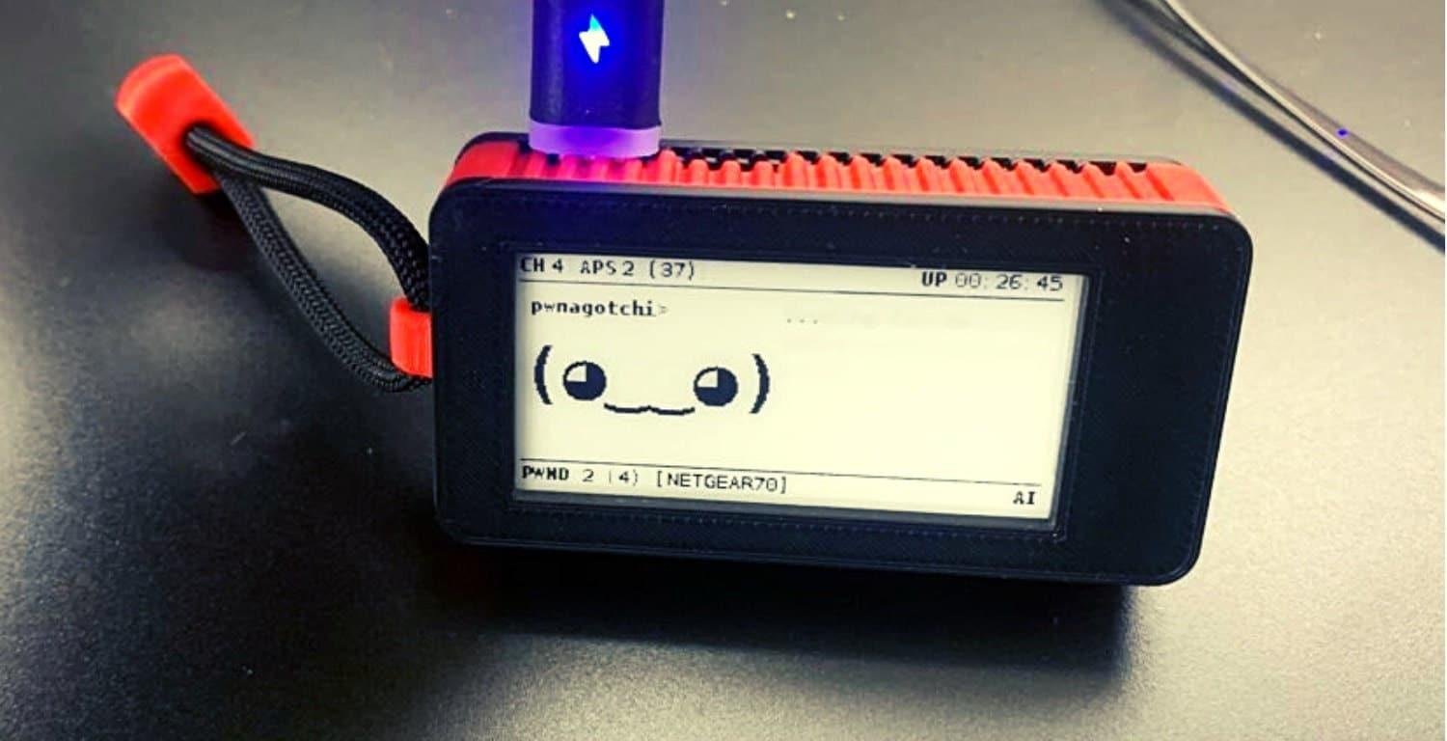
What is it?
A penetration testing multi-tool, similar to a Pwnagotchi or a Flipper Zero.
Small hand-held device that can fit in your pocket.
“A swiss army knife for pen-testers”

Slide 4
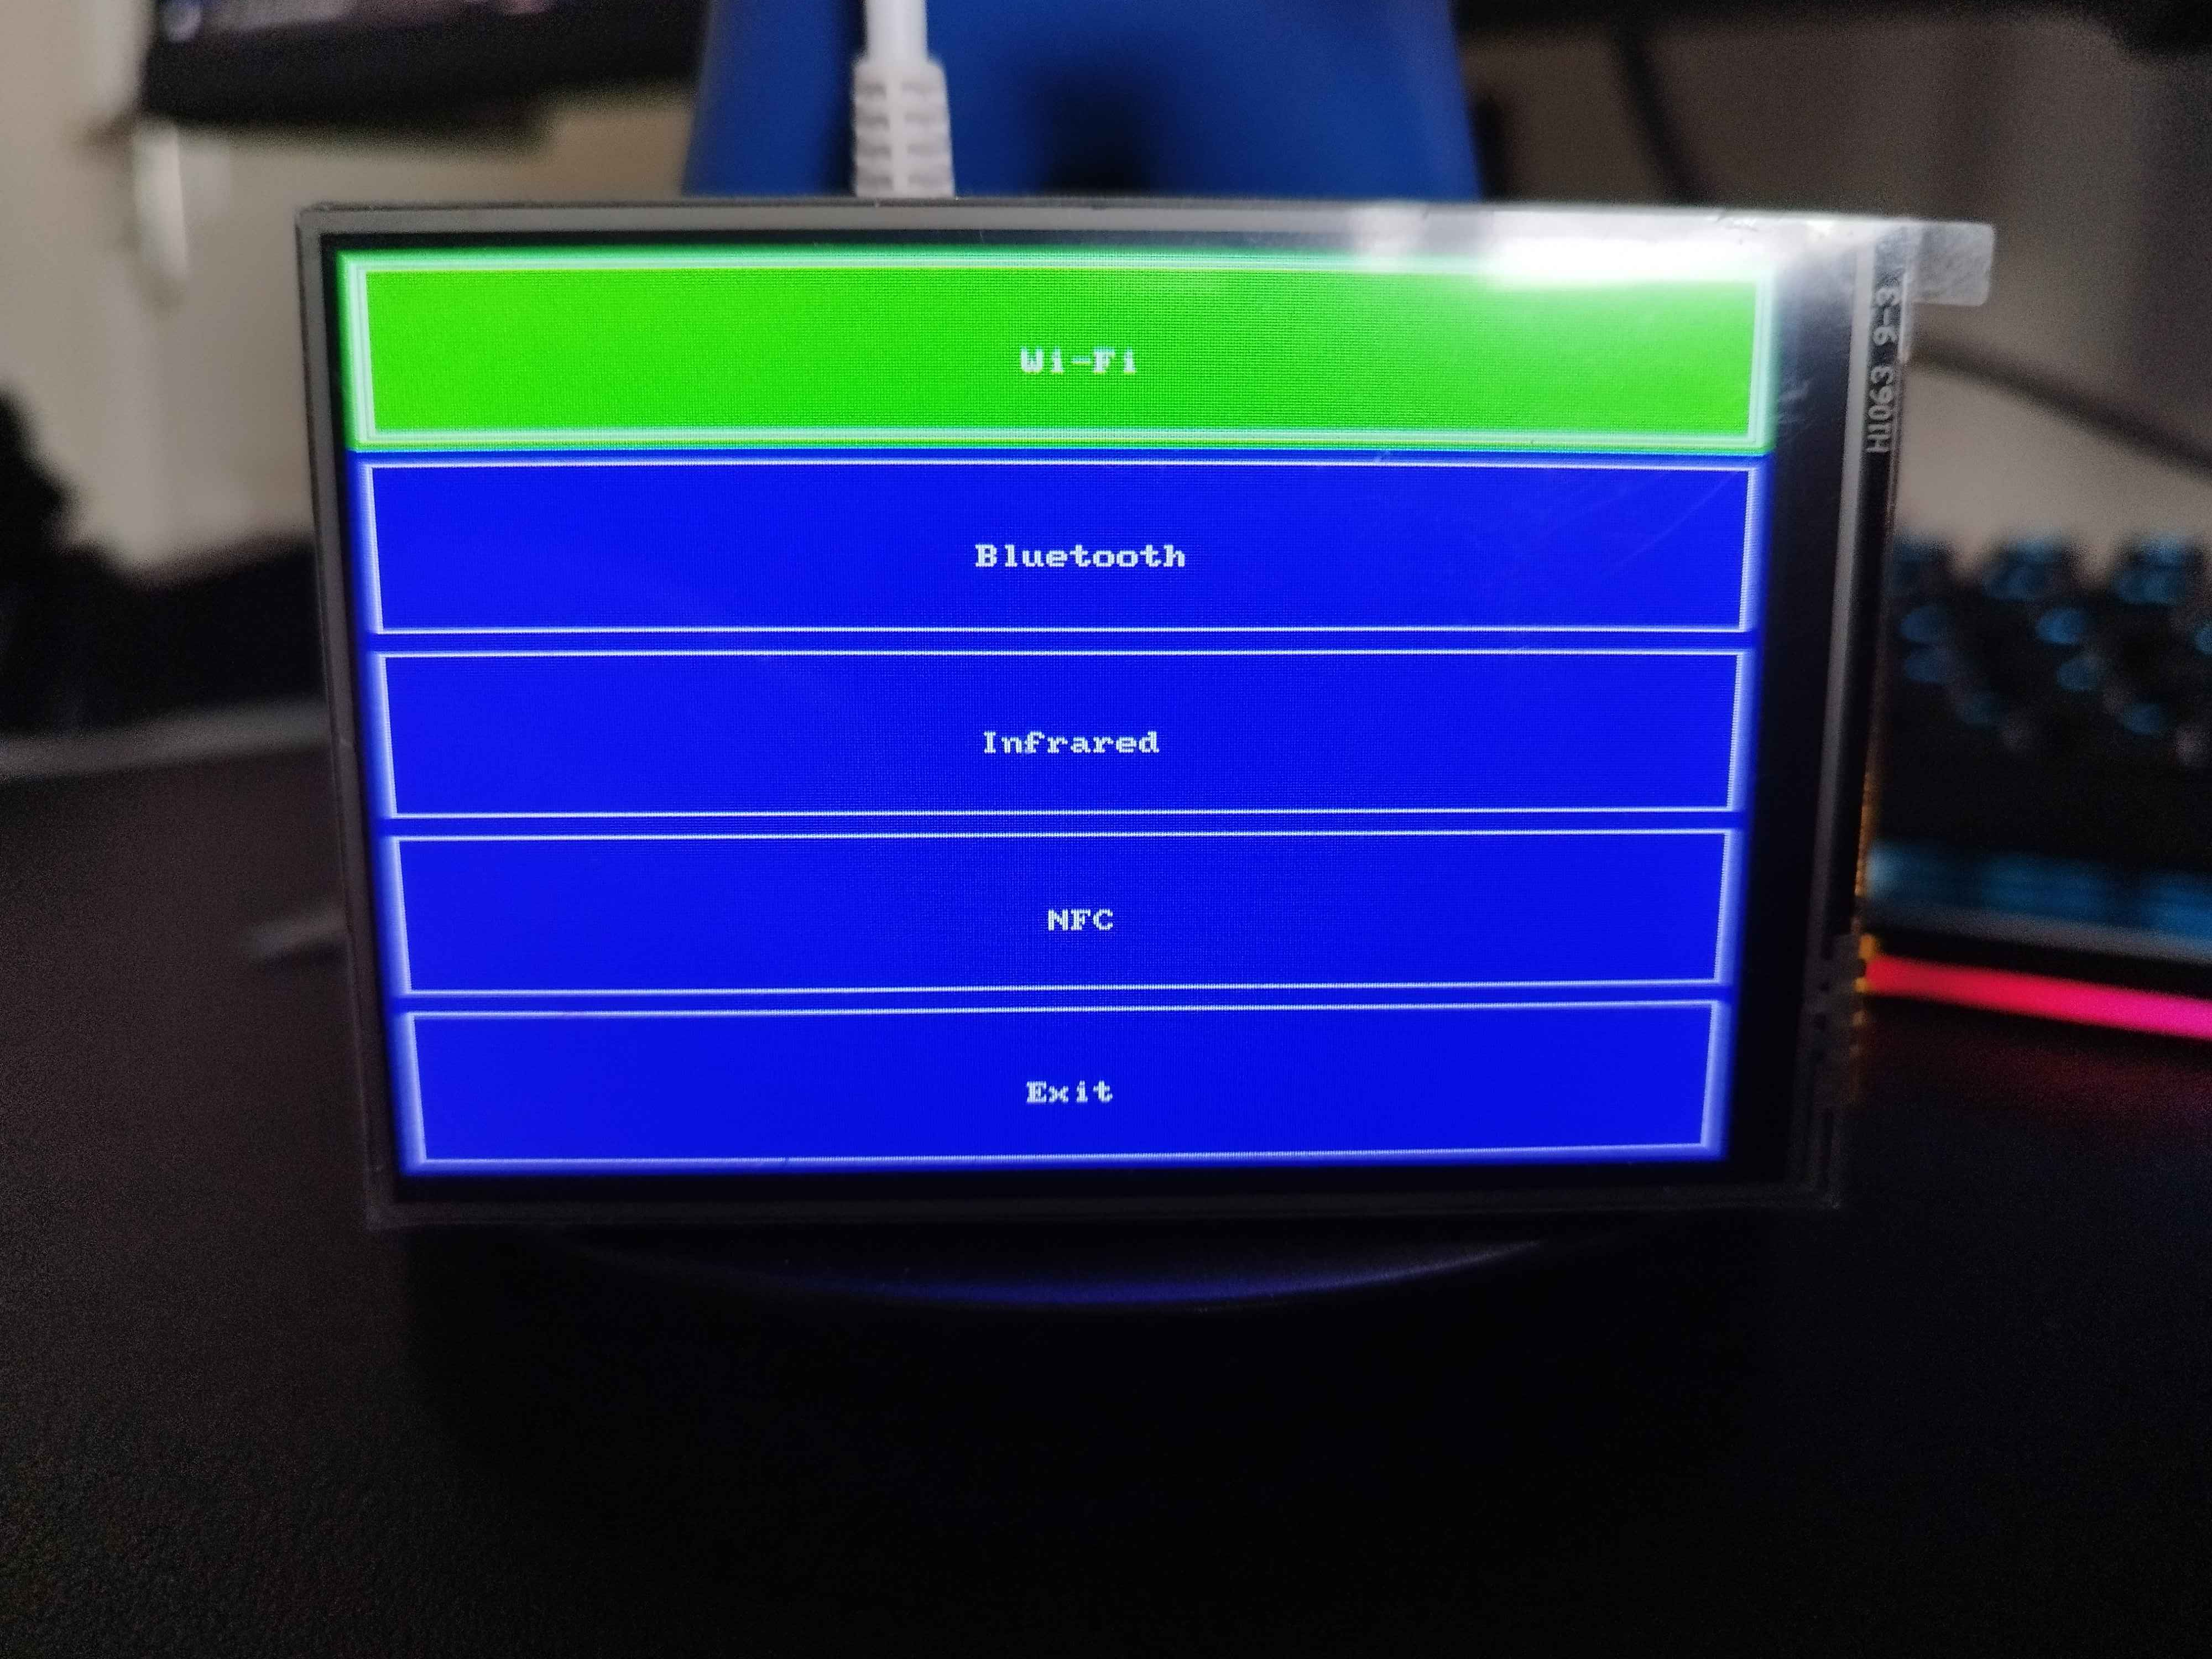
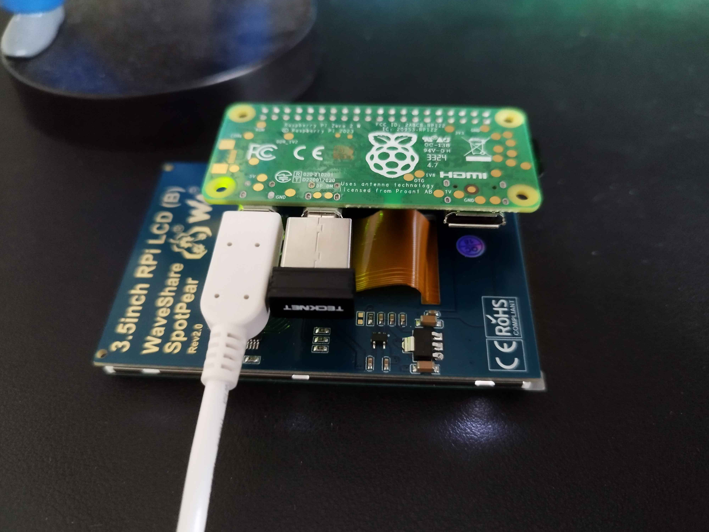
The Hardware

Slide 5
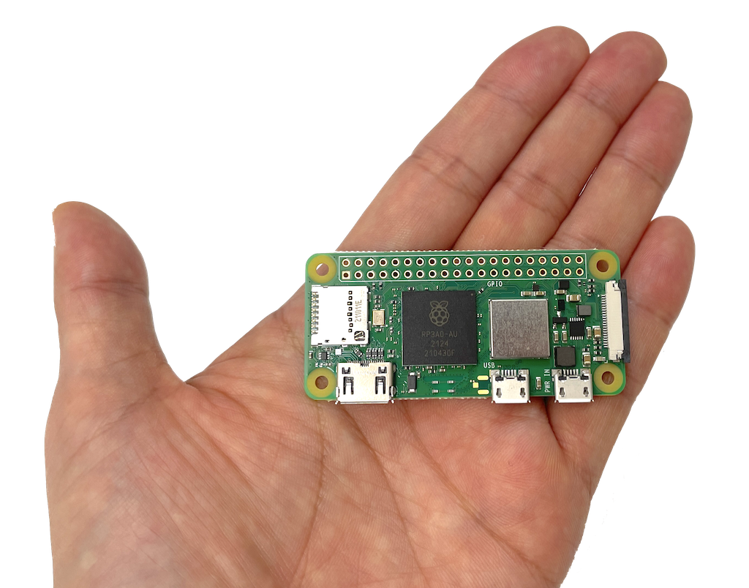


How will it be made?
Development board
Wi-Fi & Bluetooth modules
NFC / RFID hats
Infrared emitter & receiver

Slide 6
Thank You!

Slide 7
References
https://www.etsy.com/ca/listing/1397972079/pwnagotchi-ships-next-day
https://docs.flipper.net/
http://pngimg.com/image/62215
http://pngimg.com/image/62176
https://www.pngmart.com/image/tag/hacker
https://www.pikpng.com/transpng/bboTRR/
https://logos.fandom.com/wiki/Raspberry_Pi?file=Raspberry_Pi.png

