Slide 1

Evaluating Web Search with a Bejeweled Player Model
Studied article reference:
Fan Zhang, Yiqun Liu, Xin Li, Min Zhang, Yinghui Xu, and Shaoping Ma.
2017. Evaluating Web Search with a Bejeweled Player Model. In Proceedings of SIGIR ’17, Shinjuku, Tokyo, Japan, August 07-11, 2017, 10 pages.
DOI: http://dx.doi.org/10.1145/3077136.3080841
An analysis by Adam HOTAIT and Romain PASCUAL
Information Retrieval
CentraleSupélec

Slide 2


Two methods for Web-search evaluation
System-oriented studies
User-oriented studies
Set of relevance judgments to compare the quality of ranked result list in response to a fixed set of queries
Actual user behaviors during retrieval sessions to measure effectiveness of systems

Slide 3



Two methods for Web-search evaluation
Effectiveness
Cost & complexity

Slide 4
Two methods for Web-search evaluation
Effectiveness
One parameter heavily affecting effectiveness is how well we know when an user ends a search session
Cost & complexity

Slide 5


Some important vocabulary
Benefit
Cost
The amount of information on the studied subject that one can gain from the document
Temporal and cognitive efforts in processing, reading and understanding documents

Slide 6
Current models for stopping point determination
Benefit
Cost
Reciprocal Rank (RR)
Precision@N
User will stop once they find a perfect document
Percentage of relevant documents in top-N results
Upper limit for benefit
Upper limit for cost
Measures satisfaction
Measures frustration

Slide 7

The Bejeweled Player Model
The bar empties
Game is over (player loses) ↓
Frustration
The bar fills
Game is over (next level)
↓
Satisfaction

Slide 8
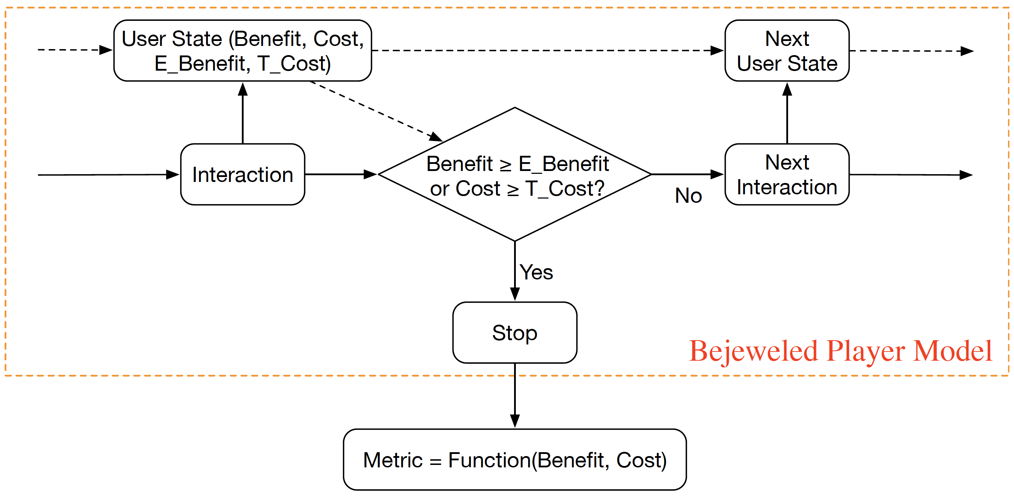
The Bejeweled Player Model

Slide 9
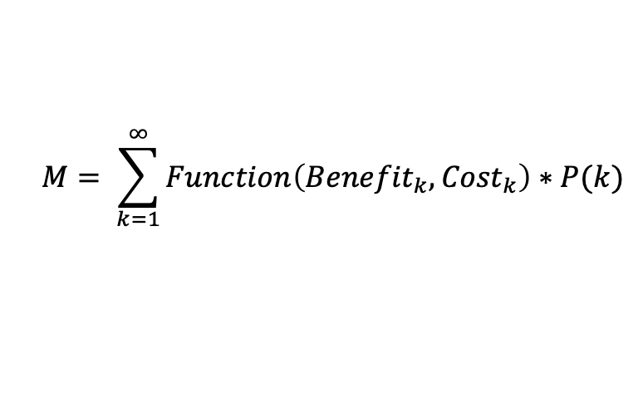
The Bejeweled Player Model
$$M= \sum_{k=1}^{∞}{Function\left({Benefit}_{k}, {Cost}_{k}\right)∗P(k)}$$
An adapted choice of the different parameters can simulate both Benefit-oriented and Cost-oriented models currently used
The BPM allows for model-abstraction
It is a “meta-model”

Slide 10

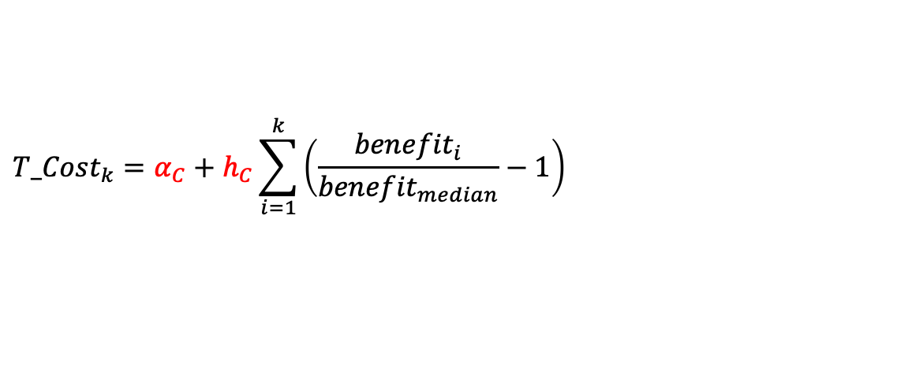
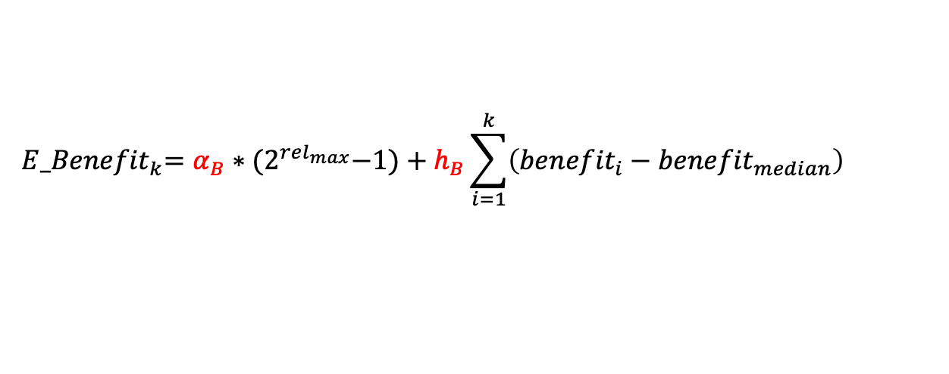
The Bejeweled Player Model
$${ E_Benefit}_{k}=α_{B}∗{(2}^{{rel}_{max}}−1)+h_{B}\sum_{i=1}^{k}{\left({benefit}_{i}−{benefit}_{median}\right)}$$
$${T_Cost}_{k}=α_{C}+h_{C}\sum_{i=1}^{k}{\left(\frac{{benefit}_{i}}{{benefit}_{median}}−1\right)}$$
where: ${benefit}_{i}$ = $2^{{rel}_{i}}−1$

Slide 11



The Bejeweled Player Model
New model
Can fit existing models
Has better results with carefully chosen parameters

