Slide 1
Machine Learning
Data Analysis
Statistics
Numerical methods
Traditionally done “by hand” or with Excel
Process Engineering / Finance
Machine Learning
Automated data analysis
Build a “model” by training with data
Apply the model when inspecting new data
More robust algorithms
Process more data more quickly
I want more...

Slide 2
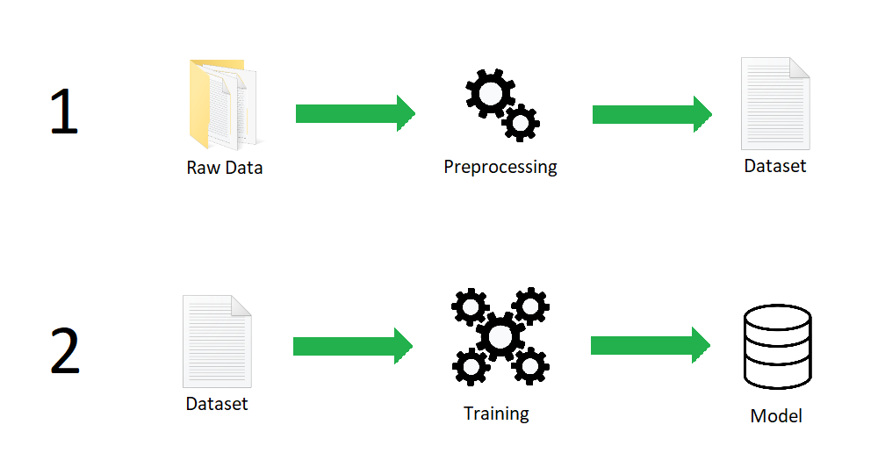
Background: Training

Slide 3
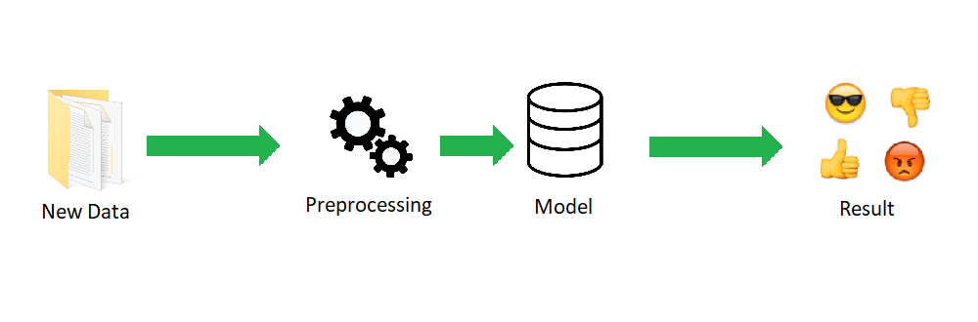
Background: Application

Slide 4
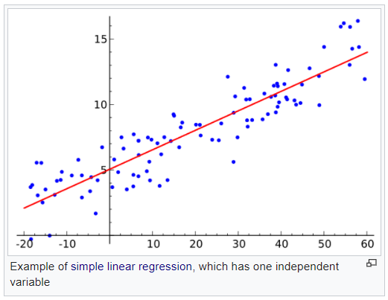
Example: Linear Regression
Y = mX + b
m and b are the model
Given many values of X and Y, we can learn what m and b are.

Slide 5
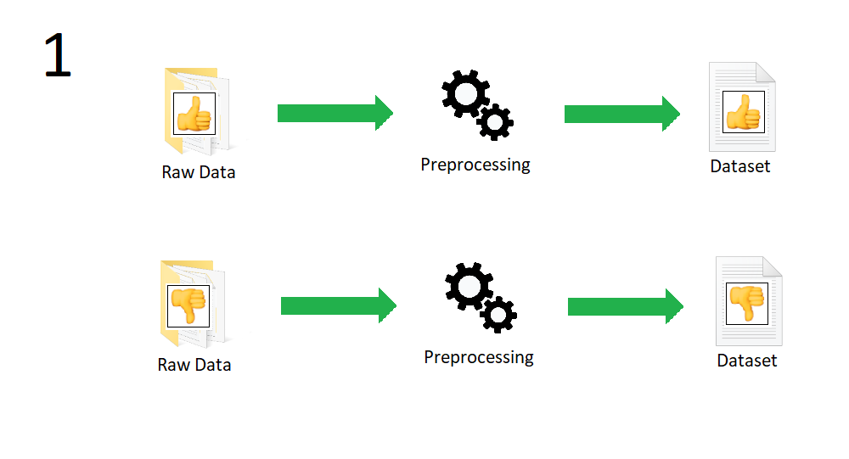
Classification

Slide 6
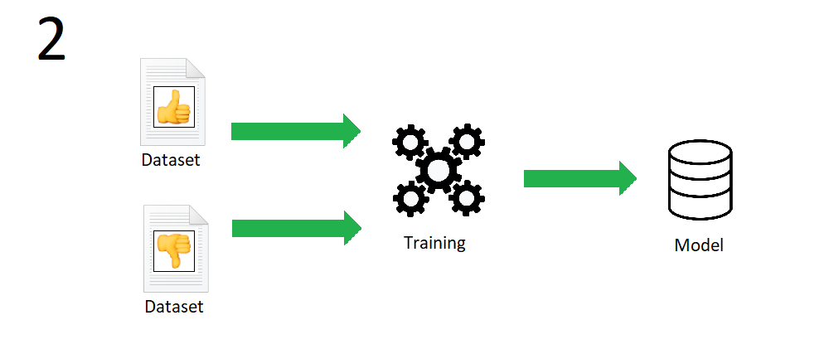
Classification

Slide 7
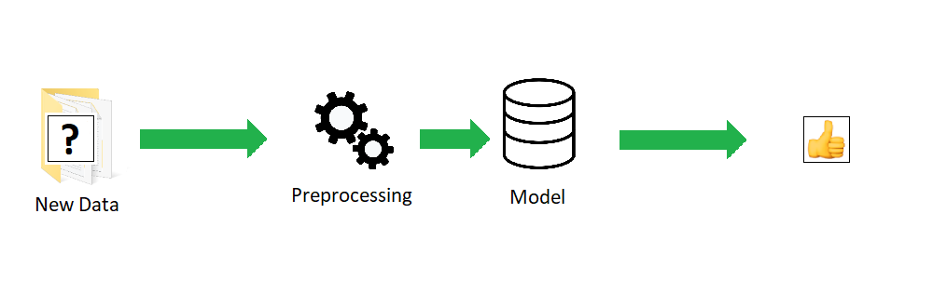
Classification

Slide 8
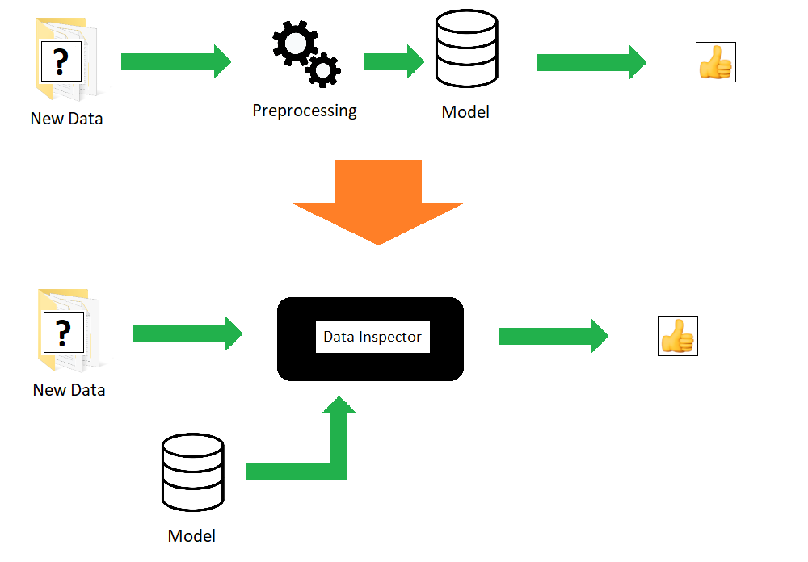
Inspection

Slide 9
Data Inspector
The model is an input along with the data that is inspected
Changing the model changes the behaviour of the Inspector
Update the model with new data as needed
Several models can be created to suit different circumstances
The model can be updated while the system is running

Slide 10
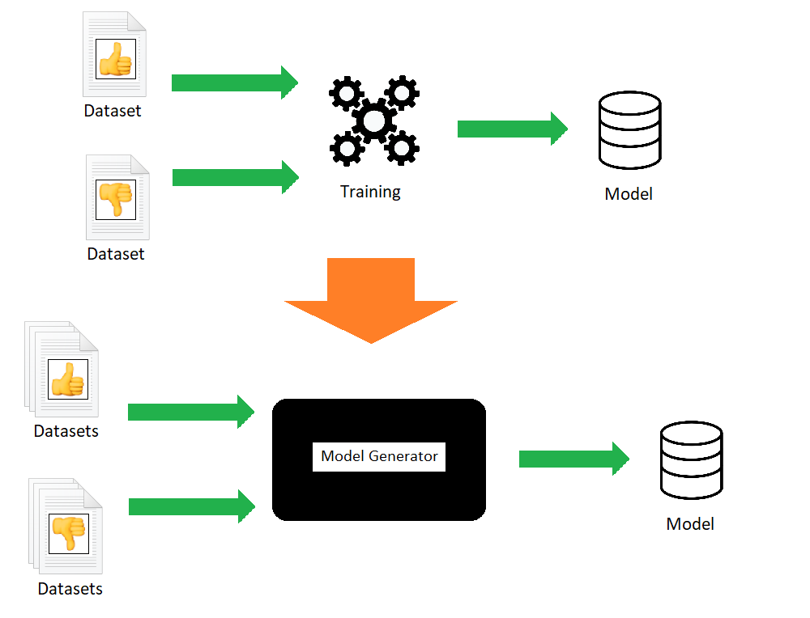
Generating a model

Slide 11
Model Generator
Create a model using one or more datasets for each class
Over time, update the model using new datasets with old ones
Mix and match datasets to create different models for different inspection requirements

Slide 12
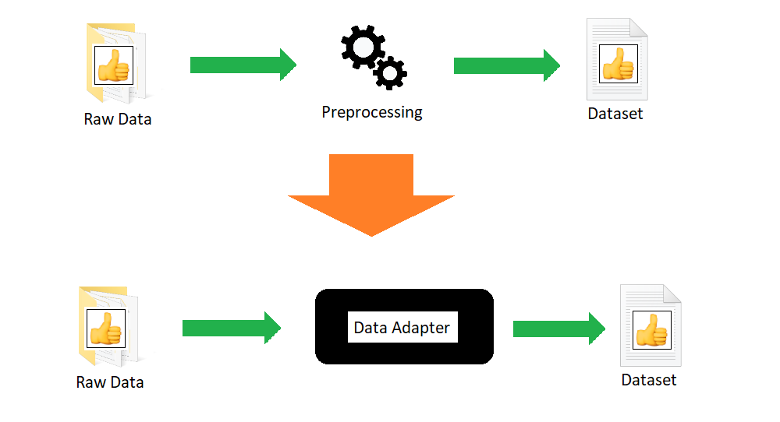
Processing data

Slide 13
Data Adapter
Generate a “dataset” with multiple source files for a given class
Dataset is saved as a file the Model generator can understand
Data adapter is different for each application
Source files can be of any type (png, csv)
The team decides how source files are read and saved as a dataset for the model generator
Boiler plate code provided. Only math is required

Slide 14
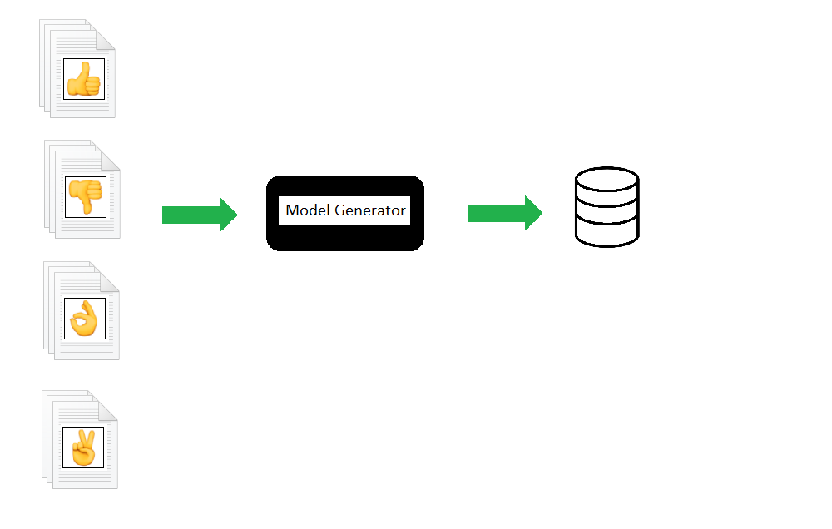
Multiple Classes

Slide 15
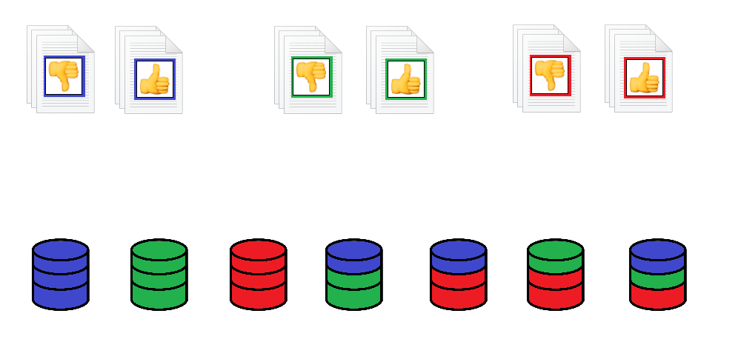
Mix and Match

Slide 16
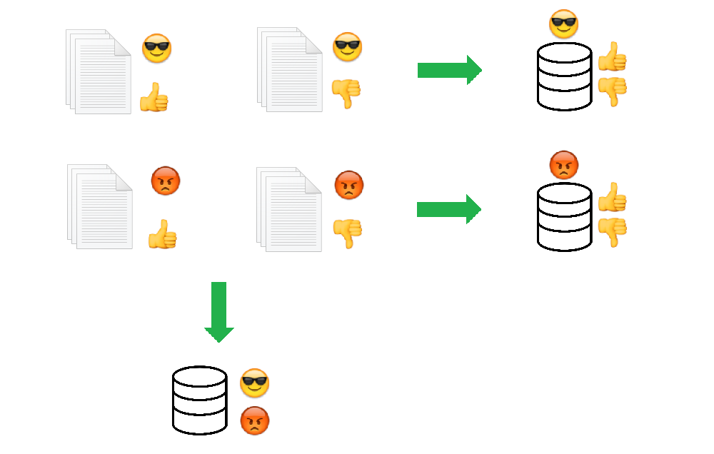
Multiple Criteria

Slide 17
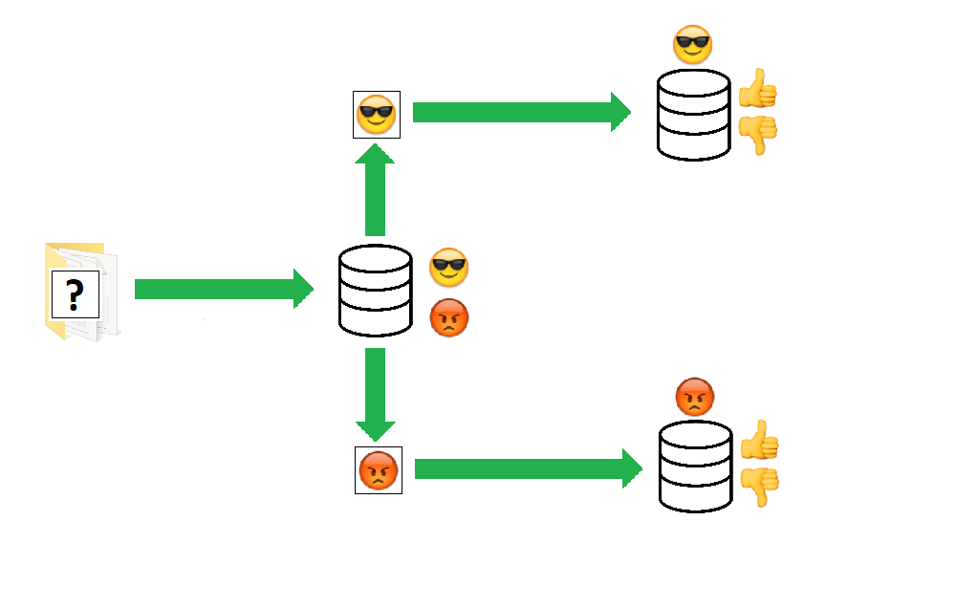
Multiple Criteria

Slide 18
Remote by default
Data Adapter, Model Generator, and Data Inspector are standalone applications
All three operations can be done in different locations
Data can be collected in the field and datasets sent by email
Models can be generated at your desk
Inspector model(s) can be updated over a network or at the station itself
The inspection station never has to go down

