Slide 1
Tax Increment Financing
TIF 101
July 7, 2020
City of Des Moines

Slide 2
Tax Increment Financing
A powerful economic development tool to generate new property tax revenue
But before diving into TIF, we need to back up to a broader topic: Urban Renewal

Slide 3
Urban Renewal
Urban renewal is a broad concept and method for improving physical and economic conditions
Designations:
Slum – Dangerous or unhealthy conditions dominate
Blight – Substantially deteriorated or inadequate conditions inhibiting growth
Economic Development – self explanatory
Urban renewal allows cities tools to address these issues. TIF is one of these tools
We do this by creating Urban Renewal Areas

Slide 4
Establishing an Urban Renewal Area
UR Area Plan is created
Contains purpose for which UR Area was created
Designates the UR Area
Contains the projects that can be done in the UR Area
Council approves the UR Plan, which activates it and creates the opportunity for TIF
Other taxing entities are consulted and given the chance to respond
Amendments
Needed to add or remove projects from URA
We list all of the planned projects in URA amendments
If project isn’t listed, cannot use TIF funds
OED amends them annually, some more often
Example – added the Animal Control facility to the SE Agriculture URA

Slide 5
Urban Renewal Areas
Accent - 77003 | Merle Hay – 77073
Beaverdale – 77071 | Metro Center – 77062
Central Place – 77004 | Northeast Gateway 1 – 77104
Drake – 77109 | SE Agri Business – 77052
Fleur Drive – 77067 | Southside – 77081
Forest Ave – 77095 | Southwest Gateway – 77108
Guthrie Ave– 77008 | SW 42nd & Army Post - 77094
Ingersoll-Grand – 77084
We submit certifications to the state for these URAs

Slide 6
Urban Renewal Area Sunset
Urban Renewal Areas do not automatically sunset by statute
TIF areas may have a statutory sunset
Council must take action to close an Urban Renewal Area
Now on to TIF

Slide 7
TIF Ordinances & TIF Areas
Once a URA is established, a TIF ordinance must be passed before the flow if TIF can start
URA creation may happen long before a TIF ordinance is passed
TIF ordinances outline the part of the URA that will be used to create the TIF Area
A URA may have multiple TIF Areas

Slide 8
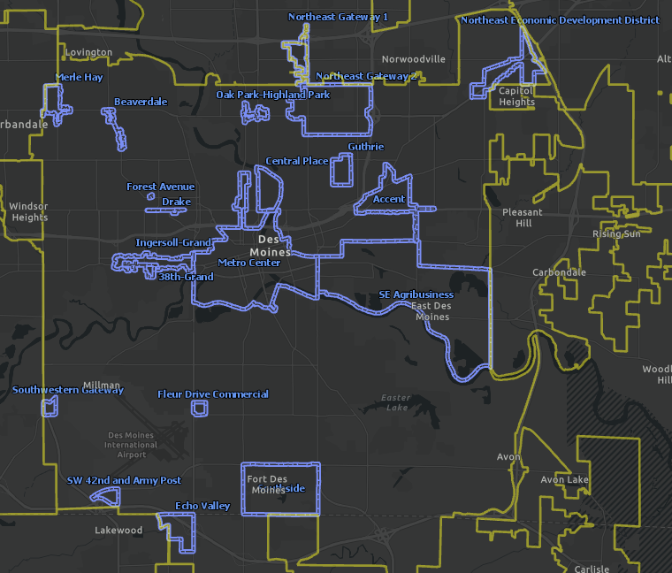
Des Moines URAs and TIF Districts

Slide 9
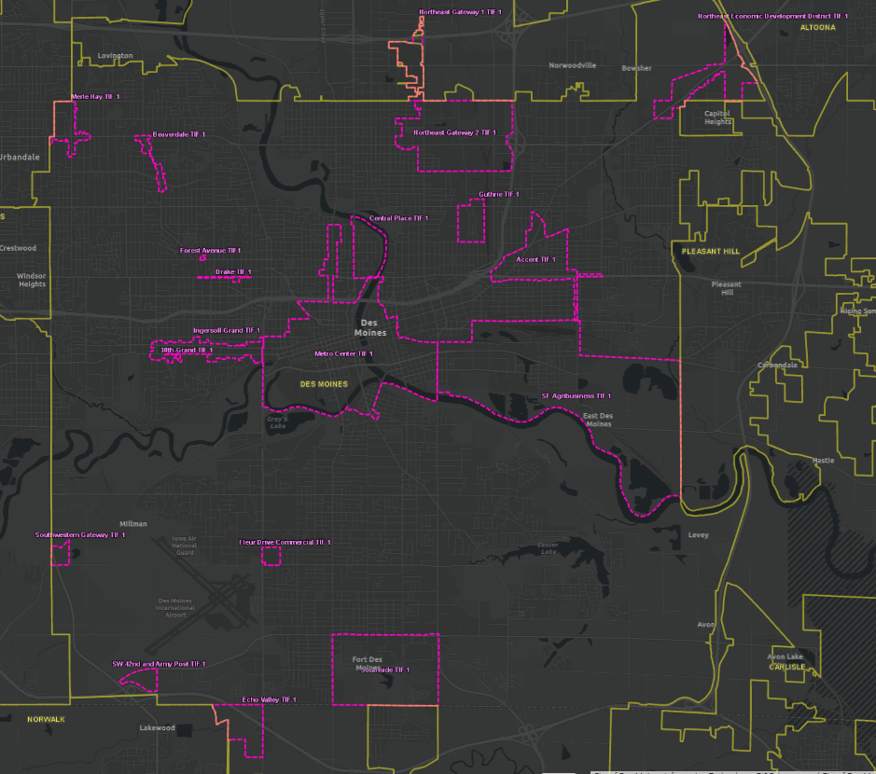
Des Moines TIF Districts Only

Slide 10
TIF Types & Sunsets
Slum and Blight
Similar to the URA definition
Perpetual: ends when the TIF has achieved the plan’s goals
Economic Development
20 years after the first year (so 21 years)
The clock starts once debt is first certified for that TIF District
Des Moines uses this extensively

Slide 11
Urban Renewal Projects
The creation of the URA allows eligible projects to be started
To be eligible
Must further the stated goals of the UR Plan
Examples from 403.17(25)
Infrastructure improvements (most common for many cities)
Loans or grants for improvements
Land or building acquisition and remodeling
Projects must be financed by the issuance of debt or undertaking of an obligation

Slide 12
How TIF Functions
In a nutshell:
A frozen base is established when we certify debt for the first time with the state for that TIF district
Any increase in valuation above this frozen base can be diverted from other levy authorities (non protected levies)
This increase is called increment, and is apportioned to the TIF authority
When the TIF ends, the (hopefully) higher tax valuations are apportioned to all taxing authorities
(Increment Valuation)/1000) x TIF Rate = TIF Revenue

Slide 13
How TIF Functions (cont’d)

Slide 14
TIF Revenue Formula (from the State)

Slide 15
TIF Example

Slide 16
TIF Certification
Every December 1, we must certify the debts for each TIF district for the following fiscal year
Recall that debt means more than bonds – here it means an obligation which also includes rebates and developer agreements
We meet with OED staff in the Fall to review each TIF district and the upcoming payments for the next fiscal year
The debts must be certified to be eligible for tax collections the following fiscal year

Slide 17
TIF Utilization
Council policy is that TIF utilization across the City shall not exceed 75%
Some districts go over this amount
The valuation of the Metro Center TIF district allows us to go over the 75% limit for some other TIF districts
All TIF increment available FY2021: $2,574,407,390
Metro Center increment available FY2021: $1,844,048,396
Every dollar of valuation diverted to increment is a dollar that cannot be taxed for the general fund

Slide 18
TIF Utilization

Slide 19
TIF Utilization

Slide 20
TIF Risks
When used, TIF reduces general tax revenues for other taxing entities in the TIF district ($1 TIF = $.33 GF)
TIF can go upside down when the tax base falls below the frozen level
Property valuations decrease
Buildings are demolished or converted to a non-profit use
Property tax assessment is successfully challenged
Agreements for TIF projects often contain a minimum assessment amount
TIF must be managed carefully
Other taxing entities are impacted in the short term, as is the general fund
TIF has been abused by some municipalities in the past

Slide 21
Questions?

