Slide 1
TerminusDB: Graph database with collaboration and version control
Adam Pawełek, Cédric Meier

Slide 2
Content
Introduction
Properties
Project Setup
Code Snippets
Conclusion and future work

Slide 3
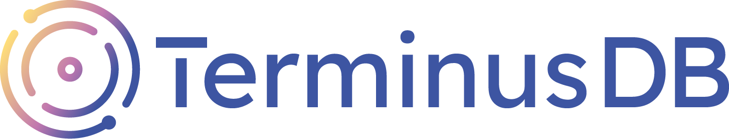
Introduction
Source: dbpedia.org
“An in-memory, distributed, and open-source document graph database for people who want the convenience of documents with the query power of graph relationships. For people who want data to be the star of their builds.”

Slide 4
Properties
Schema-Aware
WOQL Query Language
Graph Database
Open-Source
Scalability
Document and Relational
Version Control
Collaboration
Sources: Provided by PowerPoint.
Notes:
Query Language: TerminusDB uses a query language called WOQL (Web Object Query Language) that is designed specifically for working with graph data. It is a declarative language that provides a high level of expressivity, allowing complex queries to be written with relatively simple syntax.
Graph Database: TerminusDB is a graph database, which means that data is stored as nodes and edges in a graph structure. This makes it well-suited for representing complex and interconnected data, and also represents the data in a more meaningful way.
Open Source: TerminusDB is an open source project, which means that it is free to use, modify, and distribute. This makes it an attractive option for developers who want to avoid vendor lock-in and have greater control over their database.
Scalability: TerminusDB is designed to be horizontally scalable, which means that it can scale to handle large volumes of data and high traffic loads. It can also be used in a distributed architecture, enabling data to be stored and processed across multiple nodes.
Schema-Aware: TerminusDB is a schema-aware database, which means that the database schema is defined as a graph schema and can be versioned, shared and managed just like data. It enables developers to reason about data in a structured way, providing a powerful mechanism for data governance, provenance, and collaboration.
Integrated: TerminusDB is natively integrated with Git through a feature called TerminusHub, enabling version control and collaboration for both data and schema. This id
Document and Relational: TerminusDB is a multi-model database, supporting both document and relational data models. This makes it flexible and adaptable to a wide range of use cases.

Slide 5
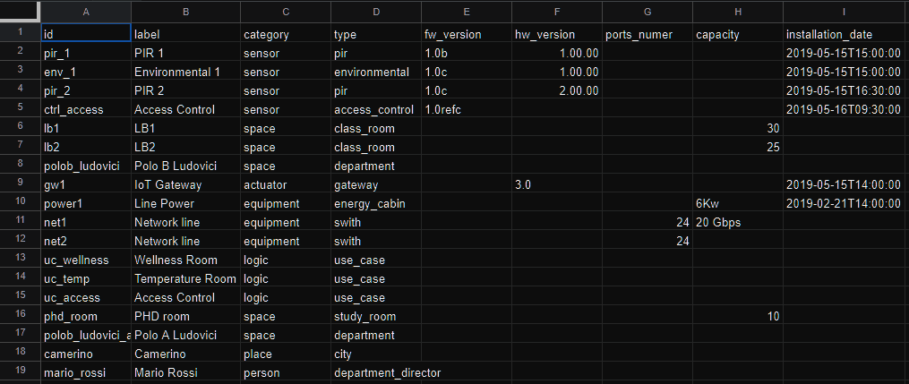
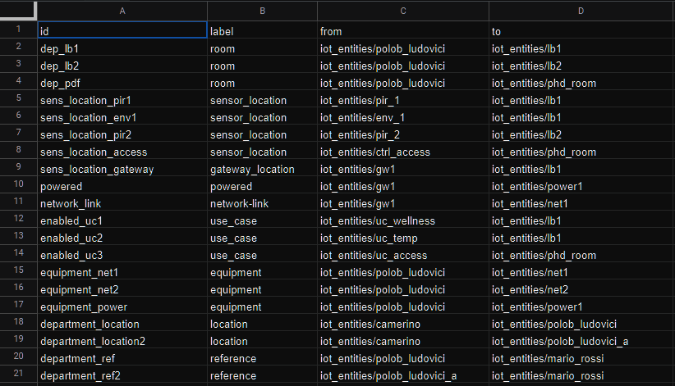
Project Setup - Data
Data-set containing a tab for nodes and edges.
Source: Provided by assignment.
Notes:
The data-set received was our initial starting point for our project.
It contains a tab for the setup of the Nodes (In graph databases these are the «things») and another tab for the Edges (In graph databases these build relationships between the nodes).
The data-set features persons, devices, rooms and locations. We also used it to create our graph model for structuring the database.

Slide 6
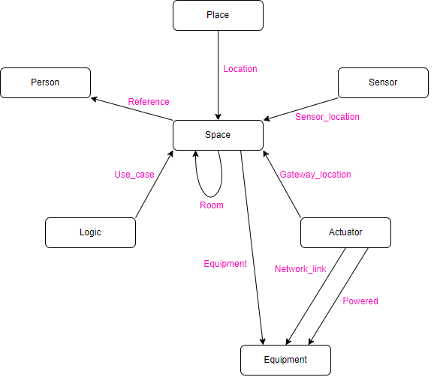
Project Setup - Diagram
Source: Own work. Software: draw.io
Notes:
Let me explain a bit the schema:
Space seems to be the most central node. Spaces are rooms, sections or buildings of Unicam.
A place provides a location for a space. Places can be regions or municipalities within Italy.
Spaces have persons that function as a reference for a space.
Logic is bound to spaces with use cases. For example, access control logic for each space is saved within this.
Rooms are located within spaces, but are themselves spaces. They split spaces into more distinct sub-spaces.
Spaces have Equipment within them.
Actuators (Defined as: «An actuator is the mechanism by which a control system acts upon an environment.») are located within spaces. Actuators also power and provide network to equipment.

Slide 7
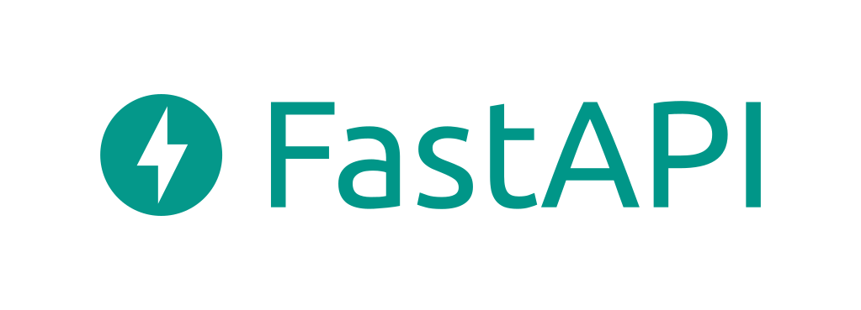

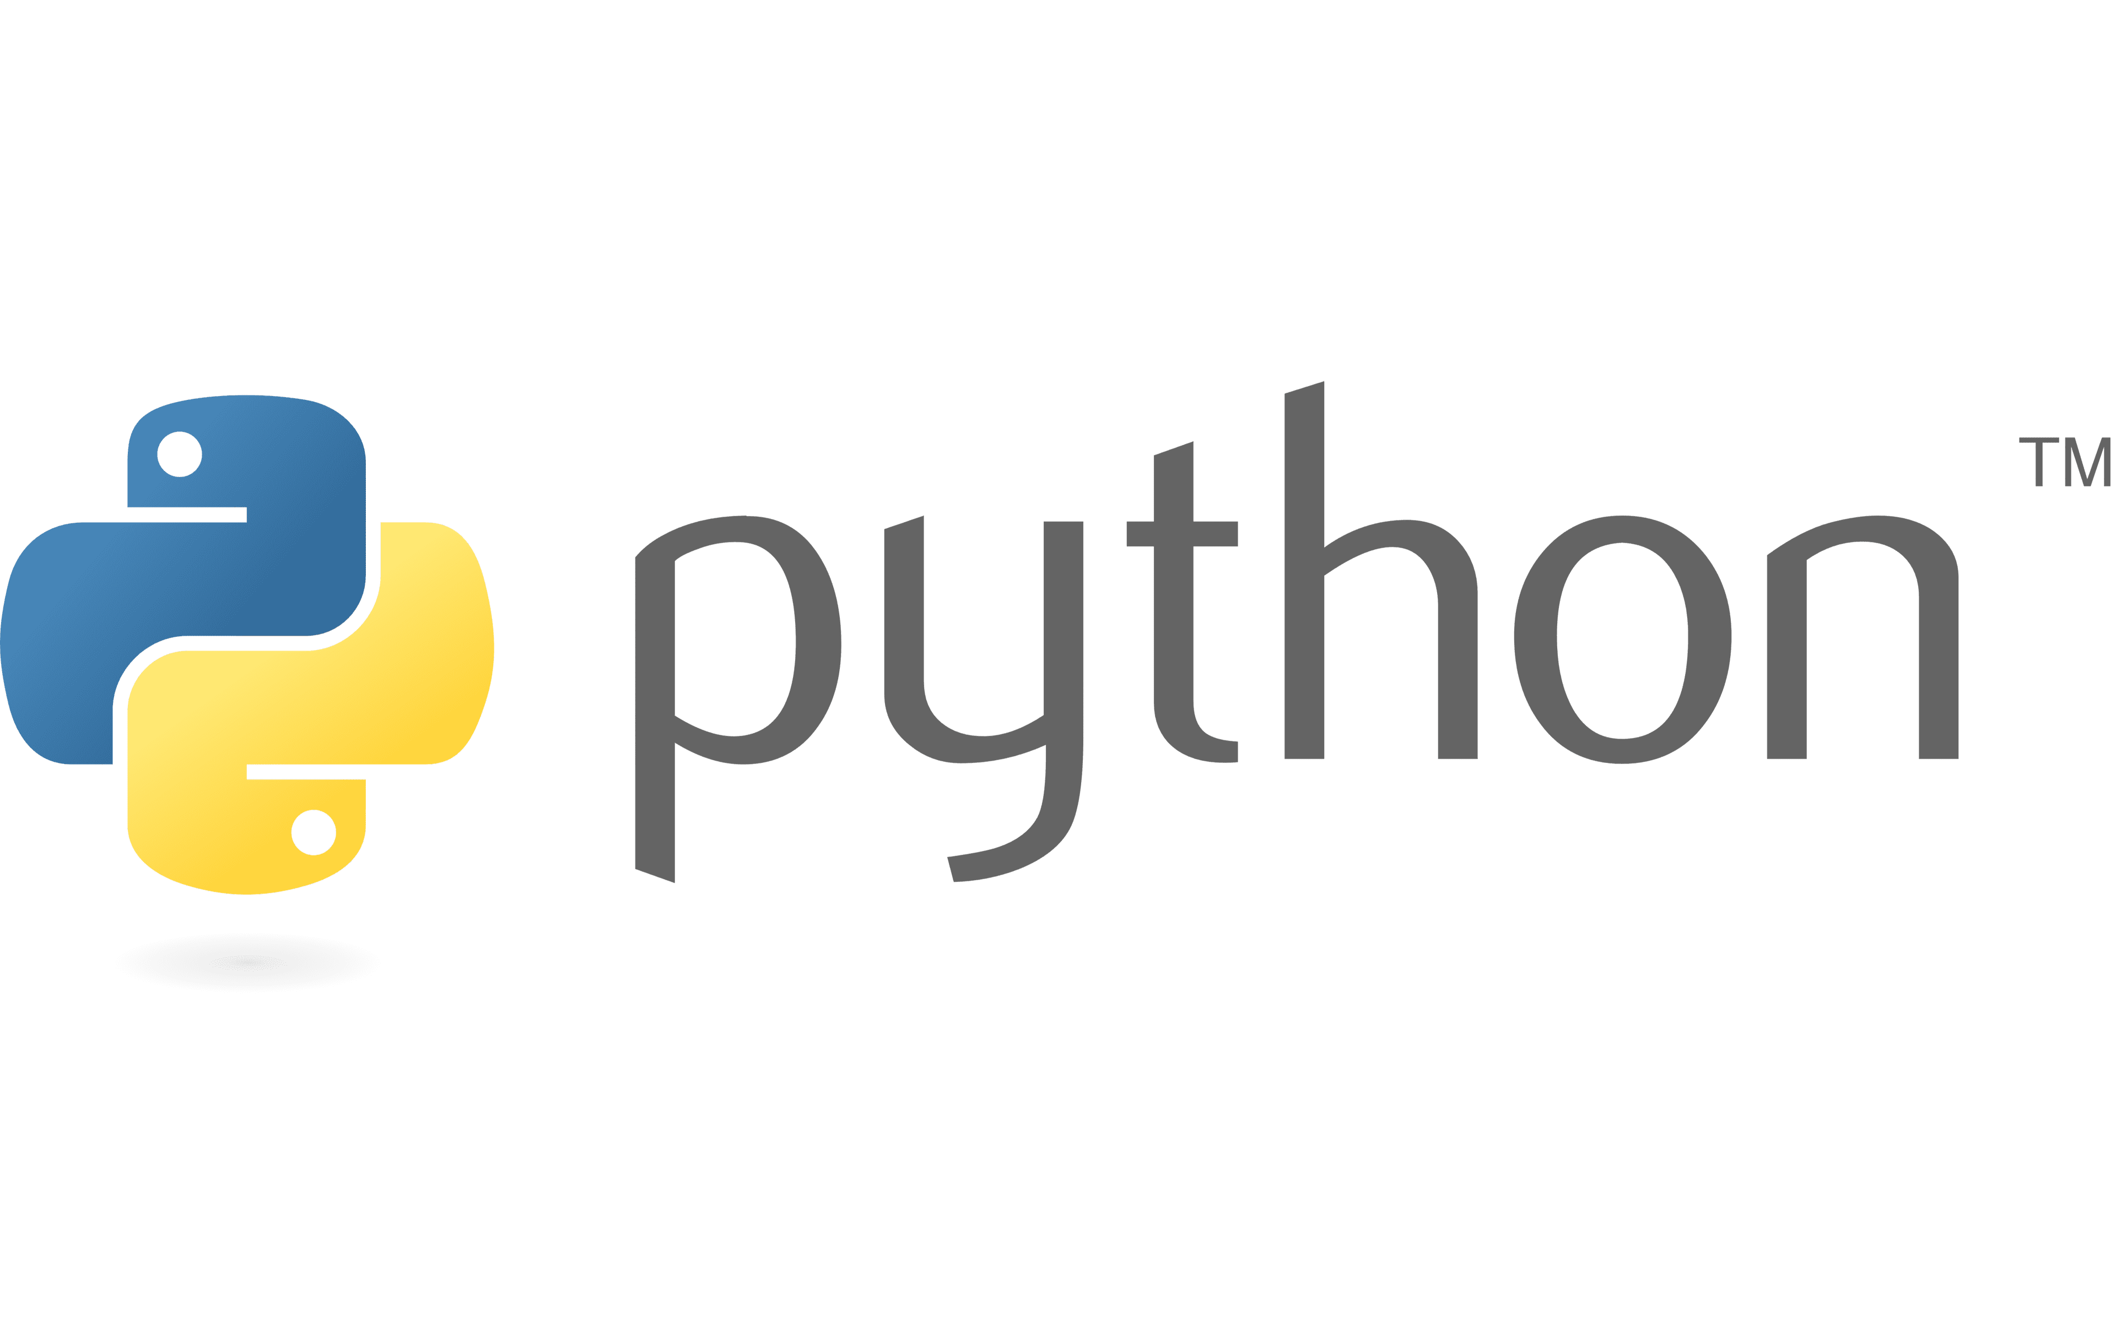
Project Setup - Technologies
Sources: 1000logos.net
Notes:
Let me explain a bit the technologies we used and for what we used them:
Python: Python is the main language we used for setting up our project. Main and many other files are written in python.
GitHub: We used Github to be able to collaborate and also to have our project publicly available.
FastAPI: We used FastAPI to test our API’s and CRUD operations.
- TerminusDB: Of course we also used functionalities from the TerminusDB project via import.

Slide 8
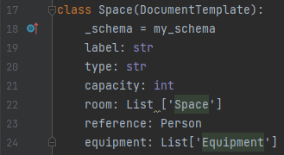
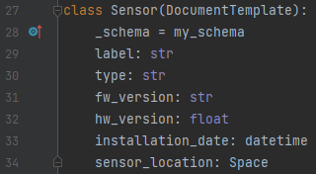
Code Snippets of Nodes and Edges
Schema definition for spaces. Editor: PyCharm
Schema definition for sensors. Editor: PyCharm

Slide 9
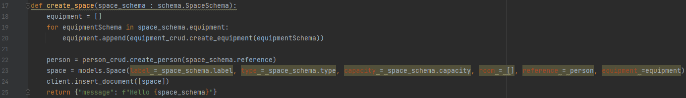
Code Snippets of Routers and CRUD operations
Router for post space. Editor: PyCharm
Create space function. Editor: PyCharm

Slide 10
Conclusion and future work
Conclusion:
Reverse engineering a schema from the data was interesting!
It was the first time for us to implement a graph database, and for one person it was the first time in general setting up a database in this scale.
Documentation and support for TerminusDB is not as big as for other databases. This made the project more interesting and more challenging to set up.
Future work:
It would be interesting to see how other databses performed with the same data.
It would also be interesting to see how the TerminusHub feature behaves in use.
There is also a possibility to build real applications ontop of this database.

Slide 11
Thank you for your attention ! Questions?

