Slide 1
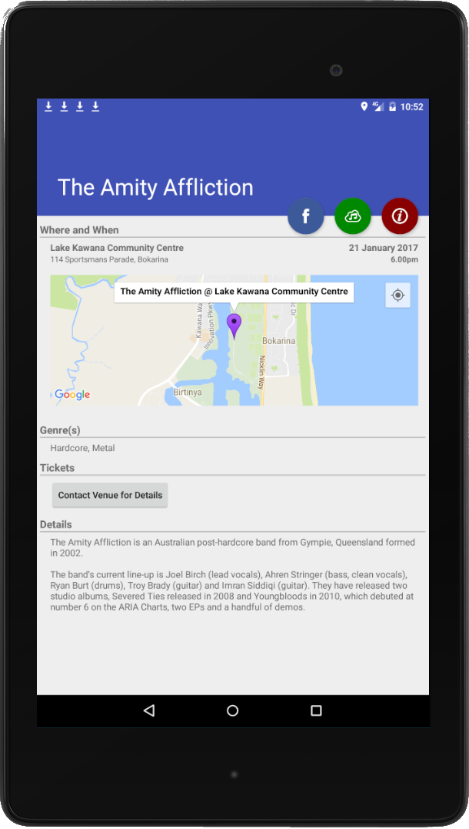
Coast Live!
Music, Made Smart
Notes:
<pause 5 seconds> The Coast Live! App for Android brings comprehensive data about live gigs on and around the Coast to your smartphone. Aggregating event details from several different sources, Coast Live! Provides an intuitive and powerful way to view and keep track of what’s going on when, and where. The journey to this point wasn’t an entirely smooth one, however.

Slide 2
Event Data (where is it?)
Notes:
The first problem to solve is finding any actual data about live events on and around the Coast. There’s some out there, but it’s spread across a number of different sources, such as …

Slide 3

Event Data (where is it?)
Notes:
Eventfinda …

Slide 4

Event Data (where is it?)
Notes:
Muso’s Garage …

Slide 5

Event Data (where is it?)
Notes:
Venue websites …

Slide 6

Event Data (where is it?)
(as of 10am on submission day)
Notes:
And, as of approximately 10am on Hackfest submission day, the Sunshine Coast Council. Unfortunately nobody seems to agree on what an event should look like, as data. And many events may appear in more than one dataset, and some datasets have tiny disagreements about where venues actually are; so it tends to get pretty messy, pretty quick.

Slide 7
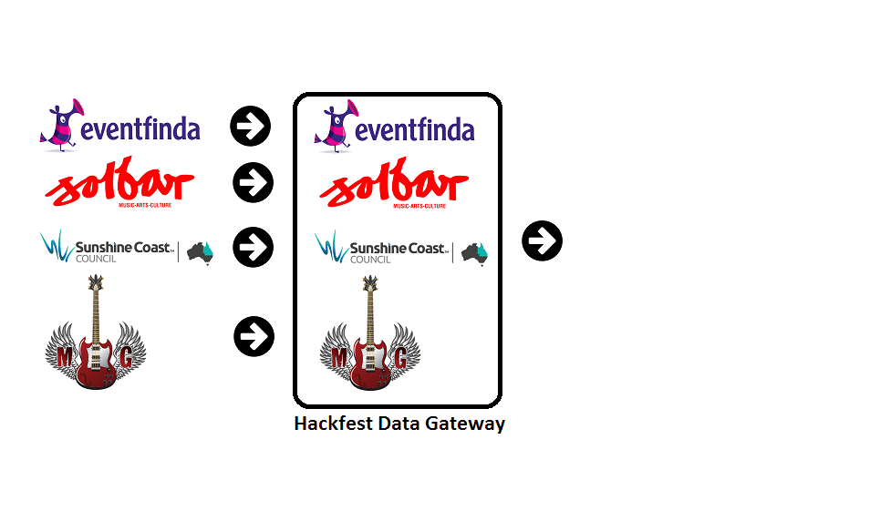
Event Data (making it usable)
Notes:
The solution to this fragmentation can be found through the Hackfest Data Gateway. Created as part of Hackfest 2015, the data gateway can speak with each datasource, collect all the data, collate and curate it intelligently, normalize the data format and structure, and produce a single unified dataset that contains all the information …

Slide 8
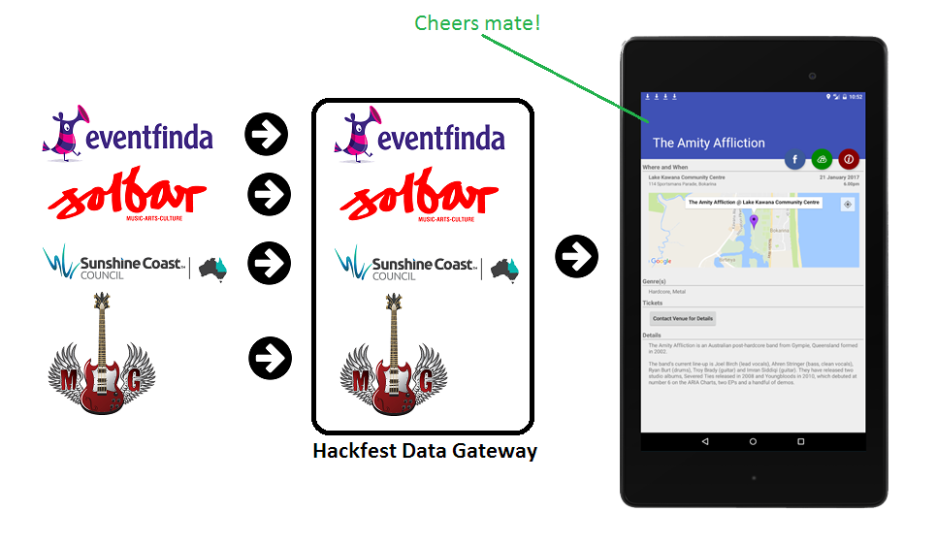
Event Data (making it usable)
Notes:
… and that’s ready to be passed on to downstream consumers. Downstream consumers such as CoastLive!. Which brings us to the CoastLive! App itself.

Slide 9
Live Demo (insert video)
Notes:
<Open app> Receiving event details from the data gateway, the Coast Live! App provides a comprehensive list of live music events on the Coast. <tap menu button, go into each section as announced> Users can browse events by artist, date, genre, and venue. Specific venues are artists can be marked as favorites <add favorites in app, demo favorites view>, allowing users to follow just those events and to automatically receive local notifications whenever a new event is published for a favorite artist or venue. Users can also customize in-app content by choosing their preferred genres of music <go to genre filter, select Funk, return to artists, and go back and clear filter>. These settings apply application-wide, and only events that match the user’s nominated genres will be displayed. Also available is the ability to view and select events on a map <go to map view, demo slider>. The slider below the map moves the search date forwards and backwards through time. Only events happening on the selected date are displayed on the map. <tap map markers> Tapping on a marker will display the details for the associated event, and also allow the user to get driving directions to the venue if they want. Or, the user can tap the ‘Additional Data’ button to overlay additional Council datasets on the event map. <add wifi AP’s to the map> Or if the user taps on the info window for an event <tap solbar, choose event, go in>, they will be taken to the details screen for that event. The same thing happens if the user taps an event in any other section of the app. The event details screen will display venue details, event date and time, offer driving directions, links to tickets, and other event information if available. The user can also tap to view the event in its original dataset, and lookup the artist on Youtube and triple-j unearthed.

Slide 10
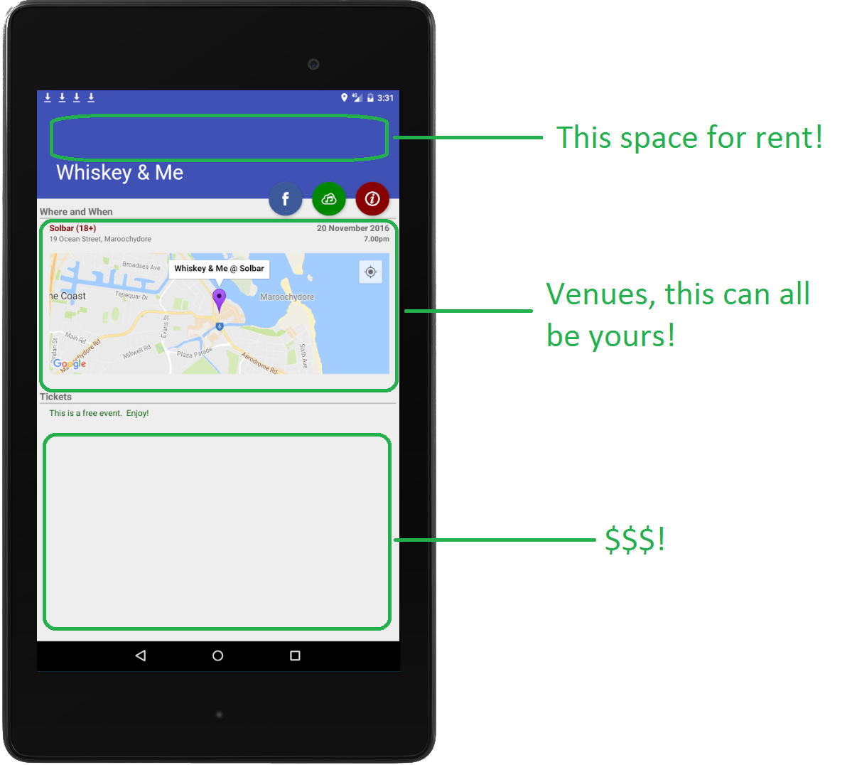
Business Potential
There’s actually lots!
Notes:
Coast Live! Offers a number of potential avenues for business development. These might include geofenced promotions at live music venues, the ability to purchase music, band merchandise, and event tickets directly within the app, push notification access and premium venue listings for businesses that want to claim their venue profile, or even simple display ads. The potential is huge!

Slide 11
Rave Reviews (1 for 1 so far)
“An awesome idea! This will save
[venue admins] tons of time!”
- Anonymous @ Solbar
1 for 1 is a 100% approval rating!
Notes:
And not only that, Coast Live! Is already receiving positive reviews from real people. The only non-Hackfest-related person to see the app so far thought that it was an awesome idea, and that it would save venues heaps of time and effort in terms of managing and promoting their events.

Slide 12
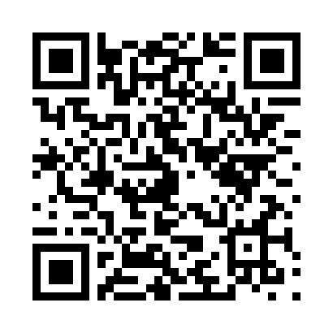
Install Today
Scan QR Code from your Android device
Or download directly from:
http://terra.suncoastpc.com.au:8181/data-gateway/release/coastlive-0.1.apk
No smoke and mirrors!
Notes:
Coast Live! Is a real, working app that uses live data from production datasets and webservices. You can install it on your Android smartphone today!

