Slide 1
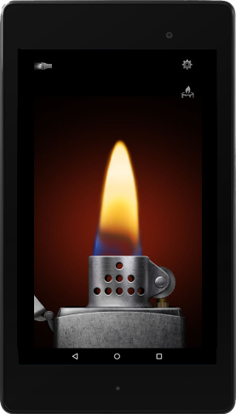


Horizon Sync
Smart Swarms creating Digital Performance Art
Notes:
<pause 5 seconds>Horizon Sync is a web and mobile solution for crafting realtime, interactive performance art at public events like concerts, festivals, and exhibitions.

Slide 2
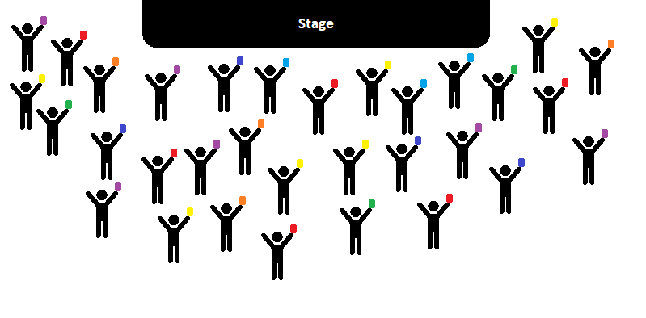
Swarms vs. Crowds
Crowds are Chaotic
Notes:
Your typical public event frequented by a large and disorganized crowd of attendees. Between them, attendees may possess a large amount of sophisticated technology, but with no intelligence, collaboration, or coordination between each device, they do little to change the chaotic nature of the crowd.

Slide 3
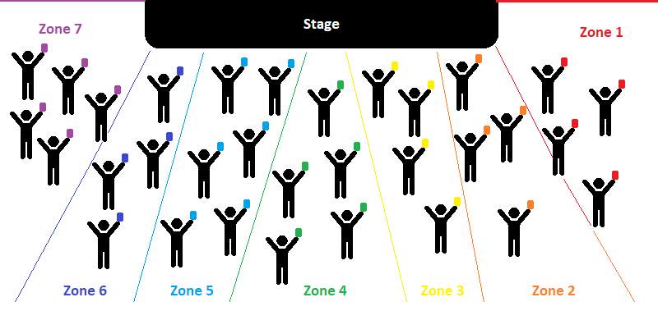
Swarms vs. Crowds
Also, go Marriage Equality!
Notes:
Horizon sync leverages the technology that eventgoers are already carrying to transform the chaotic, random crowd into a smart swarm of attendees, allowing them to become part of and participate with the performance instead of acting as passive observers.

Slide 4
Smartening the Swarm
Technology enabling Art
Notes:
But what makes the smart swarm, smart?

Slide 5
Smartening the Swarm
Event geofencing and autodetection
Technology enabling Art
Notes:
Geofencing is used to detect when a user is attending an event, based upon the event’s location and its specific audience geometry as configured by the event operator, and will automatically cause the device to load any script(s) that have been provided by the event operator.

Slide 6
Smartening the Swarm
Event geofencing and autodetection
Automatic zone assignment
Technology enabling Art
Notes:
An attendee’s specific location within the audience is used to automatically assign them to one of several preconfigured zones. The script the user’s device runs and the content they experience change as their zone changes.

Slide 7
Smartening the Swarm
Event geofencing and autodetection
Automatic zone assignment
Devices within a zone can be synchronized to within +/- 50ms of each other
Technology enabling Art
Notes:
Devices within each zone are automatically synchronized to within plus or minus 50 milliseconds of each other, compensating for issues such as clock-skew and enabling complex real-time displays to be constructed both within and across zones. It’s this last bit of magic which enables effects like …

Slide 8
Live Demo (insert ‘wave’ video)
Notes:
The digital wave. <Pause 5 seconds> It may not seem like much with only three devices, but imagine the effect scaled up across several thousand devices and you’ll get the idea.

Slide 9
Live Demo (insert ‘sync’ video)
Notes:
It’s also possible to complement a live performance by delivering synchronized content across a zone. <Pause few seconds>

Slide 10
Live Demo (insert ‘zone’ video)
Notes:
Or coordinated content across multiple zones. <Pause few seconds>

Slide 11
Live Demo (insert ‘server’ screencast)
Notes:
Configuring this content is easy, using Horizon Sync’s web-based event editor. An event operator can enter the basic details about their event, and then proceed to configuring their audience geometry. A preview of the audience setup is displayed and updated automatically as settings are changed. <Pause few seconds> After configuring the audience and the desired number of zones, the event operator can author content scripts for each zone. These are simple instructions that will run on attendee devices, and allow the event operator to do things like control the device’s screen, push text and images, and apply a variety of effects according to their needs. Once everything has been configured, a click on the ‘Publish’ button takes the event live!

Slide 12
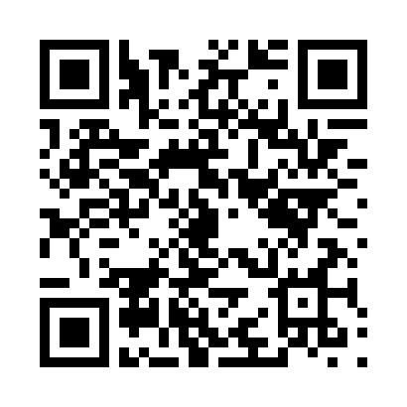
Install Today
Scan QR Code from your Android device
Or download directly from:
http://terra.suncoastpc.com.au:8181/data-gateway/release/hsync-0.1.apk
No smoke and mirrors!
Notes:
Horizon Sync is a real, working app. You can install it on your Android smartphone today!

Slide 13
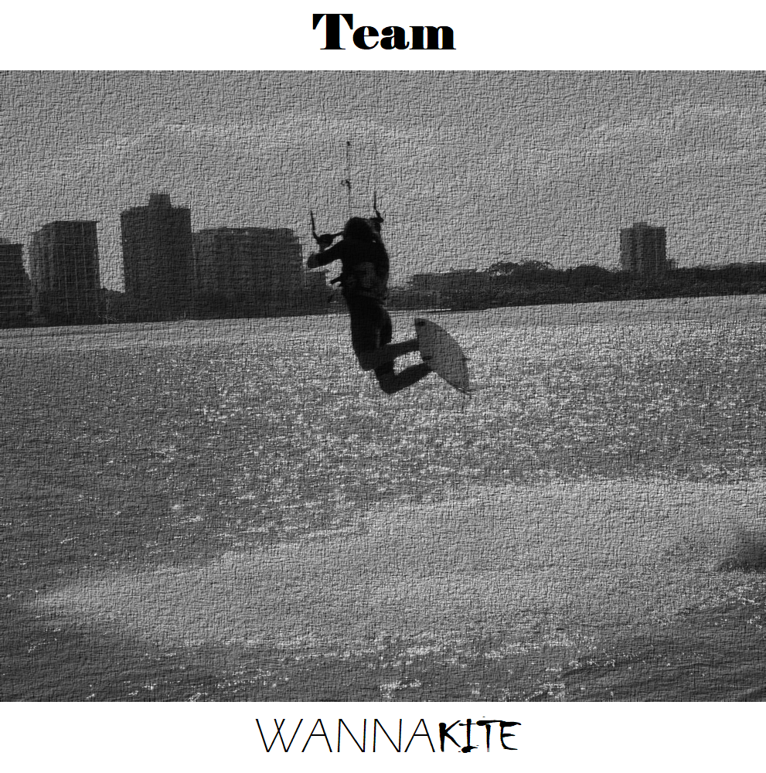
Notes:
<Pause 5 seconds>

