Slide 1
Quarterly Business Review
Q3 2026 · Sales team

Slide 2
What went well
Record bookings in September
Churn down to 2.1%
  Two enterprise logos signed

Slide 3
Pipeline
Stage | Deals | Value
Qualified | 42 | $1.2M
Proposal | 17 | $860K
Closing | 6 | $410K

Slide 4
Bookings by month

Slide 5
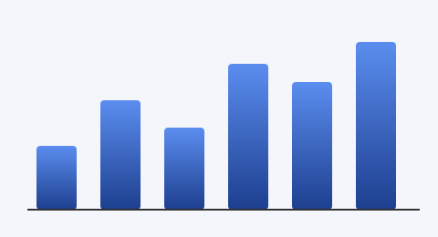
Next steps
Hire two AEs

