Slide 1





Unit A-Introduction
Lecture-5:Operators in c

Slide 2
Table of Content
Arithmetic Operators
Relational Operators
Logical Operators
Bitwise Operators
Assignment Operators

Slide 3
Recap
Data types
How to take input from the user.
Type Conversion.
What is variable and constant.

Slide 4
What is Operators?
An operator is a symbol that tells the compiler to perform specific mathematical or logical functions. By definition, an operator performs a certain operation on operands. An operator needs one or more operands for the operation to be performed.
Depending on how many operands are required to perform the operation, operands are called as unary, binary or ternary operators. They need one, two or three operands respectively.

Slide 5
Types of Operators.
Unary operators − ++ (increment), -- (decrement), ! (NOT), ~ (compliment), & (address of), * (dereference)
Binary operators − arithmetic, logical and relational operators except !
Ternary operators − The ? operator

Slide 6
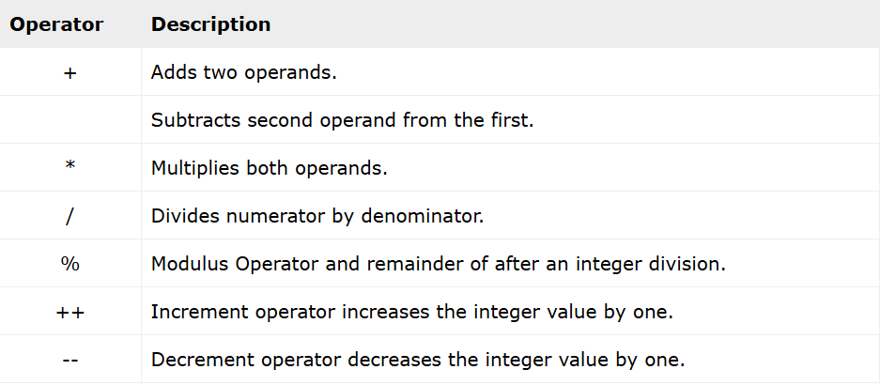
Airthmetic Operators?
Arithmetic operators in C are certain special symbols, predefined to perform arithmetic operations. We are familiar with the basic arithmetic operations − addition, subtraction, multiplication and division. C is a computational language, so these operators are essential in performing a computerised process.
In addition to the above operations assigned to the four symbols +, −, *, and / respectively, C has another arithmetic operator called the modulo operator for which we use the %symbol.

Slide 7
Example:-
#include <stdio.h>
int main(){
int op1 = 10;
int op2 = 3;
printf("Operand1: %d Operand2: %d \n\n", op1, op2);
printf("Addition of op1 and op2: %d\n", op1 + op2);
printf("Subtraction of op2 from op1: %d\n", op1 - op2);
printf("Multiplication of op1 and op2: %d\n", op1 * op2);
printf("Division of op1 by op2: %d\n", op1/op2);
return 0;
}
Output:-
When you run this code, it will produce the following output −
Operand1: 10 Operand2: 3
Addition of op1 and op2: 13
Subtraction of op2 from op1: 7
Multiplication of op1 and op2: 30
Division of op1 by op2: 3

Slide 8
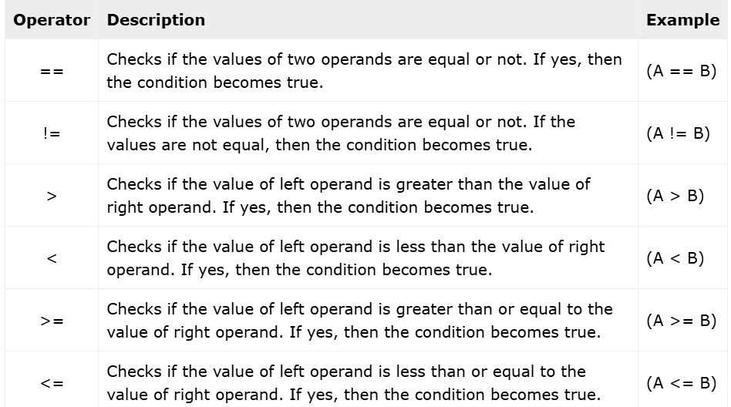
Relational Operators?
Relational operators in C are defined to perform comparison of two values. The familiar angular brackets < and > are the relational operators in addition to a few more as listed in the table below.
These relational operators are used in Boolean expressions. All the relational operators evaluate to either True or False.
C doesnt have a Boolean data type. Instead, "0" is interpreted as False and any non-zero value is treated as True.

Slide 9
Example:-
#include<stdio.h>
int main()
{
int a = 5;
int b = 10;
printf("a = %d, b = %d\n", a, b);
printf("a == b : %d\n", a == b);
printf("a != b : %d\n", a != b);
printf("a > b : %d\n", a > b);
printf("a < b : %d\n", a < b);
printf("a >= b : %d\n", a >= b);
printf("a <= b : %d\n", a <= b);
return 0;
}
Output:-
When you run this code, it will produce the following output −
a != b : 1
a > b : 0
a < b : 1
a >= b : 0
a <= b : 1

Slide 10
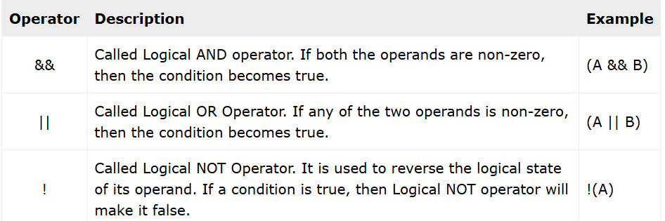
Logical Operators?
Logical operators in C evaluate to either True or False. Logical operators are typically used with Boolean operands.
The logical AND operator (&&) and the logical OR operator (||) are both binary in nature (require two operands). The logical NOT operator (!) is a unary operator.
Since C treats "0" as False and any non-zero number as True, any operand to a logical operand is converted to a Boolean data.

Slide 11
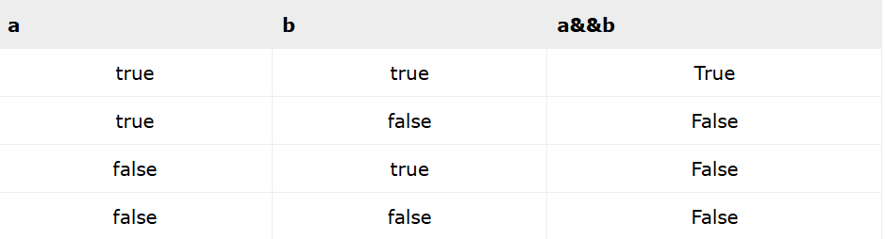
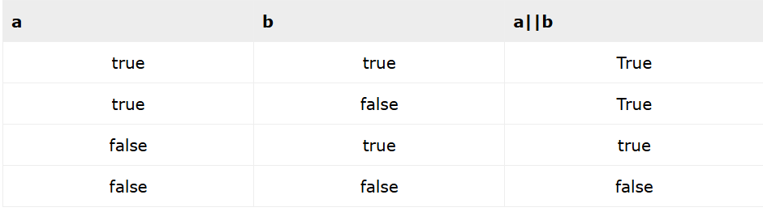

Truth Table of And OR and Not.
And Truth Table
OR Truth Table
NOT Truth Table

Slide 12
Example:-
#include<stdio.h>
int main()
{
int a = 1, b = 0;
int x = 5, y = 10;
printf("a=%d, b=%d\n", a, b);
printf("a && b = %d\n", a && b);
printf("a || b = %d\n", a || b);
printf("!a = %d, !b = %d\n", !a, !b);
printf("(x<y && y>0) = %d\n", (x < y && y > 0));
printf("(x>y || x==5) = %d\n", (x > y || x == 5));
return 0;
}
Output:-
When you run this code, it will produce the following output −
a=1, b=0
a && b = 0
a || b = 1
!a = 0, !b = 1
(x<y && y>0) = 1
(x>y || x==5) = 1

