Slide 1
LOGISTIC REGRESSION

Slide 2
INTRODUCTION
CLASSIFICATION?
Categorical
Continuous
Supervised
???
???
Unsupervised
???
???

Slide 3
INTRODUCTION
CLASSIFICATION
Categorical
Continuous
Supervised
Classification
Regression
Unsupervised
Clustering
Dimension Reduction

Slide 4
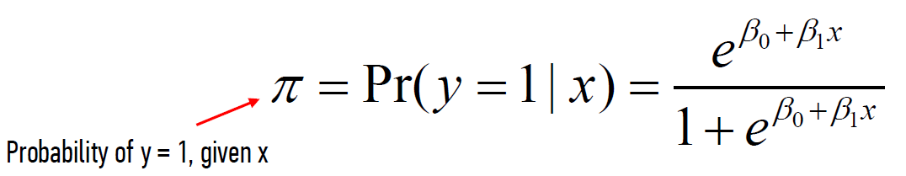
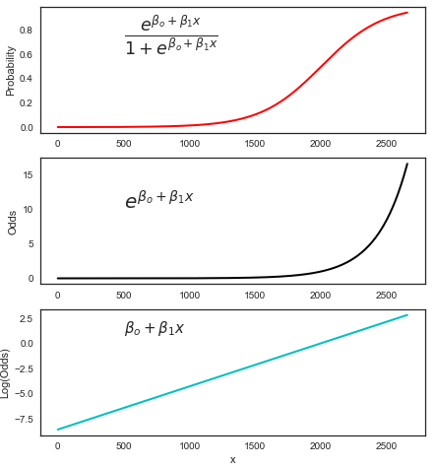
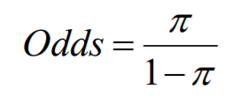


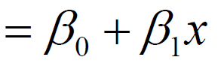
INTRODUCTION
LOGISTIC REGRESSION!
Log( )

Slide 5
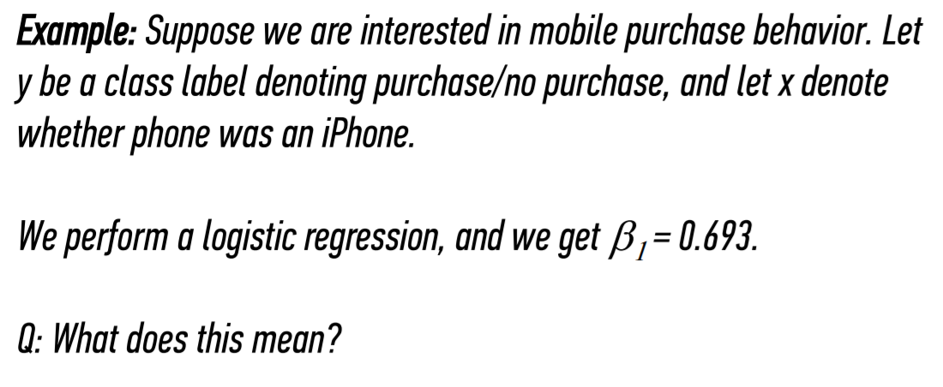
INTRODUCTION
LOGISTIC REGRESSION!

Slide 6
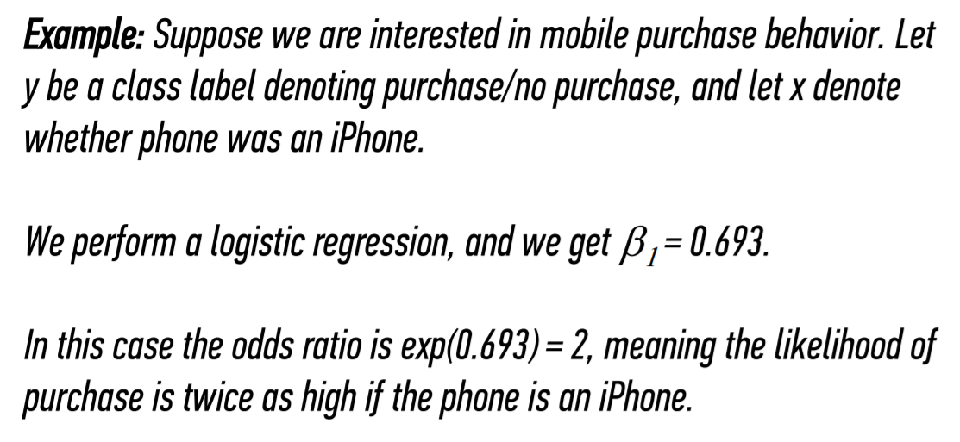
INTRODUCTION
LOGISTIC REGRESSION!

Slide 7
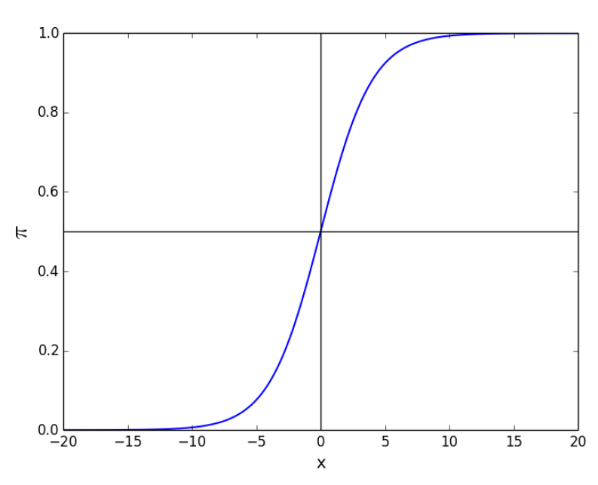
INTRODUCTION
LOGISTIC REGRESSION!
Why is it sensible that it is this shape?

Slide 8
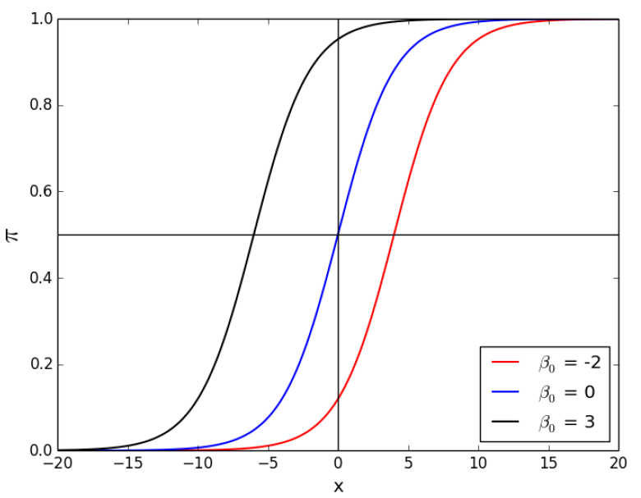
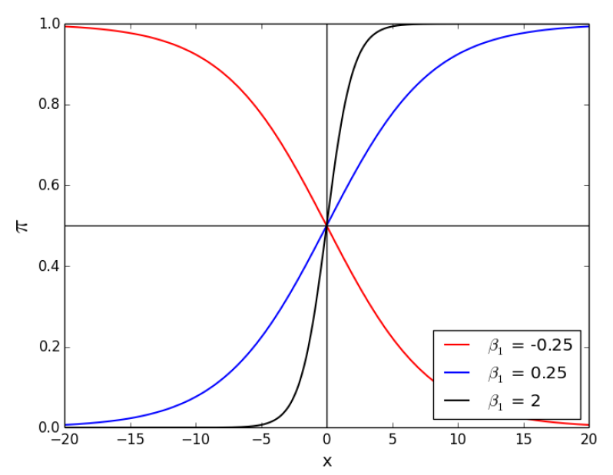
INTRODUCTION
LOGISTIC REGRESSION!
Changing the beta values…

Slide 9
INTRODUCTION
LOGISTIC REGRESSION!
Changing the beta values…

