Slide 1
PyTorch Tutorial
劉家漢
National Tsing Hua University
Department of Electrical Engineering

Slide 2
Outline
Installation Guide
Model Construction in PyTorch

Slide 3
Installation Guide

Slide 4
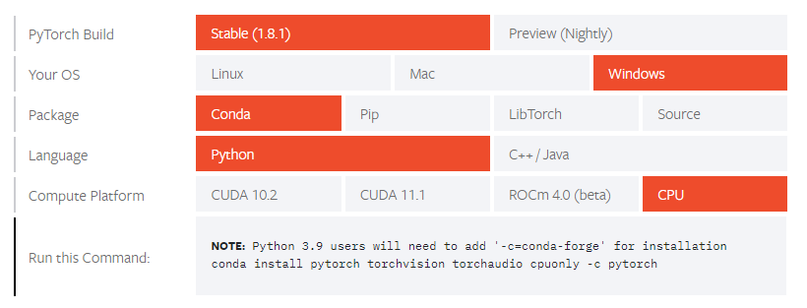
Installation Step
Checkout PyTorch official web page
Select your environment

Slide 5
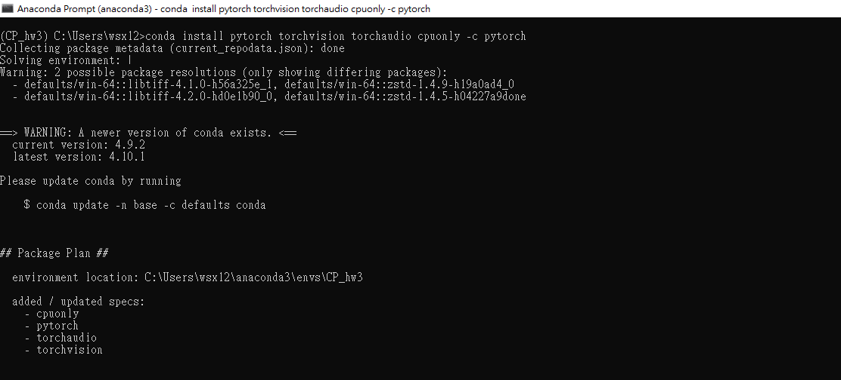
Installation Step
3. Type the command in anaconda prompt

Slide 6
Model Construction in PyTorch

Slide 7
Basic Layers
torch.nn — PyTorch 1.8.1 documentation
Homework related layers
Convolution layer
ReLU non-linearity
Pixel shuffle layer

Slide 8






Convolution Layer
Input feature map size:
(Height, Width, Channel) = (12, 12, 6)
Output feature map size:
(Height, Width, Channel) = (12, 12, 4)
Channel = 6
.
Channel = 4
.
.
.
.
3x3 Conv
.
.
.
.
.
.
.
.
.
.
.
.
Height = 12
.
Height = 12
.
.
.
.
.
.
Width = 12
Width = 12

Slide 9
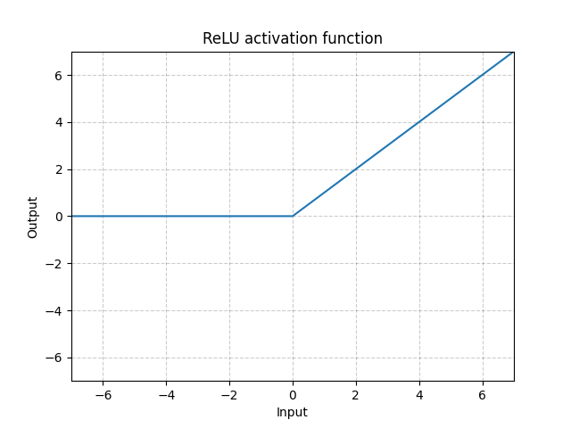
ReLU Non-Linearity
11
99
-5
123
11
99
0
123
4
-61
49
-14
4
0
49
0
12
56
94
68
12
56
94
68
94
-79
8
-1
94
0
8
0

Slide 10
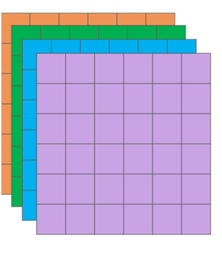
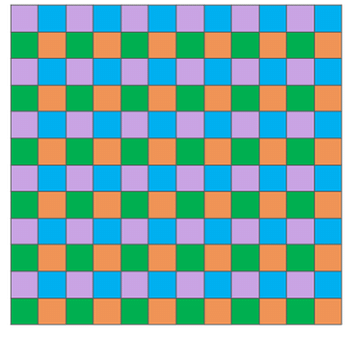
Pixel Shuffle Layer
Pixel Shuffle

Slide 11
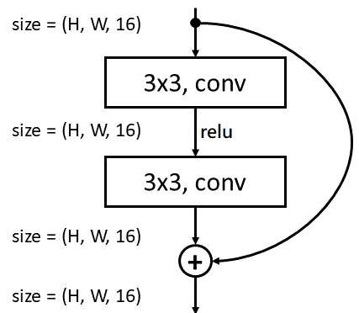
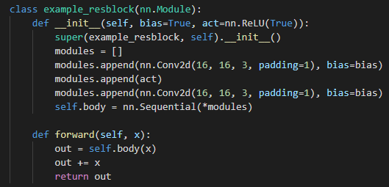
Example

Slide 12
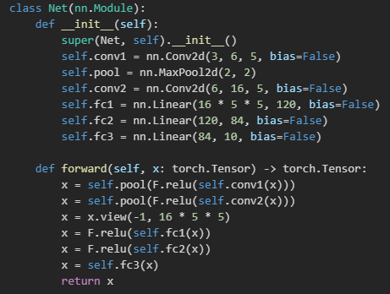
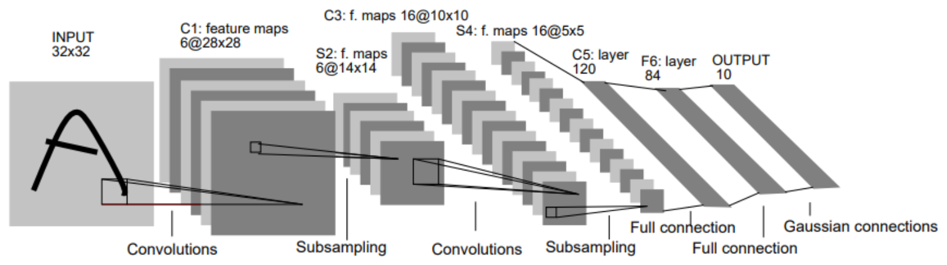
More Example
LeNet-5

