Slide 1

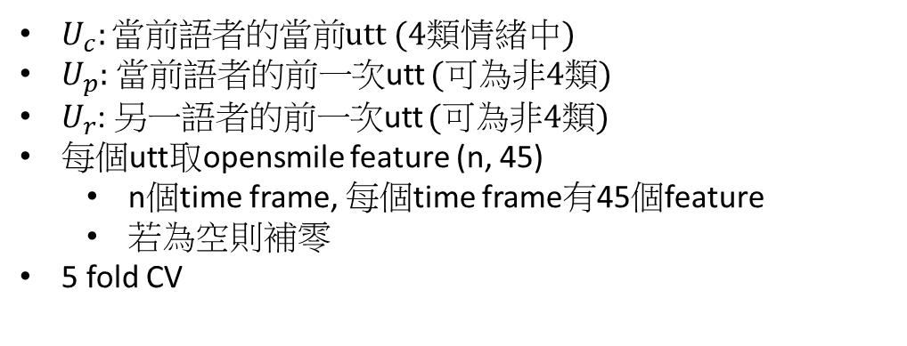







$U_{c}:當前語者的當前$utt (4類情緒中)
$U_{p}:$當前語者的前一次utt (可為非4類)
$U_{r}$: 另一語者的前一次utt (可為非4類)
每個utt取opensmile feature (n, 45)
n個time frame, 每個time frame有45個feature
若為空則補零
5 fold CV
Model | UAR | precision (predcit label 1)
SVM (oversample) | 60.86 % | 42.09 %
Random Forest (oversample) | 54.31 % | 51.54 %
MLP (oversample) | 57.43 % | 38.75 %
concatenate
$U_{c}$’s mean (1, 45)
$U_{c}$’s std (1, 45)
$U_{p}$’s mean (1, 45)
$U_{p}$’s std (1, 45)
$U_{r}$’s mean (1, 45)
$U_{r}$’s std (1, 45)
input
ML Model
output
1: $U_{c}$’s emo != $U_{p}$’s emo
0: $U_{c}$’s emo == $U_{p}$’s emo

Slide 2
Audio Feature (openSMILE), each utt: (2, 45)
Audio + Time Feature: (45*2)*3 + 1
Time feature: 自身兩次說話起始時間間隔
Model Original Dialog | Audio Feature |  | Audio + Time Feature
 | UAR | Precision (predict label 1) | UAR | Precision (predict label 1)
SVM (oversample) | 60.86 % | 42.09 % | 59.7 % | 44.45 %
Random Forest (oversample) | 54.31 % | 51.54 % | 52.72 % | 51.59 %
LogisticRegression (class_weight: 1/n) | 58.0 % | 38.78% | 59.18 % | 40.26 %
MLP (oversample) | 57.43 % | 38.75 % | 55.86 % | 40.05 %
MLP (weighted Cross Entropy) | 57.97 % | 39.48 % | 58.65 % | 40.37 %
Model Dialog_rearrange | Audio Feature (openSMILE)
 | UAR | Precision
SVM (oversample) | 59.86 % | 42.21 %
Random Forest (oversample) | 54.59 % | 42.69 %
LogisticRegression (class_weight: 1/n) | 58.08 % | 38.86 %
MLP (oversample) | 56.88 % | 38.67 %
MLP (weighted Cross Entropy) | 57.11 % | 38.88 %

Slide 3
Text feature (BERT) , each utt: (1, 768)
Text + Time Feature: 768*3 + 1
Time feature: 自身兩次說話起始時間間隔，單位秒
Model | Text Feature |  | Text + Time Feature
 | UAR | Precision (predict label 1) | UAR | Precision (predict label 1)
SVM (oversample) | 62.21 % | 50.86 % | 62.19 % | 50.77 %
Random Forest (oversample) | 57.97 % | 60.43 % | 57.95 % | 60.14 %
LogisticRegression (class_weight: 1/n) | 63.01 % | 45.57 % | 62.92 % | 45.46 %
MLP (oversample) | 61.11 % | 46.21 % | 59.44 % | 48.54 %
MLP (weighted Cross Entropy) | 60.08 % | 42.78 % | 59.95 % | 42.68 %

Slide 4
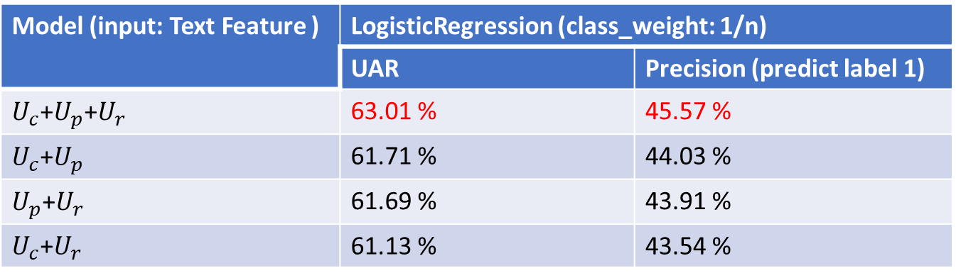

$U_{c}:當前語者的當前$utt (4類情緒中), $U_{p}:$當前語者的前一次utt (可為非4類), $U_{r}$: 另一語者的前一次utt (可為非4類)
Time Feature Only
Model (input: Text Feature ) | LogisticRegression (class_weight: 1/n)
 | UAR | Precision (predict label 1)
$U_{c}$+$U_{p}$+$U_{r}$ | 63.01 % | 45.57 %
$U_{c}$+$U_{p}$ | 61.71 % | 44.03 %
$U_{p}$+$U_{r}$ | 61.69 % | 43.91 %
$U_{c}$+$U_{r}$ | 61.13 % | 43.54 %
Model | Time Feature Only
 | UAR | Precision (predict label 1)
SVM (oversample) | 53.92 % | 35.05 %
Random Forest (oversample) | 49.91 % | 32.46 %
LogisticRegression (class_weight: 1/n) | 52.47 % | 35.53 %
MLP (oversample) | 54.6 % | 35.17 %
MLP (weighted Cross Entropy) | 53.8 % | 34.87 %

Slide 5
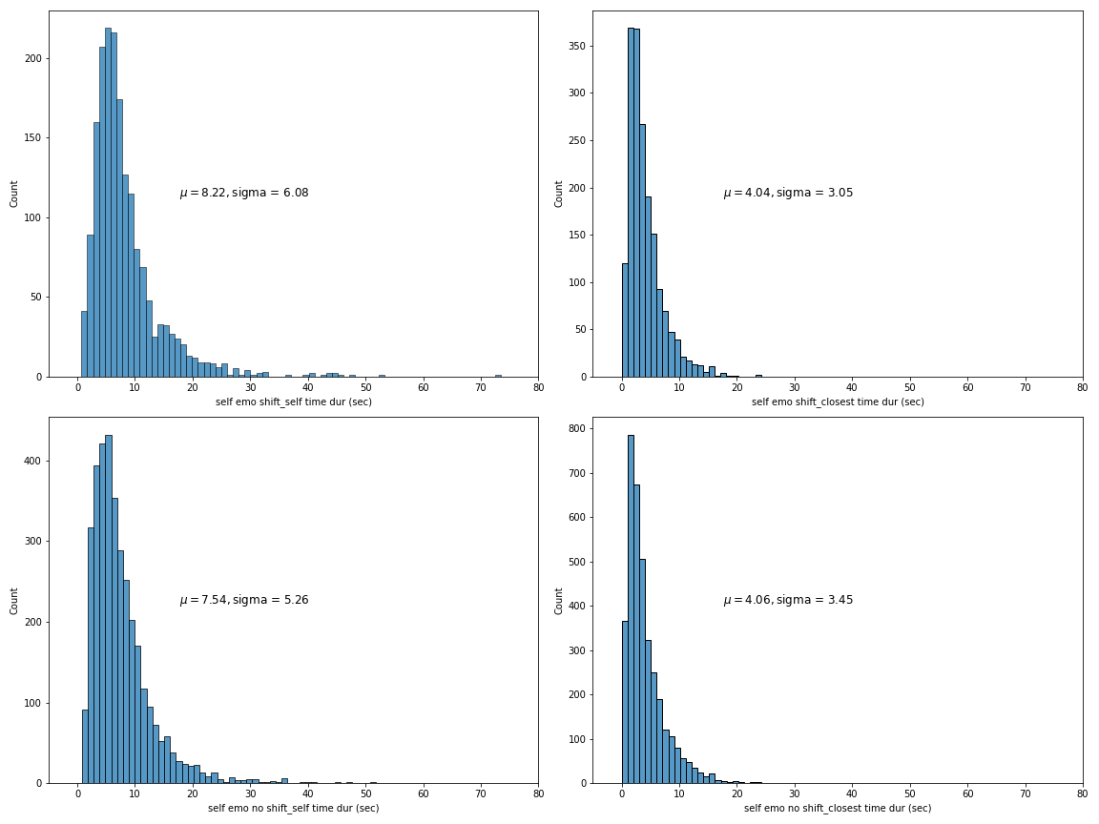
峰值: 5-6 sec
峰值: 1-2 sec
峰值: 5-6 sec
峰值: 1-2 sec

Slide 6
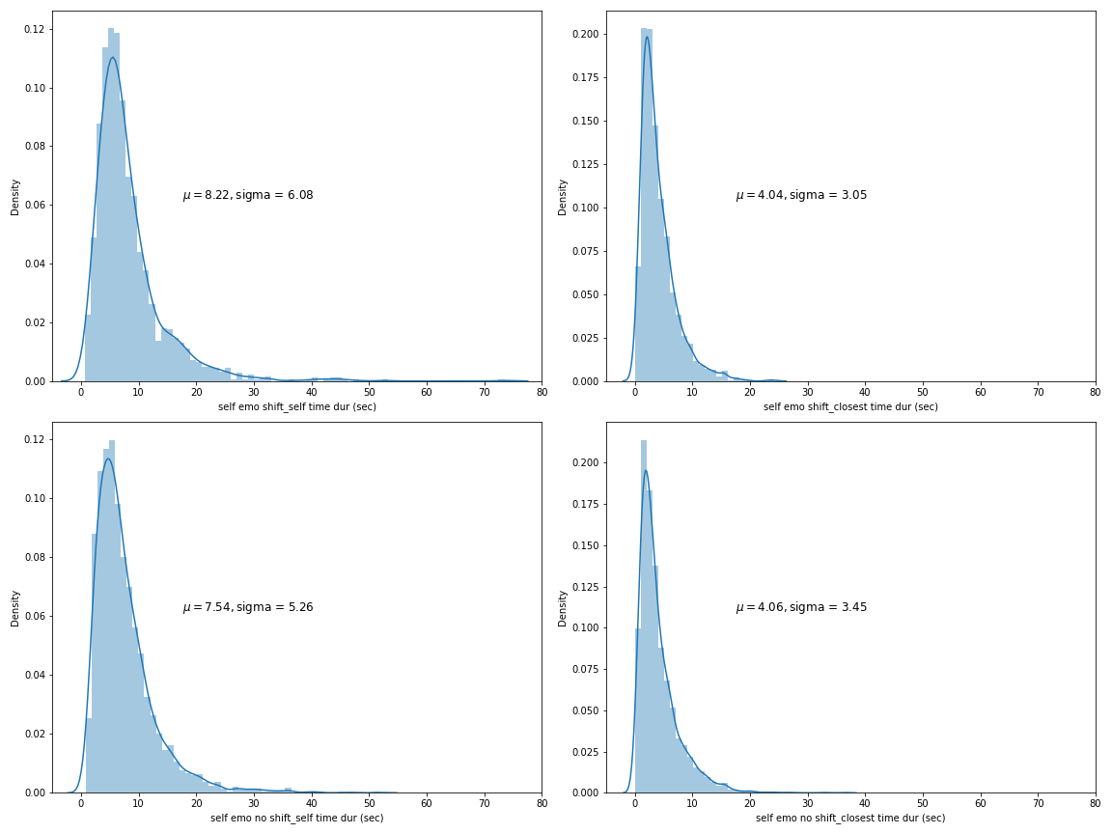
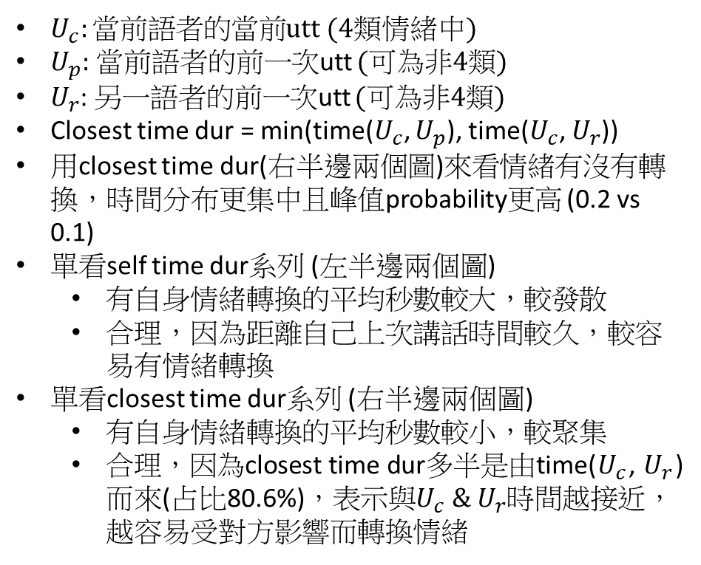
$U_{c}:當前語者的當前$utt (4類情緒中)
$U_{p}:$當前語者的前一次utt (可為非4類)
$U_{r}$: 另一語者的前一次utt (可為非4類)
Closest time dur = min(time($U_{c}$, $U_{p}$), time($U_{c}$, $U_{r}$))
用closest time dur(右半邊兩個圖)來看情緒有沒有轉換，時間分布更集中且峰值probability更高 (0.2 vs 0.1)
單看self time dur系列 (左半邊兩個圖)
有自身情緒轉換的平均秒數較大，較發散
合理，因為距離自己上次講話時間較久，較容易有情緒轉換
單看closest time dur系列 (右半邊兩個圖)
有自身情緒轉換的平均秒數較小，較聚集
合理，因為closest time dur多半是由time($U_{c}$, $U_{r}$)而來(占比80.6%)，表示與$U_{c} \& U_{r}$時間越接近，越容易受對方影響而轉換情緒

Slide 7
Dialog_edit result
Skip the utt which is not in {ang, hap, neu, sad}
Model Dialog_rearrange | Audio Feature (openSMILE)
 | UAR | Precision
SVM (oversample) | 59.05 % | 21.75 %
Random Forest (oversample) | 50.89 % | 34.48 %
LogisticRegression (class_weight: 1/n) | 60.25 % | 18.72 %
MLP (oversample) | 57.67 % | 25.0 %
MLP (weighted Cross Entropy) | 60.12 % | 19.96 %

Slide 8
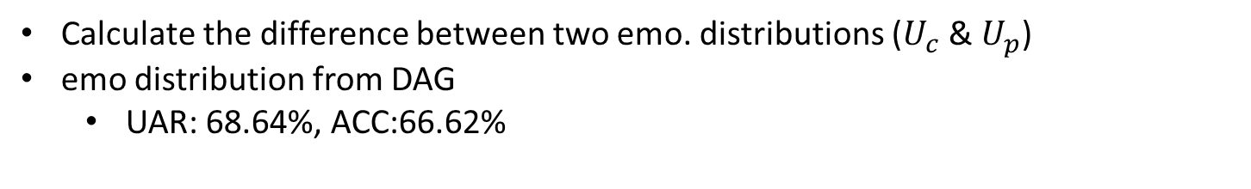
Other Feature
Calculate the difference between two emo. distributions ($U_{c}$ & $U_{p}$)
emo distribution from DAG
UAR: 68.64%, ACC:66.62%
Dialog_rearrange Skip the utt which is not in {ang, hap, neu, sad} | EMO SHIFT (86.01 %) mean +- std | EMO NO SHIFT (13.99 %) mean +- std
cosine_similarity (0~1) | 0.57+-0.54 | 0.84+-0.3
kl_divergence (0~inf) | 0.98+-1.66 | 0.31+-0.66
earth_mover_dist (0~inf) | 0.92+-0.78 | 0.72+-0.57

