Slide 1
EE 655000 Machine Learning Final Project Proposal - 排煙脫硫警示預測
108061806 簡婉軒, 108061892 Shreya Upadhyay,
109061804 邱信豪, 109061520 陳俊宇
Behavior Informatics and Interaction Computation Lab, National Tsing Huan University, Taiwan

Slide 2
Outline
Data Description
Framework
Data Preprocessing
Methodology
Machine learning based
Deep learning based
Future work

Slide 3
Data Description
Dataset Description
The dataset contains 25 measurement and sampling variables recorded from fuel gas desulfurization equipment (FGD), which is an equipment operating process data with desulfurization results as labels.
Training set: 20621 samples.
Testing set: 500 samples

Slide 4
Framework – ML based model
90%
normalization + up-sampling
Feature Ranking and selection
Train data
Training data
SVM
RF
KNN
10%
valid data
Stacking / voting classifier
Predicted values
test data
Trained model
Prediction probabilities

Slide 5
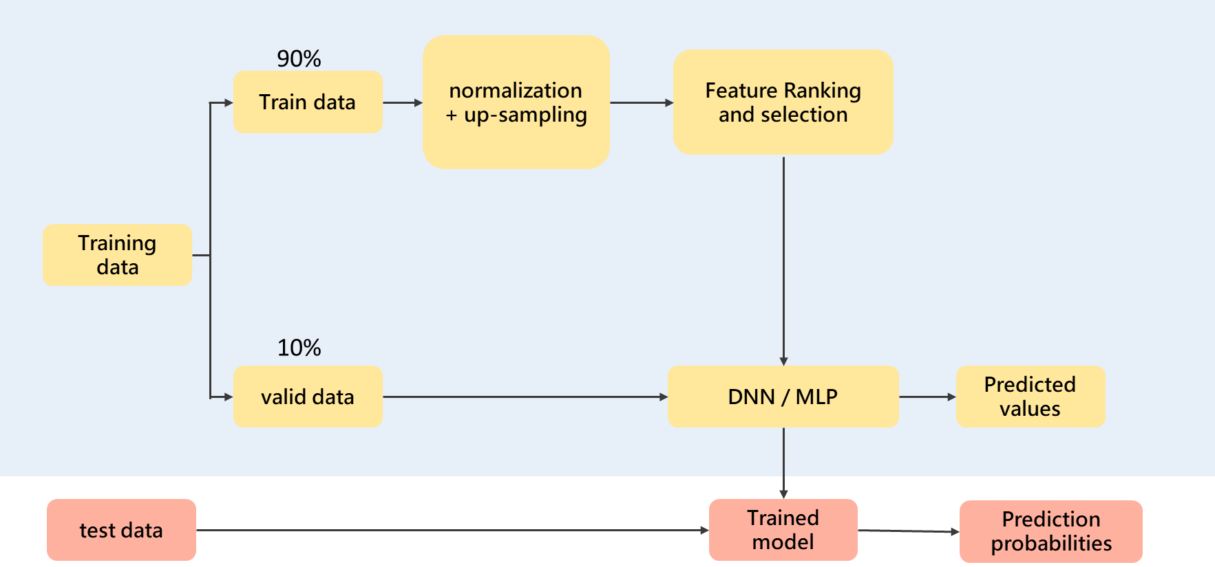
Framework – DL based model

Slide 6
Data Preprocessing
Creating validation set from training set
Training set: 18558 files
validation set: 2063 files
Normalization
Up-sampling
To avoid data imbalance.
Feature selection

Slide 7
Methodology
Machine learning based methods
SVM, Random Forest, KNN, XGBoost…
Deep learning based methods
DNN, MLP

Slide 8
Baselines – ML based model
Data type | SVM |  | Random Forest |  | GaussianNB |  | KNN
 | acc | F1 Score | acc | F1 Score | acc | F1 Score | acc | F1 Score
Raw data | 0.471 | 0.219 | 0.718 | 0.542 | 0.458 | 0.265 | 0.521 | 0.336
normalized | 0.603 | 0.376 | 0.694 | 0.524 | 0.452 | 0.27 | 0.609 | 0.425
normalized + feature selection(LassoCV) | 0.608 | 0.413 | 0.7 | 0.528 | 0.48 | 0.231 | 0.685 | 0.549
normalized + upsampling | 0.541 | 0.422 | 0.679 | 0.521 | 0.418 | 0.302 | 0.567 | 0.462
normalized + upsampling + feature selection(LassoCV) | 0.568 | 0.451 | 0.689 | 0.544 | 0.372 | 0.269 | 0.659 | 0.554

Slide 9
Baselines – DL based model
Deep learning based methods
DNN => 3 layer DNN with dropout layers to avoid overfitting.
With hidden layer contain 1024 neuron, batch size 64, run for 150 epochs.
Optimizer: Adam.
Loss: Cross Entropy loss.
Data type | DNN
 | acc | F1 Score
normalized | 0.688 | 0.537
normalized + upsampling | 0.541 | 0.422

Slide 10
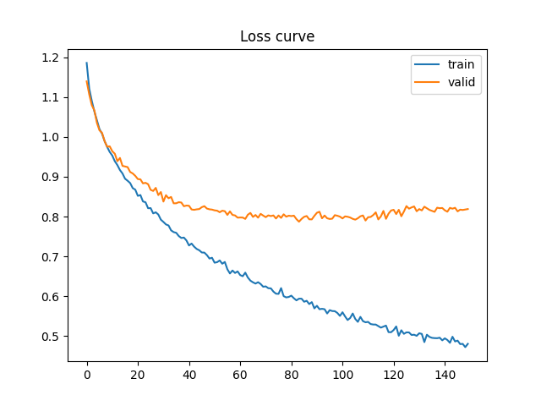
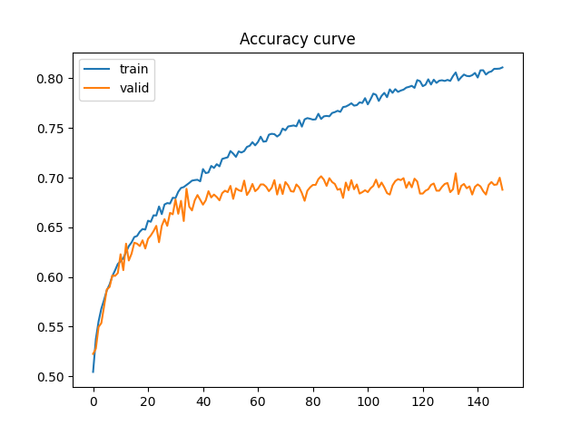
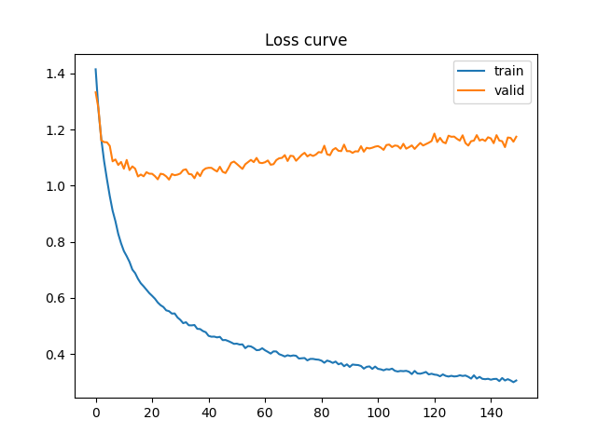
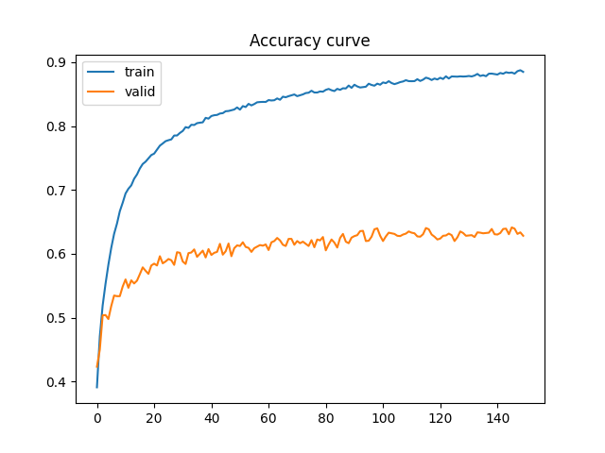
Baselines – DL based model
The learning curves:
normalized
Normalized + upsampling

Slide 11
Future work
Focus on the ML base model.
To do: XGBoost, Logistic regression, Decision tree, LDA, …
Try other preprocessing methods.
Use the voting, stack method to ensemble models.

Slide 12
Thanks

