Slide 1
A. portfolio
Adam Aldred

Slide 2
Design Process Functionality and features
Research and Brainstorming
Design wireframe layouts
Choose a color scheme and font styles
Collect and resize images
Use of flex box and tables
Prototype testing Html, Css and JavaScript
Evaluate the design
Produce final product
Responsive on all devices
JavaScript - on click functions
JavaScript - Welcome message
JavaScript - date, time, weather
Links - LinkedIn, GitHub and Google Maps
Gallery
Icon in the tab

Slide 3
Usability considerations
alt attribute on image tags and lang attribute on the html tag for accessibility
title attribute on anchor tags, buttons, images and links for a description
The use of white space and padding to unclutter the website
Font and background color contrast ratio
Transparent background for font on images
A responsive website on all devices
The use of correct and relevant content - focus more on content and layout functions

Slide 4
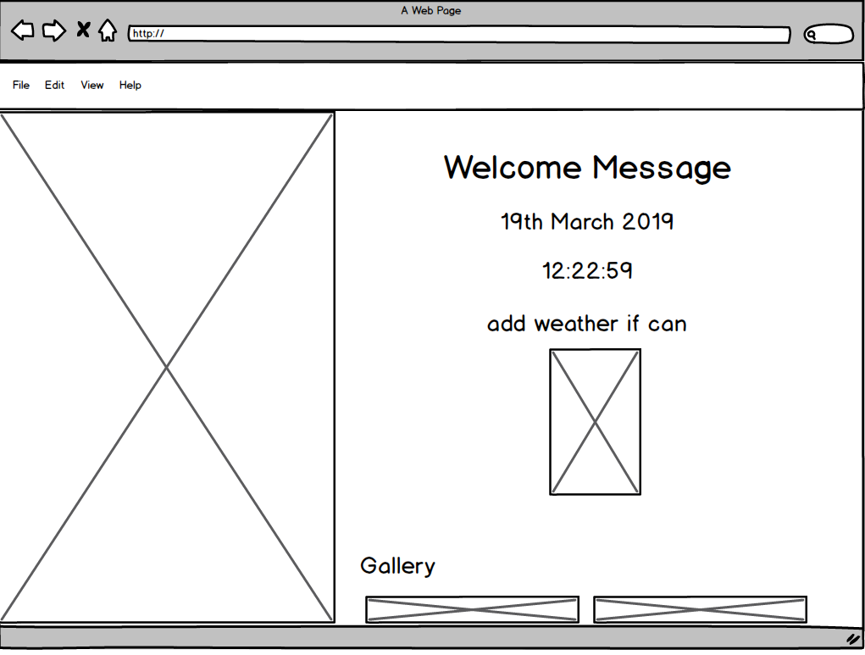
Wireframes – Welcome Message

Slide 5
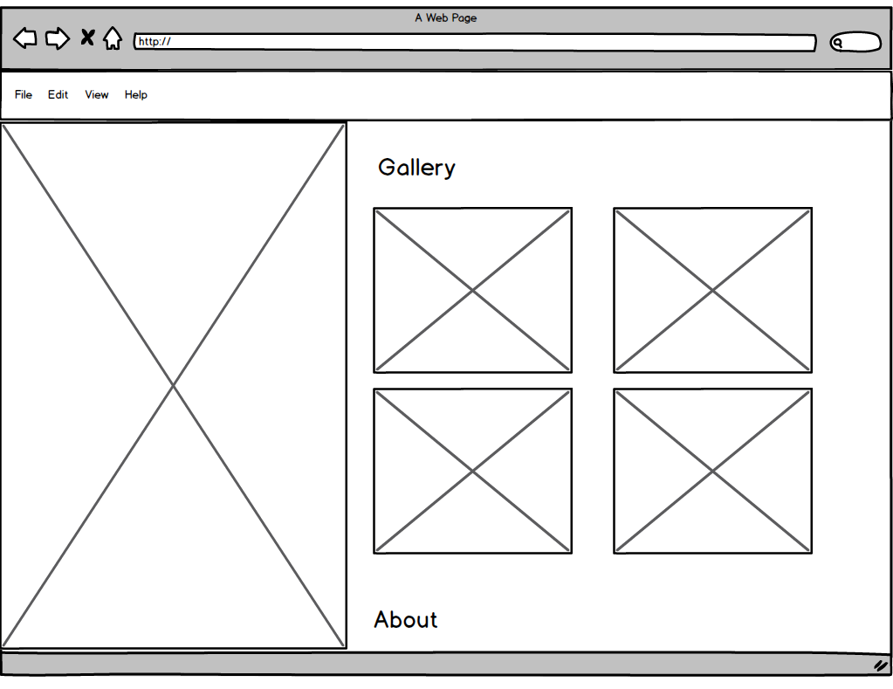
Wireframes – Gallery – Flex Box

Slide 6
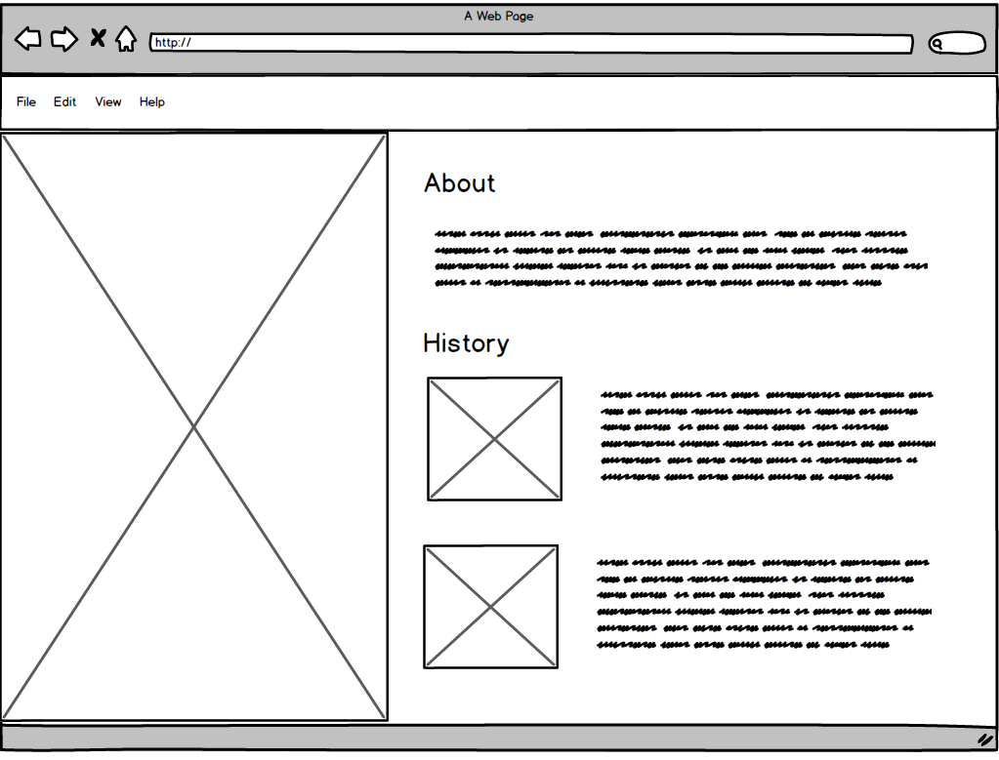
Wireframes – History – Flex Box

Slide 7
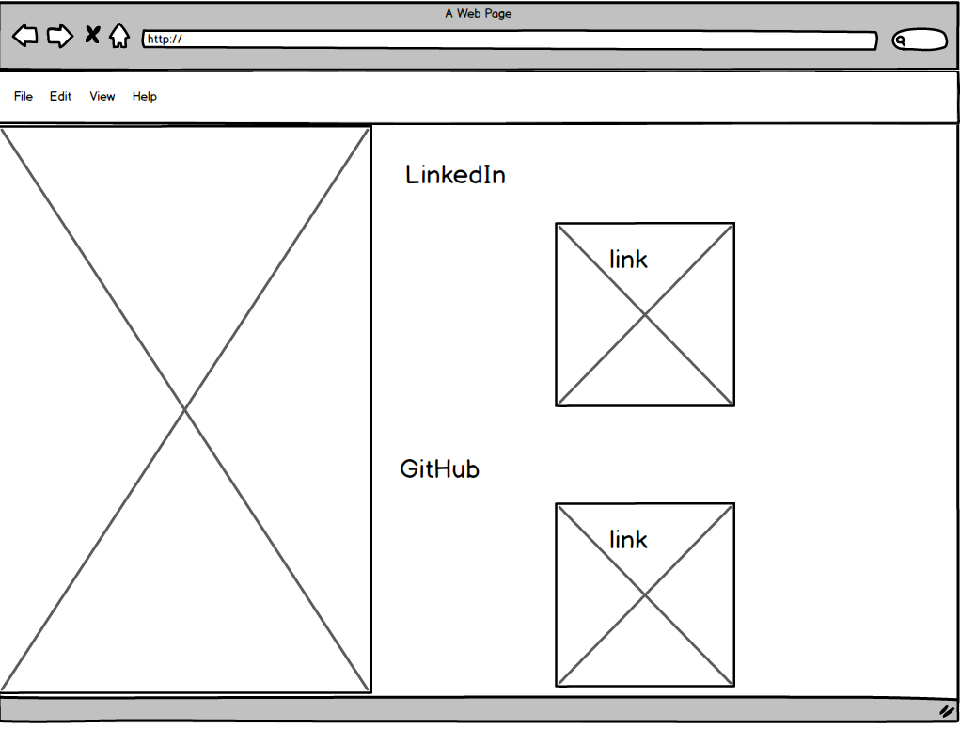
Wireframes – Image links

Slide 8
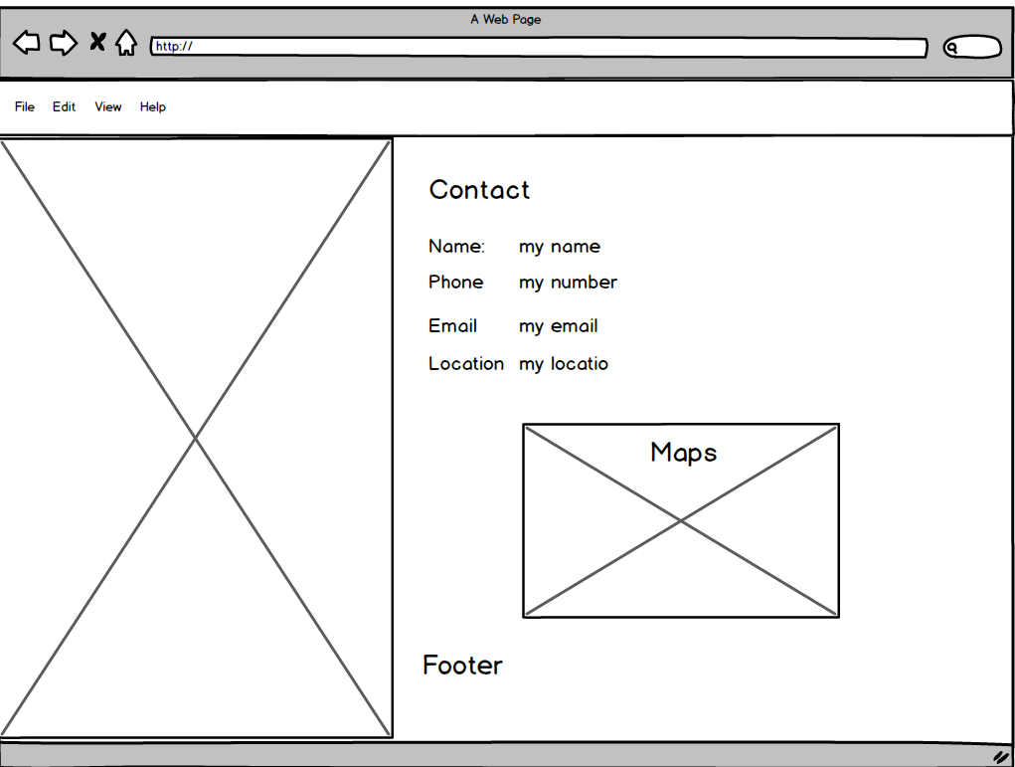
Wireframes – Contact – Table

Slide 9
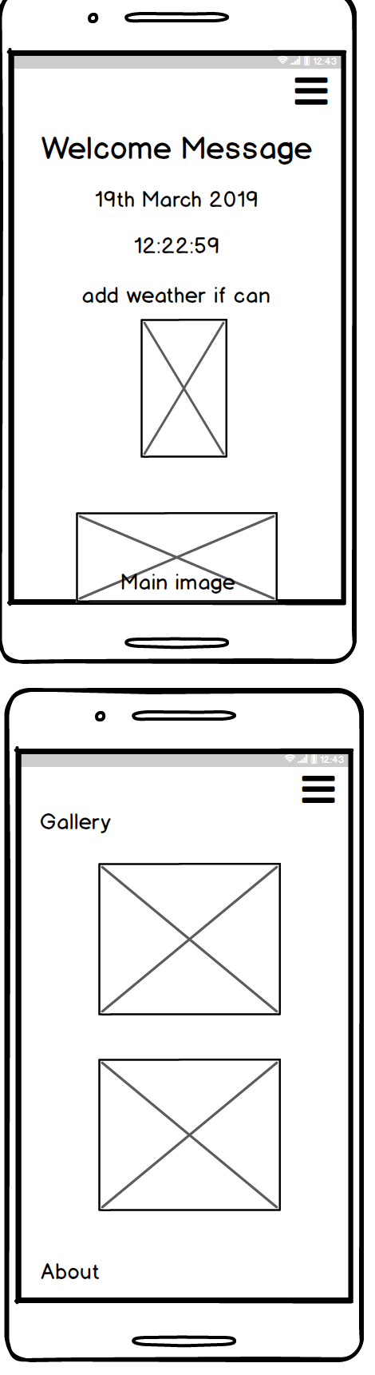
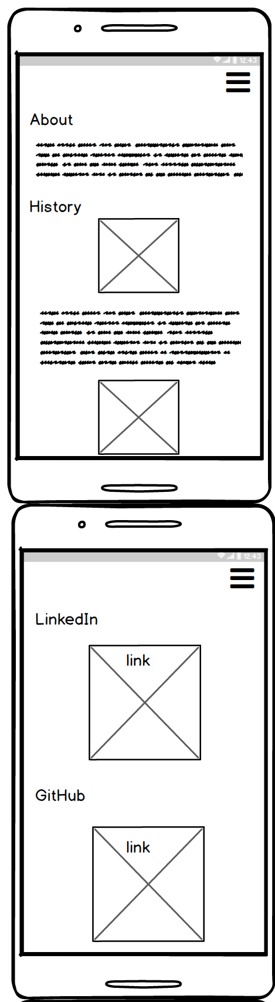
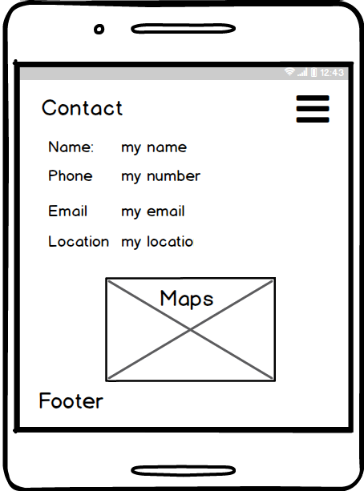
Wireframes – Phone size

Slide 10
Tech and languages
Html5
Css3
JavaScript
Fireworks
Photoshop
GitHub
Balsamic
Visual Studios
terminal
Cloud Flare – (CDN)

Slide 11
Project Planning and Timeline
Day 1-2
1. Research and Brainstorming
2. Design wireframe layouts
3. Choose a color scheme and font styles
Day 2-4
4. Collect and resize images
5. Use of flex box and tables
6. Prototype testing Html, Css and JavaScript
Day 4-6
7. Evaluate the design
8. Produce final product

Slide 12
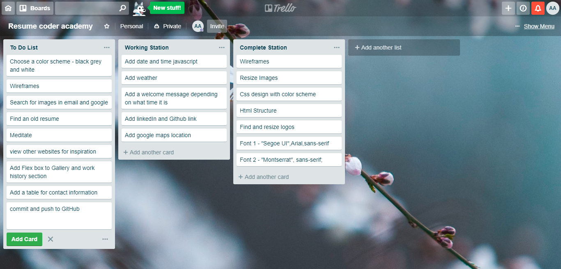
Trello

Slide 13
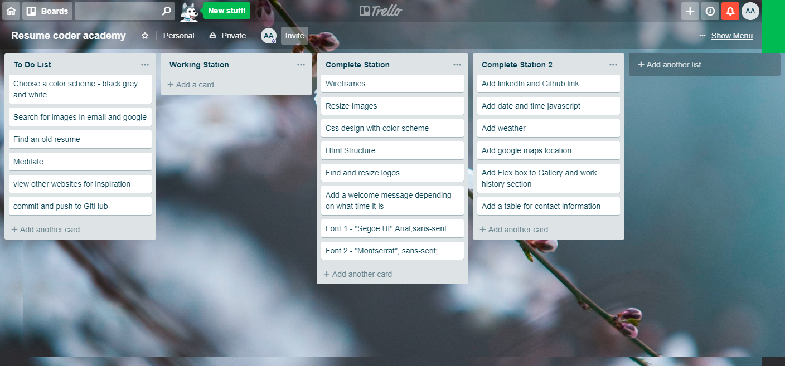
Trello

Slide 14
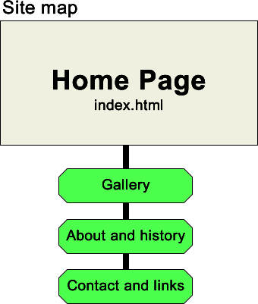
Sitemap

Slide 15
Show website
Click Me https://adam22gary.github.io/

