Slide 1
A. portfolio
Adam Aldred

Slide 2
Design Process Functionality
Design wireframe layout
Choose a color scheme
Use of flex box
Use of a table
Use of Html and Css
Use of JavaScript
Trello and GitHub
Responsive on all devices
JavaScript - on click functions
JavaScript - date, time, weather
Links - LinkedIn, GitHub and Google Maps

Slide 3
Usability considerations
alt attribute on image tag for accessibility
title attribute on anchor tag, button, images and links for a description
The use of white space and padding to unclutter the website
Font and background color contrast ratio
Font on an image has a transparent background
A responsive website on all devices
The use of correct and relevant content - focus more on content and layout functions

Slide 4
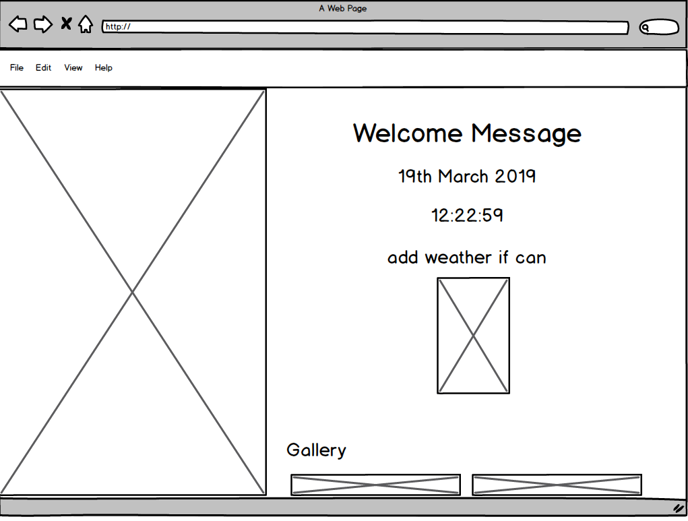
Wireframes – Welcome Message

Slide 5
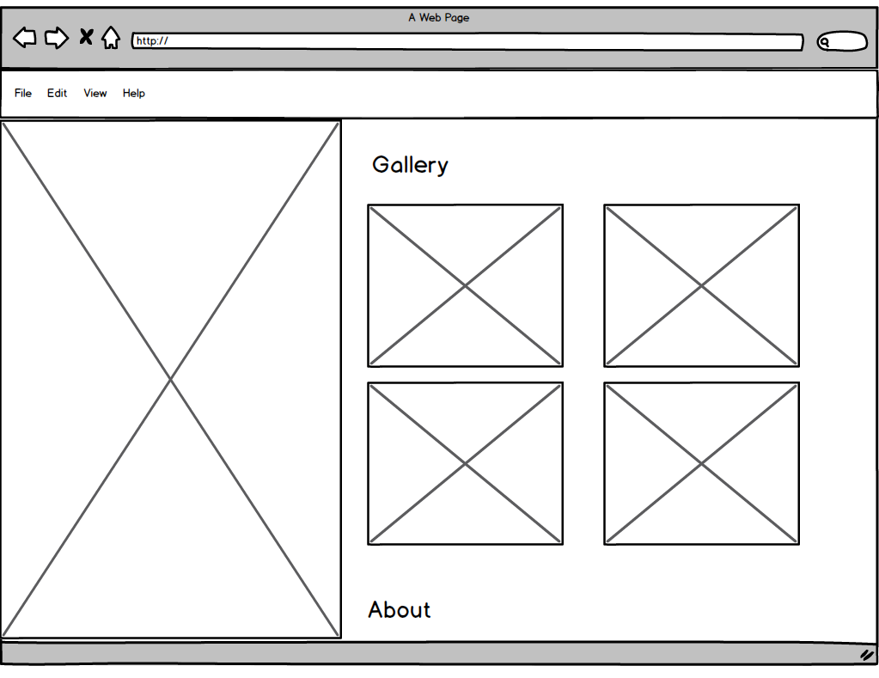
Wireframes – Gallery – Flex Box

Slide 6
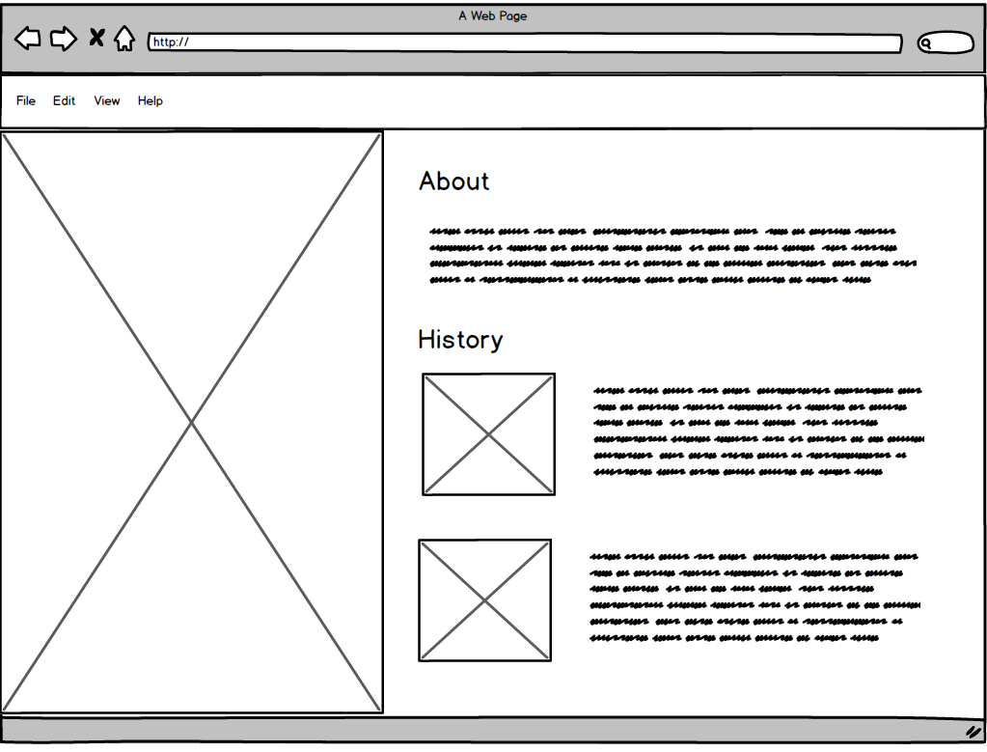
Wireframes – History – Flex Box

Slide 7
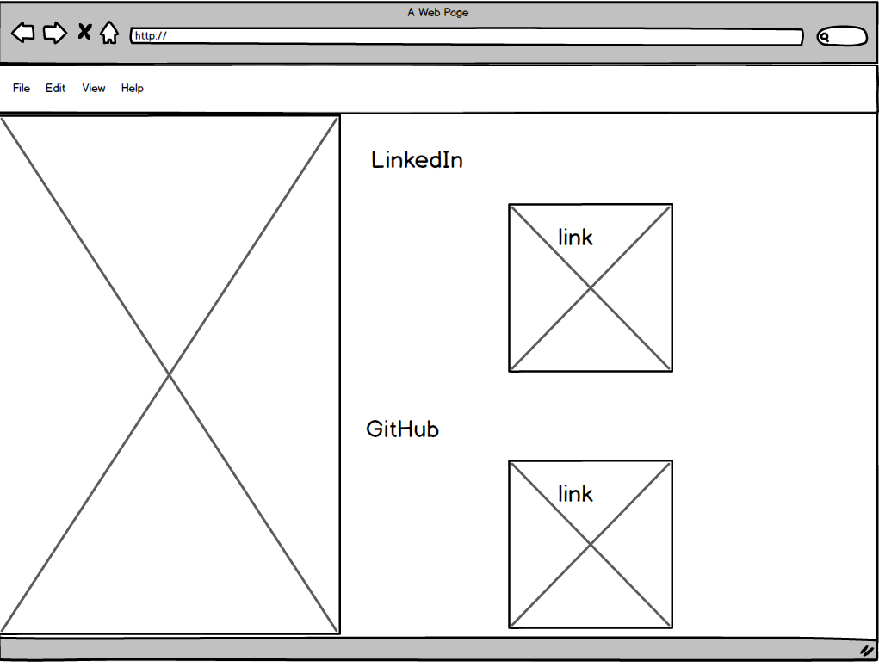
Wireframes – Image links

Slide 8
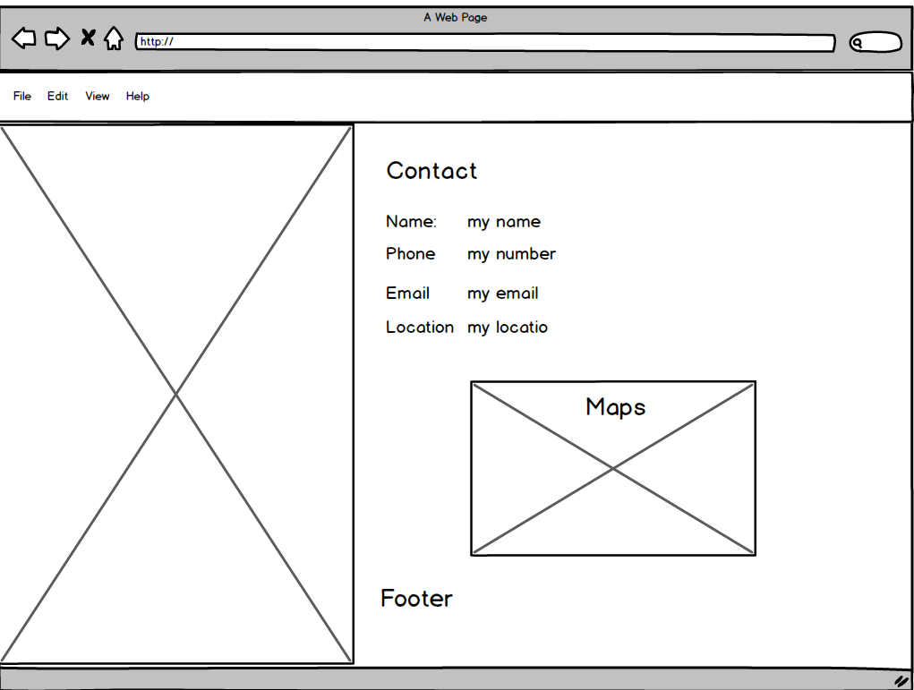
Wireframes – Contact – Table

Slide 9
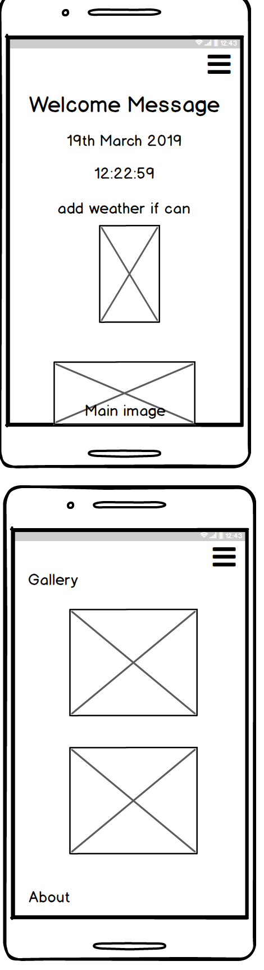
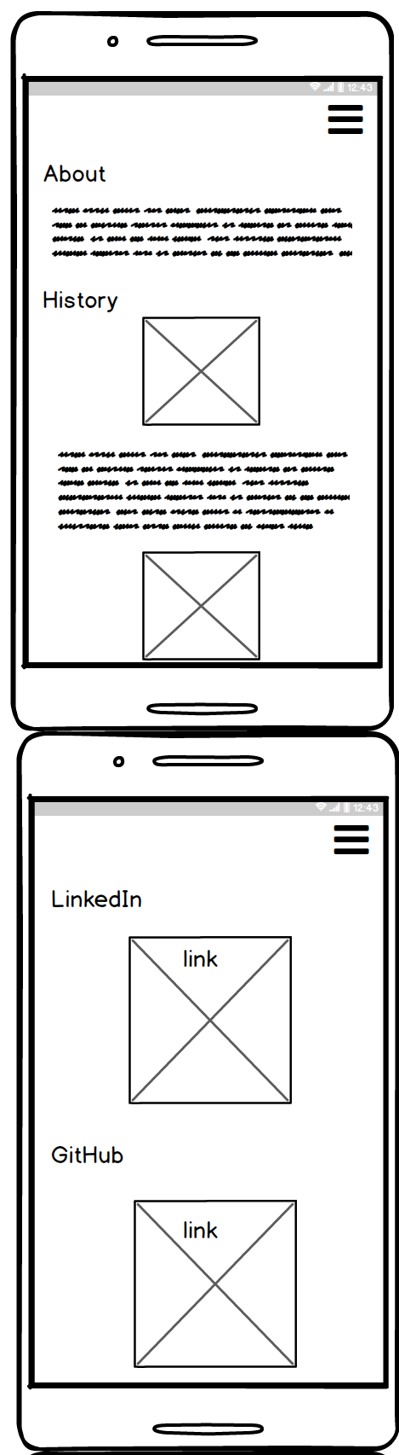
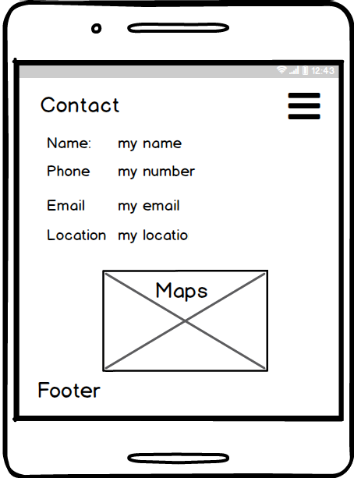
Wireframes – Phone size

Slide 10
Tech and languages
Html
Css
JavaScript
Fireworks
Photoshop
GitHub
Balsamic
Visual Studios
terminal
Cloud Flare – (CDN)

Slide 11
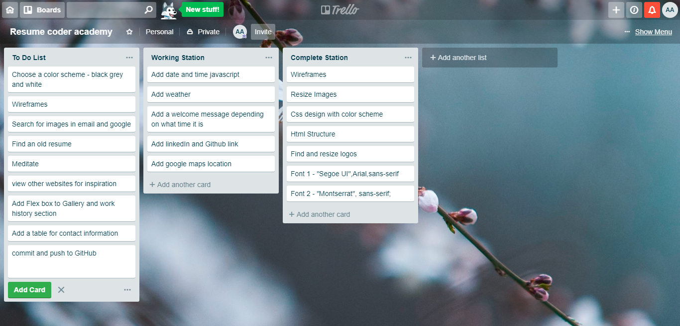
Trello

Slide 12
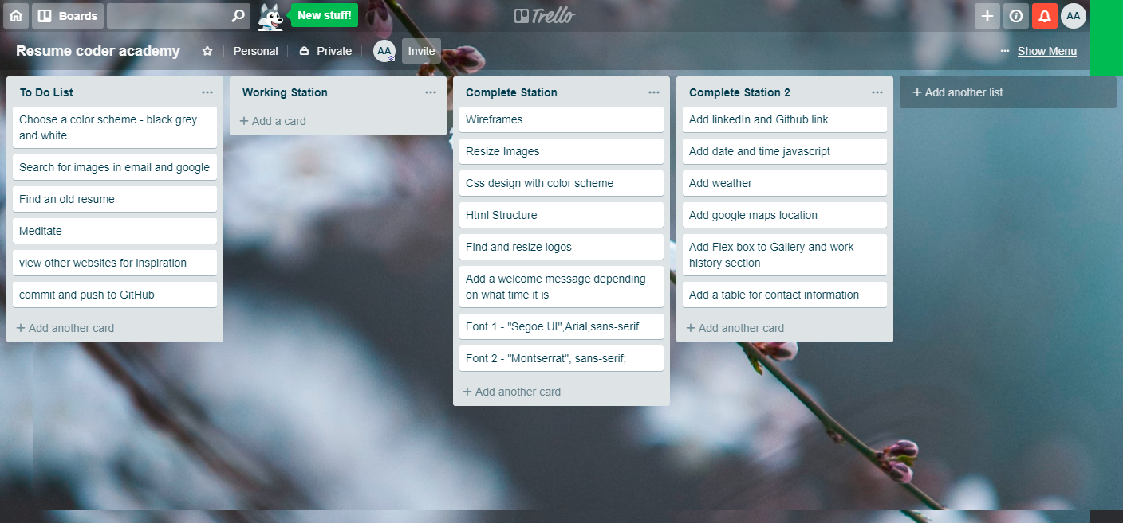
Trello

Slide 13
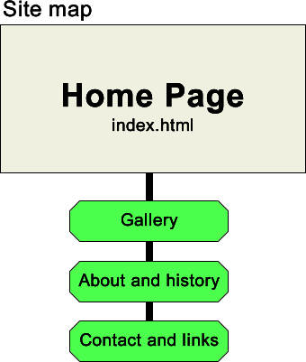
Sitemap

Slide 14
Show website
Click Me https://adam22gary.github.io/

