Slide 1
A. portfolio
Adam Aldred

Slide 2
Design Process Functionality
Research and Brainstorming
Design wireframe layouts
Choose a color scheme and font styles
Collect and resize images
Use of flex box and tables
Protype testing Html, Css and JavaScript
Evaluate the design
Produce final product
Responsive on all devices
JavaScript - on click functions
JavaScript - date, time, weather
Links - LinkedIn, GitHub and Google Maps

Slide 3
Usability considerations
alt attribute on image tags for accessibility
title attribute on anchor tags, buttons, images and links for a description
The use of white space and padding to unclutter the website
Font and background color contrast ratio
Transparent background for font on an image
A responsive website on all devices
The use of correct and relevant content - focus more on content and layout functions

Slide 4
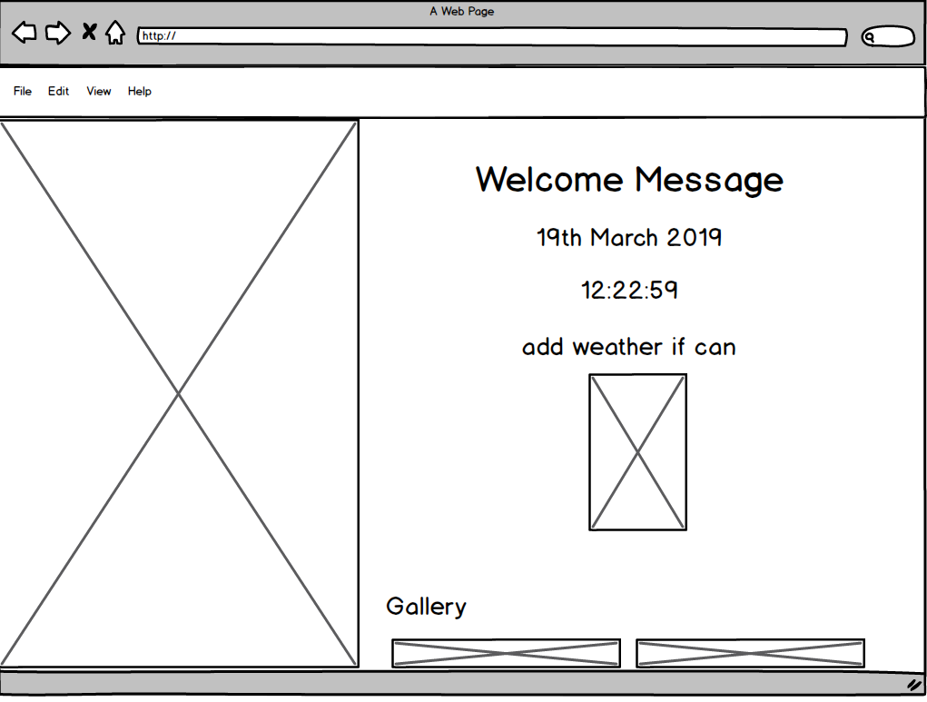
Wireframes – Welcome Message

Slide 5
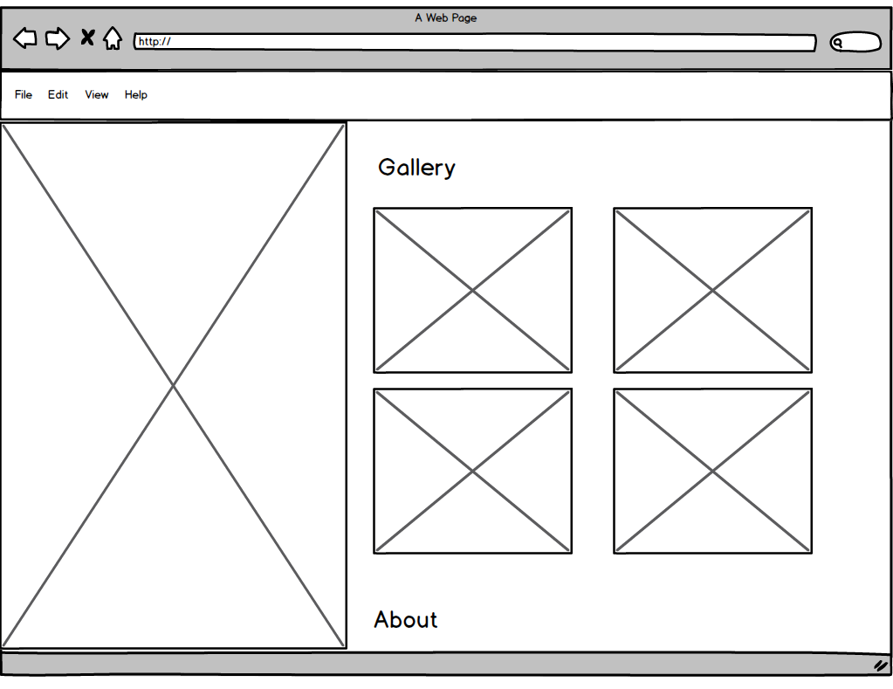
Wireframes – Gallery – Flex Box

Slide 6
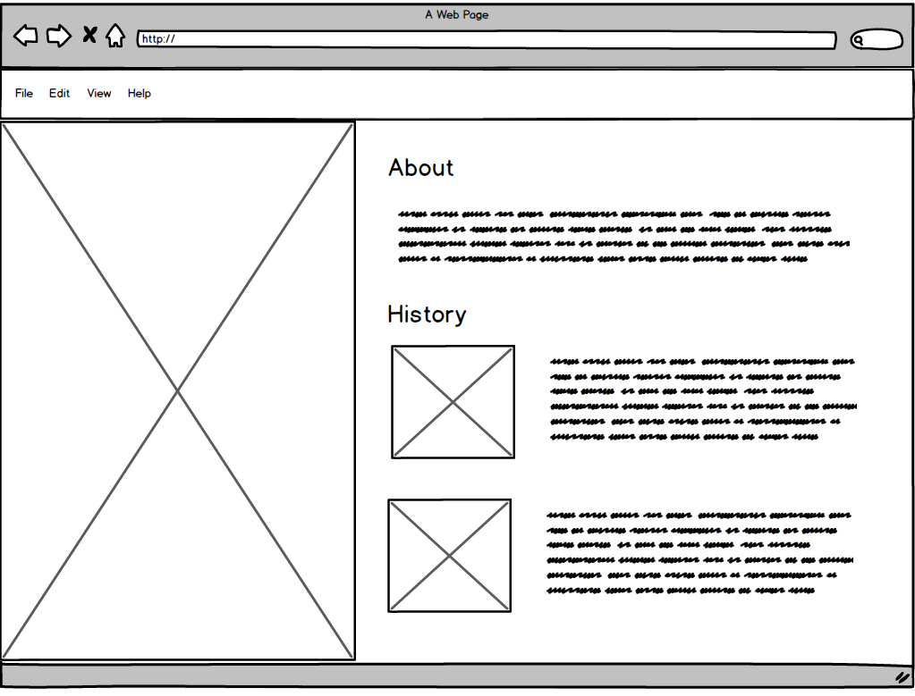
Wireframes – History – Flex Box

Slide 7
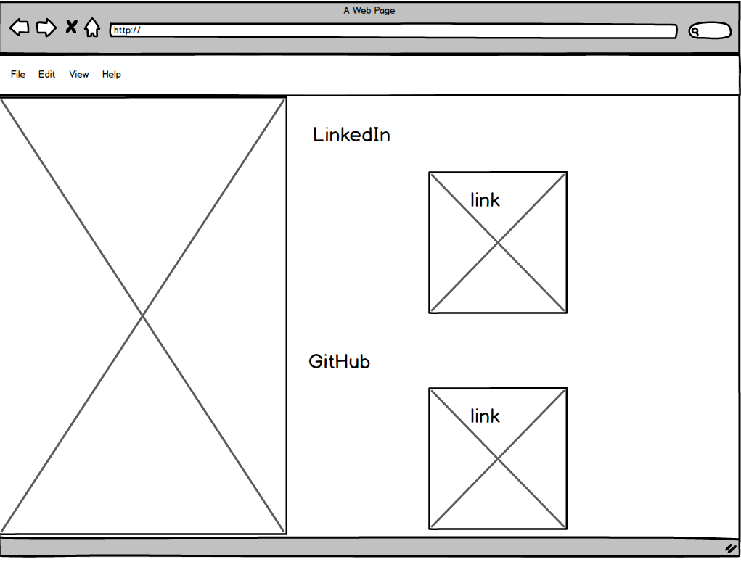
Wireframes – Image links

Slide 8
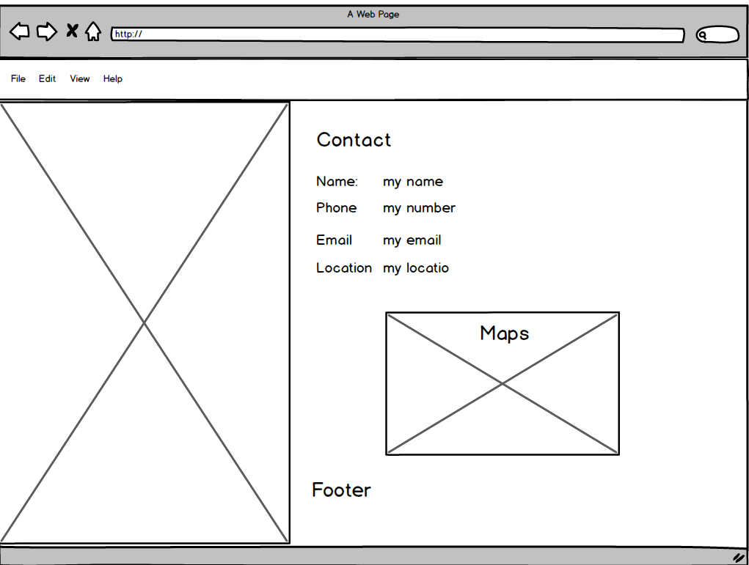
Wireframes – Contact – Table

Slide 9
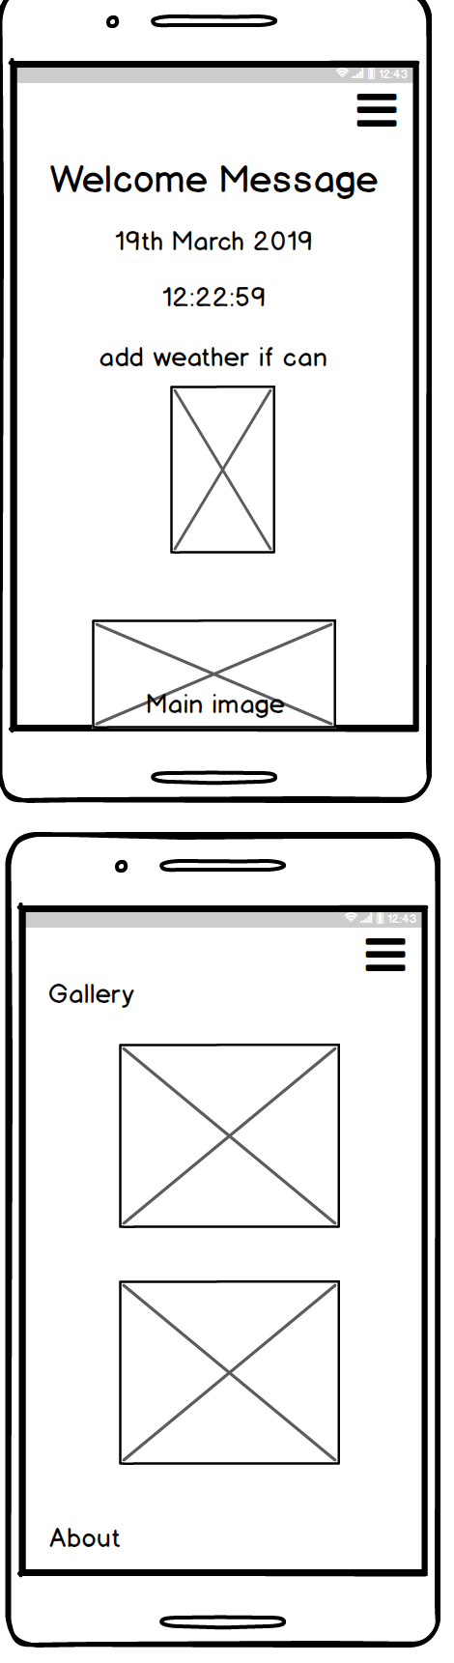
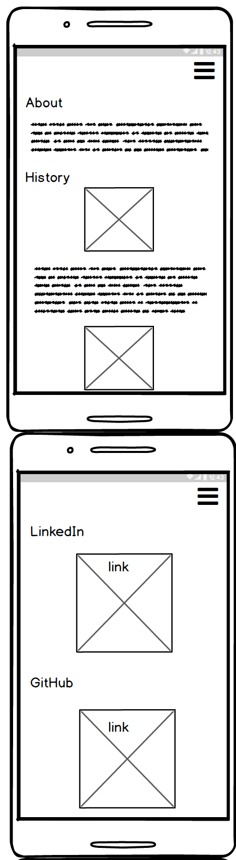
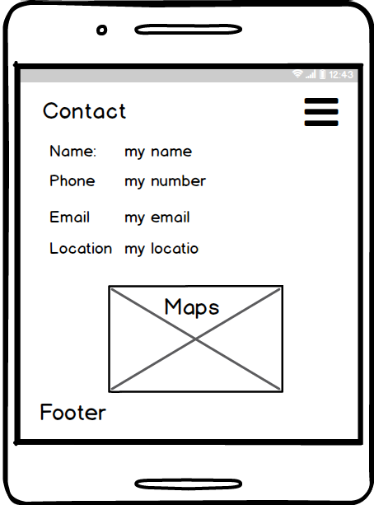
Wireframes – Phone size

Slide 10
Tech and languages
Html5
Css3
JavaScript
Fireworks
Photoshop
GitHub
Balsamic
Visual Studios
terminal
Cloud Flare – (CDN)

Slide 11
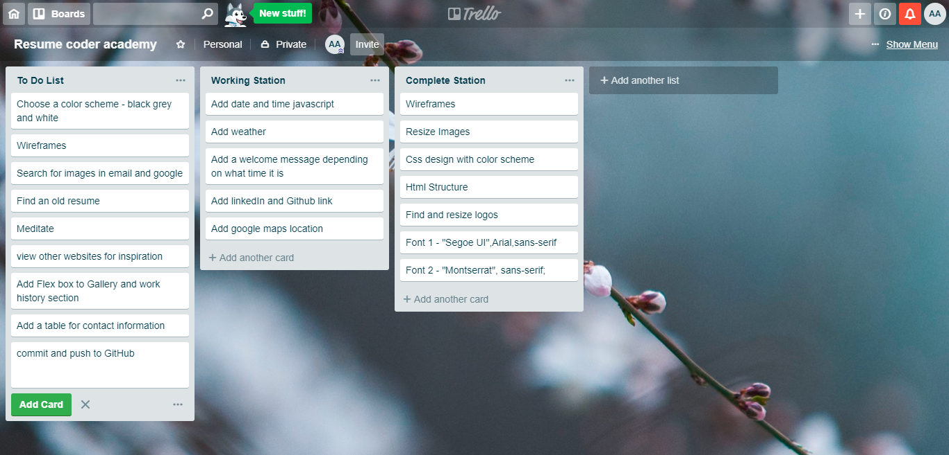
Trello

Slide 12
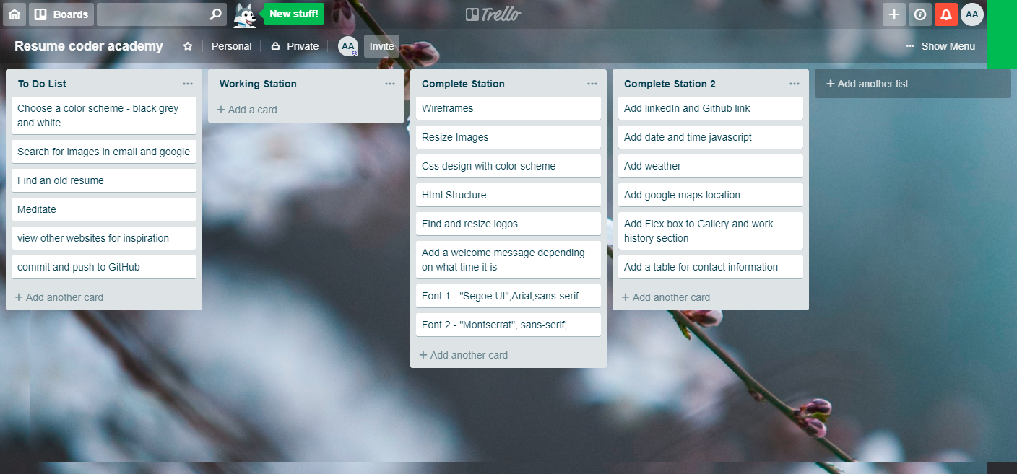
Trello

Slide 13
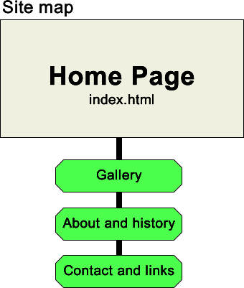
Sitemap

Slide 14
Show website
Click Me https://adam22gary.github.io/

