Slide 1

Team RUN IT! presents:
Adam Li
Ana Terra
Anita Foster
Alexandra Ruby
Nans Rivet
Rupam Saha

Slide 2
Customer
Go To Market
Competitors and Risk
Financial Management
Products & Services
Mission of Green Haven
Green Haven seeks to create a more environmentally conscious New Haven community through education. Our goal is to engage and inspire the community to commit to lifestyles that are focused on sustainability, ultimately empowering citizens, reducing our carbon footprint, and elevating the city of New Haven.
Recycling creates ~20x more jobs than landfilling waste
Recycled waste generated $746M in sales in CT last year
Increasing the recycling rate to 50% saves $365,000
Yale’s sustainability efforts are insular and can be leveraged

Slide 3
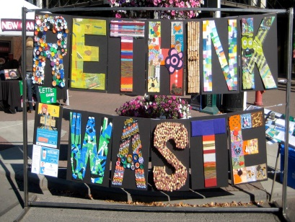

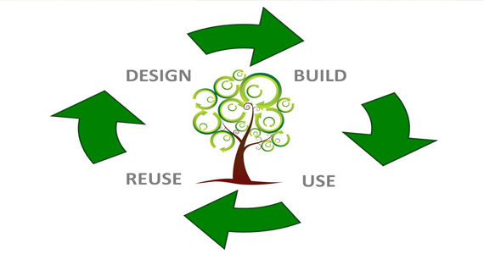
Mission of Green Haven
Products & Services
Customer
Go To Market
Financial Management
Competitors and Risk
Repurposed Items
Create Recyclable Items: bags, pencil and laptop cases, sponge holders, lunch boxes, notebooks, wallets, craft storage
Community Engagement
Community guest artists
Operations
The team! (culture and compensation)
“Recycling Day”
Partner with existing Yale initiatives
Repurposing Workshops
Production
Inputs

Slide 4

Mission of Green Haven
Customer
Go To Market
Financial Management
Competitors and Risk
Products & Services
94% people are interested
69% people have bought recycled products
Target customers 69% of the age 15-50 population
Unique Selling Proposition
Market Positioning
Promotional Tools
Selling a lifestyle through sustainability – environmental friendly products
People who want to make a “green” New Haven for the next generation
Social Networking Sites, Word of Mouth, Ambassadorship Program, ‘Green’ Discounts

Slide 5


Mission of Green Haven
Competitors and Risk
Products & Services
Financial Management
Customers Go To Market
 | Yale Eli Surplus Exchange | Garbage Museum | Etsy | Green Haven (us)
Outreach Programs
Yale and Community
Building a ‘’Green’’ Lifestyle
Reduce Recycle Reuse
Financial Risk
Expand donor base
State and federal grants
Internal/External Fraud
Audits
Set payment controls
Harm to Reputation
Periodic impact assessment
Due diligence of sustainability
Employee Turnover
Continuous Flow Documents
Team Green Culture

Slide 6

Mission of Green Haven
Financial Management
Products & Services
Competitors and Risk
Customer Go To Market
Our business model (non-profit)→ Budget : Sales + fundraising – costs
Our budget = $112,006 /year (3 year plan)
Uses / resources
Performances/ efficiency (financial + social)
Efficiency (% resources dedicated to our mission statement)
Efficiency over 1$ donated
(over 1$ donated how much contribute to our mission statement)
Value created on the waste (value before and after production)
People reached by our mission
Funds needed= $60,000/ year (3 year contract)
$ 29,816.39 /year
1630 people / year

Slide 7
Thank you!

