Slide 1


Forest Packing: Fast Parallel, Decision Forests
Author: James Browne
In Collaboration With: Disa Mhembere, Tyler M. Tomita, Joshua T. Vogelstein, Randal Burns

Slide 2
Agenda
What is Forest Packing?
Why is forest inference slow?
Inference Acceleration
Memory Layout
Traversal Methods
Results

Slide 3


Why do we need fast decisions?

Slide 4
Forest Inference
New Observation →
B
A
B
C
B
A
C
B
C
A
B
A
A
C
A
C
B
A
A
C
B
C
C
A
Class A
Class B
Class A
Tree 1
Tree 2
Tree 3

Slide 5
Standard Inference Reality
Internal Node
Leaf Node
Processed Node
Cache Miss
Prefetch Instruction
Tree 1
Tree 2
Tree 3
Time →
Tree 1
Tree 2
Tree 3
Time →
Tree 1
Tree 2
Tree 3
Time →
Tree 1
Tree 2
Tree 3
Time →
Tree 1
Tree 2
Tree 3
Time →
Tree 1
Tree 2
Tree 3
Time →
Tree 1
Tree 2
Tree 3
Time →

Slide 6
Inference Acceleration Methods
Model Structure
Make smaller trees
Make full trees
Use less trees
Reduce Mispredictions
Assume direction
Predication
Batching
Reduced Accuracy
Minimally Affective
High Latency

Slide 7
Memory Optimizations
BF
DF
DF-
Breadth First (BF)
Depth First (DF)
Combined Leaves (DF-)
Statistical Layout (Stat)
Contiguous Likely Path
Bin
Contiguous Tree Space
Trees Share Leaves
1
1
1
2
3
2
3
α
2
4
5
4
5
3
4
6
7
8
9
6
7
8
9
β
α
α
β
1
2
3
4
5
6
7
8
9
1
3
5
9
8
4
7
6
2
1
2
4
3
α
β
Stat
Bin
1
1A
1B
α
2
α
2A
2B
3B
3
4
3A
4A
β
4B
β
α
β
α
α
β
β
α
α
β
β
α
1
2
3
4
α
β
1A
1B
2A
3A
4A
3B
2B
4B
α
β

Slide 8
Memory Optimization: Why Bins?
High frequency nodes in single page file
Increases cache hits
Reduces cache pollution
Access Frequency
100%
50%
25%
12.5%

Slide 9
Traversal Optimization: Round-Robin
Internal Node
Leaf Node
Processed Node
Cache Miss
Prefetch Instruction
w/ 2 Line Fill Buffers
Tree 1
Tree 2
Tree 3
Time →
Tree 1
Tree 2
Tree 3
Time →
Tree 1
Tree 2
Tree 3
Time →
Tree 1
Tree 2
Tree 3
Time →
Tree 1
Tree 2
Tree 3
Time →
Tree 1
Tree 2
Tree 3
Time →
Tree 1
Tree 2
Tree 3
Time →
Tree 1
Tree 2
Tree 3
Time →
Tree 1
Tree 2
Tree 3
Time →

Slide 10
Traversal Optimization: Prefetch
Internal Node
Leaf Node
Processed Node
Cache Miss
Prefetch Instruction
w/ 2 Line Fill Buffers
Tree 1
Tree 2
Tree 3
Time →
Tree 1
Tree 2
Tree 3
Time →
Tree 1
Tree 2
Tree 3
Time →
Tree 1
Tree 2
Tree 3
Time →
Tree 1
Tree 2
Tree 3
Time →
Tree 1
Tree 2
Tree 3
Time →
Tree 1
Tree 2
Tree 3
Time →

Slide 11
Inference Execution
Tree 1
Tree 2
Tree 3
Standard
Tree 1
Tree 2
Tree 3
Round-Robin
Tree 1
Tree 2
Tree 3
Prefetching

Slide 12
Prediction Method Comparison

Slide 13
Prediction Method Comparison

Slide 14
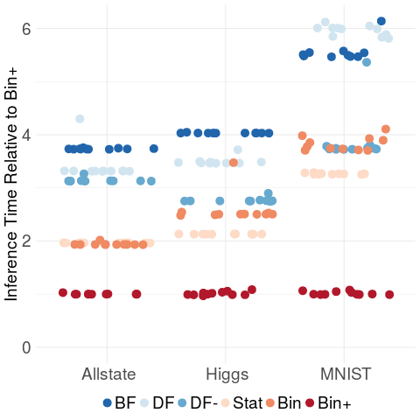
Memory Optimization Comparisons
FP
Forest Packing is 2x-5x faster compared to other optimized methods
FP

Slide 15
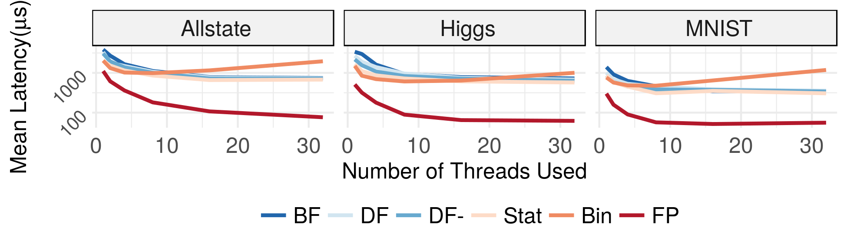
Forest Packing: Inference Latency Comparison
Forest Packing (FP) 10x faster

Slide 16
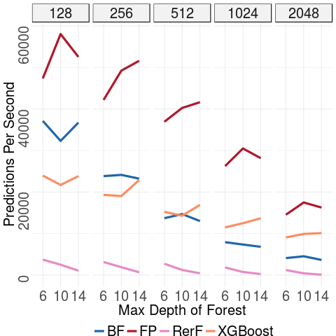




Forest Packing: Performance on Varying Forest Size
Trees in Forest
Forest Packing has higher throughput than batching
Forest Packing
R-RerF

Slide 17
Conclusion
What is Forest Packing?
Why is forest inference slow?
Inference Acceleration
Memory Layout
Traversal Methods
Results
Latency reduced by an order of magnitude
Efficiently uses additional resources
Comparable throughput to batched systems

Slide 18
Thank You
Questions?
Source Code:
https://github.com/jbrowne6/forestpacking

