Slide 1

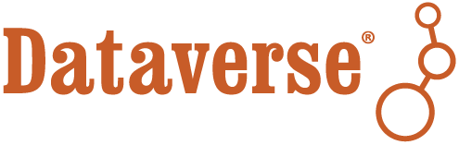


Reviewing Sensitive Data with Differential Privacy
JEDI Workshop, November 20, 2020. Organized by Data-PASSS Alliance.
As Open as Possible, As Closed as Necessary: Empowering Transparency in Publications Based on Sensitive Research Data
Mercè Crosas, Ph.D., Harvard University
scholar.harvard.edu/mercecrosas @mercecrosas

Slide 2

Differential Privacy tools to explore sensitive data
A differentially private algorithm introduces a minimum amount of noise to released statistics to mathematically guarantee the privacy of any individual in the dataset
OpenDP (https://opendp.org) is a community effort to build a trustworthy and open-source suite of differential privacy tools to explore sensitive data
We are currently working on the first release of OpenDP and Dataverse integration
What will this mean:
Opens up sensitive data to the research community
Sensitive datasets findable in Dataverse will be explorable through differentially private statistics, without ever accessing the original dataset
Statistics included: mean, histogram, quantile, median, variance, OLS regression, logistic regression, probit regression, difference of means, unbiased privacy

Slide 3

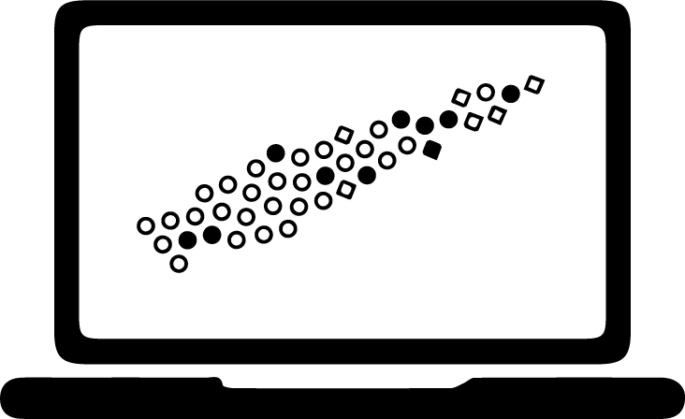


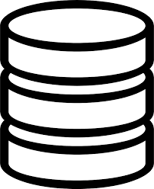
Openly findable data, secure computation and storage, differentially private releases
Public Repository
Data owner/depositor
Sensitive datasets discoverable via repository (only metadata open)
Notary Service
Approved Secure Compute Environment to run differential privacy statistics
Digitally signed attestations confirming DUA compliance
Blue
Green
Yellow
Trusted Remote Storage Agents (TRSA) or data enclaves
Data Reviewer
Differential Privacy release
Orange
Red
Impact: Infrastructure for Privacy-Assured Computation https://cyberimpact.us/

Slide 4
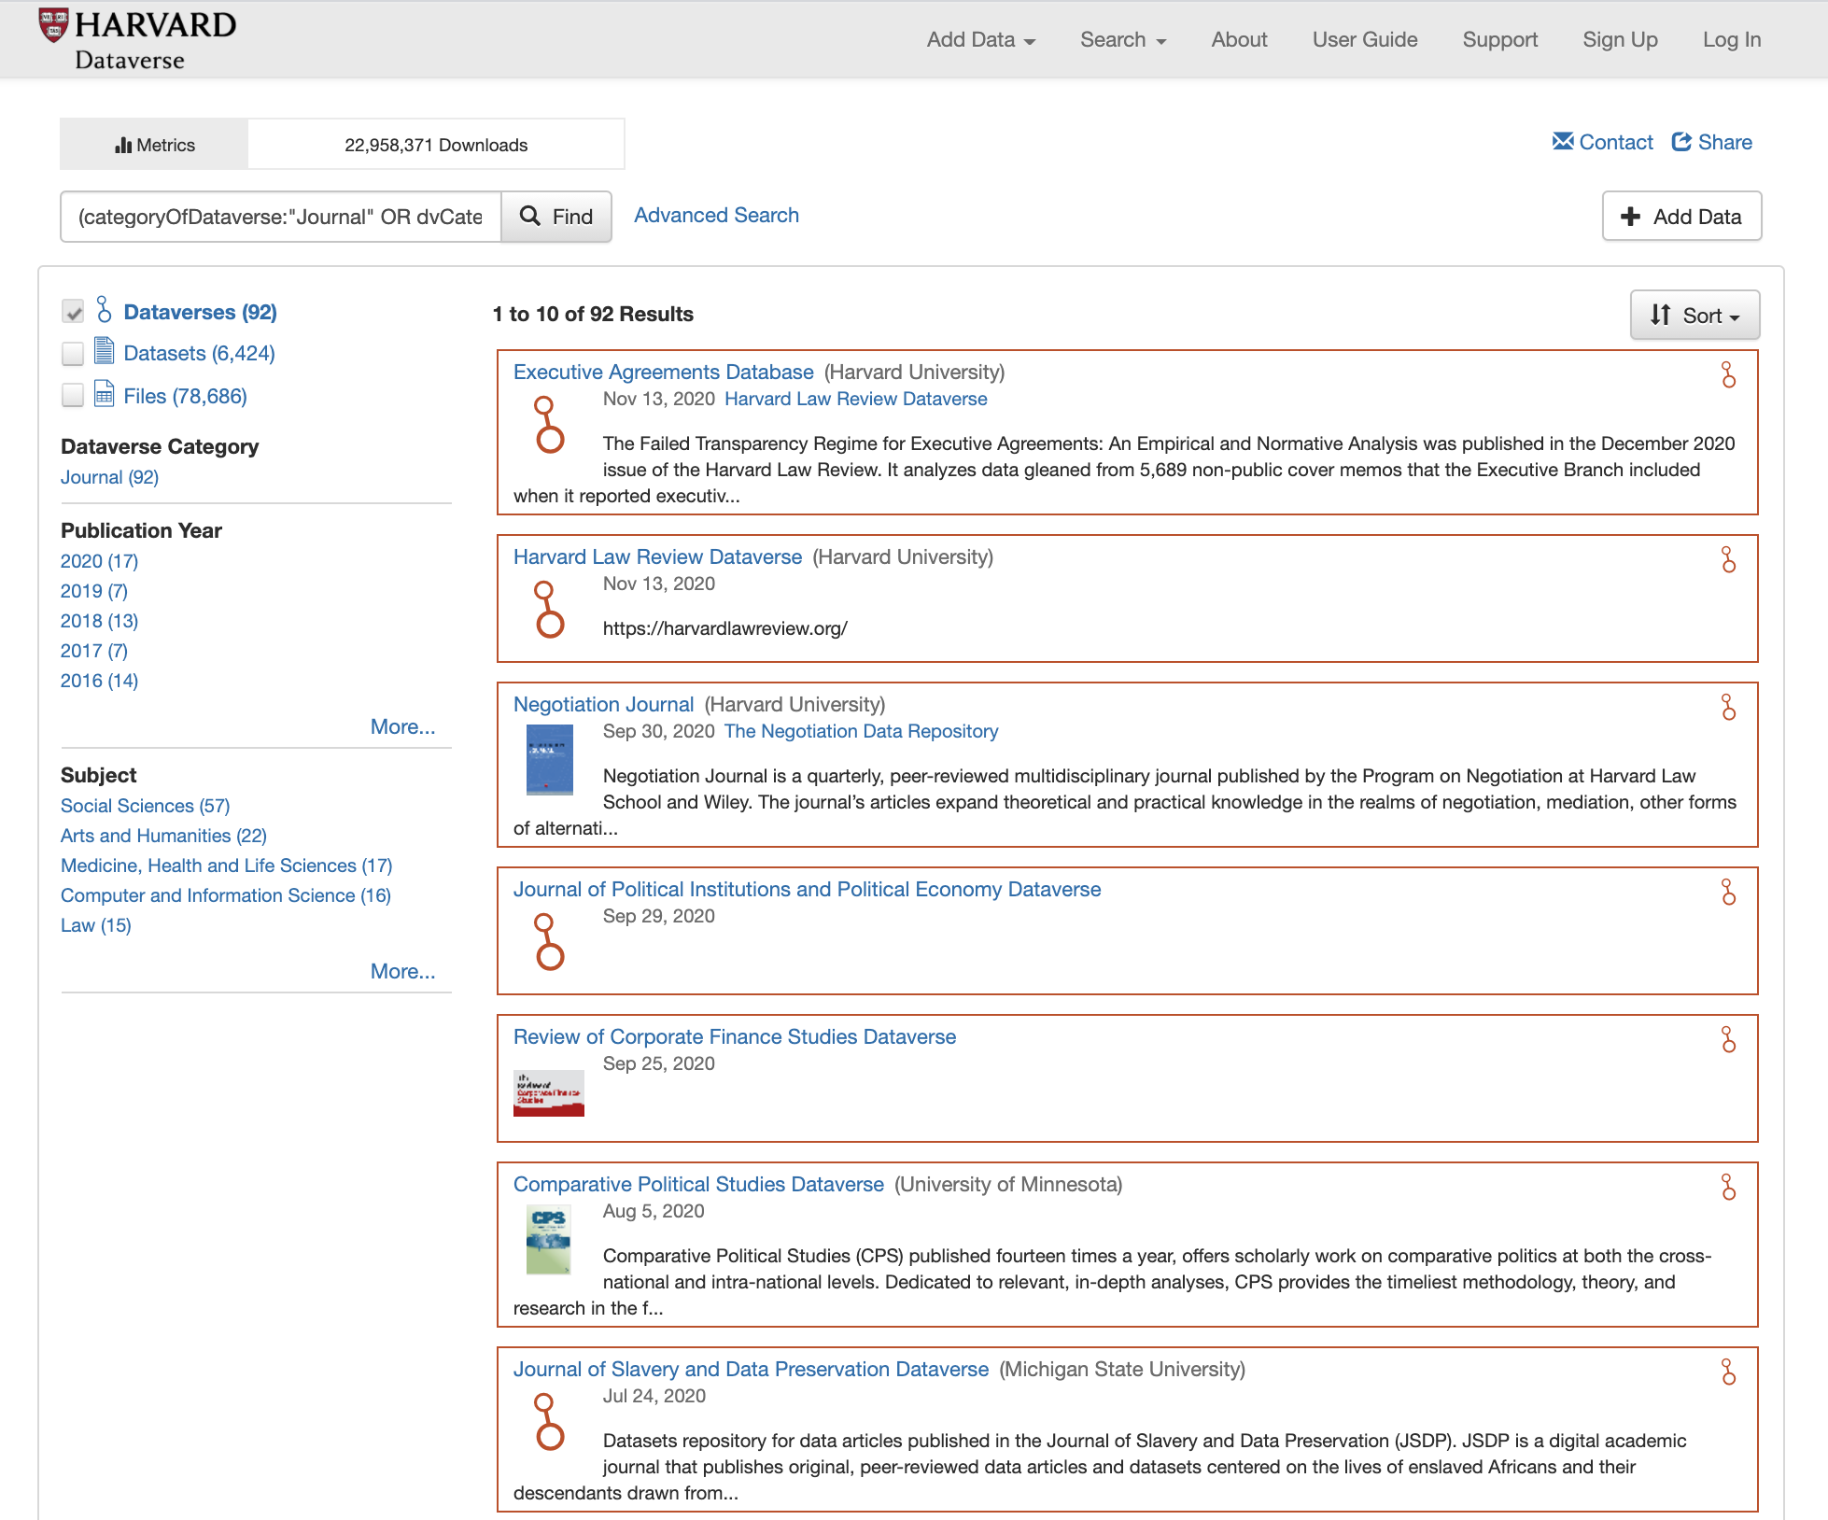
Journals’ dataverses will be able to support discovery, citation, and review of sensitive data
92 journal dataverses in Harvard Dataverse
Replication datasets currently contain non-sensitive data
With OpenDP-Dataverse integration, sensitive datasets will be archived in a secure storage
Data reviewers and users will have access to differential privacy statistics of the sensitive datasets
https://dataverse.harvard.edu

