Slide 1
Store unaltered data but secure permission to share & restrict access
Rick Gilmore
rog1@psu.edu

Slide 2
Databrary.org approach
Store in repository
Secure explicit sharing permission
Avoid alteration (e.g., blurring) if possible
Restrict access
Researchers authorized by their institutions & approved by IRBs
Permit unrestricted uses

Slide 3
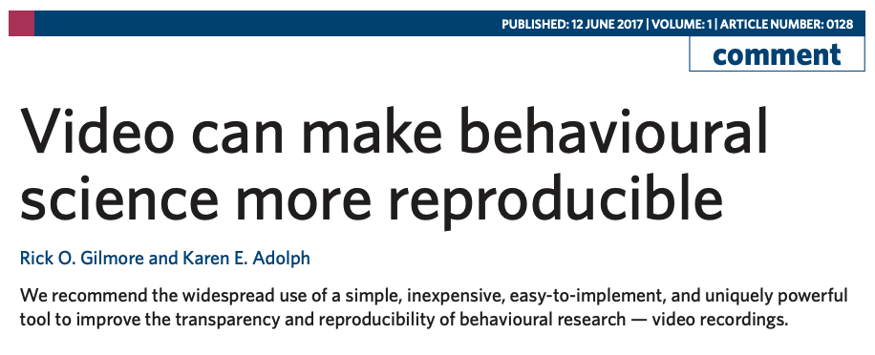
Gilmore, R. O., & Adolph, K. E. (2017). Video can make behavioural science more reproducible. Nature Human Behavior, 1. https://doi.org/10.1038/s41562-017-0128

