Slide 1

Capsule framework for Open Science with Restricted Data
Beth Plale
Professor, Indiana University Bloomington
On loan to National Science Foundation
*Opinions expressed herein are those of the author alone and do not represent the views of the National Science Foundation
August 29, 2018

Slide 2
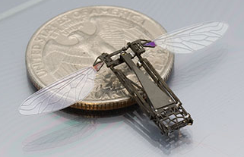


“Open science: today’s data, tomorrow’s discoveries”
Notes:
Economic impact of tomorrow’s discoveries motivating governments worldwide

Slide 3
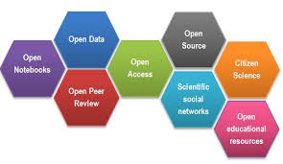
Open Science draws attention to inherent value in all primary products produced as outcome or result of research
More thoughtful research processes;
With more thought to other uses;
With more thought to reproducibility / replicability of work
Notes:
Publications behind paywall (through library subscription)
Primary data
Physical samples
Software
Other supporting materials
Social and economic benefit

Slide 4
Trajectory of research is international, highly collaborative, and interdisciplinary
Notes:
As problems grow larger, and recognition of global nature of many of our systems increases

Slide 5
Open science is an acknowledgement of inherent value of scientific data, independent of scientific / scholarly papers
Notes:
How is individual to fit their research into this larger stage?

Slide 6
Data Management Plans
Researcher writes a Data Management Plan for the important data that they expect to create during course of their research
“What constitutes reasonable data management and access will be determined by the community of interest through process of peer review and program management.” [Data Management & Sharing Frequently Asked Questions, National Science Foundation]
Notes:
DMP cornerstone of many agency public access plans
Define “Peer-review” == “merit review”

Slide 7
Funders Encourage Open Science
Investigators are expected to share with other researchers, at no more than incremental cost and within a reasonable time, the primary data, samples, physical collections and other supporting materials created or gathered in the course of work under NSF grants. PAPPG, National Science Foundation

Slide 8

Open as possible, closed as necessary*
Principle articulated in "Guidelines on FAIR Data Management in Horizon 2020", EU Horizon 2020 programme
Notes:
Tension in open science: much data resulting from externally funded research can be made open, but here are important cases where controls on the data must remain.
Overriding principle should be the data should be open as possible, closed as necessary.
Data should be made open - open access, open use, open license – and perhaps made open by default,

Slide 9
Capsule framework
Controlled compute environment, capsule framework, is viable approach to accessing and sharing restricted data that
satisfies sharing while protecting data from unintended uses or uses prohibited by law
Notes:
Compute environments on which the capsule notion is based have become increasingly secure while at the same time retaining the speed and ease of use expected by researchers.
Combined with policy and use agreements, the capsule has a place in the spectrum of solutions for making data "open as possible, closed as necessary."

Slide 10
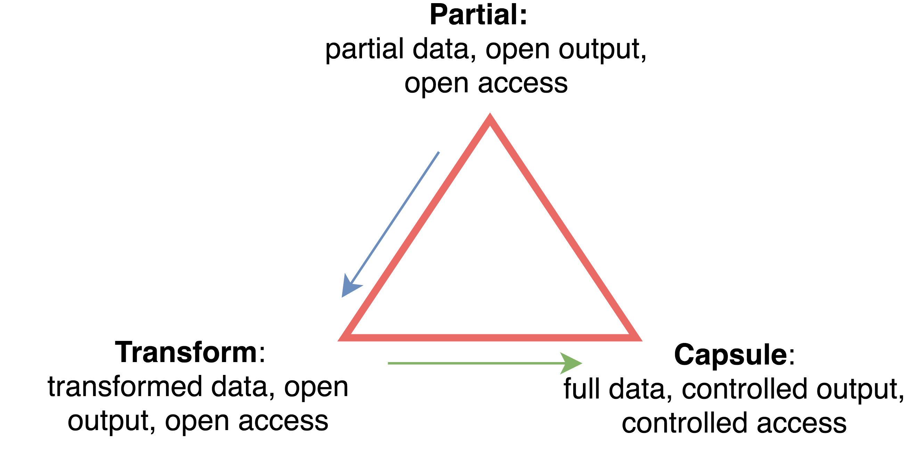
Forms of data availability
Notes:
1. Partial: metadata of dataset made visible while dataset is not.
Metadata may have restricted aspects.
Has limitations but nevertheless facilitates discovery and reveals analytical trends.
2. Transformation: derived, aggregated, anonymized, or synthesized to obscure sensitive information. Resulting dataset is released.
In cabin video obscures drivers face, or obscures identity while leaving emotions apparent.
Extracted features from texts (bags of words)
3. Capsule framework: direct touching of restricted content but in controlled setting

Slide 11
Capsule framework
Implemented through combination of
policy, processes, and software services,
to protect the data and
make the software infrastructure as easy to use as possible.
Includes a trust model that captures tradeoffs that are made during design of the system.
e.g., how much trust do you put on user?
Notes:
Tradeoff on trust on user and ease of use of the environment

Slide 12
Capsule framework
Includes a trust model that captures tradeoffs that are made during design of the system
Policy decisions influenced by situation of use:
restrictions on the data;
assumptions of use; and
limits of software services.
Notes:
Threat model: e.g., how fully do you or can you trust the user while still making the system useable?

Slide 13
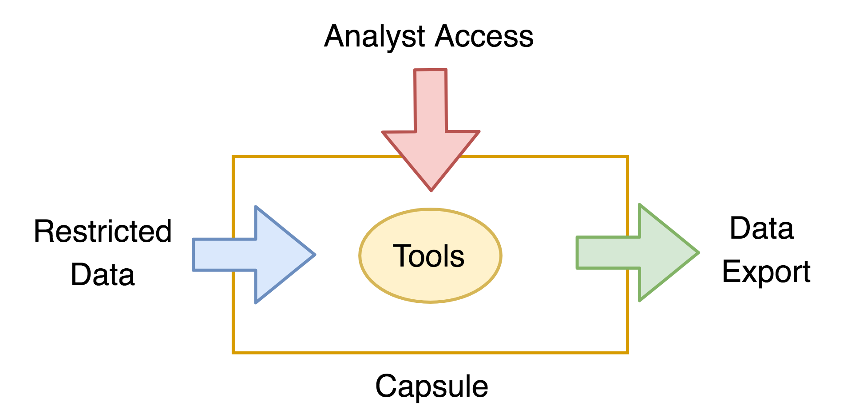
Capsule technical design
?
?
?
?
Notes:
All points are design decisions guided by

Slide 14


Slide 15
Mission and Purpose
To contribute to research, scholarship, and the common good by collaboratively collecting, organizing, preserving, communicating, and sharing the record of human knowledge.
A trusted digital preservation service enabling the broadest possible access worldwide.
An organization with over 100 research libraries partnering to develop its programs.
A range of transformative programs enabled by working at a very large scale.
Notes:
Our mission is a library mission: collect, organize, preserve, make accessible research materials.
We have had a number of special programs that are so important that I’ve listed a few here. You might think of these as a part of our DNA.

Slide 16
Current Major Cooperative Initiatives
Distributed manual copyright reviews.
Establishing a distributed shared print monograph archive.
Expanding and enhancing access to US Federal Government Documents.
Expanding services of the HathiTrust Research Center.

Slide 17
Scale of the HathiTrust Collection
16,639,076 total volumes
8,075,459 book titles
446,580 serial titles
5,823,676,600 pages
746 terabytes
6,256,362 open volumes (~38% of total)
Collection includes (mostly) published materials in bound form, digitized from research and academic library collections.

Slide 18
Capsule framework is implemented through policy, processes, and software services working together to protect the data while making the software infrastructure as easy to use as possible.

Slide 19
HathiTrust Policies
Human facing
Non-consumptive Use Research Policy
Terms of Use
Infrastructure facing
HathiTrust Rights Database
Trust (threat) model
Export review
Human review of results exported from Capsule
Human facing
policy
mutually reinforcing
Infrastructure facing “service agreement”

Slide 20
Non-consumptive Use Research Policy
Fesearch in which computational analysis is performed on one or more volumes but not research in which researcher reads or displays substantial portions of an in-copyright or rights-restricted volume to understand expressive content presented within that volume.
Examples: text extraction, automated translation, image analysis, file manipulation, OCR correction, and indexing and search.
https://www.hathitrust.org/htrc_ncup
Notes:
Applies to both textual or image objects
Give examples of

Slide 21
Terms of Use
Agreement between HTRC/HT and individual intending to use HTRC Data Capsule service. Top 4 terms:
Read and comply with Non-Consumptive Use Research Policy.
Use their Capsule for non-consumptive research purposes only as defined in Section 1 of the policy.
Prior to first use, User submits form indicating intended use and expected forms of outputs.
By using HTRC Data Capsule service, User acknowledges that information about their activities while in Capsule may be reviewed in manner consistent with HathiTrust privacy policy.
https://www.hathitrust.org/htrc_dc_tou
Notes:
At time of consent, user has already established an authenticated identity through the analytics gateway
2. Use their Capsule: not for reading books
3. intended use and expected forms of outputs: both needed for export review
4. information about their activities : audit trail in case

Slide 22
Rights Database
Database for storing and tracking rights information for each digitized volume in HathiTrust
At core of system is algorithm that considers a) copyright status and/or explicit access controls associated with the volume, b) volume's digitizing agent (e.g., Google or the University of Chicago), and c) identity of user (if known) in order to determine access rights.
How used: demo capsule uses only public domain content.
https://www.hathitrust.org/rights_database
Notes:
Copyright is complex, and although there are good efforts in modeling and expressing copyright status information for library holdings, HT requires a practical (implementable) approach
How used: demo capsule uses only PD; researcher has with them a working set of books, and rights to those are tracked by system

Slide 23
Threat model
Threat model: structured representation of all information that affects security of an application.
Two most relevant clauses:
Analysts are themselves considered to act in good faith, but this does not preclude possibility of them unwittingly allowing system to be compromised.
Reasonable assumption and motivates why analysts are required to sign use agreement.

Slide 24
Trust model
Users have VNC access to their virtual machines in non-secure mode so that they have a graphical interface to the machine. They also have SSH access in non-secure mode so that they can upload data sets and install software more easily.
However, VNC access does provide a channel for potential data leak; through use agreement and user profile, HTRC is comfortable that analyst is acting in good faith.

Slide 25
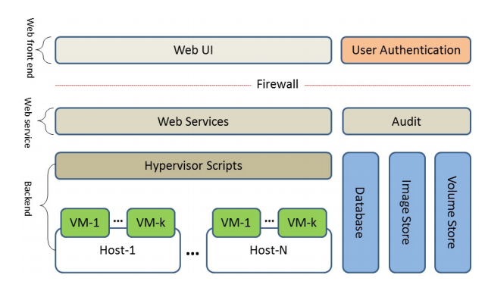
Capsule architecture in HathiTrust
k*N user VMs running in back end layer; managed by a hypervisor. All software implementing Capsule framework is open source.

Slide 26
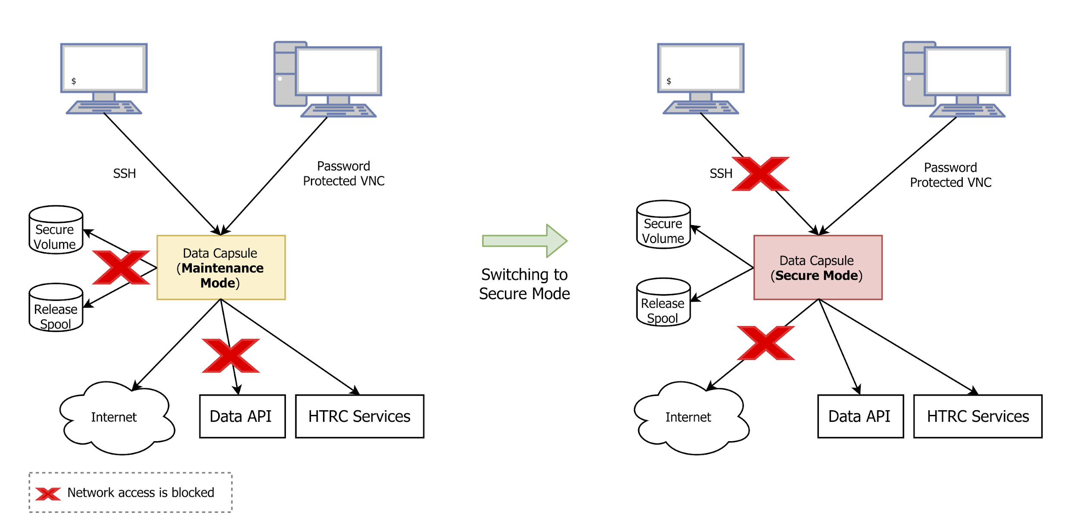
Mode 1 – Maintenance
Access to Internet permitted
HT DL

Slide 27
Mode 2 - Secure
Access to Internet denied
HT DL

Slide 28
Takeaways
I believe in the capsule model for controlled access to restricted data
HT long trajectory (2011-2018) confounded by
Authors Guild et al. v HathiTrust et al., 11 Civ 6351 (S.D.N.Y Sep 12 2011)
Non-consumptive objective: no eyeballs on texts
Complete freedom to install researcher’s own tools
Recently built a toolkit comes default with every capsule; toolkit as starting point might have simplified design space
Running on few (small) serves at Indiana University. Challenge to push to bigger resources.
Notes:
On September 12, 2011, the Authors Guild, along with other individual authors and associations of authors, filed a complaint against HathiTrust and five American universities for copyright infringement. (Authors Guild, et al. v HathiTrust, et al., 11 Civ 6351 (S.D.N.Y., Sep. 12, 2011)).
Before the next scheduled hearing for the Google Books suit had even taken place, the Authors Guild filed a complaint against HathiTrust, seeking an injunction. "These books, because of the universities' and Google's unlawful actions, are now at needless, intolerable digital risk," said Authors Guild president Scott Turow. (http://www.publishersweekly.com/pw/by-topic/digital/copyright/article/48739-authors-guild-sues-libraries.html).
Judge Baer’s statement in this ruling reflects our collective ongoing commitment to lawful uses of our digital library collection, a collection created from our many great print collections and the work of generations of librarians:
I cannot imagine a definition of fair use that would not encompass the transformative uses made by Defendants' MDP [Mass Digitization Project] and would require that I terminate this invaluable contribution to the progress of science and cultivation of the arts that at the same time effectuates the ideals espoused by the ADA [Americans With Disabilities Act].

Slide 29
Resources
Non-Consumptive Use Research Policy https://www.hathitrust.org/htrc_ncup
HathiTrust Rights Database https://www.hathitrust.org/rights_database
Trust (threat) model (somewhat outdated)
Plale, Beth; Prakash, Atul; McDonald, Robert (2015). The Data Capsule for Non-Consumptive Research: Final Report. Available from http://hdl.handle.net/2022/19277
Terms of Use https://www.hathitrust.org/htrc_dc_tou
HTRC Data Capsule accessible at https://analytics.hathitrust.org

Slide 30
Thank you plale@indiana.edu

