Slide 1
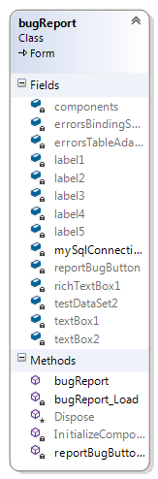
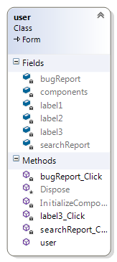
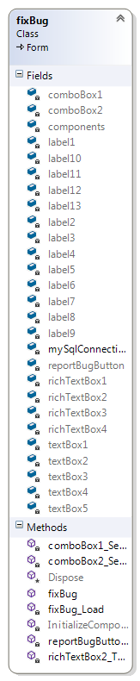
Search for an error
to be fixed.
Each user registers
Bug added to search database
User directed back to log in page
Each user logs in
Report the bug
Admin can delete users
Bug added to fixBug database
Fix a bug
Updated Bug added to fixBug database

